Slide 1
Entity Relationship Diagram + DML
Database Engineering

Slide 2
AGENDA
INSERT
UPDATE
ERD
Components ERD
crow’s foot notation
You gained inspiration for your project (functional design) for an ERD beginning.

Slide 3
INSERT
INSERT INTO table_name (column1, column2, column3, ...) VALUES (value1, value2, value3, ...);
Notes:
INSERT INTO songs (id, artist_id, name)
VALUES
(101, 62, “Ordinary life”),
(102, 62, “Starboy”)
INSERT INTO artists VALUES (71, "Jaqueline");

Slide 4
UPDATE
UPDATE table_name SET column1 = value1, column2 = value2, ... WHERE condition;
Notes:
UPDATE artists
SET name = “Jaxx”
WHERE id = 71

Slide 5

Software Development Life Cycle

Slide 6
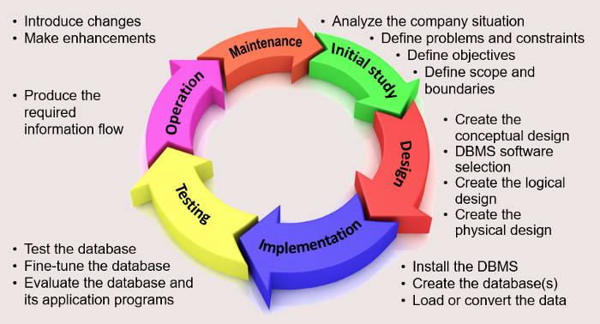
Database Lifecycle (DBLC)
Coronel and Morris (2019)

Slide 7
Phase 1: Database Initial Study
Goals :
Analyse business situation
Surroundings
Organisational structure
Define problems and constraints
Define objectives
Define scope and boundaries

Slide 8
Phase 2: Database Design
Critical DBLC phase
Ensuring that the final product meets requirements
Focus on data requirements
Sub-phases
Creating conceptual design
Making logical design
Making physical design

Slide 9
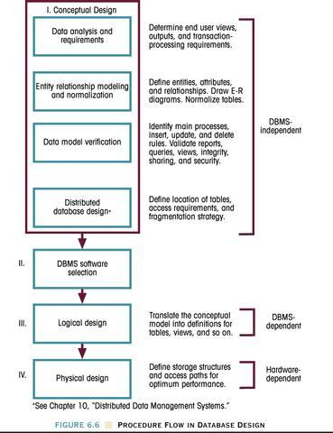

Slide 10
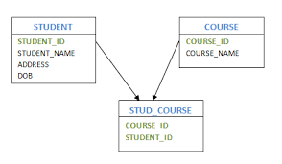
Components of the ERD - Entities
Entity
STUDENT, COURSE, PRODUCT
Attributes
StudentName, Phone, Email, CourseName
Determinants
Unique numbers
Relations
Lines
Cardinality
Crow’s foot notation
Notes:
Entities are things that people want to track. F.E. EMPLOYEE, CUSTOMER, PRODUCT etc.
Attributes are parts of entities that describe characteristics. F.E. EmployeeName, Phone, Email.
Identifiers are attributes that name/identify an instance of the enitity. Usually numbers.
They are also called primary keys. PK’s in a different table to create relations, they are called FK’s in the non-originating table.

Slide 11
Components of the ERD: RELATIONS
Relationships are indicated
Forms of relationships
1 : 1 A student is assigned a pass; this pass can be traced back to a unique student.
1 : N A student (!!!) may have several cars registered in his name, but the car is only registered to one person.
N : M A student can purchase multiple games and a game can be purchased by multiple customers.
Cardinality

Slide 12
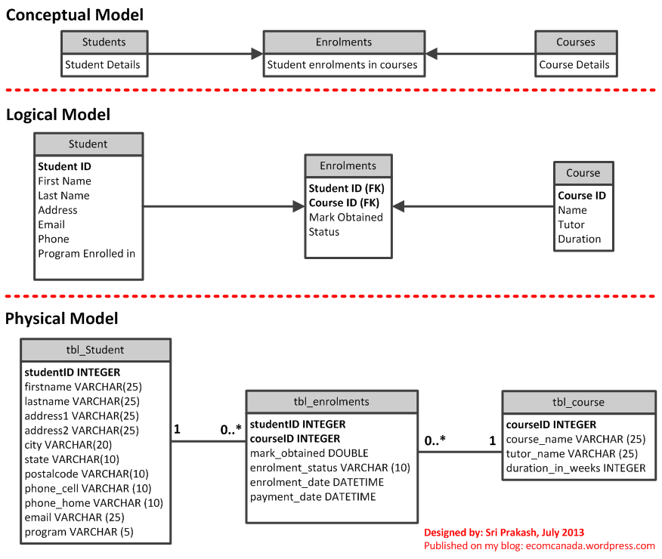
Data model typen

Slide 13
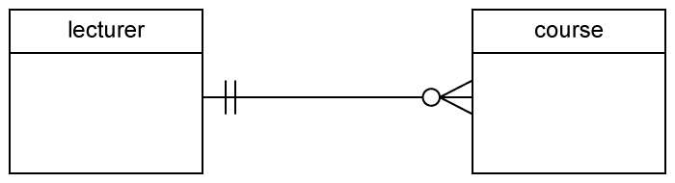
Designing a database
Different ways to draw a design
Each with their own lines and symbols
We will use the crow's foot notation as invented by James Martin (1990)
Other styles include UML and IDEF1X
Example:

Slide 14




Data Modeling Notation: Crow’s Foot
Symbol | Meaning | Numeric Meaning

Slide 15
Data Modeling Notation: Crow’s Foot
Symbol | Meaning | Numeric Meaning
 | Mandatory-One | Exactly one

Slide 16
Data Modeling Notation: Crow’s Foot
Symbol | Meaning | Numeric Meaning
 | Mandatory-One | Exactly one
 | Mandatory-Many | One or more

Slide 17
Data Modeling Notation: Crow’s Foot
Symbol | Meaning | Numeric Meaning
 | Mandatory-One | Exactly one
 | Mandatory-Many | One or more
 | Optional-One | Zero or one

Slide 18
Data Modeling Notation: Crow’s Foot
Symbol | Meaning | Numeric Meaning
 | Mandatory-One | Exactly one
 | Mandatory-Many | One or more
 | Optional-One | Zero or one
 | Optional-Many | Zero or more

Slide 19
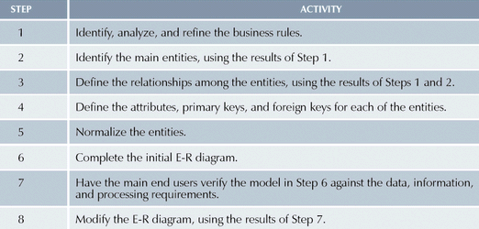
Entity Relationship Modeling

Slide 20
Entity Relationship Modeling and Normalization

Slide 21
DB Design Strategies
Top-down
Identify data sets (search for entities)
Relationships
Define data elements (search for attributes)
Bottom-up (bijv. factuur)
Identify data elements (search for attributes)
Group them into data sets

Slide 22
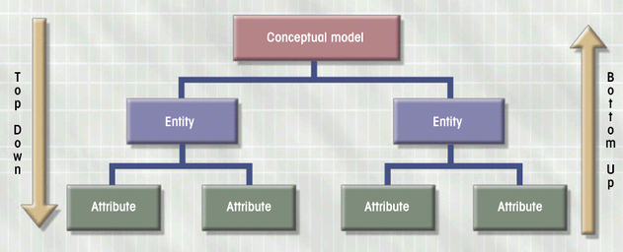
Top-Down vs. Bottom-Up

Slide 23
Top-Down design
Search for nouns
Example 1: A school
Students follow different courses. A course is given by teachers.
Each teacher gives one or more courses. A course is given by one teacher.

Slide 24
Top-Down design
Search for nouns
Example 1: A school
Students follow different courses. A course is given by teachers.
Each teacher gives one or more courses. A course is given by one teacher.

Slide 25
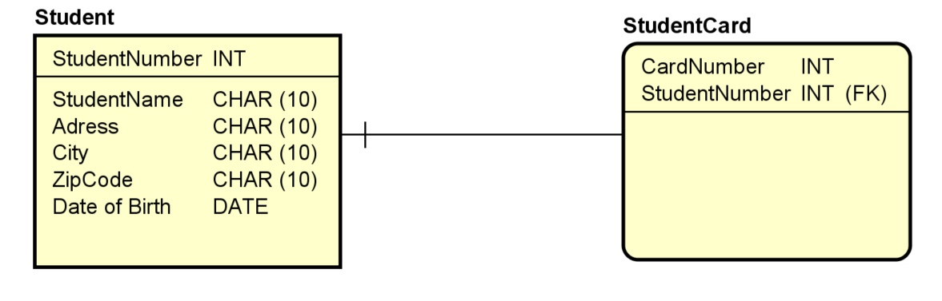
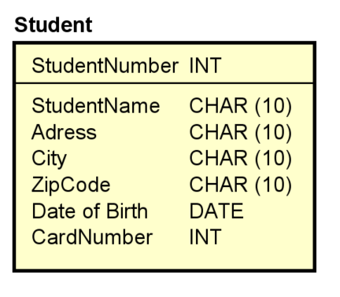
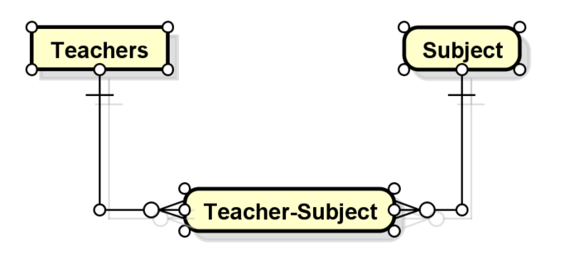
The 'basic' steps to design an ERD
Identify entities
Nouns
Items we want to track (track)
Rule: 1 instance/record does not deserve a table
Identify relationships between entities
A student has a number of classes ➔ 1 : N
1:1 relationships are often characteristics that 1 entity is redundant
1 student has 1 student card assigned to him/her
N:M relationships are converted into an association table
Assign correct attributes
Note the attributes from the description

Slide 26
Agreements
Entities: name in singular Example: STUDENT instead of STUDENTS
If an entity has only one attribute, treat it as an attribute of another entity.

Slide 27
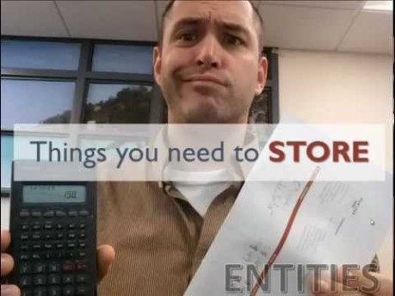
Data modelling explained :

Slide 28
EXAMPLE 1
An artist (singer/songwriter) has made 1 or more albums. An album has many songs. A user has 1 or more playlists. A playlist has 1 or more songs.

Slide 29
QUIZ TIME - Tutorial!

