Slide 1
Database engineering with PHP
Arrays and form validation

Slide 2
Inhoud
Arrays
Numeric
Associative
Multidimensional
Array functies
Form validatie

Slide 3
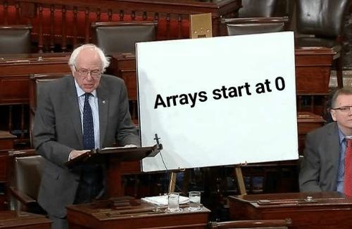
Arrays
Guess who’s back!

Slide 4
What are arrays
A special variable that can contain multiple values
There are three types of arrays
Numeric
Associative
Multidimensional

Slide 5
Numeric arrays
Numeric is the normal array you already know
Start counting from 0
Can be initialized in a few ways
$arr = array("one", "two", "three", "four", "five");
$arr = ["one", "two", "three", "four", "five"];
$arr[0] = "one";
$arr[1] = "two";
$arr[2] = "three";
$arr[3] = "four";
$arr[4] = "five";

Slide 6
Associative array
An array that uses “Key-Value pairs”
Uses custom “keys” instead of numbers
$arr = array(
"name" => "Donald",
"age" => 60,
"gender" => "male"
);
$arr = [
"name" => "Donald",
"age" => 60,
"gender" => "male"
];
$arr["name"] = "Donald";
$arr["age"] = 60;
$arr["gender"] = "male";

Slide 7
Printing Associative array
Access by key
Indexnumbers do not work!
Given the following array
Printing a single element
Output: Donald
Printing all alemens
Output:
foreach($arr as $key => $value){
echo "Key is: $key; Value is: $value <br>";
}
$arr = array(
"name" => "Donald",
"age" => 60,
"gender" => "male"
);
Key is: name; Value is: Donald Key is: age; Value is: 60 Key is: gender; Value is: male
echo $arr["name"]. "<br>";

Slide 8
Multidimensional arrays
And array in which the values are arrays
Or the value of a key
2D array
The variable $users contains three arrays
These arrays contain key-value pairs
Look at it like a table!
$users = [
["name" => "Donald", "age" => 60, "gender" => "male"],
["name" => "Harold", "age" => 75, "gender" => "male"],
["name" => "Kane", "age" => 90, "gender" => "male"],
];

Slide 9
Multidimensional arrays
A multidimensional array in PHP
As table
$users = [
["name" => "Donald", "age" => 60, "gender" => "male"],
["name" => "Harold", "age" => 75, "gender" => "male"],
["name" => "Kane", "age" => 90, "gender" => "male"],
];
name | age | gender
Donald | 60 | male
Harold | 75 | male
Kane | 90 | male

Slide 10
Printing Multidimensional arrays
Looks a lot like printing a normal array
But you need to take the 2nd dimension into account
$users = [
["name" => "Donald", "age" => 60, "gender" => "male"],
["name" => "Harold", "age" => 75, "gender" => "male"],
["name" => "Kane", "age" => 90, "gender" => "male"],
];
foreach($users as $user){
foreach($user as $key => $value){
echo "Key is: $key; Value is: $value <br>";
}
echo "<br>";
}

Slide 11
Printing Multidimensional arrays
name | age | gender
Donald | 60 | male
Harold | 75 | male
Kane | 90 | male
foreach($users as $user){
foreach($user as $key => $value){
echo "Key is: $key; Value is: $value <br>";
}
echo "<br>";
}
Key is: name; Value is: Donald Key is: age; Value is: 60 Key is: gender; Value is: male Key is: name; Value is: Harold Key is: age; Value is: 75 Key is: gender; Value is: male Key is: name; Value is: Kane Key is: age; Value is: 90 Key is: gender; Value is: male

Slide 12
Array functions
Handy dandy tools

Slide 13
Demo #1
What, a demo already?

Slide 14

Form validation
Never trust the outside world

Slide 15
Form validation
Checking and verifying the data from a form
You are in control
Often comes down to two big checks
Empty
Validation/sanitation

Slide 16
Form validation
You can check if a variable is empty with the empty() function
Or check if it does not exist
Returns true or false
You can act based on this return value
if (empty($_POST['email']))
if (empty($_POST['email'])){
echo "Forgot email";
}

Slide 17
Form validation
Is all data accounted for?
Check if the data is correct
Sanitize the data if needed
Filter_input()
if (!$email = filter_input(INPUT_POST, 'email', FILTER_VALIDATE_EMAIL)) {
echo "Invalid email";
}
$name = filter_input(INPUT_POST, 'name', FILTER_SANITIZE_SPECIAL_CHARS);

Slide 18
Form validation
When all data has been checked and verified, you can use the data
Generate a response
Write the data to a file
Send the data to a database
Do not forget to inform a user if there are errors!

Slide 19
Demo #2
Forming the form

Slide 20
Questions?

