Slide 1
Database engineering with PHP
File uploading and File I/O

Slide 2
Content
The server
Uploading of files
Security
Reading files

Slide 3

The Server
Where files are stored

Slide 4
The server
Three variants
Bare metal
Virtual
Container
Often Linux as OS
LAMP stack
Linux, Apache, MySQL, Php
Windows is also used, but less often
IIS express

Slide 5
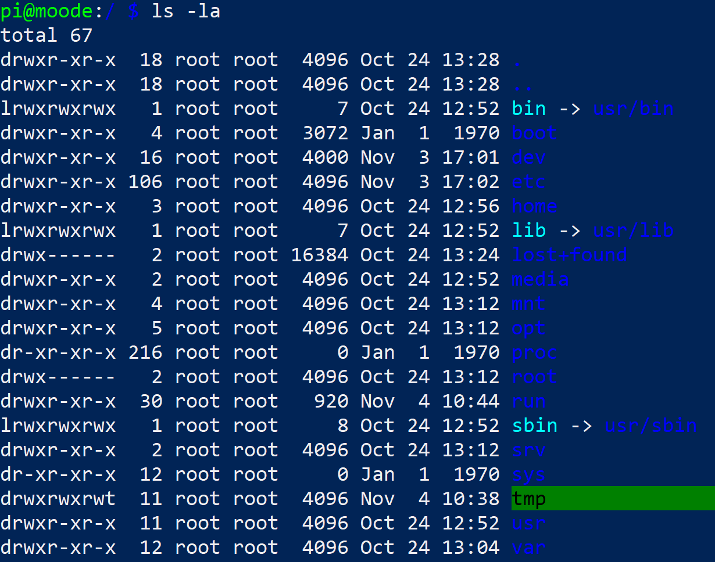
The server
A Linux OS is different from a Windows OS
No c:\
Everything is a file
Even hardware is technically a file
Permissions
User
Root

Slide 6
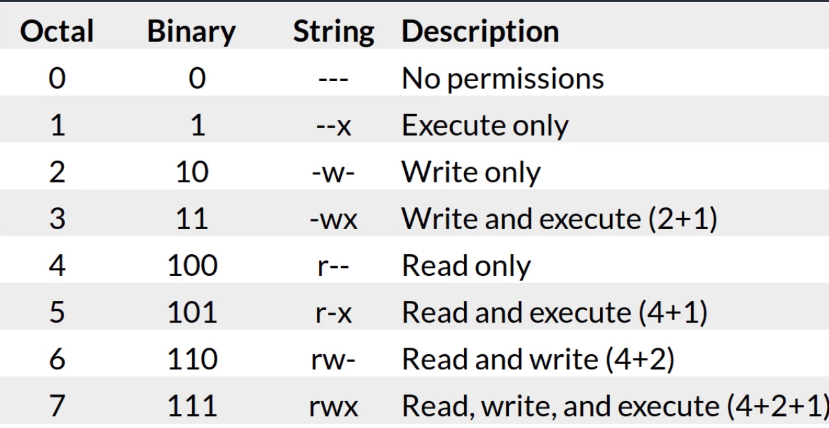
Permissions
Folders and files have permissions
Read, Write, Execute
Is a part of the security of the OS

Slide 7
Why is this important?
When uploading files you might run into permission problems
You are not allowed to save files everywhere
For your current development environment this should nog be an issue
Unless you use a Mac OS or a flavour of Linux
The command chmod could aid you

Slide 8

Uploading files
What comes down, has to be loaded up!

Slide 9
Uploading
The process of copying a file from client to server
Has some risks
Need some security checks
Consist out of two components
Form
PHP handler code

Slide 10
Form
Two new components
Enctype
Without “enctype” the file will never be received by the server
Input type=file
Creates the file picker
<form action="uploadfiles1.php" method="post" enctype="multipart/form-data">
<input type="file" name="uploadedFile" id="file" >

Slide 11
Demo #1
Uploading files

Slide 12

File I/O

Slide 13
Files
Clumps of data
Can be categorized in roughly two categories
Binary
Text
Binary files have to be read in a special manner

Slide 14
Showing files in a folder
Can be achieved by using a handler to a folder
Opening a folder
Closing the handler
Reading the folder
Grabbing the file names
$dirOpen = opendir("upload");
closedir($dirOpen);
while ($curFile = readdir($dirOpen))

Slide 15
Reading of files
Like with folders, files also use a handler
To a file
The first parameter is the path to the file
The second parameter is the mode
In this case Read
https://www.php.net/manual/en/function.fopen.php
Reading the file, line by line
Closing the handler
$handler = fopen("data/products.csv", "r");
while(!feof($handler)){
$line = fgets($handler);
}
fclose($handler);

Slide 16
Demo #2

Slide 17
Questions?

