Slide 1
Database engineering with PHP
Sessions & Cookies

Slide 2
Content
States
Cookies
Sessions
When to use cookies and when to use sessions

Slide 3

States
The current state of affairs

Slide 4
States
A website is “stateless”
It does not remember
HTTP protocol
Sometimes you want to remember states
How?

Slide 5
Remembering data
A database?
A possible solution, but a bit too much for simple data
A hidden form?
Difficult to maintain
Keeping states in the HTML DOM
Files on the server per user?
Sounds ok, but a file for every unique user?

Slide 6
Superglobals?
A GET parameter in the URL is a solution
Easily readable
Visible for every user
A solution for certain situations!
Performing an action based on a link
Two new superglobals
Cookie
Session

Slide 7

Cookies
Om nom nom

Slide 8

Wat are cookies
Small files on a client
Contain a minimal amount of data
So no gigabytes, think in bytes
Are persistent, will stay on a client after closing the browser

Slide 9
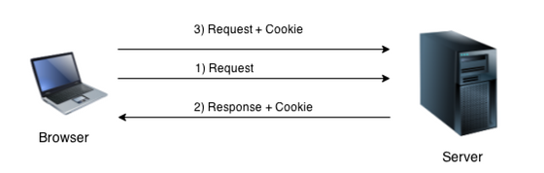
Cookies and PHP
By using PHP, you can “set” cookies
Take into account the order of operations
PHP “lives” on the server
You can use a cookie in the request after setting

Slide 10
Cookies and PHP
setcookie function
Name of the cookies
The value of the cookie
The time after which the cookie gets deleted
setcookie(COOKIENAME, COOKIEVALUE, EXPIRETIME);
$expire = time()+60; //Time in seconds
setcookie("user", "Jannes", $expire);

Slide 11
Down-sides cookies
Cookies are client-side
All info in a cookie is manipulatable by a user
Cookies only contain small amounts of data
Reputation

Slide 12
Demo #1
Cookies

Slide 13
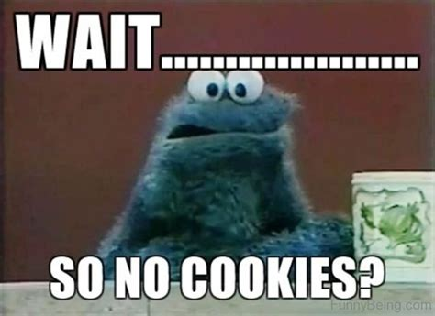
Sessions
Different cookies

Slide 14
Wat are sessions
Small amounts of data belonging to a user on the server
Are linked to a user by a “session cookie”
So sessions have a relation with cookies
Just like with cookies, sessions contain small amounts of data
Is persistent during the browsing of a webpage on the same domain
The session will be removed when you leave the domain

Slide 15
Demo #2
Sessies

Slide 16
Sessions versus cookies
Sessions are invisible for normal users
Cookies are easily manipulated
Session are persistent during the visit of a website
Cookies are persistent until the given time
Unless the user deletes them
Sessies can be used for “sensitive” data
Cookies can be used for persistent non-sensitive data

Slide 17
Questions?

