Slide 1
Database engineering with PHP
Databases & PHP

Slide 2
Content
Connecting with a database
Try-catch
Executing commands
Insert
Update
Collecting results
Select

Slide 3
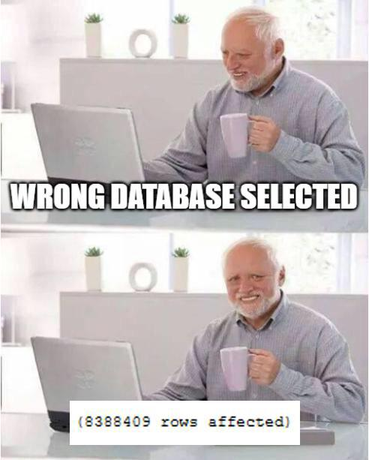
Connecting with a database
That special connection

Slide 4
Technique
PDO
PHP Data Object
Object Oriented
A method to execute commands on a database
A combination of PHP functions and SQL
All techniques learned at the database section can be applied here!

Slide 5
The connection string
In order to make a connection with a database you need four things
Location
Database name
Username
Password
The combination of a location and a database name creates a “connection string”
Example:
"mysql:host=mysql;dbname=pdo_test;charset=utf8"

Slide 6
PDO connect
By using the connection string, username and password, we can connect to the database
The “function”:
This function returns a “handler” which we are going to use
This can fail!
Try-catch
More info in the demo
new PDO("mysql:host=mysql;dbname=dbe_demo;charset=utf8", "root", "qwerty");
$dbHandler = new PDO("mysql:host=mysql;dbname= dbe_demo;charset=utf8", "root", "qwerty");

Slide 7

Executing commands
To command…

Slide 8
Commands
We are going to execute SQL commands from within PHP
Two types of commands:
Without a result set as a response
With a result set as a response
Insert
Update
We execute by using two special functions
Prepare
Execute

Slide 9
Prepare and execute
The prepare function prepares a query to be executed
Checks on mistakes
Adds the possibility to add parameters
This functions returns a “prepared statement”
We can execute this prepared statement
All these functions can possible fail!
$stmt = $dbHandler->prepare("INSERT INTO `artist` (`id`, `name`)
VALUES (NULL, 'Vengaboys');");
$stmt->execute();

Slide 10
Query variables
You can append parameters to queries
By using a special markup in the query itself
After preparing you need to bind the parameters
And indicate the datatype of the parameter
$stmt = $dbHandler->prepare("INSERT INTO `artist` (`id`, `name`)
VALUES (NULL, :artistName);"
);
$artistName = "The Village People";
$stmt->bindParam("artistName", $artistName, PDO::PARAM_STR);

Slide 11
Demo #1

Slide 12

Collecting results
…And conquer!

Slide 13
Collecting results
The type of query determines if you get a response with content
Insert and update do not respond with content
They only return the affected rows
Select responses with one, none or many rows of content
You can use this content in PHP

Slide 14
Collecting results
The setup is the same as with an insert or update query
Creating a connection
Defining a query
Preparing the query
Bind the variables
Executing the query
After the execution of the query we need to “fetch” the data

Slide 15
Fetching
The result set will be saved in the statement after execution
In order to actually get the data, we need to fetch the data
This is possible in three manners
Fetch
Fetch and bind
Fetchall
Fetch will return one row at the time
Fetchall will return everything at once

Slide 16
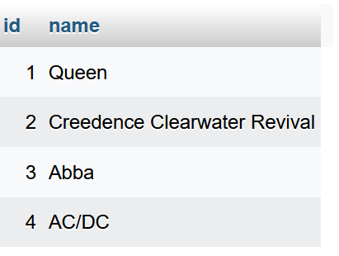
Fetch
One row at the time
Until there are no results left
Often done in combination with an associative array
Fetchall will return everything in one go

Slide 17
Fetch and Bind
Works like a normal fetch
Places data in own custom variables instead of an associative array
You can create these custom variables

Slide 18
Demo #2

Slide 19
Questions?

