Slide 1
EmmerCity Daderbase

Slide 2

CHECK-IN

Slide 3
TWO OPTIONS
OPTION 1:
Compare data with your eyes
Complain about dump data
OPTIE 2:
Using QUERYs and not making up anything yourself
Notes:
INSERT INTO songs (id, artist_id, name)
VALUES
(101, 62, “Ordinary life”),
(102, 62, “Starboy”)
INSERT INTO artists VALUES (71, "Jaqueline");

Slide 4
OPTION 1
You won't find out who the thief is
You won't find out where he is going
You won't find out who helped him
You all see dump data and marvel at that
Notes:
UPDATE artists
SET name = “Jaxx”
WHERE id = 71

Slide 5
OPTION 1
Curiosity about data is much appreciated
But Emmen really doesn't have an airport
Notes:
Maar gebruik dan wel daarna alles zoals het moet.

Slide 6
OPTION 2
What does the database look like?
What is the first fact I got?

Slide 7
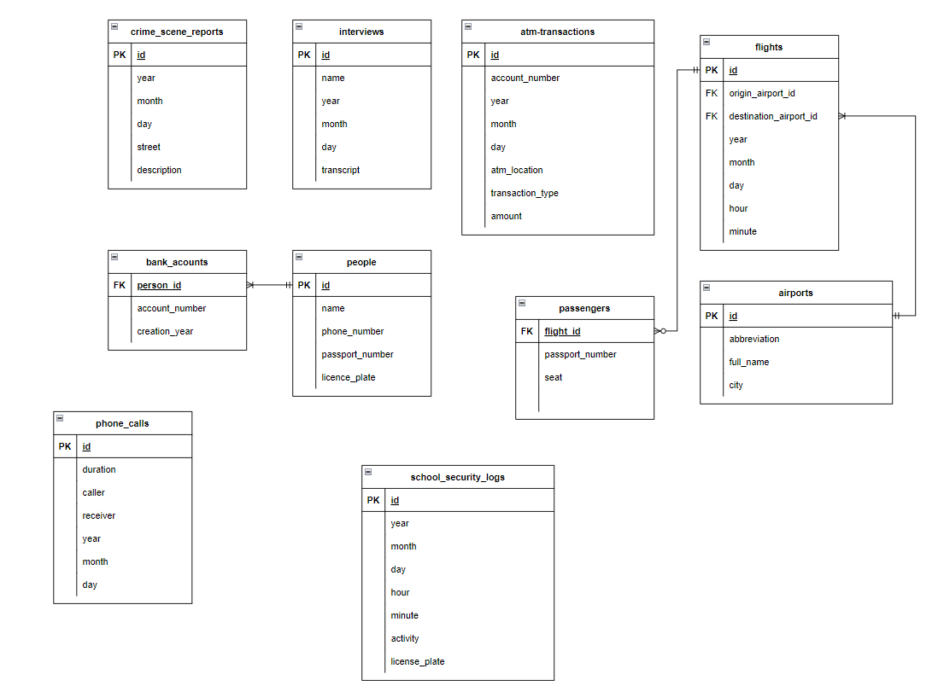
Draw IO (or your favourite ERD drawing program) paper?
What does the database look like?

Slide 8
Start your scavenger hunt
What is the first big thing I got?
took place July 28
SELECT year, street, description
FROM crime_scene_reports
WHERE month = 7 AND day = 28;
Notes:
Reguliere query: SELECT – FROM - WHERE

Slide 9
crime_scene_report
ANSWER: 2022
Theft of the Jukebox in room 1.016 took place at 10:15am at NHL Stenden university of applied sciences Emmen. Interviews were conducted today with three witnesses who were present at the time – each of their interview transcripts mentions the school.

Slide 10
interviews
SELECT transcript, name
FROM interviews
WHERE year = 2022
AND month = 7
AND day = 28;

Slide 11
-- Ruth: Sometime within ten minutes of the theft, I saw the thief get into a car at the school park lot and drive
off. If you have security footage from the school parking lot, you might want to look for cars that left the
parking lot in that time frame.
-- Raymond: As the thief was leaving the school, they called someone who talked to them for less than a minute.
In the call, I heard the thief say that they were planning to take the earliest flight out of Emmen tomorrow.
The thief then asked the person on the other end of the phone to purchase the flight ticket.
-- Eugene: I don't know the thief's name, but it was someone I recognized. Earlier this morning,
before I arrived at NHL Stenden, I was walking by the ATM on Hondsrugweg and saw the thief there
withdrawing some money.
-- Emma: I am the school receptionist, and someone came in, suspiciously whispering into a phone
for about half an hour. They never went to class or anything.

Slide 12
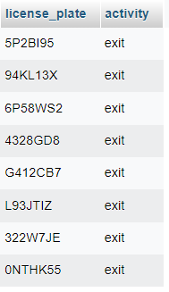
Based on Ruth saying that after 10 minutes of theft
(which occurred at 10.15 am (crime_scene_report))
SELECT license_plate, activity
FROM school_security_logs
WHERE year = 2022
AND month = 7
AND day = 28
AND hour = 10
AND minute BETWEEN 15 AND 25;
Notes:
En nee dit zijn geen NL license_plate (en nee, ons security logs van school houdt geen licenseplates bij)

Slide 13
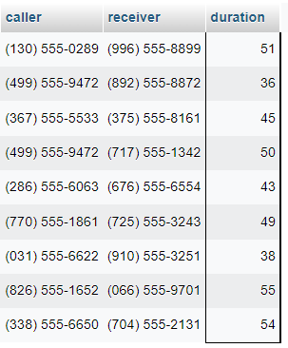
Based on Emma mentioned phone conversation
(About half an hour conversation... define about half an hour)
SELECT caller, receiver
FROM phone_calls
WHERE year = 2022
AND month = 7
AND day = 28
AND duration<60;
Notes:
Nee dit zijn geen NL telefoonnummers

Slide 14
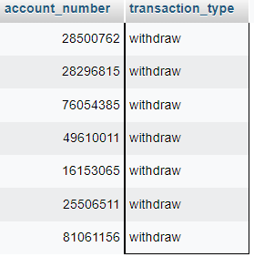
Based on Eugene
SELECT account_number, transaction_type
FROM atm_transactions
WHERE year = 2022
AND month = 7
AND day = 28
AND atm_location = "Hondsrugweg"
AND transaction_type="withdraw";
Notes:
Nee dit zijn geen NL telefoonnummers

Slide 15

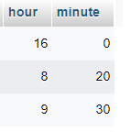
Based on Raymond
SELECT hour, minute
FROM flights
WHERE year = 2022
AND month = 7
AND day = 29
ORDER BY hour, minute
LIMIT 1;
Notes:
Nee dit zijn geen NL telefoonnummers

Slide 16
Based on Raymond
SELECT flights.id, airports.full_name, airports.city
FROM flights, airports
WHERE airports.id = flights.destination_airport_id
AND year = 2022
AND month = 7
AND day = 29
AND hour = 8
AND minute = 20;
-- Flight id = 36 - Groningen-Eelde Airport - Eelde
SELECT flights.id, airports.full_name, airports.city
FROM flights, airports
WHERE airports.id = flights.origin_airport_id
AND year = 2022
AND month = 7
AND day = 29
AND hour = 8
AND minute = 20;
-- Coming from Emmen Airport - Emmen
Notes:
Onze eerste join

Slide 17
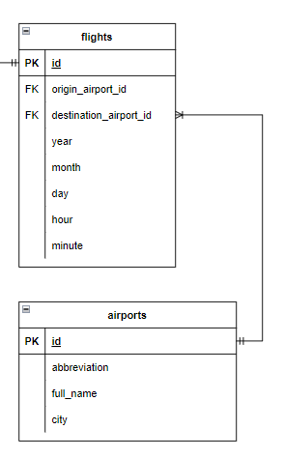
Information from two or more tables:
FROM flights, airports
WHERE airports.id = flights.origin_airport_id
FROM flights
(INNER) JOIN airports ON airports.id = flights.origin_airport_id
Notes:
Onze eerste join

Slide 18
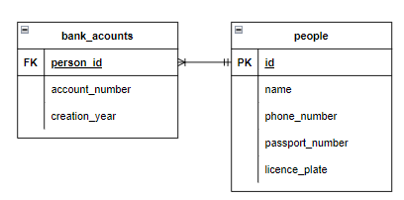

Slide 19
SELECT *
FROM people, bank_accounts
WHERE bank_accounts.person_id = people.id
AND passport_number IN (SELECT passport_number
FROM passengers
WHERE flight_id = 36)
AND phone_number IN (SELECT caller
FROM phone_calls
WHERE year = 2022
AND month = 7
AND day = 28
AND duration < 60)
AND license_plate IN (SELECT license_plate
FROM school_security_logs
WHERE year = 2022
AND month = 7
AND day = 28
AND hour=10
AND minute BETWEEN 15 AND 25)
AND account_number IN (SELECT account_number
FROM atm_transactions
WHERE year = 2022
AND month = 7
AND day = 28
AND atm_location = "Hondsrugweg"
AND transaction_type = "withdraw")
Notes:
Onze eerste join

Slide 20
SELECT *
FROM people, bank_accounts
WHERE bank_accounts.person_id = people.id
AND passport_number IN (SELECT passport_number
FROM passengers
WHERE flight_id = 36)
AND phone_number IN (SELECT caller
FROM phone_calls
WHERE year = 2022
AND month = 7
AND day = 28
AND duration < 60)
AND license_plate IN (SELECT license_plate
FROM school_security_logs
WHERE year = 2022
AND month = 7
AND day = 28
AND hour=10
AND minute BETWEEN 15 AND 25)
AND account_number IN (SELECT account_number
FROM atm_transactions
WHERE year = 2022
AND month = 7
AND day = 28
AND atm_location = "Hondsrugweg"
AND transaction_type = "withdraw")
Notes:
Subquery

Slide 22
SELECT caller, receiver
FROM phone_calls
WHERE year = 2022
AND month = 7
AND day = 28
AND duration < 60
AND caller = "(367) 555-5533";
- receiver = (375) 555-8161
SELECT name
FROM people
WHERE phone_number = "(375) 555-8161";
- The ACCOMPLICE is: Robin

Slide 23
Who the thief is: Bruce
Where the thief escaped to: Groningen-Eelde
The ACCOMPLICE is: Robin

Slide 24
The SQL Murder Mystery (knightlab.com)
https://mystery.knightlab.com/

