Slide 1
DDL – Create Tables
Database Engineering

Slide 2
Intention and desired outcome
INTENTION:
Learning together how to use DDL and DML
DESIRED OUTCOME:
• You know what DDL is.
• You know how to create a database and a table.
• You know which datatypes there are.
• You are inspired to practice practice practice…. !!!!

Slide 3
Agenda
Database Engineering– Period II
SESSION
THEME
DDL AND DML
ACTIVITY
0
DDL
SYNTAX
DATATYPES
ATTRIBUTES
DML
CONSTRAINTS

Slide 4
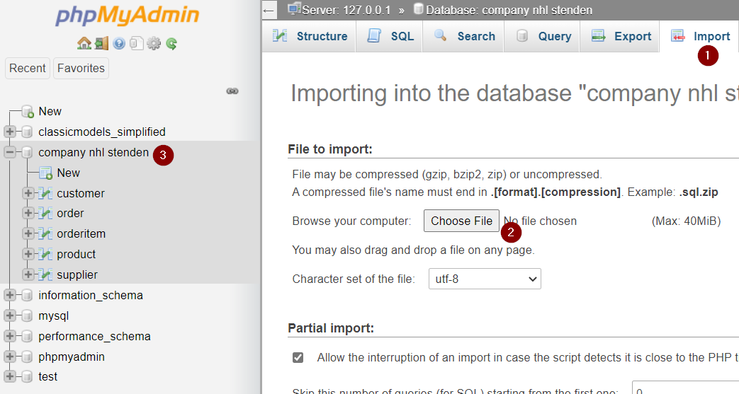
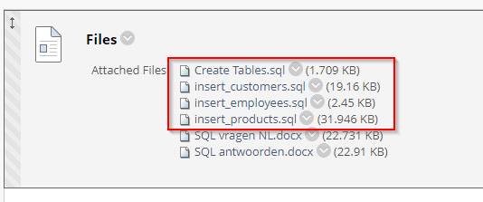
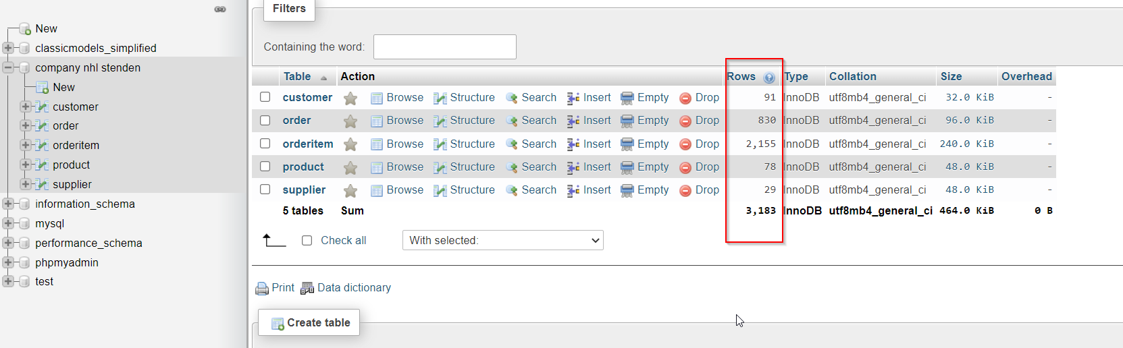
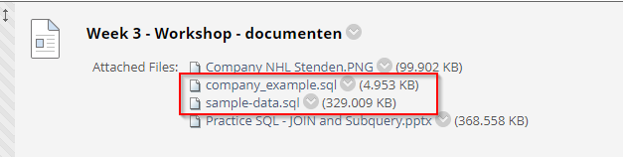
Remember??...

Slide 5
SQL file
SET SQL_MODE = "NO_AUTO_VALUE_ON_ZERO";
START TRANSACTION;
SET time_zone = "+00:00";
CREATE DATABASE IF NOT EXISTS `company NHL Stenden` DEFAULT CHARACTER SET utf8mb4 COLLATE utf8mb4_general_ci;
USE `company NHL Stenden`;
CREATE TABLE `customer` (
`Id` int(11) NOT NULL,
`FirstName` varchar(40) NOT NULL,
`LastName` varchar(40) NOT NULL,
`City` varchar(40) DEFAULT NULL,
`Country` varchar(40) DEFAULT NULL,
`Phone` varchar(20) DEFAULT NULL
) ENGINE=InnoDB DEFAULT CHARSET=utf8mb4;
CREATE TABLE `order` (
`Id` int(11) NOT NULL,
`OrderDate` datetime NOT NULL,
`OrderNumber` varchar(10) DEFAULT NULL,
`CustomerId` int(11) NOT NULL,
`TotalAmount` decimal(12,2) DEFAULT 0.00
) ENGINE=InnoDB DEFAULT CHARSET=utf8mb4;
CREATE TABLE `orderitem` (
`Id` int(11) NOT NULL,
`OrderId` int(11) NOT NULL,
`ProductId` int(11) NOT NULL,
`UnitPrice` decimal(12,2) NOT NULL DEFAULT 0.00,
`Quantity` int(11) NOT NULL DEFAULT 1
) ENGINE=InnoDB DEFAULT CHARSET=utf8mb4;
CREATE TABLE `product` (
`Id` int(11) NOT NULL,
`ProductName` varchar(50) NOT NULL,
`SupplierId` int(11) NOT NULL,
`UnitPrice` decimal(12,2) DEFAULT 0.00,
`Package` varchar(30) DEFAULT NULL,
`IsDiscontinued` bit(1) NOT NULL DEFAULT b'0'
) ENGINE=InnoDB DEFAULT CHARSET=utf8mb4;
CREATE TABLE `supplier` (
`Id` int(11) NOT NULL,
`CompanyName` varchar(40) NOT NULL,
`ContactName` varchar(50) DEFAULT NULL,
`ContactTitle` varchar(40) DEFAULT NULL,
`City` varchar(40) DEFAULT NULL,
`Country` varchar(40) DEFAULT NULL,
`Phone` varchar(30) DEFAULT NULL,
`Fax` varchar(30) DEFAULT NULL
) ENGINE=InnoDB DEFAULT CHARSET=utf8mb4;

Slide 6
SQL
DCL
TCL
DQL
DDL
DML
SELECT
CREATE
DROP
ALTER
TRUNCATE
INSERT
UPDATE
DELETE

Slide 7
DDL - Structure
DDL stands for Data Definition Language
Used to set up or modify the database
You could say DDL works on a different layer than DML

Slide 8
CREATE DATABASE
CREATE DATABASE databasename;
CREATE DATABASE [IF NOT EXISTS] databasename;
DELETE A DATABASE
DROP DATABASE databasename;
DROP DATABASE [IF EXISTS] databasename;

Slide 9
DEMO 1

Slide 10

CREATE TABLE Syntax
CREATE TABLE table_name ( column1 datatype [attribute], column2 datatype [attribute], column3 datatype [attribute], ....
<constraints> );
Being consistent is important!

Slide 11

CREATE TABLE - Datatypes
Many data types will be similar to how you know them from PHP (or other languages)
Numberic
INT (INTEGER, SMALLINT, BIGINT, TINYINT, MEDIUMINT)
FLOAT, DOUBLE
NUMERIC, DECIMAL
String
CHAR, VARCHAR
ENUM
Date and time
DATE, DATETIME, TIMESTAMP

Slide 12
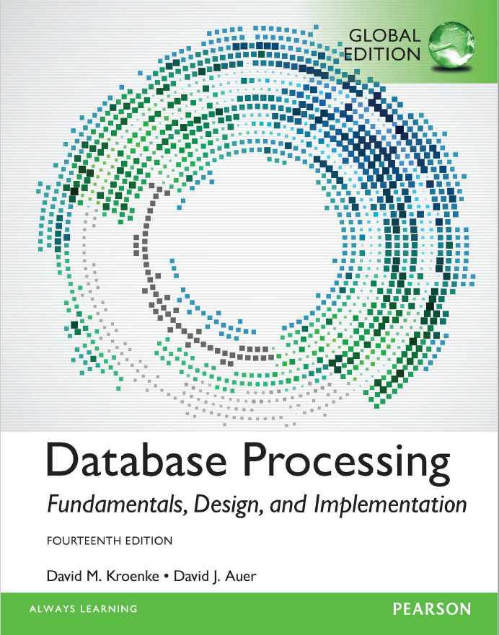
BOOK - Datatypes
PAGE: 289-290

Slide 13
CREATE TABLE - Attributes
What are attributes in DDL?
Other extra applications/functionalities that you want to place on a column.
ATTRIBUTE | MEANING
[NOT] NULL | Is an input of the column mandatory or not
AUTO_INCREMENT | For numerical data types. Provides automatic increment when a new row is added.
DEFAULT | Provide a default value for values ​​that receive a NULL. A NULL is replaced by the prescribed DEFAULT value

Slide 14
DEMO 2

Slide 15

Constraints
Constraints are (as the name suggests) limits
Constraints are placed on columns within the tables
While creating the table it is possible to place the constraint
But it is also possible to change them after the time (with: ALTER TABLE)
Examples of constraints are:
UNIQUE
When a column is unique, the column allows only unique values
INDEX
Indexes are used to find rows with specific column values quickly
CHECK
The CHECK constraint is used to limit the value range that can
be placed in a column.

Slide 16
Constraints
CREATE TABLE table_name ( column1 datatype [attribute], column2 datatype [attribute], column3 datatype [attribute], ....
constraint <constraint_naam> <constraint_type>(column_naam1)
);
Example
CONSTRAINT CHK_Person CHECK (Age>=18 AND City=Emmen')
By giving a constraint a name, it is possible to modify or even remove it later (based on that name).
Name
Column
Column

Slide 17
Constraint
Primary and foreign keys can also be imposed via a constraint. In essence, these are limitations that are imposed on the data.
Syntaxis
Constraint PK_userid PRIMARY KEY(userid);
Constraint FK_user_order FOREIGN KEY(userid) REFERENCES USER(userid)
Notes:
In the above constraint, the constraint is announced, given a name, the type of constraint chosen and indicated on which column this constraint is located. Then the reference (relation) is made to the primary key in another table.

Slide 18
DEMO 3

Slide 19
DML – INSERT & UPDATE (RECAP)
INSERT INTO table_name (column1, column2, column3, ...) VALUES (value1, value2, value3, ...);
UPDATE table_name SET column1 = value1, column2 = value2, ... WHERE condition;
Notes:
UPDATE
UPDATE <tabelnaam> SET <column_naam> = <waarde> [WHERE <column_naam> = <waarde>]
We updaten de waardes door middel van het SET keywoord. Hierbij geven we aan welke van column de waarde(s) aangepast moeten worden.
SET is uit te breiden met meerdere aanpassingen door ze met komma’s te scheiden.
SET name = ‘Gerjan’, age = age + 1, etc.
Zonder een WHERE statement zal dit de gehele column aanpassen!

Slide 20
DEMO 4

Slide 21
QUESTIONS?

