Slide 1
Normalization
Database Engineering

Slide 2
Programme
Goal of Normalization
Functional dependencies
Normal forms
First, Second, and Third Normal Forms

Slide 3
Concept Design: Tools and Sources
Conceptual
Model
Information sources
Design tools
Business rules and data constraints
Data Flow Diagrams (DFD)
Functional Design
User Views (Output)
Normalization
Data dictionary
E-R diagram
ERD
Definiëren
and
validation
Notes:
Examples of business rules:
Some examples of typical business rules and the requirements from which they arise.
Requirement: The warehouse employee must be able to ship orders in order to provide customers with their purchase. Business rule: The shipping date cannot be before the order date.
Requirement: The rental agent must be able to assign a car to a renter so that they can drive. Business rule: A renter cannot rent more than one car at the same time.
Requirement: The buyer must be able to place orders without the intervention of others. Business rules: He may only do business with suppliers from the region. He is also allowed to make independent purchases up to a certain amount.
Requirement: The seller may give discounts to customers to promote customer satisfaction. Business rules: Only long-term customers are allowed to receive a discount. The discount is also a maximum of 15% on all purchases.

Slide 4
DB Design Strategy Notes ERD modelling ⬄ Normalization
Top-down approach
ERD modelling:
Identify data sets (search for entity-types)
Relations
Define data elements (search for attributes)
Bottom-up approach
Normalization:
Identify data elements (search for attributes)
Group them into data sets
Check on a relational model which is build Top-down

Slide 5
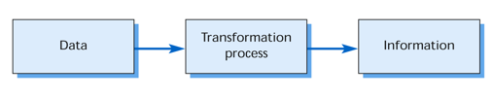
Top down vs. Bottom up
TOP DOWN
Conceptual model
Attribute
Entity
Entity
Attribute
Attribute
Attribute
BOTTOM UP

Slide 6

Goal Normalization
Aims to reduce data redundancy
anomalies
Inconsistency
redundancy
Notes:
The aim of normalization is to avoid redundancy. Redundancy means that certain information is presented simultaneously in more than one place. The main disadvantages of redundancy are: risks of inconsistency, if the same type of information is present in more than one place at the same time, the places of storage information may contradict each other; data maintenance more difficult: some changes must be made simultaneously in different places.

Slide 7
Example data redundancy

Slide 8
Anomalies
Leads to various problems
INSERT anomalies
new convention, Gaming at 30-12-2021
UPDATE anomalies
date of Multi Event changes to 30-12-2021
DELETE anomalies
Jan is not going to the “Star Trek Convention”
Notes:
Insert anomaly Suppose we want to insert a new convention in Table 1, for example, Gaming, date 30-12-2021. The problem is that we only Gaming can add to the above table, when someone registers as a participant for Spellenspektakel. This is called a Insert Anomaly.
Delete Anomaly Suppose John decides not to go to the Star Trek convention, so this row of the table is deleted. The problem now is that we have lost the information about the date of the Star Trek Convention. This is called a delete anomaly.
Update anomaly Suppose the date of Multi Event changes to 30-12-2008. In this case, two rows must be updated. It is possible to forget accidentally one, which would yield an inconsistency in the table. This is called a Change anomaly.

Slide 9
Example 2: administration of a library (books)
problems:
Changing of phonenr on more places (update anomaly)
When returning the book also phonenr dissapear (delete anomaly)
How comes ?
Dependency: name -> phonenr
name is a determinant of phonenr

Slide 10
Administration of a library (books)
Solution: 2 tables
Table: borrowed books
Notebook: name + phone number

Slide 11
Normal Form (NF)
1st NF relates to a single table and its structure
2nd NF, 3rd NF and Boyce-Codd (BCNF) relates to 1:1 and 1:M relations
4th and 5th NF is about N:M relations
Normal Forms form a hierarchy
3 NF
1 NF
4 NF
5 NF
2 NF

Slide 12
First Normal Form (1NF)
Each “cell” contains exactly one value
0NF → 1NF:
Adding extra tuples (rows)
Separate the repeating groups

Slide 13
1e Normaal vorm (1NF)
Each “cell” contains exactly one value
No repeating groups (columns)
No process data
Next table is not in 1NF:
DepartmentID | Manager_ID | Employee_ID | Employee_Name
D101 | 12345 | 20000 20001 20002 | Carl Sagan Mag James Larry Bird
D102 | 13456 | 30000 30001 | Jim Carter Paul Simon
Notes:
Process data are attributes of which the value can be determined (calculated) based on other attributes (not to be confused with functional dependence).
Not all data present on a form need to be included. You do not include data that can be created through a process, for example calculating VAT or today's date. You also do not include constants that never change, for example the company name, your own address.

Slide 14
Table in 1NF
DepartmentID | Manager_ID | Employee_ID | Employee_Name
D101 | 12345 | 20000 | Carl Sagan
D101 | 12345 | 20001 | Mag James
D101 | 12345 | 20002 | Larry Bird
D102 | 13456 | 30000 | Jim Carter
D102 | 13456 | 30001 | Paul Simon

Slide 15
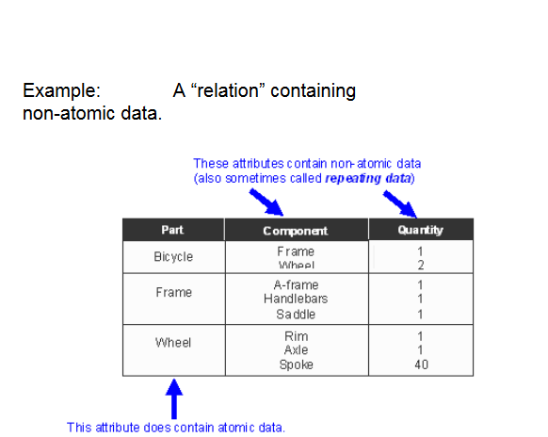
Not in 1NF

Slide 16
Table in 1NF
Part | Component | Quantity
Bicycle | Frame | 1
Bicycle | Wheel | 2
Frame | A-frame | 1
Frame | Handlebars | 1
Frame | Saddle | 1
Wheel | Rim | 1
Wheel | Axle | 1
Wheel | Spoke | 40

Slide 17
Not in 1NF
Programming
Student | Date of birth | Language1 | Level1 | Language2 | Level2 | Language3 | Level3
Anita | 27-06-1991 | Java | Good | C++ | Very Good
Jos | 24-04-1990 | PHP | Average | Java | Average | C++ | Average
Lisa | 12-08-1988 |  |  | Java | Good
Programming Language
Student | Geb. datum | Taal | Niveau
Anita | 27-06-1991 | Java | Good
Jos | 24-04-1990 | PHP | Average
Lisa | 12-08-1988 | Java | Good
Anita | 27-06-1991 | C++ | Very Good
Jos | 24-04-1990 | Java | Average
Jos | 24-04-1990 | C++ | Average

Slide 18
2e step 1NF
Student
Programming Language
Student | Date of birth
Anita | 27-06-1991
Jos | 24-04-1990
Lisa | 12-08-1988
Student | Language | Level
Anita | Java | Good
Jos | PHP | Average
Lisa | Java | Good
Anita | C++ | Very Good
Jos | Java | Average
Jos | C++ | Average

Slide 19
Functional Dependencies
Redundancy is often caused by a functional dependency
A functional dependency (FD) is a link between two sets of attributes in a relation
We can normalise a relation by removing undesirable FDs
Student number → First name
Student number → Last name
Student number → Date of birth
First name ≠ Date of birth

Slide 20
Functional Dependencies
A set of attributes, A, functionally determines another set, B, or:
there exists a functional dependency between A and B (A → B), if whenever two rows of the relation have the same values for all the attributes in A, then they also have the same values for all the attributes in B.

Slide 21
Example
SSN determines the Firstname of the employee
SSN→ Firstname
Department name determines the Location and the manager
“Department name” → {Location, Manager}
SSN and ProjectID determine the amount hours worked on
{SSN, ProjectID }→ Hours_worked_on

Slide 22
2e Normal Form (2NF)
A relation is in second normal form (2NF) if it is in 1NF and no non-key attribute is partially dependent on a candidate key
In other words, no C → B where C is a strict subset of a candidate key and B is a non-key attribute.
1NF → 2NF:
cleavage of the attributes that depend on a part of the primary key in a separate table.

Slide 23

1NF → 2NF

Slide 24
1NF → 2NF
Student number
Student name
Student number
Student name
Student number
Course code
Course title
registration date
Study centre code
Study centre name
Student number
Course code
registration date
Study centre code
Study centre name
Course code
Course title

Slide 25
Not in 2NF
Partid | WarehouseID | Quantity | Warehouse-Address
1 | A | 20 | Het Lage Holt 21
1 | B | 10 | Van Schaikweg 94
2 | A | 24 | Het Lage Holt 21

Slide 26
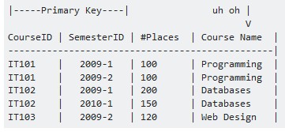
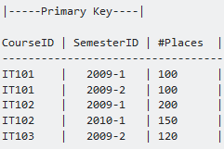
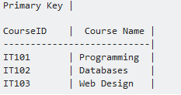
1NF to 2NF – Example

Slide 27
3RD Normal Form (3NF)
Third normal form
A relation is in third normal form (3NF) if it is in 2NF and all the attributes in a table are determined only by the candidate keys of that table and not by any non-prime attributes
2NV→3NV
cleavage of the indirectly dependent attributes in a separate table

Slide 28
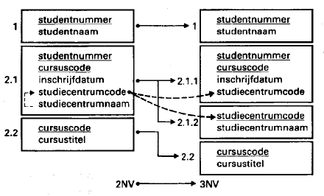
2NF → 3NF
Student number
Student name
Student number
Student name
Student number
Course code
registration date
Study centre code
Study centre name
Student number
Course code
registration date
Study centre code
Study centre code
Study centre name
Course code
Course title
Course code
Course title

Slide 29
Third Normal Form
Example of a 2NF table that fails to meet the requirements of 3NF
Tournament Winners
Tournament | Year | Winner | Date of Birth Winner
Indiana Invitational | 1998 | Al Fredrickson | 21 July 1975
Cleveland Open | 1999 | Bob Albertson | 28 September 1968
Des Moines Masters | 1999 | Al Fredrickson | 21 July 1975
Indiana Invitational | 1999 | Chip Masterson | 14 March 1977

Slide 30
2NF to 3NF – Example
Tournament Winners
Tournament | Year | Winner
Indiana Invitational | 1998 | Al Fredrickson
Cleveland Open | 1999 | Bob Albertson
Des Moines Masters | 1999 | Al Fredrickson
Indiana Invitational | 1999 | Chip Masterson
Dates of Birth Winner
Winner | Date of Birth
Chip Masterson | 14 March 1977
Al Fredrickson | 21 July 1975
Bob Albertson | 28 September 1968

Slide 31
In summary until 3NF
Each field in a record should be dependent on the primary key (1NF), the entire primary key (2NF), and nothing but the primary key (3NF)

Slide 32
Assignment (5 minutes)
Normalize:

Slide 33
Assignment
Dependencies:

Slide 34
Solution
assumptions:
Teacher name is unique, subject is unique
1 subject is given by 1 teacher

Slide 35
Checklist Normalization
Non-normalized
Collect all attributes;
Mark the process data. Process data are attributes of which the value can be determined (calculated) based on other attributes (not to be confused with functional dependence).
From the 0th to the 1st normal form
Do not copy any process data;
Separate the repeating groups (surplus value attributes). Be aware: there can be several parallel groups as well as nested groups;
Select an appropriate key for the main group;
Select an appropriate key for the separated group. This always contains one or more attributes from the separated group, combined with the key attribute from the main group.
With nested groups, separate the subgroup from the group and repeat the above-mentioned steps until there are no subgroups left over.
From the 1st to the 2nd normal form
Separate groups that depend only on a part of the key. This occurs only in groups with a key consisting in two or more attributes. Be aware: the remaining group with multiple keys remains in existence, even when it contains no other attributes.
From the 2nd to the 3rd normal form
Separate groups that are dependent on a non-key attribute;
Mark the attribute or attributes on which the group is dependent as the primary key(s);
Retain the key of the group separated from the original group as a reference key.

Slide 36
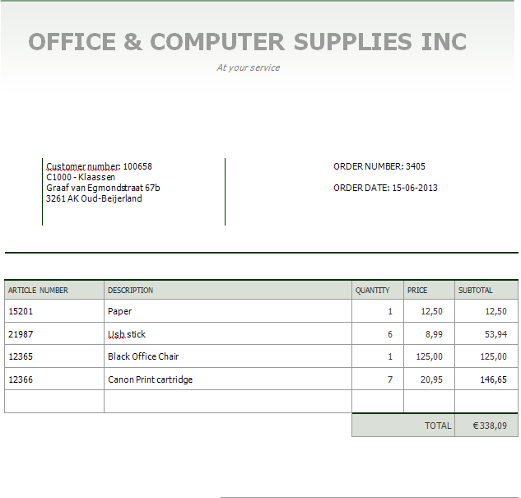

Slide 37
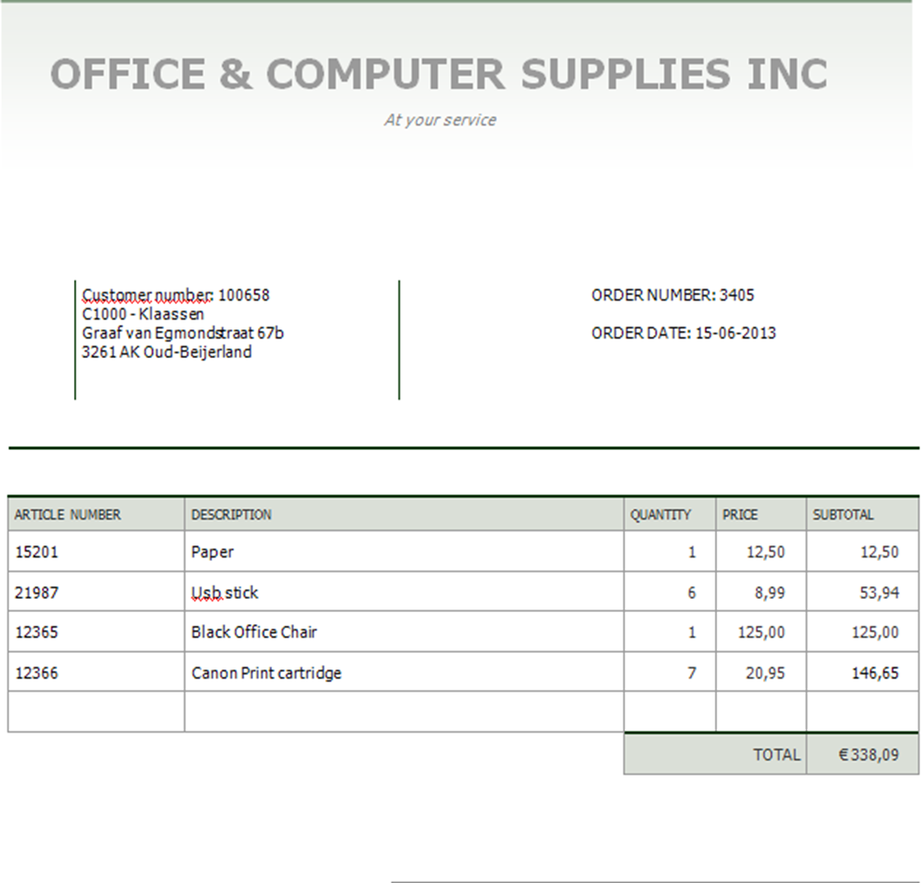
FROM 0NF TO 1NF
0NF
order nr order date customer nr customer name
Address
zip code place art. nr art. description amount price subtotal * end total *
determine
repeating
group
art. nr art. description amount price
Determine PK
Main group order nr order date customer nr customer name
Address
zip code place
1NF
Order nr order date customer nr customer name
Address
zip code place
Order nr art nr art. description amount price

Slide 38
From 1 NF to 2 NF
1NF
Order nr order date customer nr customer name
Address
zip code place
Order nr art nr art. description amount
price
Functional dep. Order nr order date customer nr customer name
Address
zip code place
Order nr art nr art.description ←
amount price ←
2NF
Order nr order date customer nr customer name
Address
zip code place
Order nr art nr amount
Art nr art.descriptionprice

Slide 39

From 2NF to 3NF
Functional dep.
Order nr order date customer nr customer name Address zip code place
Order nr art nr amount
Art nr
art.description
price
3NF
Order nr order date customer nr customer nr customer name Address zip code place ordernr artnr number artnr art.descriptionprice
2NF
Order nr order date customer nr customer name
Address
zip code place
Order nr art nr amount
Art nr art.descriptionprice
Entity ORDER
CUSTOMER
ORDER ROW
ARTICLE

Slide 40
0NF
order nr order date customer nr customer name
Address
zip code place art. nr art. description amount price subtotal * end total *
1NF
Order nr order date customer nr customer name
Address
zip code place
Order nr art nr art. description amount
price
2NF
Order nr order date customer nr customer name
Address
zip code place
Order nr art nr amount
Art nr art.descriptionprice
3NF
Order nr order date customer nr customer nr customer name Address zip code place ordernr artnr number artnr art.descriptionprice
Entiteit ORDER
KLANT
BESTELREGEL
ARTIKEL

