Slide 1
Database engineering with PHP
Repetition of databases & login systems

Slide 2
Content
Repetition of steps for databases and PHP
Login systems

Slide 3
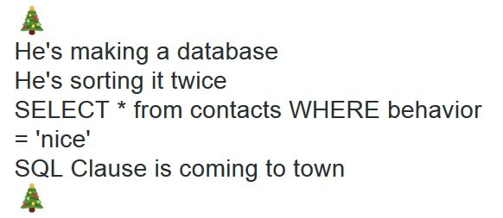
The database routine
Repeat after me

Slide 4
Technique
PDO
PHP Data Object
Object Oriented
All techniques learned in the databases section can be reused!

Slide 5
The routine
Creating a connection
Defining a query
Preparing a query
Binding variables
Executing the query
Did you execute a select query? Then you need to use one of the three fetch methods after running
Fetch
Fetch and bind
Fetch All

Slide 6
Creating a connection
Create a connection with the “new PDO” function
Returns a database handler
A kind of toolbox in which all database operations are listed
$dbHandler = new PDO("mysql:host=mysql;dbname=dbe_demo;charset=utf8", "root", "qwerty");

Slide 7
Defining a query and preparing
After creating a connection, you can prepare queries
And possibly. bind parameters
$stmt = $dbHandler->prepare("INSERT INTO `artist` (`id`, `name`)
VALUES (NULL, :artistName);"
);
$artistName = "The Village People";
$stmt->bindParam("artistName", $artistName, PDO::PARAM_STR);

Slide 8
Executing and fetching
Once the query is prepared and possibly. parameters are bound, then you can execute
After that, you can fetch results
$stmt->execute();
while($result = $stmt->fetch(PDO::FETCH_ASSOC)){
var_dump($result);
}
$results = $stmt->fetchall(PDO::FETCH_ASSOC);
foreach($results as $result){
var_dump($result);
}

Slide 9
Errors
Think carefully about catching mistakes
Try-Catch
Do think about the user
Are there any results?
$stmt->rowCount();

Slide 10
Demo #1

Slide 11
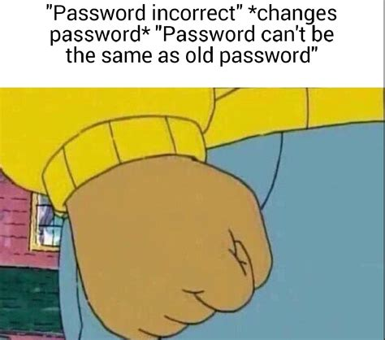
Login systems
Your password needs to contain the following characters…

Slide 12
Login systems
Logging in to a website is a combination of many techniques
Reading forms
Reading a database table
comparing
Setting sessions
Registering is a similar combination
A new topic: hashing

Slide 13
Users and passwords
The combination of a username and a password creates a user
You can save this in a database
Ask yourself: Do you want to know what the passwords of your users are?
And do you want to bear the possible consequences of that?
There is a solution, encrypting passwords
Hashing

Slide 14
Hashing
Converting data into a fixed amount of text For example:
The string “Never gonna give you up”
Becomes: 80ed516cebacf1c9d6b7c749bd428fb9
After a MD5 hash
A very complicated mathematical process
Fortunately, PHP has built-in features for this

Slide 15
Password hash functions
There are 2 good functions that make it possible to hash and check passwords
The result is the string: $2y$10$.vGA1O9wmRjrwAVXD98HNOgsNpDczlqm3Jq7KnEd1rVAGv3Fykk1a
This is what is stored in the database!
Returns a boolean
In this case “True”
$hashedPass = password_hash("qwerty");
password_verify("qwerty", $hashedPass);

Slide 16
Setting the session
After checking the password, you can set a session
In this you put, for example, the logged-in username
Now you can use the session to determine whether a user can access a page
Don't forget to start the session!
Once per page

Slide 17
Demo #2

Slide 18
Questions?

