Slide 1
Middleware for
High Availability and Scalability in Multi-Tier and Service-Oriented
Architectures
© Francisco Pérez-Sorrosal
Advisor: Marta Patiño-Martínez
Distributed Systems Laboratory (DSL/LSD)
Universidad Politécnica de Madrid
Madrid, Spain
Notes:
Please, let me present you the results of my PhD thesis…

Slide 2



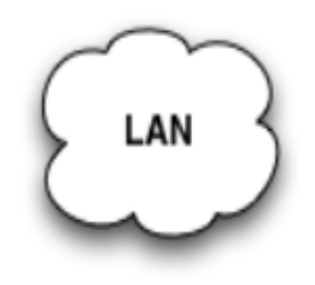
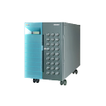
Motivation
Stateful Data &
Transactions
Apps.
Data
Services
EXPENSIVE
Company A
Ph.D. Thesis © Francisco Pérez-Sorrosal
May 13th 2009
Notes:
Modern companies rely on information systems to support their businesses. Many of the current applications that support these businesses are based on multi-tier and service-oriented architectures. These applications are used to be deployed in centralized systems such as the one shown in this figure. (PRESS KEY) Applications manage stateful data at middleware level and use transactions in order to keep the consistency of these data when concurrent accesses occur.
However, in these days, applications need to be adapted to changing environments in order to support increasing loads and failures of components.
When the load increases (PRESS KEY), the simplest solution is to upgrade the underlying system to support the new workload requirements. (PRESS KEY) However, this is an expensive solution and may not be affordable for many companies.
In the same way, if a software or hardware component fails (PRESS KEY), the failure may compromise the availability of all the applications running in it. So, it is also important to recover the consistency of the system after a failure.
Therefore, new solutions are required to provide high availability and scalability to current applications and infrastructures.

Slide 3

Motivation
Apps.
Services
Data
Apps.
Services
Data
Company B
State
Consistency
Cluster
Replica
Data
Services
Apps.
Ph.D. Thesis © Francisco Pérez-Sorrosal
May 13th 2009
Notes:
Replication is a well-known technique that allows to adapt a system to changing environments. This figure represents a cluster, (PRESS KEY) that is composed by a set of replicas that provide redundancy to data, services or applications.
In this scenario, high availability can be ensured because if a replica fails (PRESS KEY), the other replicas can take over the client requests.
At the same time, (PRESS KEY) scalability can be also achieved if we take advantage of the processing capacity of each replica of the cluster. However, when adding new replicas, current cluster infrastructures can only scale-out stateless applications.
(PRESS KEY) A main challenge for scaling-out stateful applications is to preserve the state consistency in all the replicas of the cluster. In order to achieve this objective, transaction management has to be adapted properly to replicated environments in order to allow a consistent scale-out and enable a better throughput and adequate response times.
To the best of our knowledge, current middleware systems don’t scale stateful applications consistently. So, a main goal of this thesis has been to provide high availability and scalability to stateful multi-tier applications running in clusters whilst preserving state consistency.

Slide 4
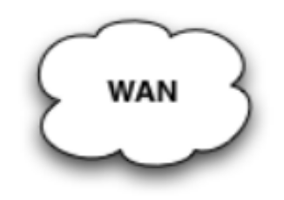

Motivation
Critical Service
Company A
Service A
Service C
Composite
Application
Service B
Company B
Ph.D. Thesis © Francisco Pérez-Sorrosal
May 13th 2009
Notes:
Nowadays, companies also offer many applications based on service-oriented architectures. These applications may be composed by multiple services that are provided by different companies through wide area networks. Some of these services are critical for these composite applications and maintain stateful data. These critical services should be replicated in order to avoid possible failures.
For example, the figure shows a composite application that involves the services A, B and C provided by the companies A and B. (PRESS KEY) A critical Service C (shown in red) is provided by the company A. If this service fails (PRESS KEY), the composite application becomes unavailable. However, if the critical service has a replica in the company B (PRESS KEY), the application can contact the replica and continue operating normally despite the failure.
So, the other goal of this thesis has been to describe and implement a framework that provides high availability for stateful services deployed in service-oriented architectures.

Slide 5
Outline
High Availability (HA) and Scalability in Multi-Tier Architectures
  Protocols for High Availability in MTAs
  A Protocol for HA and Scalability in MTAs
High Availability in Service-Oriented Architectures
  WS-Replication Framework
Conclusion
Publications
Ph.D. Thesis © Francisco Pérez-Sorrosal
May 13th 2009
Notes:
This is the outline for the remainder of the presentation.
First of all, we are going to introduce the work done in HA and Scalability in multi-tier architectures and then the work done in HA for service-oriented architectures.
Finally, we will conclude and show the results of the thesis.
Let’s start describing a little bit of background about our work in high availability in multi-tier architectures...

Slide 6
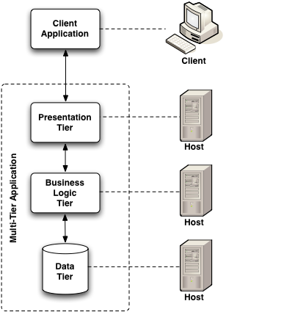
Multi-tier Architectures: Motivation
Great success of MTAs
  CORBA, .NET & J(2)EE
Cache requires concurrency control
  Serializability
  Synchronization with the underlying database
Many databases provide
  Classical isolation levels + Snapshot Isolation
Cache
Application
Server
Ph.D. Thesis © Francisco Pérez-Sorrosal
May 13th 2009
Notes:
(PRESS KEY) MTAs are present in enterprises for deploying their business applications. The success of technologies such as CORBA or J2EE has to do with this fact.
A multi-tier architecture allows to divide applications in modules addressing different scopes. The figure shows an example of a 3-tier architecture. The application offers a user interface through the presentation tier. The business logic of the application runs on the so-called application servers (PRESS KEY). Finally, the data managed by the business logic is stored in the data tier, usually a database.
An application server acts a cache for the data tier (PRESS KEY). This allows to increase application performance. (PRESS KEY) The cache requires concurrency control in order to guarantee that the state maintained at the application server is consistent with the state hold at the database level. Nowadays the highest isolation level provided by applications servers is serializability. Serializability ensures that the concurrent execution of a set of transactions is equivalent to a serial execution of the same set of transactions.
However, serializability is not implemented in many database systems because is too strict and aborts many concurrent transactions. (PRESS KEY) SI is a recent isolation level that potentially increases the performance of applications providing almost the same consistency level as serializability. However, currently there are no caches at the application server level that provides SI. One of the objectives of this thesis has been to provide concurrency control based on snapshot isolation at the application server.

Slide 7
HA and Scalability in MTAs: Context
J2EE application servers
  Transactional Services:
    ACID Transactions (JTA)
    Advanced Transactions (Activity Service)
    Our implementation available at http:\\jass.objectweb.org
  Component Model: Enterprise Java Beans (EJBs)
    Stateless (SLSB) and Stateful (SFSB) Session Beans, Entity Beans (EB) & Message-Driven (MDB)
When replicating EJBs:
  SLSBs & MDBs don’t keep state => NOT Replicated
  SFSB beans keep client-related state across requests
  EBs represent persistent data in a datasource
Ph.D. Thesis © Francisco Pérez-Sorrosal
May 13th 2009
Notes:
We have developed a set of replication protocols for providing high availability and scalability in the context of MTAs. Our protocols have been implemented using the J(2)EE platform. In a few words, the J(2)EE specifies how to build compatible application servers using Java technology.
The two main elements of J(2)EE related to the replication work done in this thesis are the transactional service and the component model, called Enterprise Java Beans.
J2EE supports ACID transactions and advanced transaction models. Application servers include a transaction manager in order to deal with flat transactions. To deal with advanced transaction models, we implemented an open-source version of the activity service.
When replicating EJBs we are interested only in the components that keep stateful data. This means to take into consideration SFSBs and EBs. SFSBs hold session state related to clients and EBs hold persistent data stored in a data source. SLSBs and MDBs don’t maintain state, so they don’t need to be considered.
Finally, J(2)EE specification doesn’t state anything about the replication of the application server infrastructure, so the implementers are free to choose an alternative.

Slide 8
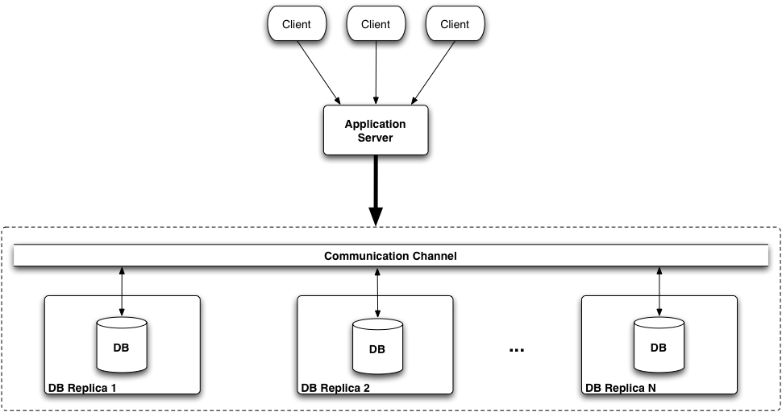
Horizontal Replication
(DB Replication)
BOTTLENECK
& SINGLE POINT
OF FAILURE
Replication
Protocol
(X)
X
X
X
Ph.D. Thesis © Francisco Pérez-Sorrosal
May 13th 2009
Notes:
There are different ways of replicating data in a multi-tier architecture.
This figure shows the so-called horizontal replication.
In this case, the data is replicated horizontally at the database level and only one copy of the data is cached at the application server. In this scenario, (PRESS KEY) only one replication protocol is required, in this case at the database level. (PRESS KEY) However, the application server becomes a potential bottleneck and a single point of failure.

Slide 9
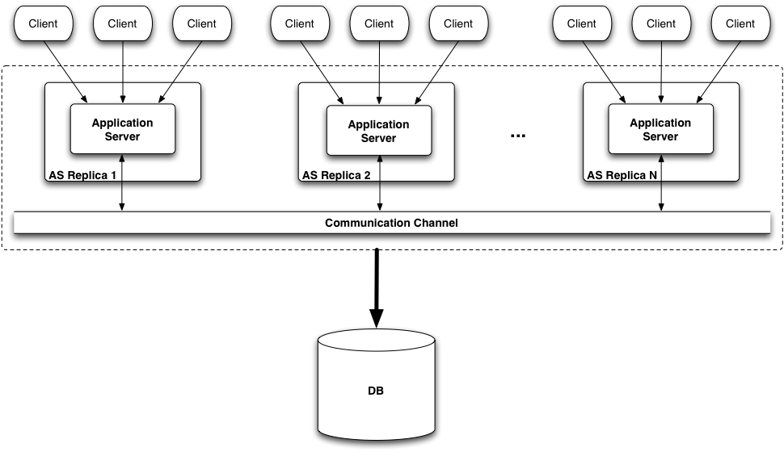
Horizontal Replication
(App. Server Replication)
(X)
(X)
(X)
Replication
Protocol
BOTTLENECK
& SINGLE POINT
OF FAILURE
X
Ph.D. Thesis © Francisco Pérez-Sorrosal
May 13th 2009
Notes:
When the horizontal replication (PRESS KEY) is done at the application server, multiple copies of the persistent data are maintained at the middle-tier. Current middleware systems implement replication following this schema. However, most of them rely on the database layer to guarantee the consistency at the middle-tier.
(PRESS KEY) So, in this case, bottlenecks may appear at the database tier, that is also a single point of failure.

Slide 10
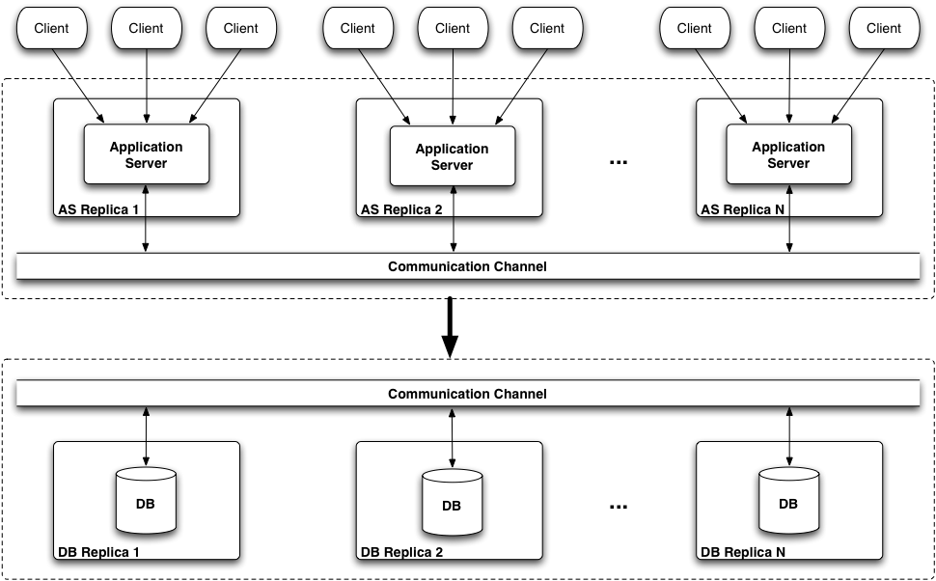
Horizontal Replication
(AS and DB Replication)
(X)
(X)
(X)
Replication
Protocols
COMPLEX
X
X
X
Ph.D. Thesis © Francisco Pérez-Sorrosal
May 13th 2009
Notes:
The final approach consist of replicating both tiers and synchronize them.
(PRESS KEY) However, this is a complex solution, because it requires 2 replication protocols (PRESS KEY) that must be coordinated. Moreover, the failure scenarios are also complex to solve.

Slide 11
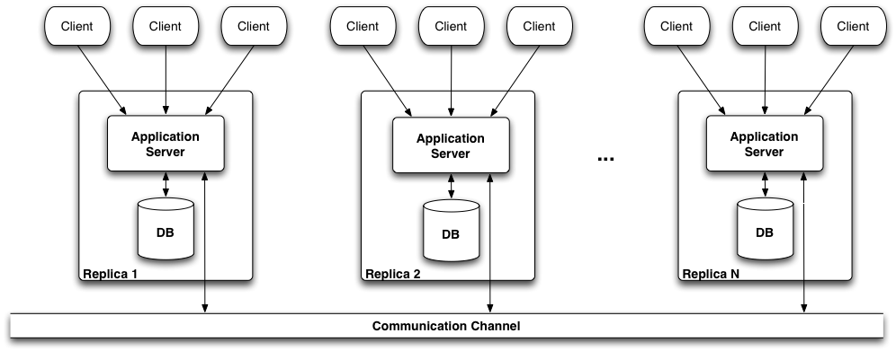
Our Solution: Vertical Replication
Replication
Protocol
Unit of
Replication
No single bottleneck
No single point of failure
Only one replication protocol
Ph.D. Thesis © Francisco Pérez-Sorrosal
May 13th 2009
Notes:
VR is the solution implemented in our replication protocols for MTA. It consists of replicating both tiers at the same time.
(PRESS KEY) So, in VR, the unit of replication is the block AS+DB. This avoids bottlenecks and single points of failures.
(PRESS KEY) Moreover, this approach requires only one replication protocol that works at the application server level. The application server is in charge of persisting the state in the corresponding databases.

Slide 12
Outline
High Availability (HA) and Scalability in Multi-Tier Architectures
  Protocols for High Availability in MTAs
  A Protocol for HA and Scalability in MTAs
High Availability in Service-Oriented Architectures
  WS-Replication Framework
Conclusions
Publications
Ph.D. Thesis © Francisco Pérez-Sorrosal
May 13th 2009
Notes:
Now, we are going to talk about the protocols we developed for providing only high availability in MTAs.

Slide 13
Protocols for HA in MTAs
Consider session data (SFSBs) and persistent data (EBs)
Are transaction aware & mask failures transparently
Approach: Vertical Replication + Primary-Backup
App.
Server
GCS
App.
Server
Client
DB
DB
Primary
Primary
Backup
Cluster
Ph.D. Thesis © Francisco Pérez-Sorrosal
May 13th 2009
Notes:
These are the basic ideas behind this set of replication protocols.
The protocols consider both session and persistent data, are transaction-aware and provide transparent failure masking to the client requests in the advent of failures.
The protocols follow the vertical replication approach combined with primary-backup scheme.
They use GCS facilities to implement communication among the replicas of the cluster.
In the primary-backup scheme the clients connect with a single replica (PRESS KEY) called primary, that processes all the client requests (PRESS KEY). The other replicas are backups for the state of the primary. After processing the requests, the primary replicates the changes to the replicas. When each replica receives the changes, they are injected in the database.
(PRESS KEY) Upon failures on the primary, a backup replica is chosen as new primary and clients failover to it transparently. This means that the client stubs redirect the requests to the new primary and that ongoing transactions are not be aborted.

Slide 14
Our protocols offer...
Data consistency in all the replicas
  Vertical replication + transaction management
  1-copy correctness
Exactly-once execution
  The client performs a request only once and gets the results also only once
High available transactions
  The replication protocols are transaction-aware
  Transactions are not aborted if the primary fails
Different interaction patterns
  1 Req/1 Tx, N Req / 1 Tx, 1 Req / N Txs and N Req / M Txs
Ph.D. Thesis © Francisco Pérez-Sorrosal
May 13th 2009
Notes:
So, our protocols provide data consistency in all the replicas by means of the proper control of transactions and the vertical replication at the application server level.
The system guarantees 1-copy correctness. This means that the replicated system, that is the cluster of replicas, behaves as a non-replicated one.
Moreover, they provide exactly once execution of client requests. This means that the client performs a request only once and gets the results also only once. This fact requires to provide high available transactions, so the protocols are transaction aware, what means that ongoing transactions are not aborted if the primary fails. In this way, the failures of the replicas are transparent to the clients.
Finally, our replication protocols for HA can deal with different interaction patterns from the clients: one client request managed by a single transaction in the application server, N client requests in the context of a single transaction, one client request that spans N transactions and N client requests that may include M transactions.

Slide 15
N requests/1 transaction: Goals
Support transactional conversations
  Several client requests inside a single transaction
Upon failover, resume the conversation from the last interaction
  Do not abort ongoing transactions
Ph.D. Thesis © Francisco Pérez-Sorrosal
May 13th 2009
Notes:
Now, we’re going to show an overview of one of the protocols. In this case the one that considers N requests per transaction.
The goal of this protocol is twofold:
First, to support transactional conversations. This means that several client requests can be managed inside a single transaction
And second, when a failure occurs in the current primary, the other goal is to resume the conversation in the new primary from the last interaction of the client without aborting any ongoing transaction.

Slide 16
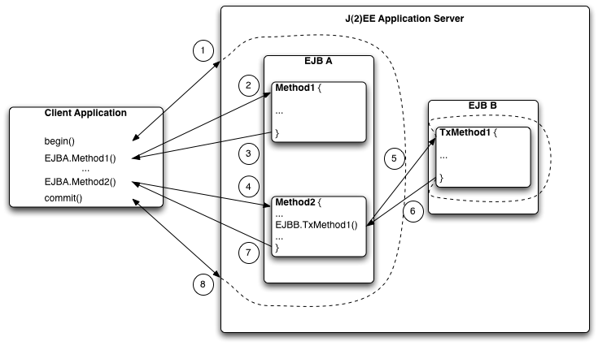
N requests/1 transaction
Client invocations inside T1
T1
T2
Client invocation that requires a new TX T2
Ph.D. Thesis © Francisco Pérez-Sorrosal
May 13th 2009
Notes:
So, this pattern considers client demarcated transactional conversations that can span multiple interactions with the application server.
The clients explicitly demarcate the transaction boundaries through the begin, commit and abort operations. (PRESS KEY) In the figure, the client application shown on the left performs two invocations to the methods of the first EJB inside the same transaction T 1. The changes produced in the state of the EJB in each invocation are considered as uncommitted changes.
(PRESS KEY) Nested transactions are considered in this protocol. The second method of the first EJB contains a nested invocation to the second EJB. This invocation requires a new transaction T2. The changes produced in T 2 will be considered as committed changes by the protocol.

Slide 17
N Req / 1 TX Replication Protocol: Primary (Begin)
beginTx + TxId
Backup
TM
TxId
Interceptors
Client
beginTx
TxId
Backup
Primary
Ph.D. Thesis © Francisco Pérez-Sorrosal
May 13th 2009
Notes:
Let’s see how this protocol work. We are going to describe the process from the point of view of the primary and the backup replicas.
In the primary, the client demarcates a transaction by means of the begin method.
(PRESS KEY) The application server intercepts the call and creates a new transaction for the client using the transaction manager. The TM returns a transaction ID for that transaction.
(PRESS KEY) Just before returning to the client, the begin invocation is replicated associating the transaction identifier (TxId).
(PRESS KEY) Finally, the transaction identifier is returned to the client.
The TxId will be used to identify the transactional context for each subsequent client request and to identify ongoing transactions when performing the failover.

Slide 18
Replication Protocol: Backup (Begin)
Store TxId
TxTable
Interceptors
beginTx + TxId
Backup
Ph.D. Thesis © Francisco Pérez-Sorrosal
May 13th 2009
Notes:
Upon receiving the begin message, (PRESS KEY) the backups store the TxId in a transaction table to keep track ongoing transactions.

Slide 19
Replication Protocol: Primary (Invocation)
TxId + Bean changes + Response
Backup
Interceptors
EJB
Response
Client
TxId
EJB
EJB
Backup
EJB
Primary
Ph.D. Thesis © Francisco Pérez-Sorrosal
May 13th 2009
Notes:
When the client performs an invocation to an EJB component, the client stub associates transparently the TxId to the invocation.
The primary intercepts the request and, by means of the TxId, invokes the components under the right transactional context.
(PRESS KEY) Just before returning to the client, the primary associates the component changes and the response to the TxId and replicates them to the backups. (PRESS KEY). This information will be required to perform the failover when necessary.
Finally, the response (PRESS KEY) for the invocation is returned to the client.

Slide 20
Replication Protocol: Backup (Invocation)
Uncommitted Table
Interceptors
Save
Response Table
TxId+ Bean changes + Response
SFSB
Apply
EB
Backup
Ph.D. Thesis © Francisco Pérez-Sorrosal
May 13th 2009
Notes:
When the backup receives a message with the changes of a client invocation, (PRESS KEY) it stores the uncommitted changes (that is, the changes that have occurred in the current non-committed transaction) and the response in tables using the TxId as identifier.
Finally, it (PRESS KEY) applies the committed changes in the components that occurred in possible committed nested transactions.

Slide 21
Replication Protocol: Primary (Commit/Abort)
Commit/abort Tx + TxId
Backup
TM
Interceptors
Client
commit/ abort Tx
Backup
EB
DB
EB
EB
Primary
Ph.D. Thesis © Francisco Pérez-Sorrosal
May 13th 2009
Notes:
Upon receiving a commit or an abort message in the primary, the primary commits or aborts the associated transaction (PRESS KEY)
(PRESS KEY) If a commit is received, the changes on persistent components are stored in the database. Otherwise, the changes are discarded.
Finally, the commit/abort message is replicated (PRESS KEY) to the backup replicas before returning to the client.

Slide 22
Replication Protocol: Backup (Commit/Abort)
Uncommitted Table
Interceptors
Apply
commitTx + TxId
SFSB
EB
EB
EB
DB
EB
Backup
Ph.D. Thesis © Francisco Pérez-Sorrosal
May 13th 2009
Notes:
When the commit message is received in the backup, (PRESS KEY) the uncommitted changes for the transaction are applied in the backup replica and (PRESS KEY) the persistent state is stored in the database.
If an abort message is received in the backup, the information stored in the tables is discarded.

Slide 23
Replication Protocol: Failover
For each
non-completed Tx
...
Interceptors
Create
TxTable
Client
Response
TM
Uncommitted Table
NOT FOUND,
RE-EXECUTE REQUEST
TxId
Response Table
Apply
SFSB
EB
Primary
Backup
Ph.D. Thesis © Francisco Pérez-Sorrosal
May 13th 2009
Notes:
Upon failover, a new primary is chosen among the backups. However, in order to provide high available transactions and consistency to the replica, (PRESS KEY) before the new primary can start processing new client requests, it has to recreate the ongoing uncommitted transactions and apply their respective uncommitted changes.
When the client stub don’t receive response from the old primary after a timeout, the stub automatically re-sends the request to the new primary.
In this way, when all the uncommitted changes are applied by the new primary:
If the new primary receives client requests already processed by the previous primary, (PRESS KEY) the response will be found in the response table. So the checkpointed response will be returned to the client.
(PRESS KEY) On the other hand, when the response is not found in the response table (PRESS KEY), the request will be just fully executed in the new primary.

Slide 24
Evaluation: ECPerf
Benchmark to evaluate the throughput and scalability of J2EE Application Servers
Emulates the processes involved in a supply-chain management scenario
The load is measured as the Injection Rate (IR)
  # of clients = IR * 5
Throughput is given in Benchmark Business Operations per Minute (BBOps/Min)
Ph.D. Thesis © Francisco Pérez-Sorrosal
May 13th 2009
Notes:
We have evaluated our replication protocols using the ECPERF benchmark. ECPerf is a benchmark for evaluating the throughput of J2EE AS implementations.
It emulates the processes that conform a supply-chain management scenario.
The load is measured as IR and the throughput is given in a unit called Benchmark Business operations per minute.

Slide 25
Experiment Setup
JBoss
  Non-replicated
JBoss Primary-Backup
  Only SFSB replication
  Shared DB
Our replication protocol
  Primary-Backup + Vertical replication
  SFSB & EB replication
  Transaction aware
J2EE App.
Server
J2EE App.
Server
J2EE App.
Server
Backup
J2EE App.
Server
J2EE App.
Server
Backup
Client
Client
Client
Host 1
Host 1
Host 1
Host 2
Host 2
Host 2
Host 4
Host 4
DB
DB
DB
DB
Backup
Host 3
Host 3
Host 3
Host 5
Cluster
Cluster
May 13th 2009
Ph.D. Thesis © Francisco Pérez-Sorrosal
Notes:
The protocols have been implemented using the JBOSS application server as a base.
The configurations evaluated in the experiments are the following:
The first one is a non replicated configuration used as a baseline. It is deployed in three nodes, one for JBoss, one for the database and another one for the clients.
(PRESS KEY) The second configuration deployed evaluates the replication mechanism provided JBOSS. It is based on a primary backup scheme with a shared database. In contrary to our protocols, JBOSS only provided session replication, so it didn’t replicate persistent components nor provided high available transactions. This configuration uses four nodes: one for the clients, two nodes for each one of the two JBoss, and one host for the shared database.
(PRESS KEY) The third one is the one required by our protocol based on a primary-backup combined with vertical replication. It replicates EBs and SFSBs and it is transaction aware. It uses five nodes: one for the clients, two nodes for each of the two AS instances, and two host for the required databases to implement the vertical replication.

Slide 26
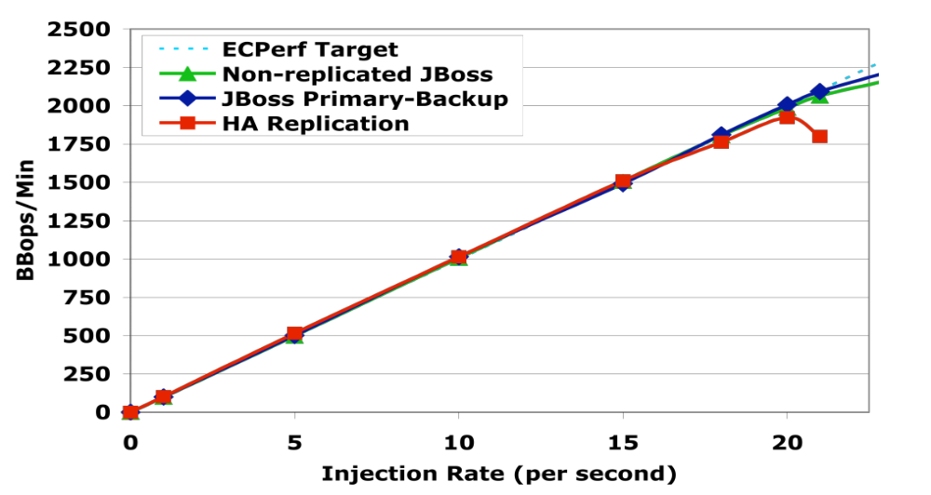
ECPerf: Throughput
20%
17
21
Ph.D. Thesis © Francisco Pérez-Sorrosal
May 13th 2009
Notes:
Here we show the throughput results of ECPERF for the three different configurations. In the x-axis is shown the injection rate introduced in the system and the y-axis shows the throughput in BBOps/Min (Benchmark Business operations per minute).
The green line is the throughput of the non-replicated JBOSS configuration used as a baseline. Then, the blue line shows the results of the primary-backup replication facilities provided by JBOSS.
Finally, our protocol is identified by the HA Replication line, the red one. Our protocol, fulfills the benchmark for an IR of 17 (PRESS KEY) and from that point on the results start to degrade.
The two baselines passed the benchmark for an IR of 21 (PRESS KEY). That is, there was a loss of throughput below a 20%, what is a very good result taking into account that our protocol replicates the persistent state and is transaction aware, whilst the baselines don’t provide these features.

Slide 27
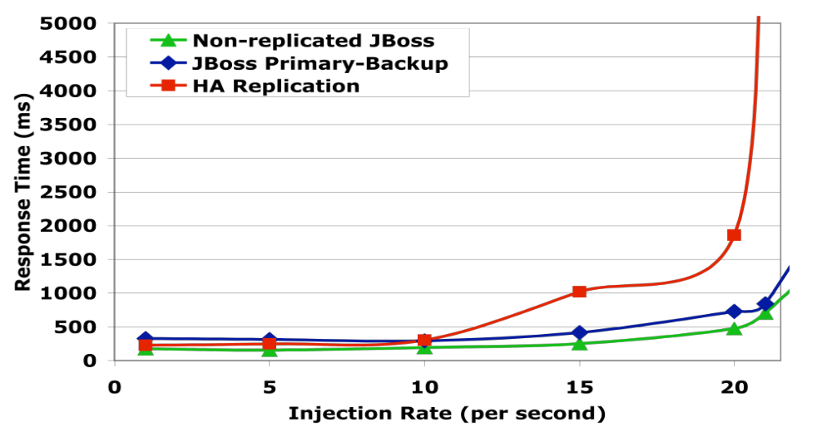
ECPerf: Response Time
ECPerf Limit
Ph.D. Thesis © Francisco Pérez-Sorrosal
May 13th 2009
Notes:
For the same context of the previous figure, here is shown the response time. The results are consistent with the ones shown in throughput.
As expected, the non-replicated JBoss offers the lowest response time, since it does not incur in any overhead due to replication.
Until an IR = 10 (PRESS KEY), the response time of our protocol is similar to the one of the JBoss Primary-Backup and the Non-Replicated JBoss.
From an IR of 10 to 20 (PRESS KEY), the overhead of replication has a noticeable impact on the response time of our protocol, becoming higher than the one of JBoss primary-backup. However, the response time is still within the limits admitted by ECPerf that is 2 seconds. This means that for moderate loads the overhead of our replication protocol is negligible and only for high loads it results in an increased, although still reasonable, response time.
From an IR of 20 the RT is above the 2 seconds allowed by the benchmark. As stated before, the reason for the performance degradation is the cost of replicating the persistent state (entity beans) and providing high available transactions.

Slide 28
Outline
High Availability (HA) and Scalability in Multi-Tier Architectures
  Protocols for High Availability in MTAs
  A Protocol for HA and Scalability in MTAs
High Availability in Service-Oriented Architectures
  WS-Replication Framework
Conclusions
Publications
Ph.D. Thesis © Francisco Pérez-Sorrosal
May 13th 2009
Notes:
The previous protocols only provide high availability but don’t allow to scale a cluster adding new replicas. The next protocol we propose, allows to achieve both, HA and scalability in MTAs.

Slide 29
Limitations of Current Middleware for HA in MTAs
Mismatch between isolation at Application Server and DBMS
  Current application servers do not work correctly with SI databases
Snapshot Isolation (SI) has become the “de-facto” standard isolation level
Current middleware does not scale-out stateful applications consistently
Ph.D. Thesis © Francisco Pérez-Sorrosal
May 13th 2009
Notes:
So, current middleware systems still have some limitations with regard the requirements of applications.
First of all, most application servers offer the serializable isolation level as the highest isolation level. However this isolation level is too strict and is not implemented at the database level. The most important DBMSs such as ORACLE or POSTGRES offer Snapshot Isolation as the highest isolation level. SI allows a better performance for read-intensive workloads because it avoids read/write conflicts in transactions.
As we have mention before, another important limitation is that current middleware does not scale stateful applications consistently when adding new replicas to a cluster.

Slide 30
Our Protocol for HA and Scalability in MTAs…
Is consistent, high available and scalable
Includes a SI cache at the middleware level for correctness and performance in a single replica
SI cache is combined with replication for scalability and fault-tolerance in a cluster
Vertical replication
  Only-one replication protocol coordinates the execution of transactions and the propagation of changes in a cluster
Ph.D. Thesis © Francisco Pérez-Sorrosal
May 13th 2009
Notes:
Our protocol...
...provides high availability, scalability and consistency to multi-tier applications.
It includes a cache for persistent components that provides snapshot isolation. The SI cache offers the required consistency and performance in a single replica.
Moreover, the cache has been replicated in a consistent way, what allows to achieve not only high availability but also scalability.
The replicated cache is combined with the vertical replication scheme to achieve state consistency in both, the midle-tier and the data tier of each replica, providing high availability and avoiding single points of failure.

Slide 31
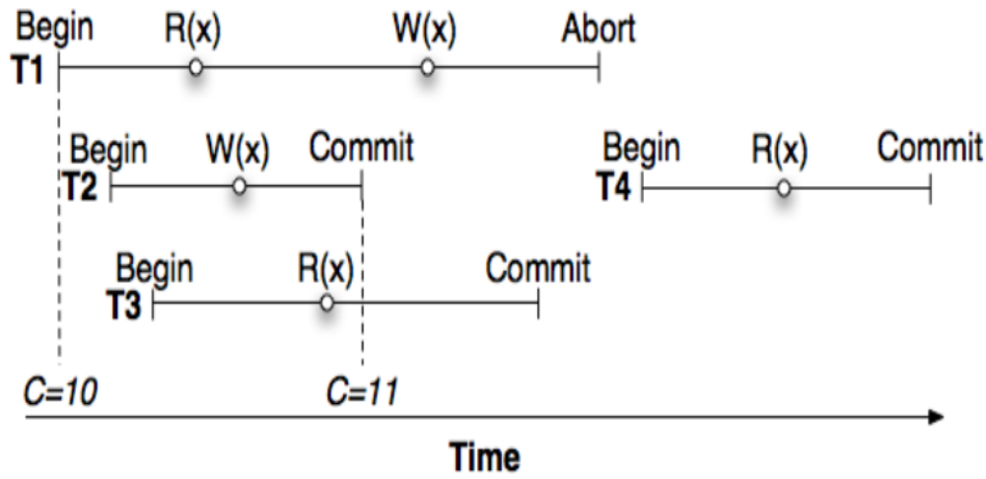
Snapshot Isolation
Previous TX T
has written X, so C=10
Validation succeeds
Increment C and set new version for X
Counter of Committed TXs
New private version of X
Reads the version of T
Reads the version of T
Start Timestamp = 10
Read-only Tx -> No validation
Conflict with T2
Start Timestamp = 11
Reads X written by T2
Ph.D. Thesis © Francisco Pérez-Sorrosal
May 13th 2009
Notes:
Let’s talk about snapshot isolation.
In SI every transaction sees a snapshot of the data when it started. The system maintains a counter C of committed transactions (PRESS KEY). When a new transaction is started, it receives as start timestamp, the current value of C . At commit time, a validation process to detect conflicts with concurrent transactions occurs.
If the validation succeeds, C is incremented and the new value is assigned to the commit timestamp of the transaction. Moreover, a new snapshot with the changes of the committed transaction is released. When a transaction writes a data element, it creates a new (private) version for it. When reading a data element, the transaction either reads its own version (if it has already accessed the element) or it reads the last committed version when it started. In this way, in snapshot isolation only transactions with write/write conflicts are problematic.
Let’s see how it works though an example.
(PRESS KEY) The example assumes that the commit counter is 10 because a transaction T (not shown in the figure) was the tenth transaction to commit in the system. Now, 3 transactions, T1, T2 and T3 start concurrently and all receive as start timestamp the value of C.
When T1 reads X, it reads the version that the previous transaction T committed. Then, T2 writes X creating a new private version. T3 reads also the version of x created by T. When T2 commits, its validation succeeds because there are no conflicts with other concurrent committed transactions. So, the commit counter is incremented and assigned to the CT of T2. When T3 commits, since it is read-only transaction, no validation is necessary and it does not receive a commit timestamp.
Finally, T1 writes x creating its own version and then commits. The validation fails since there was a concurrent committed transaction T2, that wrote the X value. Therefore, T1 has to abort. Finally, T4 starts after the commitment of T2 and receives ST of 11, so iIt will read the version of x created by T2.

Slide 32
A Protocol for HA and Scalability in MTAs
Client
Client
App.
Server
App.
Server
DB
DB
Replica 1
Replica 2
Cluster
Ph.D. Thesis © Francisco Pérez-Sorrosal
May 13th 2009
Notes:
On the contrary to the previous replication protocols, this replication protocol follows an update-everywhere approach. This means that, clients can connect to any replica of the cluster in order to perform operations.
(PRESS KEY) Every request is processed by the local replica that receives it and the changes are replicated to the other replicas using GCS facilities. (PRESS KEY)
Finally, a validation process is performed to guarantee the SI among the replicas of the cluster. (PRESS KEY) If the validation succeeds, the transaction is committed and the changes persisted in the databases.

Slide 33
Protocol Features
Transactions: Started at the same time in AS and DBS
SI Cache: Maintains a certain number of versions to
  Avoid accesses to the DB
  Guarantee conflict detection
Conflicts:
  Locally: Detected on-the-fly (Pessimistic)
  Remotely: Detected on a validation phase
Other Issues:
  Creation and Deletion of Components (CRUD Ops.)
  Garbage Collection
  Session Replication
  Failure Handling (Transparent failover of clients)
  Replica Recovery
Ph.D. Thesis © Francisco Pérez-Sorrosal
May 13th 2009
Notes:
The main features of the protocol are the following:
Transactions are started at the same time in AS and DBS. TXs read data from the same snapshot independently of whether they are read from cache or from the DB.
The cache based on snapshot isolation maintains a certain number of versions to avoid unnecessary accesses to the database and guarantee conflict detection among concurrent transactions. The versions are created by transactions that are concurrent to other ongoing transactions.
Inside a replica, the conflicts are detected locally on the fly when the updates occur. When transactions are about to commit and their changes are replicated to the other replicas in the cluster, the conflicts are detected on a second validation phase.
Other issues not commented because the lack of time are related to garbage collection, recovery of replicas etc...

Slide 34
How the Multi-version Cache Works
Update x
Update y
Commit
Read x
Read y
Update y
Abort
T1
T2
Read x
Ccounter=10
T1: STS=10
T2: STS=10
Ccounter=11
CTS=11
Cache
x = a
Ver = -1
y = b
Ver = -1
x = e
Ver =11
y = f
Ver =11
conflict
commit
Start T1
Start T2
abort
X:a
Y:b
Ph.D. Thesis © Francisco Pérez-Sorrosal
X:e
Y:f
May 13th 2009
Notes:
This example shows how the SI cache works in a single replica. It shows two concurrent clients trying to update the same data.
The replica maintains the Commit Counter that holds the number of the committed transactions in the replica.
When T1 reads the value of X (PRESS KEY), the application server starts a transaction in both the middle tier and the database and assigns to its STS the current value of the commit counter. (PRESS KEY) Then, the AS holds the value extracted from the database in the cache and assigns a default number to the version created.
(PRESS KEY) Then, T1 updates the X value creating a local copy in the cache for the new value.
Then, T2 reads the X value (PRESS KEY). The application servers starts another transaction and also assigns the value of the Ccounter to its STS. (PRESS KEY) As the X value is in the cache, a database access is avoided.
(PRESS KEY)Then, T1 uptates the Y value and the same process occur. (PRESS KEY)
When T1 commits, the possible conflicts with other concurrent TXs are checked. As there are no conflicts, the Ccounter is increased and assigned to new versions and to the commit timestamp of T1. Finally, the new versions of X and Y written by T1 are persisted in the database and the transaction commits.
Then T2 read Y, and reads the right version from the cache, that is the version that has a value that is lower or equal than its start timestamp.
When T2 writes Y, a conflict is detected with the concurrent transaction T1 previously committed because both wrote the X value. So T2 is aborted.

Slide 35
Cache Replication
Update x
Abort
T2
T1
Read x
Commit
Commit
Update x
T1: STS=10
X=e
T2: STS=10
x = f
Replica 1
Replica 2
Ccounter=11
Ccounter=10
Ccounter=11
Ccounter=10
T1: STS=10
GCS
T2: STS=10
T1: STS=10
CTS=11
CTS=11
Conflict
Conflict
T1: STS=10
x = e
Cache
x = a
Ver = -1
x = a
Ver = -1
x = e
Ver =11
Cache
x= f
Ver =11
x = e
Start T1
T2: STS=10
x = f
Abort T2
Commit
Commit
X:a
X:a
X:e
X:e
Ph.D. Thesis © Francisco Pérez-Sorrosal
May 13th 2009
Notes:
In this slide is shown how the replicated SI cache works. The example shows two concurrent clients trying to update the same value on two different replicas.
(PRESS KEY) When T1 reads X in the first replica, a transaction is created, the value of X stored in the database is placed in the cache and an initial version number is created. (PRESS KEY) Then, T1 updates X, so a new local copy of X for T1 is created storing the new value. In this case E.
(PRESS KEY) At the same time, X is updated in the second replica and the same process occurs.
(PRESS KEY) When both transactions try to commit, the changes produced are multicast using the GCS and received in total order in all the replicas.
(PRESS KEY) When the first message is processed in the 1st replica, no conflicts are detected for T1. (PRESS KEY)The Ccounter is increased and assigned to the new version of the data and to the commit timestamp of T1. Then, (PRESS KEY) the new data is stored in the database and the transaction is finally committed.
When the second message is processed in the first replica (PRESS KEY) , a conflict is detected between T2 and T1 because T1 was previously validated and committed and wrote the same data. So, the message is discarded and T2 is not executed in the first replica.
(PRESS KEY) Upon processing the first message in the second replica, a conflict is detected with the local transaction T2.
(PRESS KEY) So T2 is locally aborted and T1 validated. (PRESS KEY) After this, T1 is committed. The second message is not considered in the second replica.
Finally, at the end of the process, the contents of the databases are the same.

Slide 36
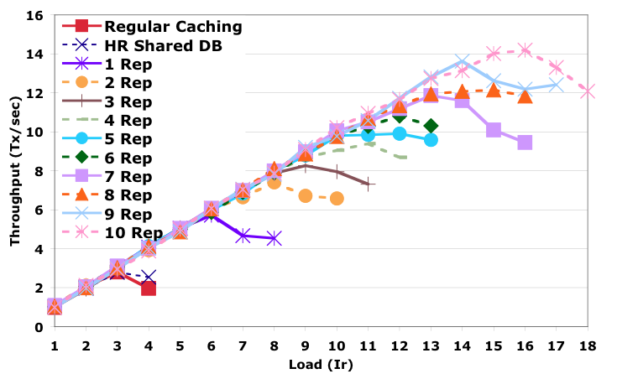
Throughput (SPECjAppServer)
Our Protocol
Baselines
Ph.D. Thesis © Francisco Pérez-Sorrosal
May 13th 2009
Notes:
The evaluation of the protocol has been done using a new version of the ECPERF benchmark called SPECjAPPSERVER. The protocol has been implemented modifying the internals of the JOnAS application server. More specifically we have modified the transaction management and the component container in order to include the SI cache. We also included a new cluster service in order to perform the replication process.
This figure shows the overall throughput in TX/S for increasing loads measured in IR.
The figure shows two baselines (PRESS KEY). The first one evaluates the regular caching of JOnAS without replication in a single replica (the red line).
The second one has been obtained deploying a horizontal replication configuration using 2 JOnAS instances and a shared database (the line shown in dark blue).
Finally, our replication approach has been evaluated using up to 10 replicas. In all configurations, the clients are executed in a separated machine and each AS and its database are collocated in the same server.
The first noticeable fact is that traditional caching and horizontal replication can only handle a load up to an IR of 3. (PRESS KEY)
In contrast, our replicated multi-version cache outperforms these two implementations by a factor of 2, even if there is only one replica (PRESS KEY). The reason is that the multi-version cache is able to avoid many database reads compared to regular caching. Horizontal replication did not help because the shared database was already saturated with two application server replicas.
(PRESS KEY) The replicated multi-version cache is able to handle a load up to 14 achieving the required throughput with 9 and 10 replicas. That is, by adding new replicas to the cluster a higher number of clients requests can be served.
Even when the replicated cache configurations saturate (that is, when the throughput is lower than the injected load), configurations with a higher number of replicas exhibit a more graceful degradation. For instance, for IR = 13, both the 5-replica an 8-replica configuration are saturated. However, the throughput achieved with 8 replicas is higher than with 5 replicas, providing a better service to the clients.
This is very important, since it will help the system to cope with short-lived high peak loads without collapsing.
So, to summarize, we have achieved scalability for stateful applications, increasing the throughput when new replicas are added to a cluster.

Slide 37
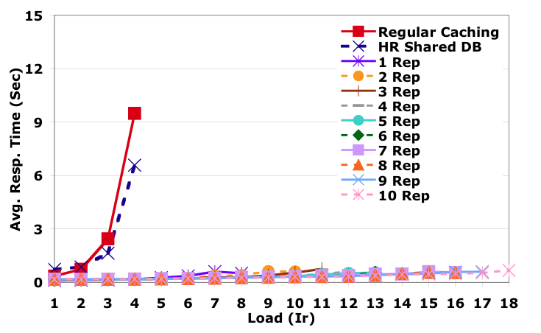
Response Time: Read-only Txn
Ph.D. Thesis © Francisco Pérez-Sorrosal
May 13th 2009
Notes:
This figure shows the response times for read-only transactions.
It can be observed that the lines of our protocol are almost flat independently of the number of replicas even at high loads when the system reaches saturation. This contrast with the behavior of the two baselines, that grows exponentially. The reason is that for read-only queries our application server caching is very effective avoiding expensive database access in many cases.
Moreover, read-only transactions don’t require communication among the replicas.

Slide 38
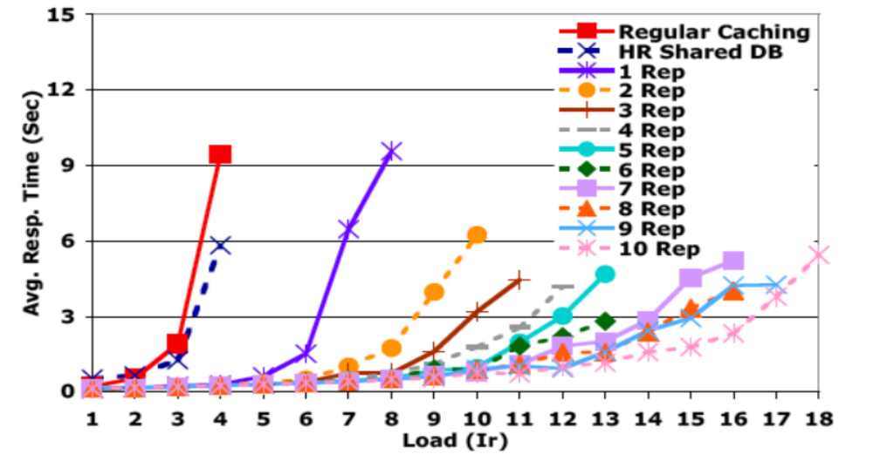
Response Time: Update Txn
Ph.D. Thesis © Francisco Pérez-Sorrosal
May 13th 2009
Notes:
Update transactions are quite different.
The response times for traditional caching and horizontal replication are worse than the ones for the multi-version approach even for low loads. This means that our caching strategy saves expensive accesses to the database.
Moreover, the more replicas the system has, the more graceful is the degradation of the response time at the saturation point. As we have mention before, this is important since acceptable response times can be provided in case of short-lived peak loads.

Slide 39
Outline
High Availability (HA) and Scalability in Multi-Tier Architectures
  Protocols for High Availability in MTAs
  A Protocol for HA and Scalability in MTAs
High Availability in Service-Oriented Architectures
  WS-Replication Framework
Conclusions
Publications
Ph.D. Thesis © Francisco Pérez-Sorrosal
May 13th 2009
Notes:
Let’s change gears and let’s talk about our work on HA in service oriented architectures.

Slide 40
HA in SOA: Motivation
Some Web Services are critical for the interaction among organizations and should remain available despite failures
WS-Replication Framework helps on replicating these critical Web Services
Ph.D. Thesis © Francisco Pérez-Sorrosal
May 13th 2009
Notes:
Some Web Services are critical for the interaction among organizations and should remain available despite failures, for example when the full organization that provides the critical service is disconnected from the Internet.
Our WS-Replication Framework helps on how to replicate critical Web Services across organizations

Slide 41
HA in SOA: The WS-Replication Framework
WS-Replication is a framework that eases the replication of WSs
  SOAP-based web services
Properties:
  Respects WS autonomy
  Provides transparent fault-tolerance
Components:
  Deployer tool
  WS-Multicast service
  WS-Dispatcher
Ph.D. Thesis © Francisco Pérez-Sorrosal
May 13th 2009
Notes:
So, we have developed this replication framework to provide high availability for critical web services based on SOAP communication in an easy way.
The main properties provided by the framework are the following:
It respects the web service autonomy. This means that the replicated services are accessed as normal non-replicated web services.
If a replica fails, the failure is masked to the caller.
The framework has been implemented using Java technology and its functionality is provided as a web service too.
The framework is composed of three main building blocks:
First of all, a deployer tool, allows us to configure and deploy automatically a standard web service into a set of replicas.
A multicast service allows to multicast SOAP-based messages to a set of web service replicas.
Finally, the dispatcher is a component that interfaces with the group communication and takes care of the matching between client invocations and the messages of the replication protocol.

Slide 42
Background: Active Replication
Client
Client
m1
m2
Service
Replica 1
m2
Service
Replica 2
m2
Service
Replica 3
m2
m1
m1
m1
Ph.D. Thesis © Francisco Pérez-Sorrosal
May 13th 2009
Notes:
So, the way we provide HA in our framework is replicating the critical services in different locations.
In order to evaluate the framework, we implemented a replication protocol based on active replication to provide high availability to web services.
(PRESS KEY TWICE) In active replication, all the client requests to a replicated service are processed by all the replicas. The requests sent to a service must be processed in the same order in all the replicas to guarantee that they have the same state. (PULSAR). To ensure this, we have used total order multicast to send the requests.
Moreover, the operations performed by the replicas must be deterministic.
With this approach, if one replica fails (PRESS KEY), the rest of the replicas can continue providing service in a transparent way for the client, without loosing any state.
Depending on the level of reliability we want to achieve, the client can resume its processing after obtaining the first reply from a replica, a majority of replies or all the replies.

Slide 43
WS-Replication: Invoking a Replicated Service I
Client
WS
WS
Replica 1
Replica 2
WS-Proxy
WS-Proxy
WS-Dispatcher
WS
WS
WS-Dispatcher
WS-Multicast
WS-Multicast
transport
transport
Ph.D. Thesis © Francisco Pérez-Sorrosal
May 13th 2009
Notes:
In this slide we are going to describe an invocation to a replicated web service using our framework.
The figure shows the infrastructure of a replicated WS deployed in two replicas. The deployer tool creates a wrapper of the original web service (shown in red) adding the required elements of our framework.
When a client performs a request to a WS, a proxy created by the framework is in charge of redirecting the WS invocation to the dispatcher. (PRESS KEY)
The dispatcher transforms the web service invocation into a multicast message using the underlying multicast infrastructure. The request is multicast to all the replicas in the group including itself using the SOAP transport mechanism.
(PRESS KEY) When receiving the message, the flow of messages follow the inverse order till the dispatcher, that reconstructs the web service invocation from the multicast message and finally invokes the target web service.

Slide 44
WS-Replication: Invoking a Replicated Service II
Client
WS
WS
Replica 1
Replica 2
WS-Proxy
WS-Proxy
WS-Dispatcher
WS
WS
WS-Dispatcher
WS-Multicast
WS-Multicast
transport
transport
Ph.D. Thesis © Francisco Pérez-Sorrosal
May 13th 2009
Notes:
Once the operation has been processed... (PRESS KEY)
The dispatcher that originally replicated the data of the client request, has to wait for a certain number of responses from the replicas in the group. In this case let’s imagine that it waits for all responses of the replicas before returning the response to the client.
(PRESS KEY) Once the WS-Dispatcher has collected all the responses from the replicas, the outcome of the operation is delivered to the client through the proxy

Slide 45
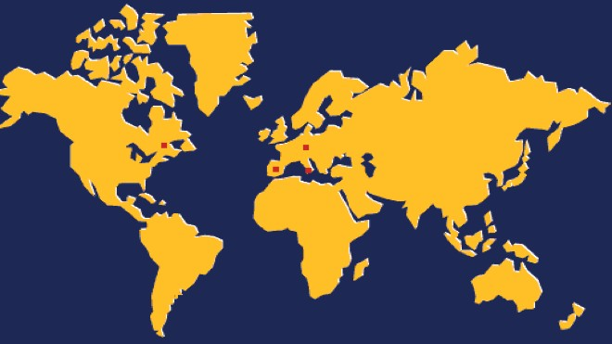
WS-Replication Evaluation: Setup
Critical Service
Montreal
Zurich
Bologna
Madrid
Load Generator
Ph.D. Thesis © Francisco Pérez-Sorrosal
May 13th 2009
Notes:
We performed an evaluation of our framework in a WAN scenario. The goal was to measure the overhead of the replication framework and its performance in this environment.
(PRESS KEY) A critical service for managing transactions in SOAs was replicated in three different locations (Zurich, Bologna and Montreal).
(PRESS KEY) Then, we placed a request generator in Madrid to emulate clients injecting load into an application that uses the critical transactional service.

Slide 46
WS-I & WS-CAF Integration
Client
Emulator
WS-I
Applic.
DB
Madrid Host 1
Madrid Host 2
WS-Rep.
WS-Rep.
WS-Rep.
WS-CAF
WS-CAF
WS-CAF
Bologna
Zurich
Montreal
Ph.D. Thesis © Francisco Pérez-Sorrosal
May 13th 2009
Notes:
In order to stress the WS-Replication framework, we developed a benchmark to evaluate its use in a real environment. We based the benchmark on an application described by the WS-Interoperability organization. The application simulates a retailer that is provisioned by a set of suppliers.
We modified this application in order to use the WS-CAF transactional service, that becomes critical for the functionality of the application. The WS-CAF service was replicated in the three different locations we mention before using our replication framework.
In the example application (PRESS KEY), emulated clients perform requests on the application and the application uses the replicated transactional service transparently by means of our replication framework.

Slide 47
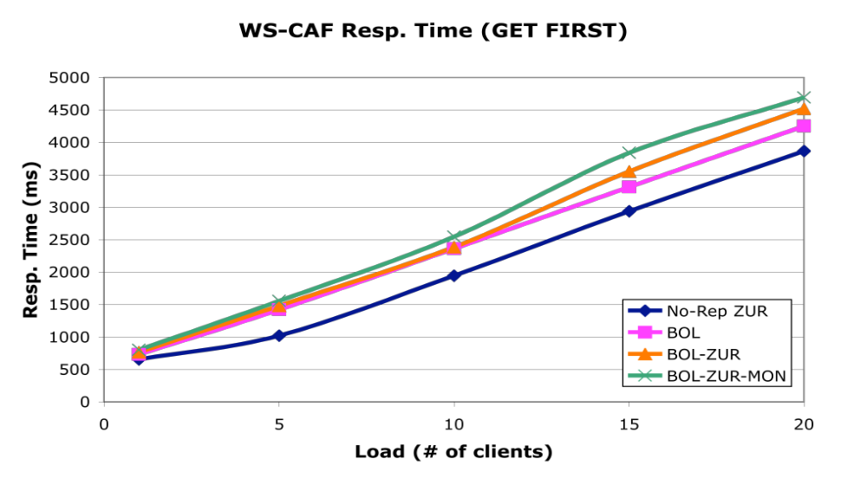
WS-CAF Replication
10%
Ph.D. Thesis © Francisco Pérez-Sorrosal
May 13th 2009
Notes:
Here we show the response times obtained for the evaluation of our framework in the WAN environment. In all the experiments, the emulated clients and the WS-I application were run in Madrid in two different nodes.
For comparison purposes, we evaluated the application without replicating the WS-CAF. In this case (shown as No-Replication line), the WS-CAF was located in Zurich.
Then, we executed the experiments replicating the WS-CAF with our framework. First, we evaluated the framework using only one replica in Bologna. Then we evaluated the framework with two and three replicas adding Zurich and Montreal. In all the experiments, the replication framework is configured to wait only for the first response received.
As we can see the results for experiments including the WS-Replication framework are good enough with regard to the baseline. The overhead of replication in terms of response time is much smaller in relative terms. The increase in response time between one and three replicas is smaller than a 10% for the higher load (PULSAR). This is quite beneficial because the main concern in WAN replication is response time and the overheads obtained are very affordable.

Slide 48
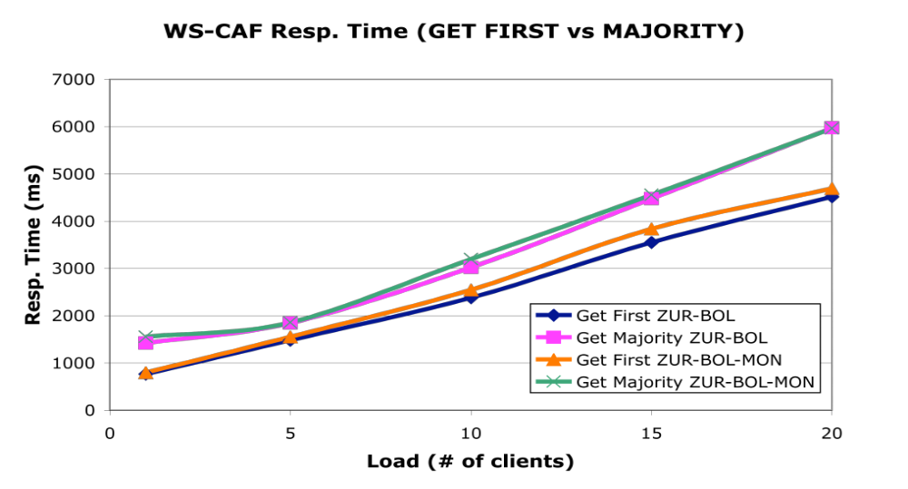
WS-CAF Replication
Ph.D. Thesis © Francisco Pérez-Sorrosal
May 13th 2009
Notes:
In this Figure is compared the difference that exists when the replicated web service is configured to wait for the first response or for a majority of responses before returning to the client.
In the experiments waiting for a majority of replies (pink and green lines), means to wait for at least two responses.
(PRESS KEY) As one might expect, regarding response time, the relative overhead is slightly higher. This is unavoidable, since when waiting for a majority of responses , one has to wait for the second slowest reply.

Slide 49
Outline
High Availability (HA) and Scalability in Multi-Tier Architectures
  Protocols for High Availability in MTAs
  A Protocol for HA and Scalability in MTAs
High Availability in Service-Oriented Architectures
  WS-Replication Framework
Conclusions
Publications
Ph.D. Thesis © Francisco Pérez-Sorrosal
May 13th 2009
Notes:
To conclude the talk...

Slide 50
Conclusions
We have developed a set of replication and recovery protocols for providing consistent high availability and scalability to multi-tier applications
Main contributions:
  Transaction-aware replication
  Exactly-once execution of client requests
  Deal with several interaction patterns
  Scalability through a replicated SI cache in the app. server
  Online recovery (Not presented because the lack of time)
Results show that the proposed protocols are affordable
Ph.D. Thesis © Francisco Pérez-Sorrosal
May 13th 2009
Notes:
...on the one hand...
We have developed a set of replication and recovery protocols to provide high availability and scalability with consistency to stateful applications based on multi-tier architectures.
In contrast to other existing protocols, our high availability protocols are transaction aware and provide exactly once execution for client requests.
One of the protocols, allows to scale stateful applications using a replicated cache based on snapshot isolation. To the best of our knowledge, this feature is not provided by current middleware systems.
An online recovery protocol (not presented here because the lack of time) has also been developed to complement the scalable replication protocol.
The results obtained in the experiments have shown that the protocols are affordable in terms of performance and the guarantees offered, despite of the overheads introduced by the replication process

Slide 51
Conclusions
We have also developed a framework to provide high availability to SOAs
WS-Replication provides seamless replication to critical WSs
Adequate engineering proved to provide affordable performance
Evaluation of a realistic application in WANs has shown a quite reasonable overhead
Ph.D. Thesis © Francisco Pérez-Sorrosal
May 13th 2009
Notes:
On the other hand...
We developed a replication framework to build replication protocols that provide high availability in the context of service-oriented architectures.
The framework eases the deployment and use of web services replicas, making transparent its use to the final users.
The evaluation of the framework with a real application in a real WAN environment has exhibit very good results.

Slide 52
Outline
High Availability (HA) and Scalability in Multi-Tier Architectures
  Protocols for High Availability in MTAs
  A Protocol for HA and Scalability in MTAs
High Availability in Service-Oriented Architectures
  WS-Replication Framework
Conclusions
Publications
Ph.D. Thesis © Francisco Pérez-Sorrosal
May 13th 2009
Notes:
To conclude the talk...

Slide 53
Publications
Jorge Salas, Francisco Pérez-Sorrosal, Marta Patiño-Martínez and Ricardo Jiménez-Peris. WS-Replication: a Framework for Highly Available Web Services. WWW, 2006.
  Acceptance rate: 11 %
  Percentile top 0 % in Microsoft’s Libra (WWW category)
Francisco Pérez-Sorrosal, Marta Patiño-Martínez, Ricardo Jiménez-Peris and Bettina Kemme. Consistent and Scalable Cache Replication for Multi-tier J2EE Applications. Middleware, 2007.
  Acceptance rate: 20 %
  Percentile top 12 % in Microsoft’s Libra (Dist. And Parall. Computing category)
Francisco Pérez-Sorrosal, Marta Patiño-Martínez, Ricardo Jiménez-Peris and Jaksa Vuckovic. Highly Available Long Running Transactions and Activities for J2EE Applications. ICDCS, 2006.
  Acceptance rate: 13 %
  Percentile top 3 % in Microsoft’s Libra (Dist. And Parall. Computing category)
Ph.D. Thesis © Francisco Pérez-Sorrosal
May 13th 2009
Notes:
Finally, the work done along this period has been published in these papers…

Slide 54
Thank You!
QUESTIONS?
Ph.D. Thesis © Francisco Pérez-Sorrosal
May 13th 2009

