Slide 1
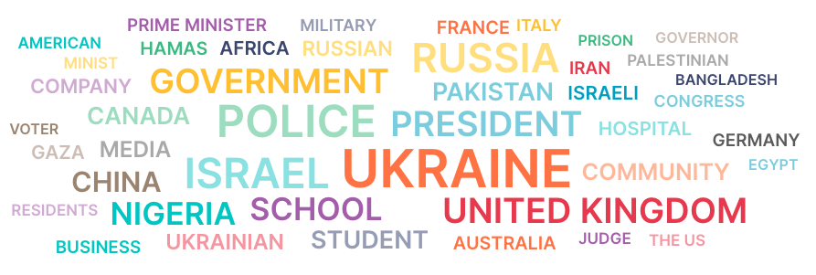
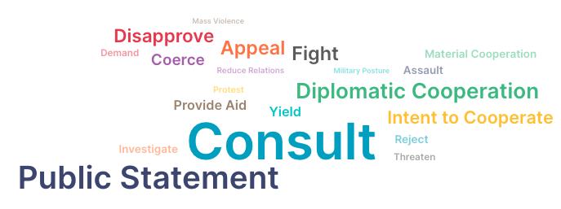
GDELT Insight Hub Dashboard
Francisco Reales
LinkedIn: franciscoreales

Slide 2

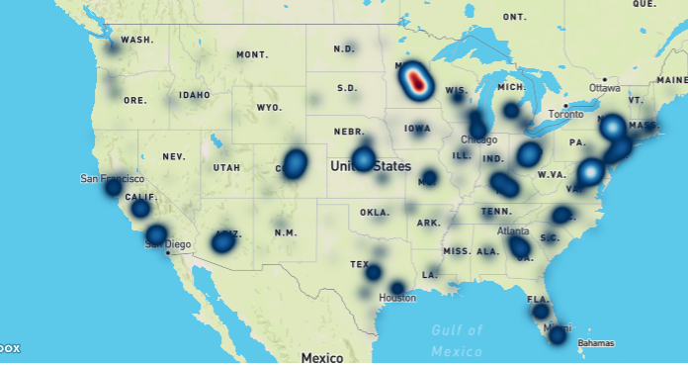
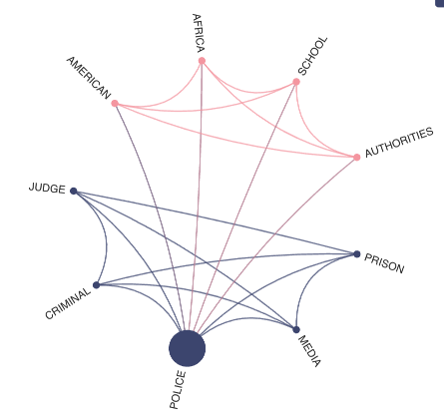
How Jane Leverages Insight Hub to Protect Clients Daily
Heatmap of Unrest in the US
May 25th, 2020: Jane spots a protest spike in Minneapolis and advises a major client to boost security, safeguarding lives and assets
Meet Jane Doe,
Global Security Analyst
SecureWatch Inc (NY, USA)
Graph of main actors and events
Post-NY protest: Jane identifies involved actors and assesses future unrest risks using the dashboard.
Discover how Insight Hub can empower your team to make informed decisions

Slide 3
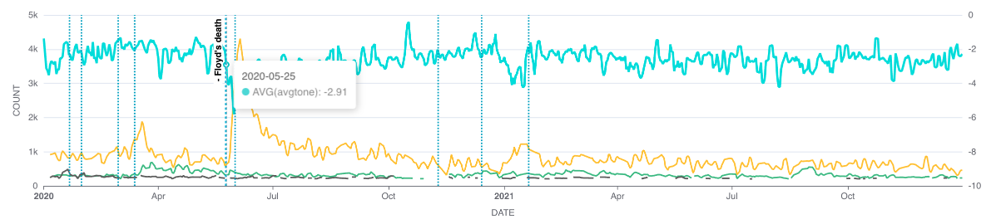
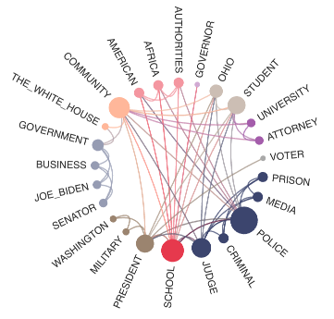
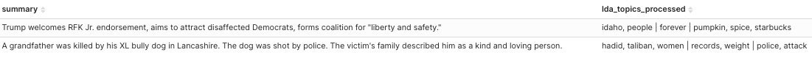
What makes Insight Hub indispensable
Protests over time
Stay informed: Daily monitoring for critical global events
Visualize Risk: Use heatmaps to asses and respond geographic risks
Spot Emerging Threats: Leverage pattern recognition to anticipate risks before they escalate
Reveal Hidden Narratives: Uncover global news themes with advanced topic modeling
Graph of main actors and events
Headlines of news in the world

Slide 4
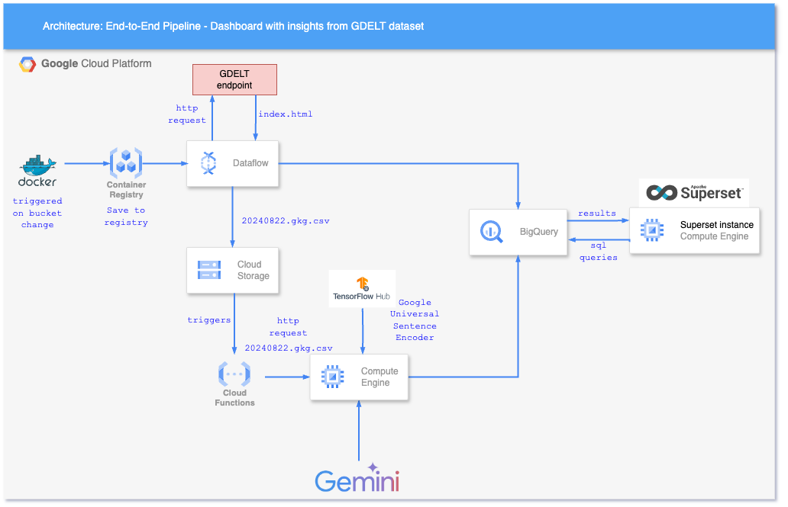
The end-to-end pipeline and architecture
Data Flow Pipeline: Ingests full datasets and daily batches
Relevant news retrieval: Gets relevant news through kmeans clustering on text embeddings and performs topic modeling
Bigquery: Serves as the main storing and querying unit
Superset: Enables data visualization and query creation
Daily data ingestion
Relevant news retrieval

Slide 5
Vision
Insight Hub aims to evolve from a powerful analytics tool into an indispensable global risk management platform, driving smarter decisions through data, collaboration, and advanced AI empowering organizations to navigate an increasingly complex world with confidence.
Want to know more:
Link to Insight Hub Dashboard (It has all the notes on the explenations of the systems and models implemented):
http://34.176.13.48:8088/superset/dashboard/p/zMeRoy7QjdB/
Github of the project:
https://github.com/francisco64/factored-datathon-2024-quantumwhite

