Slide 1
Fading
Yan Fei

Slide 2
Contents
Concepts
Cause of Fading
Slow and Fast Fading
Fading Models
Solution

Slide 3
Concept
What is Fading?
It is about the phenomenon of loss of signal in telecommunications.
A fading channel is a communication channel that experiences fading.
Notes:
It refers to the distortion that a carrier-modulated telecommunication signal experiences over certain propagation media.

Slide 4
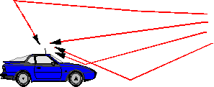
Cause of Fading
In wireless systems, fading is due to multipath propagation.
Notes:
In wireless communications, signal fading is caused by multi-path effect.

