Slide 1

Real-Time Medical Asset Tracking System
Francisco Acosta
TECH460 | Fall Semester | October 11, 2026

Slide 2
Introduction
Organization
Cook Children’s Health Care System is a leading pediatric health network delivering complex, high-demand patient care across multiple clinical facilities.
Challenge
Hospital Nurses spend up to 60 minutes per shift searching for mobile medical equipment, leading to clinical inefficiencies and increased hospital operational costs (24x7, 2024).
Areas for Improvement
Eliminating manual asset tracking, reducing equipment loss rates, and optimizing asset utilization efficiency.
Proposed Solution
Implement an automated real-time medical asset tracking system powered by an Ultra-Wideband (UWB) IoT ecosystem to provide continuous, high-precision asset tracking.
Benefit
Redirects up to 60 minutes of daily nurse search time back to bedside care while eliminating redundant equipment and labor expenses.

Slide 3
Executive Summary
In modern healthcare operations, rapid access to mobile medical equipment is essential for direct patient care and clinical efficiency. This project focuses on eliminating time nurses spend searching for equipment across hospital units at Cook Children’s by evaluating and implementing:
• Real-time asset tracking
• Automated workflow integration that eliminates manual check-outs
• Continuous asset visibility via interactive dashboards
• Enterprise security & operational sustainability
This automated IoT solution reclaims up to 60 minutes per nurse per shift, redistributing labor hours back to bedside pediatric patient care while preventing redundant equipment purchases and loss.

Slide 4
Organization Profile and
Problem Statement

Slide 5
The Organization
Cook Children’s is a top-ranked, non-profit pediatric healthcare network headquartered in Fort Worth, Texas. Founded with a commitment to improving the health and well-being of children, the organization has grown into a comprehensive healthcare system serving patients and families throughout North Texas. Cook Children’s combines specialized pediatric medical care with research, education, and community health initiatives to address the diverse healthcare needs of children and their families. As a pediatric organization, Cook Children’s prioritizes patient care and works to provide accessible, high-quality healthcare across its network.

Slide 6

Products and Services
Medical Care
• Primary and specialty
pediatric care
• Emergency and urgent
care
• Inpatient and outpatient
treatment
• Pediatric surgery
• Rehabilitation
• Behavioral health
Support Services
• Diagnostic testing
• Pharmacy services
• Care coordination
• Home health services
• Health education
Specialized and Community Services
• Complex-care programs
• Pediatric medical centers
• Specialty programs
• Community health
initiatives

Slide 7

Areas for Improvement with Technology
Medical Equipment Management and Tracking
Concerns
• Nurses spend valuable
time searching for
shared medical
equipment
(Qtait, 2025).
• Equipment may
be in another room,
department, or floor.
• Nurses may not know
whether equipment is
available, clean, or ready
for use.
• Time spent searching
takes nurses away from
direct patient care.
Improvements
• Attach an IoT sensor
to mobile medical
equipment.
• Provide real-time
equipment location and
availability.
• Nurses badges
automatically
record equipment
checkout and usage.
• Track cleaning and
maintenance status.
• Provide a dashboard for
managing equipment.
Benefit
• Reduce the time nurses
spend searching for
equipment and give that
time back to patient
care.
• Real-time asset tracking
research has
demonstrated potential
for improving the
efficiency of locating
hospital equipment
(Qtait, 2025).

Slide 8

Problem Statement
Nurses spend significant amounts
of time manually tracking medical equipment, which is an operational inefficiency that disrupts clinical workflows, reduces direct patient care time, and can contribute to unnecessary spendings (Qtait, 2025).

Slide 9
Technology Selection and Design

Slide 10
Alternative Technology Approaches
Checkout System
Hardware
Wall-mounted kiosks with RF scanners + Passive RFID asset tags
Network
Logs transactions on a local DB over an isolated encrypted hospital LAN
Workflow
Two-step scan (Staff Badge + Asset Tag )
Software
Windows GUI (Inventory count, active checkouts, logs)
Access Control
• Nurses: Read availability / write check-ins & transfers
• Charge Nurses: Add assets, clear forgotten
checkouts, mark missing or damaged assets
• Admins: Full permission & log management
IoT Ecosystem
Hardware
Ceiling gateways + Active Ultra-Wideband (UWB) asset tags (with Clean, Dirty, and Maintenance buttons)
Network
Encrypted Wi-Fi VLAN streaming to local DB
Workflow
Automated room-level tracking that pairs UWB assets with nurse room assignments (Zero manual scanning)
Software
Real-time visual floor map, inventory alerts, geofencing to alert if equipment leaves the facility
Access Control:
• Nurses: View live asset maps & toggle hygiene states
• Charge Nurses: Manage stock thresholds &
maintenance escalations
• Admins: Gateway, network, and permission
configuration

Slide 11
Qualitative Analysis
Checkout System
Operation: Intermittent
Requires physical stops at kiosks to scan badges & equipment tags.
Availability: Dependent on Infrastructure
Relies on continuous kiosk uptime, local LAN, and database connectivity.
Cost: High
Driven by kiosk hardware and ongoing labor overhead.
Implementation: Simple
Modular wall mounting with standard local database setup and minimal IT friction.
Benefit to Company: Minimal
Basic audit trails prevent theft/hoarding but offers minimal real-time workflow relief.
IoT Ecosystem
Operation: Continuous
Automated tracking requires zero staff scan time and eliminates manual check-out stops.
Availability: Continuous Asset Visibility
Segmented Wi-Fi VLAN provides real-time, room-level tracking.
Cost: Moderate
Gateway and tag investments are offset by substantial long-term labor savings.
Implementation: Complex
Requires ceiling gateway installation, Wi-Fi VLAN segmentation, and tag calibration.
Benefit to Company: Enterprise Efficiency
Drastically reduces nurse search times, automates restocking, and prevents asset loss.

Slide 12
Quantitative Analysis
Checkout System
Operation: Intermittent Workflow Kiosk Burden
Consumes unnecessary time during two scanning transaction (badge + tag)
Availability: Restricted
Visibility limited to last scan, with 0% accuracy once moved from kiosk.
Cost: High
Passive RFID tags average $8 a unit and wall kiosks average $1,200–$1,800/station (Halstead, 2020).
Implementation: Rapid Local Deployment
0 hours of RF map calibration needed (Halstead, 2020).
Benefit to Company: Reduces Asset Loss
Cuts current asset loss of 15% (Altus) but offers minimal real-time relief for daily nurse searches.
IoT Ecosystem
Operation: Automated Zero-Touch
Precise tracking requiring 0 staff scan time; reclaims 30–60 min/shift (Margarita, 2026; Collins, 2025).
Availability: Continuous
Real-time visibility across all active hospital zones.
Cost: Moderate
Real-time tags cost $15–$50 each and ceiling gateways cost $150–$400 each (CPCON Group, 2026).
Implementation: Complex
Requires ceiling gateway deployment & 3–5-year battery cycle management (CPCON Group, 2026).
Benefit to Company: Enterprise ROI
Reclaims portion of $14B industry productivity loss (Margarita, 2026) and increases asset utilization from
35% to 70% (Jina, 2024).

Slide 13
Recommended Solution: IoT Ecosystem
Infrastructure Architecture
IoT Sensors
• UWB tags send real-time signals
to ceiling gateways.
• Integrated physical buttons:
Clean / Dirty / Maintenance
Ceiling Gateways
Transmits location data over isolated, encrypted Wi-Fi VLAN to a hybrid Relational/NoSQL DB.
Automated Workflow
Zero-touch room-level tracking that pairs UWB asset tags directly with nurse room assignments upon entry
Software & Access Control
User Dashboard
• Live visual floor maps tracking
exact asset positions.
• Low-stock inventory alerts with
charge nurse escalation
thresholds.
Role-Based Access Control
• Nurses: View floor maps, check
availability, toggle hygiene states.
• Charge Nurses: Reallocate stock,
manage maintenance, clear
alerts.
• System Administrators:
Manage RBAC rules, gateway
states, and network
configurations.
Justification & Impact
Clinical Productivity
Reclaims 30–60 min/shift per nurse by replacing manual check-outs with room proximity pairing (Margarita, 2026; Collins, 2025).
Cost & Asset Efficiency
• Eliminates redundant equipment
purchases and cuts loss via automated
geofencing.
• Redirects wasted search hours directly
back to patient care
(Margarita, 2026).
Cost & Asset Efficiency
Segmented Wi-Fi VLAN isolates tracking data, minimizing PHI exposure while integrating with staff assignment feeds.

Slide 14
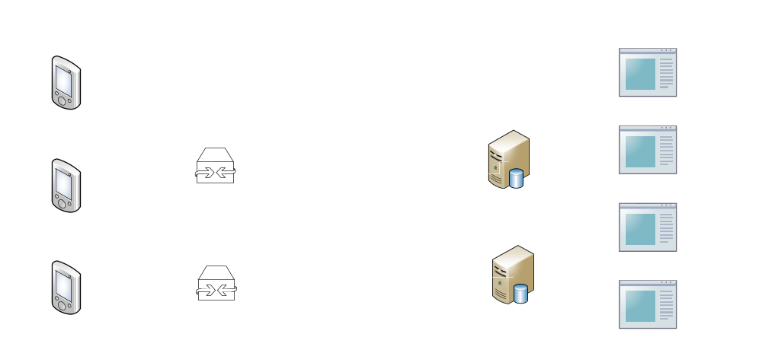
High-Level Design: IoT Ecosystem

Slide 15
Implementation Plan

Slide 16
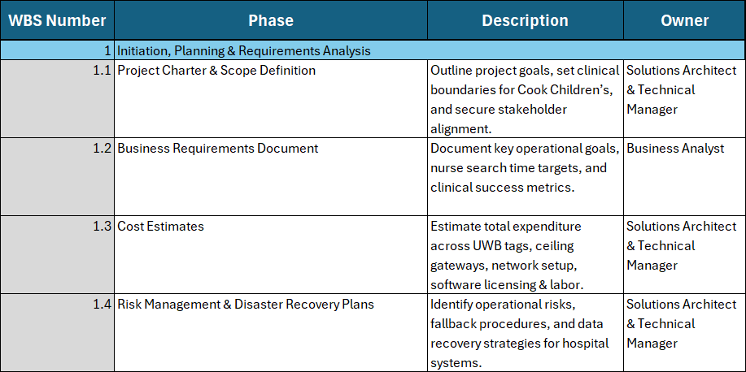
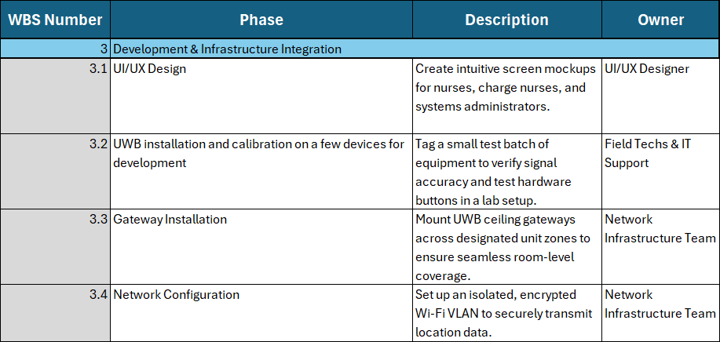
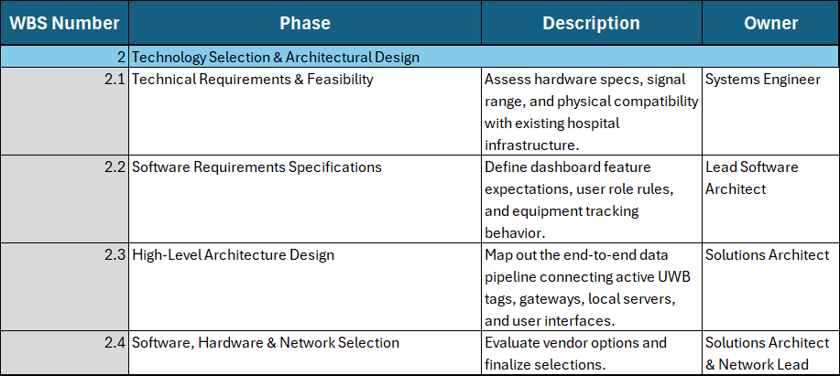
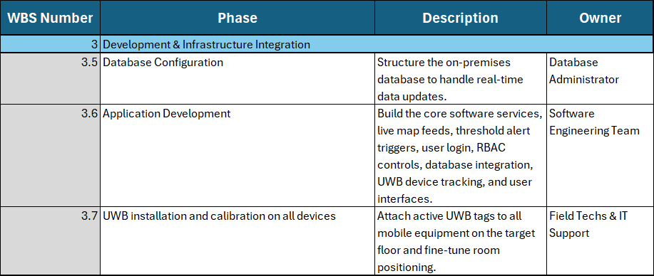
Work Breakdown Structure

Slide 17
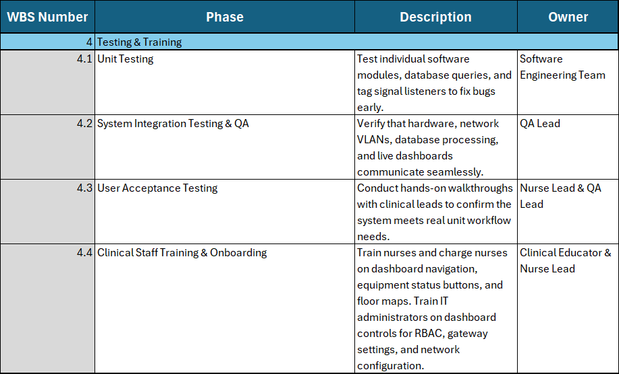
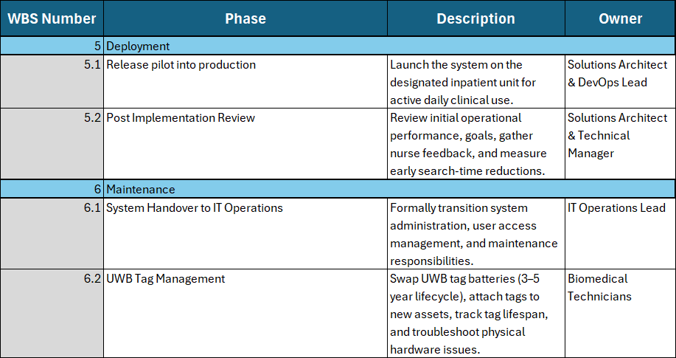
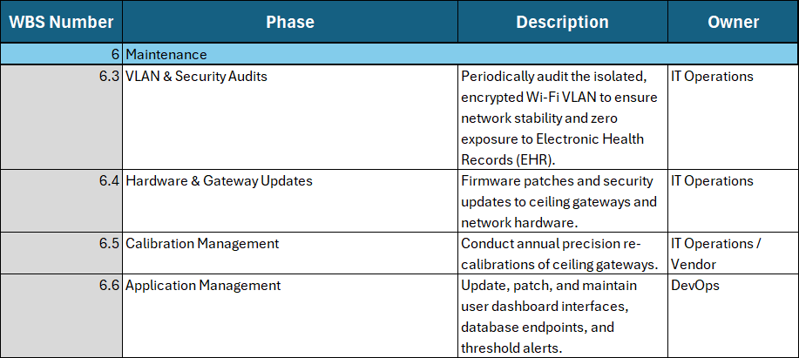
Work Breakdown Structure (Cont.)

Slide 18
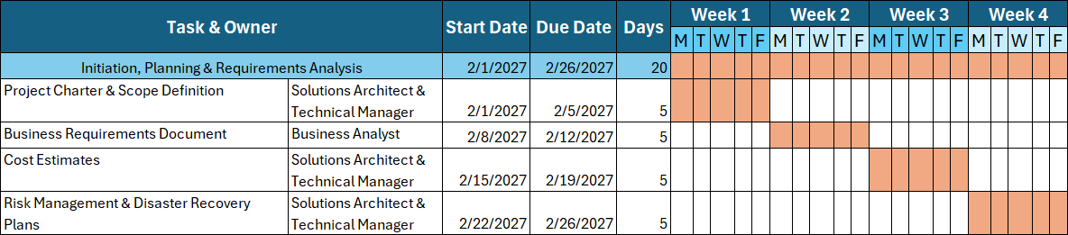
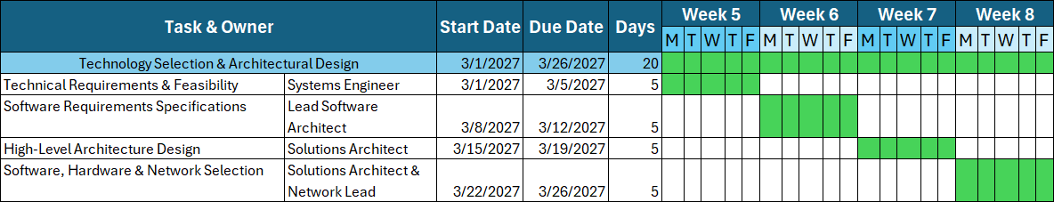
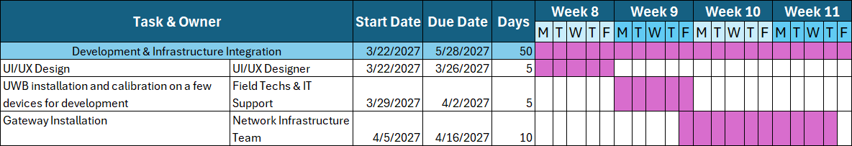
Project Schedule

Slide 19
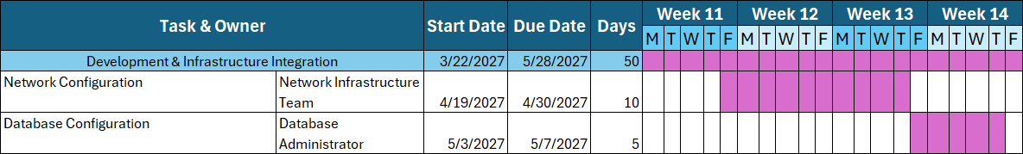
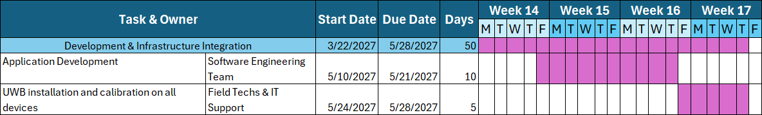
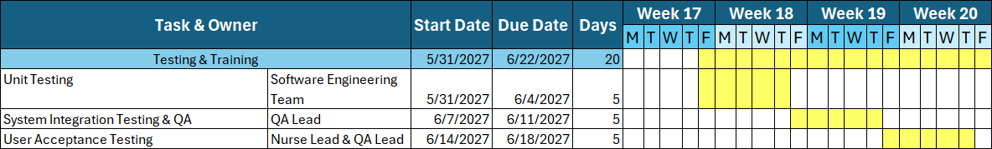
Project Schedule (Cont.)

Slide 20
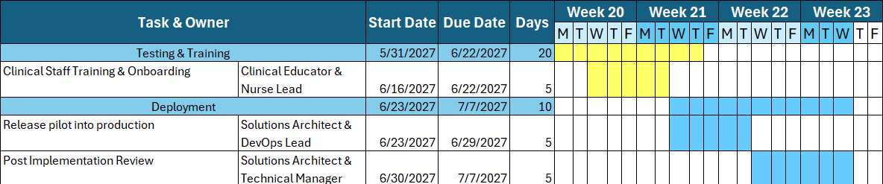
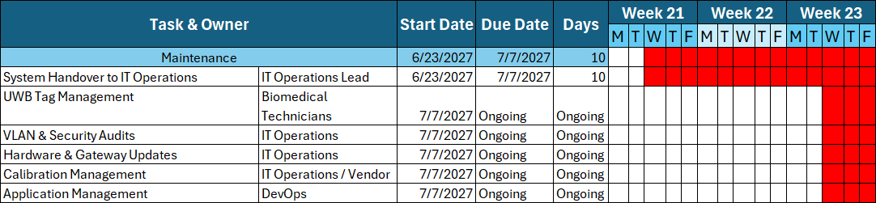
Project Schedule (Cont.)

Slide 21
Validation
Accuracy Testing
Calibrate UWB tags and ceiling gateways on a targeted hospital floor to ensure each equipment’s location is accurately tracked.
Network & VLAN Security Verification
Conduct security audits on the dedicated, encrypted Wi-Fi VLAN to guarantee isolation from hospital Electronic Health Records.
Nurse Search Time Benchmarking
Run timed simulations with a test group of nurses to compare manual search times against the IoT ecosystem’s search speeds before full rollout.
UI/UX Usability Assessments
Conduct user acceptance testing (UAT) with floor and charge nurses to ensure maps are intuitive, as well as fast to navigate.
Stress Testing
Simulate peak network load with hundreds of active tags transmitting concurrently to verify database performance and uninterrupted server uptime.

Slide 22
Evaluation & Continuous Improvement
Evaluation Metrics
Efficiency & Time Savings
Track equipment lookup reductions and clinical hours returned to patient care.
Financial Return on Investment (ROI)
Quantify savings from reduced asset loss, zero duplicate purchasing, and labor efficiency gains.
System Health & Tracking Accuracy
Monitor UWB gateway network uptime, signal precision, tag battery levels, and registry validity.
User Experience & Adoption
Collect nurse feedback on dashboard UI clarity, mobile responsiveness, and map accuracy.
Infrastructure & Load Performance
Audit DB query speeds, network bandwidth usage, and peak-time map render times.
Security & Compliance
Perform periodic audits on encrypted VLAN traffic and system logs for HIPAA compliance
Continuous Improvement
Asset Redistribution
Analyze movement trends to stage equipment across units prior to peak shifts.
Workflow Refinement
Optimize UI, search filters, and inventory alert thresholds based on floor nurse input.
Proactive Maintenance
Run automated battery health checks, periodic gateway RF recalibrations, and security patches.
Training & Expansion
Refine onboarding programs and evaluate expanding UWB coverage to additional floors.

Slide 23
Legal, Ethical, and Cultural Considerations
Legal Considerations
• HIPAA Compliance: Strict
adherence ensures location
tracking is completely isolated
from patient records and
sensitive clinical data.
• Access & Logs: System logs and
user access permissions
undergo regular audits to
comply with hospital policies.
• Hardware Safety: Ceiling
gateway installations and UWB
hardware strictly meet
healthcare facility safety
standards.
Ethical Considerations
• Asset-Only Focus: Real-time
tracking is strictly limited to
medical equipment, assuring
staff the system is built
purely for availability.
• Equitable Access: Location
data is shared equally across
all hospital units to eliminate
equipment hoarding and
ensure balanced patient
care.
• Data Integrity: RBAC
enforces strict authorization
so only designated leads
modify system settings or tag
registries.
Cultural Considerations
• Staff Empowerment: Positioned
as a supportive productivity tool
to eliminate nurse search
frustration rather than a staff
monitoring mechanism.
• Shared Ownership: Fosters a
culture of collaborative asset
stewardship across shift
handoffs, nursing teams, and
clinical departments.

Slide 24
Incorporation of Feedback
Peer Feedback: Anderson St James
"One area I would consider improving is narrowing the final problem statement. It currently combines equipment tracking and patient vital monitoring into one problem..."
Implementation
• Scope Isolation: Excluded vital monitoring
to eliminate scope creep and
implementation hurdles.
• Targeted Focus: Directs 100% of system
design toward solving equipment search
times to improve critical operational
bottlenecks.
Peer Feedback: Christopher Hellmuth
"Who will be taking care of the UWB tags once they are installed... break it down by what each team would be responsible for.“
Implementation
Added Maintenance Phase: Incorporated long-term support directly into the Work Breakdown Structure (WBS) and Project Schedule.
Role Assignments:
• Biomedical Technicians: Tag lifecycle, 3–5-year battery
swaps, and physical hardware.
• IT Operations & DevOps: Wi-Fi VLAN security audits,
gateway firmware updates, dashboard uptime, and
threshold management.
• Vendor Support: Partnered with IT Operations for annual
precision recalibration of ceiling gateways.

Slide 25
Career Readiness
Systems & Data Architecture
• IoT Hardware: Engineered a UWB sensor and ceiling gateway tracking pipeline.
• Hybrid Database Design: Structured on-premises Relational/Non-Relational schema for real-time positioning
logs and asset staff assignment paring.
Enterprise Network & Security
• Network Isolation: Designed encrypted, segmented Wi-Fi VLANs to isolate tracking traffic.
• Compliance & Governance: Embedded HIPAA standards, RBAC controls, and security auditing into
core system design.
Systems Engineering & Analytics
• Project Management: Built a 23-week Project Schedule and Work Breakdown Structure (WBS) for
cross-functional deployment.
• Business ROI Modeling: Applied quantitative decision frameworks to project ROI, track productivity recovery,
and model capital costs.
Strategic Planning & Career Application
• Holistic System Design: Evaluated legal, ethical, and workplace cultural factors to protect privacy
and support equity.
• Target Roles: Serves as a production-grade project demonstrating full lifecycle systems engineering
for Software Engineering and Systems Architecture roles.

Slide 26
Conclusion
Operational Efficiency & Patient Care
Eliminating up to 60 minutes of daily equipment search time per nurse per shift directly translates into higher quality direct bedside care and increased nursing productivity (24x7, 2024).
Financial Optimization
Implementing continuous real-time asset visibility could increase equipment utilization from 35% to 70%, preventing redundant equipment purchases and eliminating asset loss via geofencing alerts.
Enterprise Security & HIPAA Compliance
Deploying on an isolated, encrypted local Wi-Fi VLAN ensures robust security that minimizes interactions with sensitive Electronic Health Records (EHR) and Protected Health Information (PHI).
Sustainable Operations & Clear Ownership
Establishing explicit post-deployment ownership across IT Operations, Biomedical Technicians, and Vendors guarantees hardware battery lifecycles, network stability, and long-term system calibration.
Implementation Readiness
The recommended UWB IoT ecosystem is fully structured across a 23-week WBS implementation plan, providing Cook Children’s with a scalable, highly effective asset-tracking model.

Slide 27
References
24x7. (2024, April 24). Nurses searching for equipment led to $14B in lost productivity.
  https://24x7mag.com/management/equipment-management/nurses-searching-for-equipment-led-to-14b-in-lost-productivity
Altus. How RFID location tracking can help prevent equipment loss.
  https://www.altus-inc.com/insight/blog/how-rfid-location-tracking-can-help-prevent-equipment-loss
Collins, J. (2025, October 16). RFID asset tracking in healthcare: How to improve efficiency and
  reduce costs. AiRISTA. https://www.airistaflow.com/blog/rfid-asset-tracking-in-healthcare/
CPCON Group. (2026, March 10). RFID meaning: What is radio frequency identification and
  how does it work? https://cpcongroup.com/insights/article/rfid-what-it-is-how-it-works/
Halstead, J. (2020, November 20). A breakdown of 7 RFID costs, from hardware to implementation.
  Link Labs. https://www.link-labs.com/blog/rfid-cost
Jina, D. (2024, February 21). Healthcare RTLS design: Asset tracking, patient flow &
  hospital WiFi. Purple. https://www.purple.ai/en-us/blogs/healthcare-rtls-101
Margarita, V. (2026, January 20). Healthcare RTLS: A comprehensive guide to real-time location
  systems in hospitals. Navigine.
  https://navigine.com/blog/using-real-time-location-system-in-healthcare/
Qtait, M. (2025, March 31). Time Wasters Facing Nurses During Work in Hospital Departments.
  Sage Journals. https://journals.sagepub.com/doi/full/10.1177/23779608251328278

