Slide 1
Mapeo Objeto Relacional
Base de Datos

Slide 2
Merging Relational and Object Models
Object-oriented models support interesting data types --- not just flat files.
  Maps, multimedia, etc.
The relational model supports very-high-level queries.
Object-relational databases are an attempt to get the best of both.

Slide 3
Complex Data Types
Motivation:
  Permit non-atomic domains (atomic ≡ indivisible)
  Example of non-atomic domain: set of integers,or set of tuples
  Allows more intuitive modeling for applications with complex data
Intuitive definition:
  Retains mathematical foundation of relational model
  Violates first normal form.

Slide 4
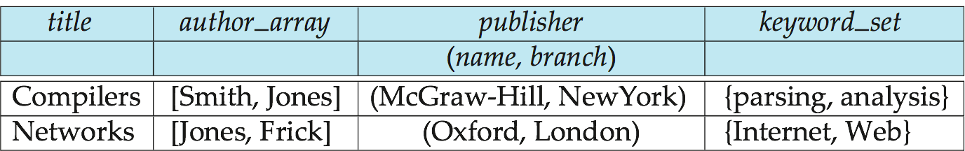
Example of a Nested Relation
Example: library information system
Each book has
  title,
  a list (array) of authors,
  Publisher, with subfields name and branch, and
  a set of keywords
Non-1NF relation books

Slide 5
Complex Types and SQL
Extensions introduced in SQL:1999 to support complex types:
  Collection and large object types
    Nested relations are an example of collection types
  Structured types
    Nested record structures like composite attributes
  Inheritance
  Object orientation
    Including object identifiers and references
Not fully implemented in any database system currently
  But some features are present in each of the major commercial database systems
    Read the manual of your database system to see what it supports

Slide 6
User Defined Types
A user-defined type, or UDT, is essentially a class definition, with a structure and methods.
Two uses:
  As a rowtype, that is, the type of a relation.
  As the type of an attribute of a relation.

Slide 7
Structured Types and Inheritance in SQL
Structured types (a.k.a. user-defined types) can be declared and used in SQL
create type Name as
(firstname varchar(20),
lastname varchar(20))
final
create type Address as
(street varchar(20),
city varchar(20),
zipcode varchar(20))
not final
  Note: final and not final indicate whether subtypes can be created
Structured types can be used to create tables with composite attributes
create table person (
name Name,
address Address,
dateOfBirth date)
Dot notation used to reference components: name.firstname

Slide 8
Structured Types (cont.)
User-defined row types
  create type PersonType as (
  name Name,
  address Address,
  dateOfBirth date)
  not final
Can then create a table whose rows are a user-defined type
create table customer of CustomerType
Alternative using unnamed row types.
create table person_r(
name row(firstname varchar(20),
lastname varchar(20)),
address row(street varchar(20),
city varchar(20),
zipcode varchar(20)),
dateOfBirth date)

Slide 9
Constructor Functions
Constructor functions are used to create values of structured types
E.g.
create function Name(firstname varchar(20), lastname varchar(20))
returns Name
begin
set self.firstname = firstname;
set self.lastname = lastname;
end
To create a value of type Name, we use
new Name(‘John’, ‘Smith’)
Normally used in insert statements
insert into Person values
(new Name(‘John’, ‘Smith),
new Address(’20 Main St’, ‘New York’, ‘11001’),
date ‘1960-8-22’);

Slide 10
Type Inheritance
Suppose that we have the following type definition for people:
create type Person
(name varchar(20),
address varchar(20))
Using inheritance to define the student and teacher types
create type Student
under Person
(degree varchar(20),
department varchar(20))
create type Teacher
under Person
(salary integer,
department varchar(20))
Subtypes can redefine methods by using overriding method in place of method in the method declaration

Slide 11
Multiple Type Inheritance
SQL:1999 and SQL:2003 do not support multiple inheritance
If our type system supports multiple inheritance, we can define a type for teaching assistant as follows:
create type Teaching Assistant
under Student, Teacher
To avoid a conflict between the two occurrences of department we can rename them
create type Teaching Assistant
under
Student with (department as student_dept ),
Teacher with (department as teacher_dept )
Each value must have a most-specific type

Slide 12
Array and Multiset Types in SQL
Example of array and multiset declaration:
create type Publisher as
(name varchar(20),
branch varchar(20));
create type Book as
(title varchar(20),
author_array varchar(20) array [10],
pub_date date,
publisher Publisher,
keyword-set varchar(20) multiset);
create table books of Book;

Slide 13
Creation of Collection Values
Array construction
array [‘Silberschatz’,`Korth’,`Sudarshan’]
Multisets
  multiset [‘computer’, ‘database’, ‘SQL’]
To create a tuple of the type defined by the books relation: (‘Compilers’, array[`Smith’,`Jones’],
new Publisher (`McGraw-Hill’,`New York’), multiset [`parsing’,`analysis’ ])
To insert the preceding tuple into the relation books
insert into books
values
(‘Compilers’, array[`Smith’,`Jones’],
new Publisher (`McGraw-Hill’,`New York’),
multiset [`parsing’,`analysis’ ]);

Slide 14
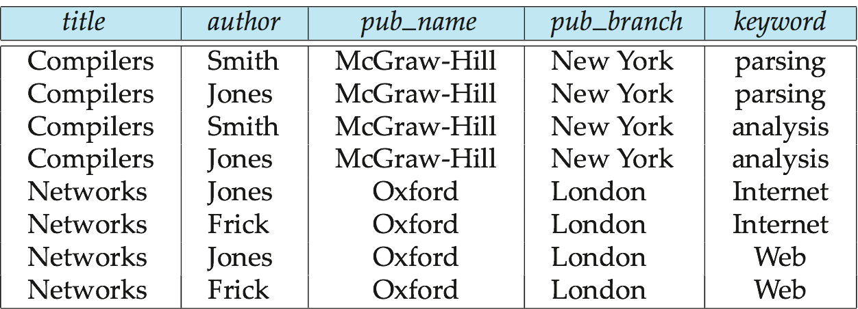
Unnesting
The transformation of a nested relation into a form with fewer (or no) relation-valued attributes us called unnesting.
E.g.
select title, A as author, publisher.name as pub_name,
publisher.branch as pub_branch, K.keyword
from books as B, unnest(B.author_array ) as A (author ),
unnest (B.keyword_set ) as K (keyword )
Result relation flat_books

Slide 15
Querying Collection-Valued Attributes
To find all books that have the word “database” as a keyword, select title
from books
where ‘database’ in (unnest(keyword-set ))
We can access individual elements of an array by using indices
  E.g.: If we know that a particular book has three authors, we could write:
select author_array[1], author_array[2], author_array[3]
from books
where title = `Database System Concepts’
To get a relation containing pairs of the form “title, author_name” for each book and each author of the book
select B.title, A.author
from books as B, unnest (B.author_array) as A (author )
To retain ordering information we add a with ordinality clause
select B.title, A.author, A.position
from books as B, unnest (B.author_array) with ordinality as
A (author, position )

Slide 16
Nesting
Nesting is the opposite of unnesting, creating a collection-valued attribute
Nesting can be done in a manner similar to aggregation, but using the function colect() in place of an aggregation operation, to create a multiset
To nest the flat_books relation on the attribute keyword:
select title, author, Publisher (pub_name, pub_branch ) as publisher,
collect (keyword) as keyword_set
from flat_books
groupby title, author, publisher
To nest on both authors and keywords:
select title, collect (author ) as author_set,
Publisher (pub_name, pub_branch) as publisher,
collect (keyword ) as keyword_set
from flat_books
group by title, publisher

Slide 17
Nesting (Cont.)
Another approach to creating nested relations is to use subqueries in the select clause,
select title,
array (select author
from authors as A
where A.title = B.title order by A.position) as author_array,
Publisher (pub-name, pub-branch) as publisher,
multiset (select keyword
from keywords as K
where K.title = B.title) as keyword_set
from books4 as B

Slide 18
Storing Nested Relations
Oracle doesn’t really store each nested table as a separate relation --- it just makes it look that way.
Rather, there is one relation R in which all the tuples of all the nested tables for one attribute A are stored.
Declare in CREATE TABLE by:
NESTED TABLE A STORE AS R

Slide 19
Example: Storing Nested Tables
CREATE TABLE Manfs (
name CHAR(30),
addr CHAR(50),
beers beerTableType
)
NESTED TABLE beers STORE AS BeerTable;

Slide 20
References
If T is a type, then REF T is the type of a reference to T, that is, a pointer to an object of type T.
Often called an “object ID” in OO systems.
Unlike object ID’s, a REF is visible, although it is gibberish.

Slide 21
Object-Identity and Reference Types
Define a type Department with a field name and a field head which is a reference to the type Person, with table people as scope:
create type Department (
name varchar (20),
head ref (Person) scope people)
We can then create a table departments as follows
create table departments of Department
We can omit the declaration scope people from the type declaration and instead make an addition to the create table statement:
create table departments of Department
(head with options scope people)
Referenced table must have an attribute that stores the identifier, called the self-referential attribute
create table people of Person
ref is person_id system generated;

Slide 22
Initializing Reference-Typed Values
To create a tuple with a reference value, we can first create the tuple with a null reference and then set the reference separately:
insert into departments
values (`CS’, null)
update departments
set head = (select p.person_id
from people as p
where name = `John’)
where name = `CS’

Slide 23
Object Identifiers Using Reference Types
Reference type
  Create unique system-generated object identifiers
  Examples:
    REF IS SYSTEM GENERATED
    REF IS <OID_ATTRIBUTE> <VALUE_GENERATION_METHOD> ;

Slide 24
User Generated Identifiers
The type of the object-identifier must be specified as part of the type definition of the referenced table, and
The table definition must specify that the reference is user generated
create type Person
(name varchar(20)
address varchar(20))
ref using varchar(20)
create table people of Person
ref is person_id user generated
When creating a tuple, we must provide a unique value for the identifier:
  insert into people (person_id, name, address ) values
  (‘01284567’, ‘John’, `23 Coyote Run’)
We can then use the identifier value when inserting a tuple into departments
  Avoids need for a separate query to retrieve the identifier:
insert into departments
values(`CS’, `02184567’)

Slide 25
User Generated Identifiers (Cont.)
Can use an existing primary key value as the identifier:
create type Person
(name varchar (20) primary key,
address varchar(20))
ref from (name)
create table people of Person
ref is person_id derived
When inserting a tuple for departments, we can then use
insert into departments
values(`CS’,`John’)

Slide 26
Path Expressions
Find the names and addresses of the heads of all departments:
select head –>name, head –>address
from departments
An expression such as “head–>name” is called a path expression
Path expressions help avoid explicit joins
  If department head were not a reference, a join of departments with people would be required to get at the address
  Makes expressing the query much easier for the user

Slide 27
Implementing O-R Features
Similar to how E-R features are mapped onto relation schemas
Subtable implementation
  Each table stores primary key and those attributes defined in that table
  or,
  Each table stores both locally defined and inherited attributes

Slide 28
Presentación
Esta presentación fue armada utilizando, además de material propio, material provisto por los siguientes autores:
Siblberschat, Korth, Sudarshan - Database Systems Concepts, 6th Ed., Mc Graw Hill, 2010
García Molina/Ullman/Widom - Database Systems: The Complete Book, 2nd Ed.,Prentice Hall, 2009
Elmasri/Navathe - Fundamentals of Database Systems, 6th Ed., Addison Wesley, 2011

