Slide 1
Serverless

Slide 2
About me
Francisco Edilton
@franciscoed
https://github.com/franciscoed/
franciscoed@gmail.com
AWS @TDSIS
Meetup AWS

Slide 3
Agenda
Definitions
Benefits
Drawbacks
Cases
Other Tools
Demo!
Q&A

Slide 4
Definitions
“Serverless is about no maintenance” - Paul Johnston
“The idea is to be able to run server-side code without worrying about the messy details of provisioning and setting up servers” – Code Ahoy

Slide 5
Benefits
Fully Managed
Zero Administration
No Patching
No Instance Monitoring
No provisioning
HA & Fault Tolerant

Slide 6
Benefits
Never pay for idle
Run code in parallel
Event Handling
Cost
http://pt.slideshare.net/TOTVS/novos-modelos-de-computao-e-arquiteturas-sem-servidores

Slide 7
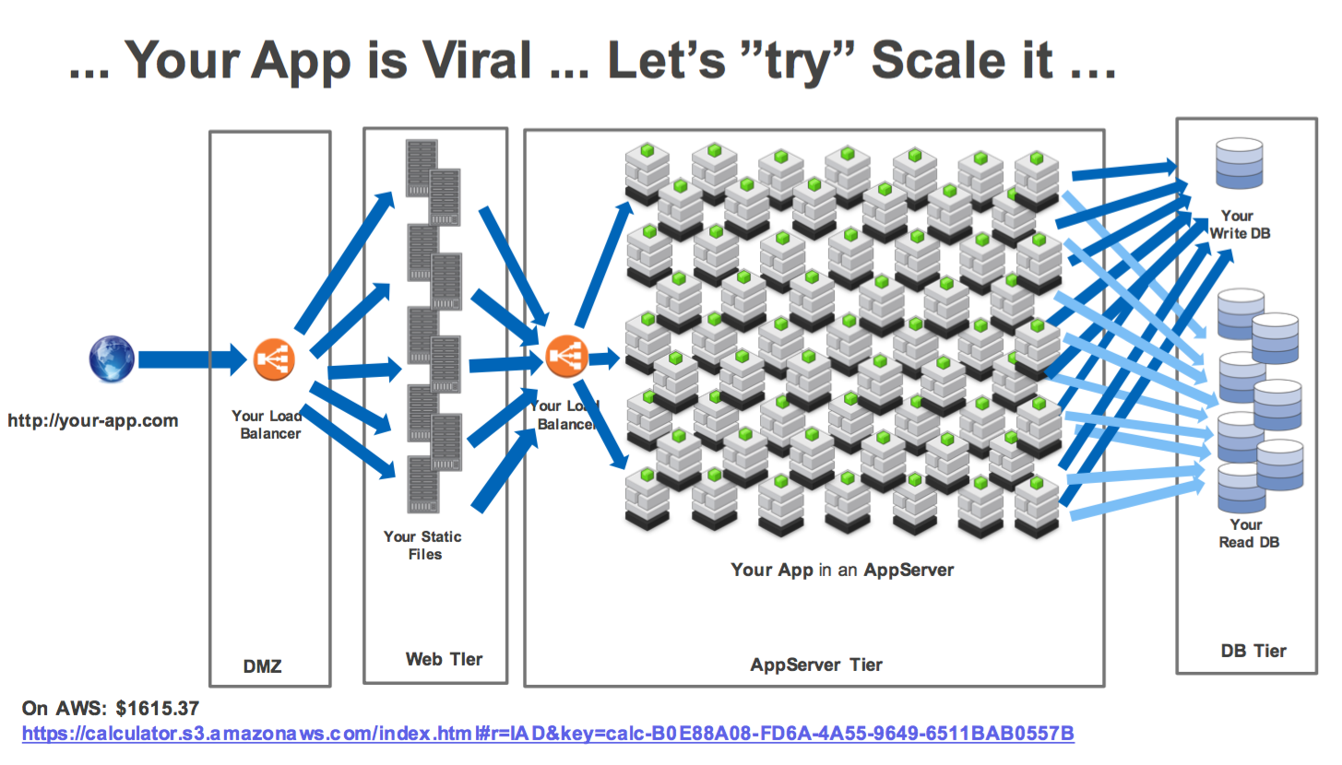

Slide 8
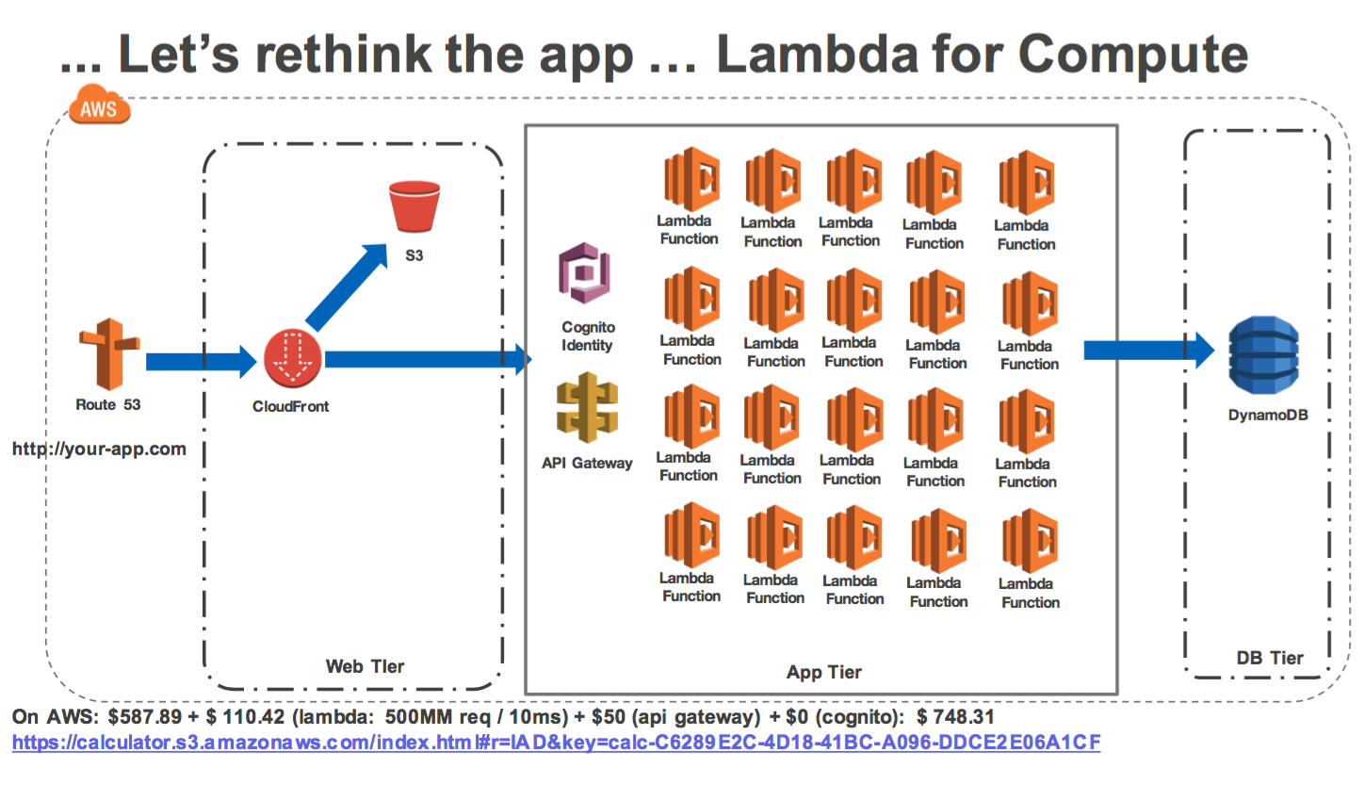

Slide 9
Drawback
If it’s down, it’s just down
Vendor lock-in
Performance
Resource Limits
http://docs.aws.amazon.com/lambda/latest/dg/best-practices.html

Slide 10
Cases
Network
DNS – Route53
VPN – VPC
Network share – EFS
What’s my IP – API Gateway + Lambda
DynDNS - https://medium.com/aws-activate-startup-blog/building-a-serverless-dynamic-dns-system-with-aws-a32256f0a1d8#.36z2comfd

Slide 11
Cases
WebSite
CloudFront
S3
Api Gateway + Lambda

Slide 12
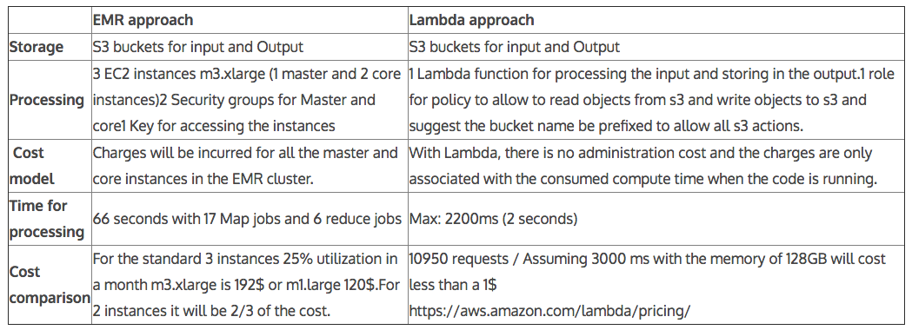
Cases
Big Data – Word Count
Fonte: http://blog.sungardas.com/CTOLabs/2016/02/aws-lambda-invasion-in-big-data/

Slide 13
Cases
Big Data – FireEye
Web UI
Cascade
Worker
10K process
Reports, Visualizations, Analytical statistics (clustering, correlation, etc)
Fonte: http://www.slideshare.net/AmazonWebServices/cmp403-aws-lambda-simplifying-big-data-workloads

Slide 14
Cases
Analytics:
CloudTrail
Tweet Analysis: https://github.com/arafato/rt-analytics
Time Series: https://blogs.aws.amazon.com/bigdata/post/Tx148NMGPIJ6F6F/Analyze-a-Time-Series-in-Real-Time-with-AWS-Lambda-Amazon-Kinesis-and-Amazon-Dyn

Slide 15
Cases
Outros:
LamdAuth: A Serverless Authentication Service
Backend Mobile: http://computournament.backendmatters.com/
GitHub Actions: https://aws.amazon.com/blogs/compute/dynamic-github-actions-with-aws-lambda/
Backups, Log Analysis, App monitor and etc.

Slide 16
Cases
Outros:
Mobile Game: http://www.slideshare.net/AmazonWebServices/gam401-build-a-serverless-mobile-game-w-cognito-lambda-dynamodb
SQL: https://blogs.aws.amazon.com/bigdata/post/Tx3IRFXZW1YRIVW/From-SQL-to-Microservices-Integrating-AWS-Lambda-with-Relational-Databases

Slide 17
Other Tools:
CloudSearch
CloudWatch
CodeCommit
CodeDeploy
CodePipeline
Cognito
Config
DynamoDB
IoT
Kinesis
ML
QuickSight
SES
SNS
SQS
SWF
WAF

Slide 18
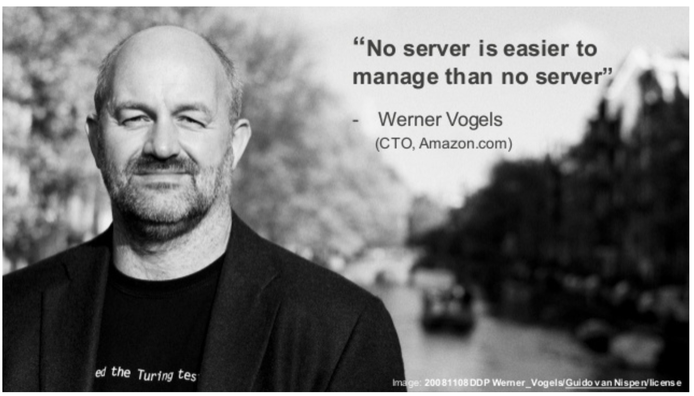

Slide 19
DEMO!

Slide 20
Chatbot Competition
Chatbot for Slack
Submission Period: August 10, 2016 (10:00am Eastern Time, USA) – September 29, 2016 (5:00pm Eastern Time, USA)
https://awschatbot.devpost.com/

Slide 21
Q&A

Slide 22
Thanks
Francisco Edilton
@franciscoed
https://github.com/franciscoed/
franciscoed@gmail.com
AWS @TDSIS
Meetup AWS

