Slide 1
Project Management with High Complexity and Uncertainty in a Government Organization: A Case Study of the Sao Paulo Tax Invoice System Development
Francisco M. Matulovic, Universidade de Sao Paulo, Brazil
Abraham Yu, Universidade de Sao Paulo, Brazil
Bruno Paschoal, Hertie School of Governance, Germany
Paulo T. Nascimento, Universidade de Sao Paulo, Brazil

Slide 2
Research question and obj.
According to our methodology, case study based and exploratorie research, and bibliographie (Eisenhardt, 1989), we start that research attemp without no initial question and only a simple objective, collect and analyze data from Sao Paulo Tax Invoice project.
As moving foward toward our efforts, advancing the case study by making interviews and always researching bibliographie, we found that Sao Paulo Tax Invoice was non conventional project and then focused ours efforts on answering an overall question, that was how they did it? How was the origin and the initial team? Question more related to case study.

Slide 3
Methodology
Case study
Exploratorie research
Semi structured interviews

Slide 4
Case introduction
Development of an incentive system by a government departament to avoid fiscal evasion in retail sector by using Information Technology (IT) to get trade and tax information for every product sold

Slide 5
Do you want to use your SSN on tax receipt? *
  By voluntarie inputing SSN (CPF) on tax receipt when checking out on retail stores, costumers share transaction information with government, to ensure tax collection. To reward a fiscal culture prometment, governemnt return to participants a percentagem of the tax paid by the store.
  * translation of “quer CPF na nota?”, now a popular question in Sao Paulo's stores

Slide 6
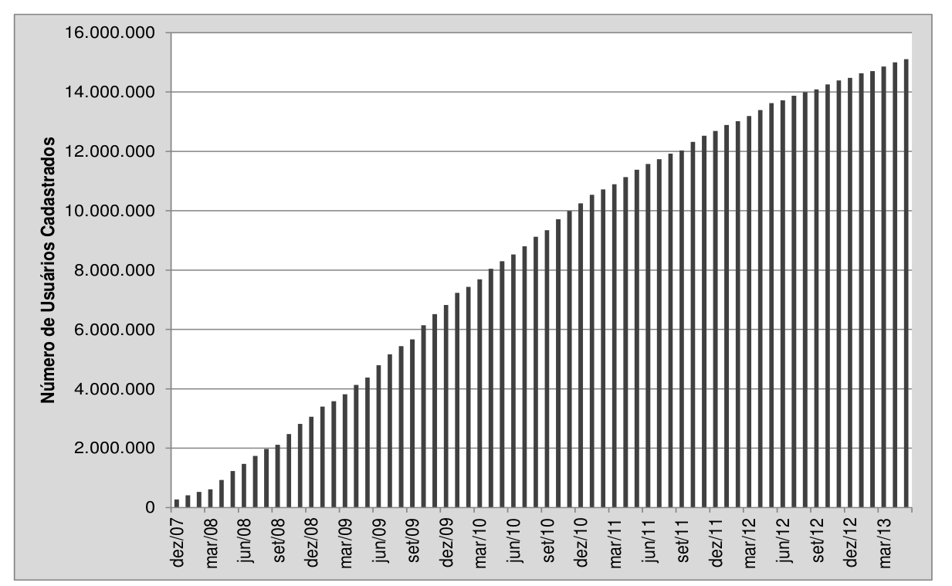
user's registration count

Slide 7
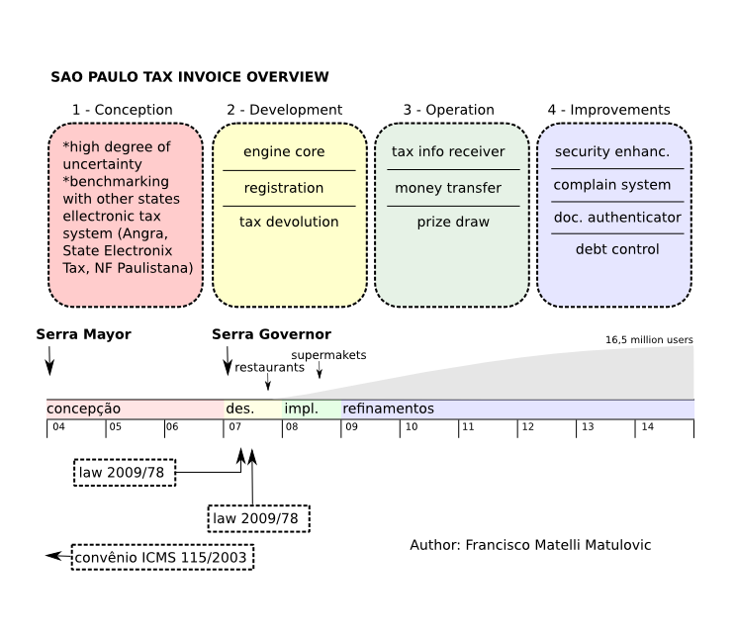

Slide 8
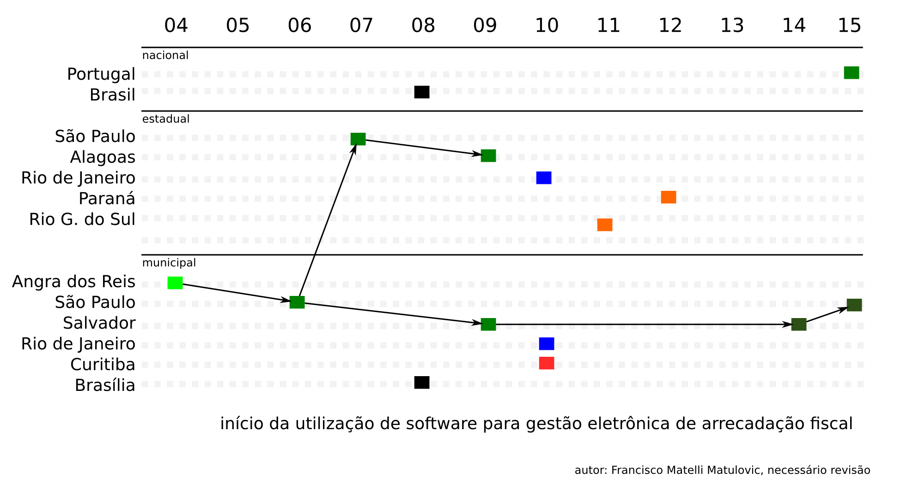
Project technology diffusion

Slide 9
Case literature review
They managed the project using the “experimental” approach (K. M. Eisenhardt and B. N. Tabrizi, 1995), and trying achive fastness (C. Moorman and A. S. Miner, 1998) (S. A. Leybourne, 2009)

Slide 10
Conclusions
Is not an intend from case study methodology to get concrete conclusions. By using Eisenthardt 1989 we tried to analyze the data collected looking for major patterns and found that some aspects from the management process of Sao Paulo Tax Invoice could be improved, but no research conclusions.
About the impact of the Sao Paulo Tax Invoice on states finances, we found out that studies are indicating a positive impact on state`s receipt from retail sector trend after the project launch.

Slide 11
New questions
Naturally what emerge as a possible frontier to expand research efforts was on analyze the SP Treasure project pipeline. The Sao Paulo Tax Invoince was a non-conventional project, and what we can pretend to answer is why is it so different, how a conventional project is managed by SP Treasury and what project they are maniging now.

