Slide 1
Complex Project Management in a Government Organization: A Case Study of the São Paulo Tax Invoice System
Francisco M. Matulovic, Universidade de Sao Paulo, Brazil
Abraham Yu, Universidade de Sao Paulo, Brazil
Bruno Paschoal, Hertie School of Governance, Germany
Paulo T. Nascimento, Universidade de Sao Paulo, Brazil

Slide 2
São Paulo State’s Tax Invoice system
Treasury Secretary of the State of Sao Paulo launched the Tax Invoice System in 2007
  Conceived to reduce tax evasion by providing incentives to consumers to asks for receipts
  In 2015 this program has nearly 17 million active users
The project was given top priority by São Paulo State governor and was led by a heavy-weight manager
  A team composed by technicians from the Treasury Secretary
  The first modules of this system was developed in less than one year
  Other modules of the system were released in 2008 and 2009

Slide 3
Research Objective and Method
Objective: understand the project management process in the development of the Tax Invoice System in 2007
Research method
  Previous researches on the SP Tax Invoice System
    Legal aspects
    Impact assessment
  Interviews with project members
    Five interviews (including project manager)

Slide 4
Development process

Slide 5
Development process

Slide 6
Development process

Slide 7
Discussion
Dialog with K. M. Eisenhardt and B. N. Tabrizi, 1995 ….
Dialog with Scrum and Agile Methodology

Slide 8
Conclusions

Slide 9
Questions?

Slide 10
Research Question and Objective
According to our methodology, case study based and exploratorie research, and bibliographie (Eisenhardt, 1989), we start that research attemp without no initial question and only a simple objective, collect and analyze data from Sao Paulo Tax Invoice project.
As moving foward toward our efforts, advancing the case study by making interviews and always researching bibliographie, we found that Sao Paulo Tax Invoice was non conventional project and then focused ours efforts on answering an overall question, that was how they did it? How was the origin and the initial team? Question more related to case study.

Slide 11
Methodology
Case study
Exploratorie research
Semi structured interviews

Slide 12
Case introduction
Development of an incentive system by a government departament to avoid fiscal evasion in retail sector by using Information Technology (IT) to get trade and tax information for every product sold

Slide 13
Do you want to use your SSN on tax receipt? *
  By voluntarie inputing SSN (CPF) on tax receipt when checking out on retail stores, costumers share transaction information with government, to ensure tax collection. To reward a fiscal culture prometment, governemnt return to participants a percentagem of the tax paid by the store.
  * translation of “quer CPF na nota?”, now a popular question in Sao Paulo's stores

Slide 14
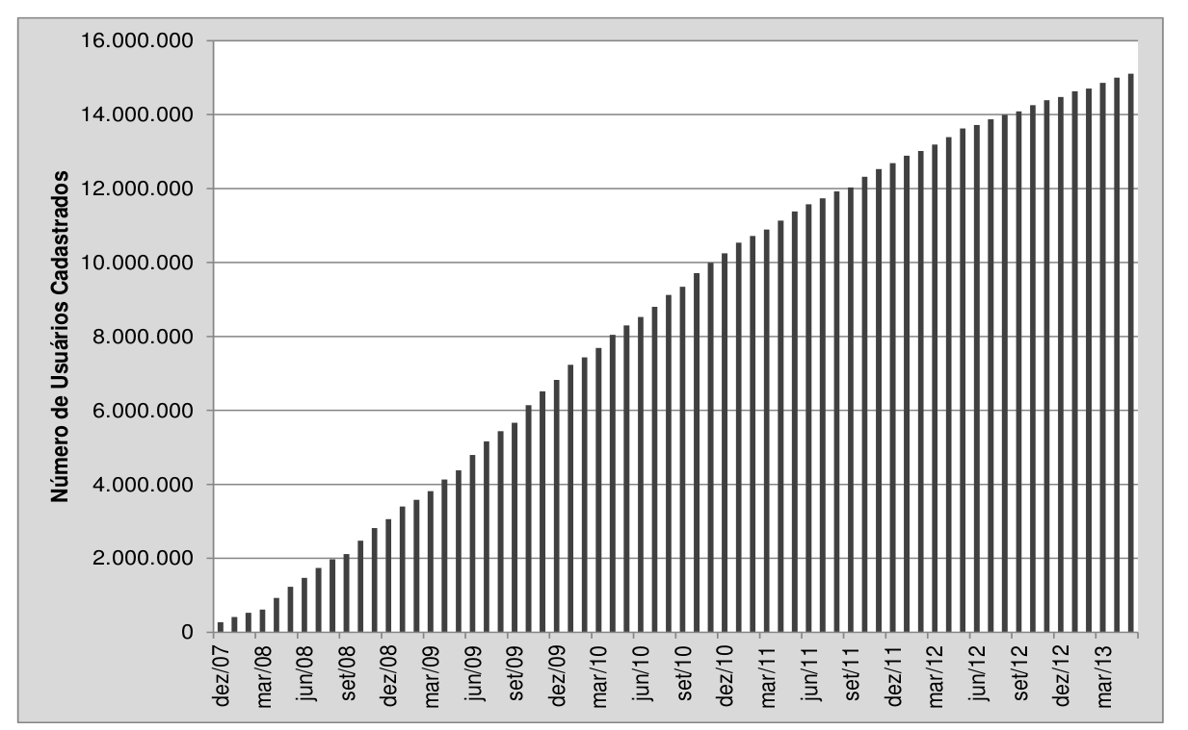
user's registration count

Slide 15
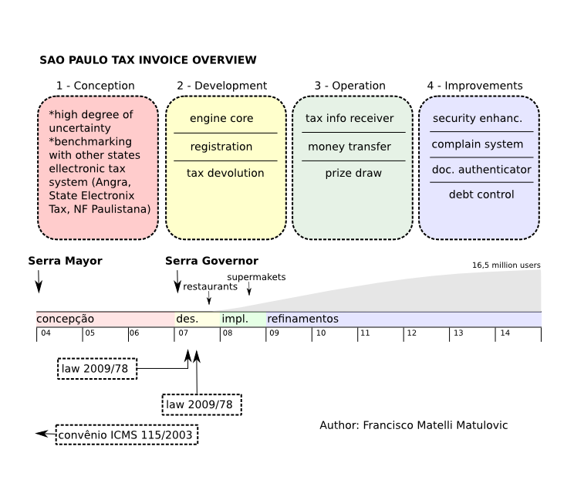

Slide 16
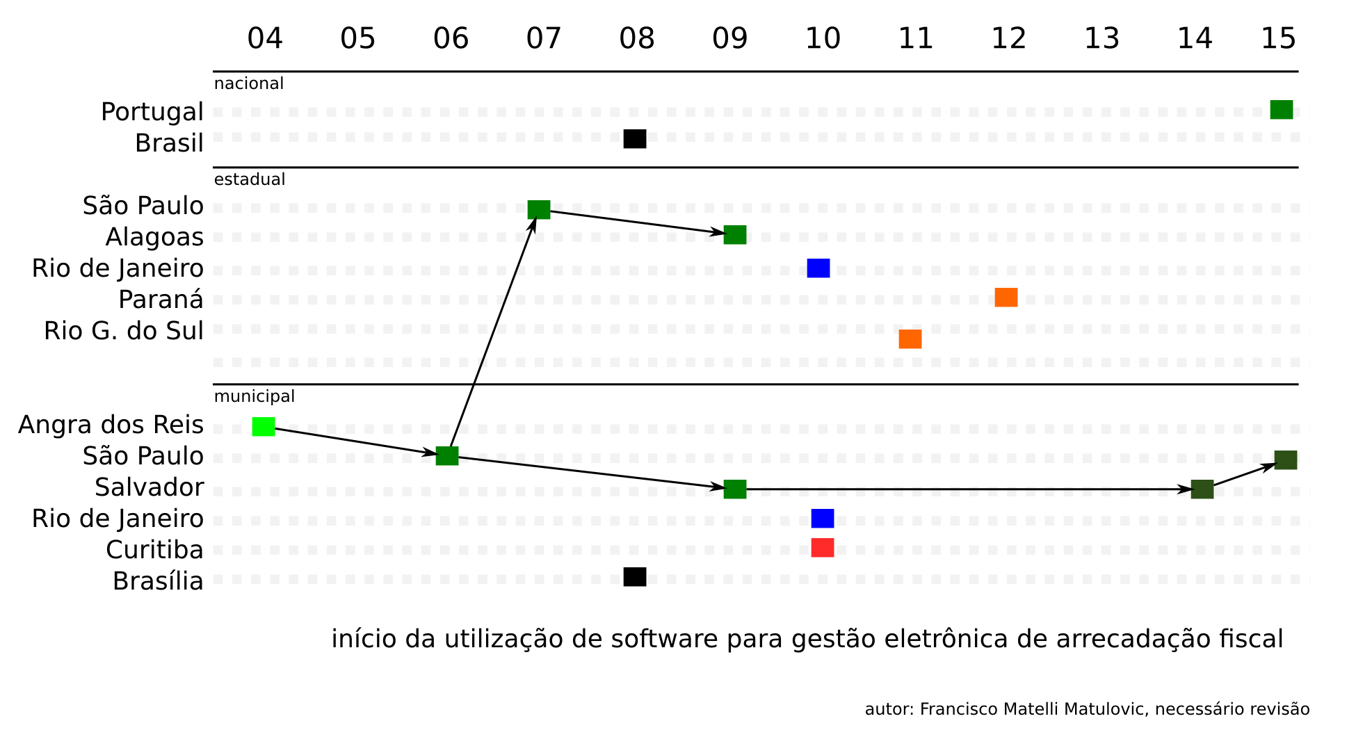
Project technology diffusion

Slide 17
Case literature review
They managed the project using the “experimental” approach (K. M. Eisenhardt and B. N. Tabrizi, 1995), and trying achive fastness (C. Moorman and A. S. Miner, 1998) (S. A. Leybourne, 2009)

Slide 18
Conclusions
Is not an intend from case study methodology to get concrete conclusions. By using Eisenthardt 1989 we tried to analyze the data collected looking for major patterns and found that some aspects from the management process of Sao Paulo Tax Invoice could be improved, but no research conclusions.
About the impact of the Sao Paulo Tax Invoice on states finances, we found out that studies are indicating a positive impact on state`s receipt from retail sector trend after the project launch.

Slide 19
New questions
Naturally what emerge as a possible frontier to expand research efforts was on analyze the SP Treasure project pipeline. The Sao Paulo Tax Invoince was a non-conventional project, and what we can pretend to answer is why is it so different, how a conventional project is managed by SP Treasury and what project they are maniging now.

