Slide 1
Brazilian IT and Software Macro Environment
Francisco Matelli Matulovic
Management graduate student – FEA USP

Slide 2
Macro Environment Term definition
1. The major external and uncontrollable factors that influence an organization's decision making, and affect its performance and strategies. These factors include the economic factors; demographics; legal, political, and social conditions; technological changes; and natural forces.
2. Specific examples of macro environment influences include competitors, changes in interest rates, changes in cultural tastes, disastrous weather, or government regulations.
Source:
http://www.businessdictionary.com/definition/macro-environment.html#ixzz31NyyhaYv

Slide 3
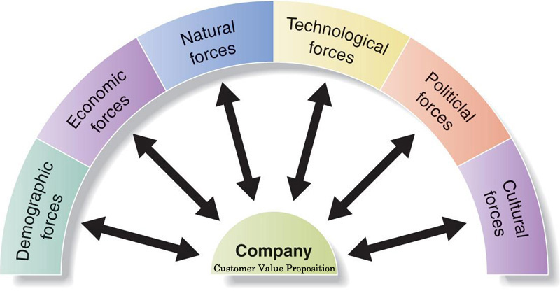
Macro Environment Chart

Slide 4
Investment Opportunities
Direct Foreign Investment (DFI). In 2003, Brazil was the 15th leading destination for DFI, and in 2012 the 4th leading country (after the USA, China and Hong Kong)
Inflation rate in the last 10 years: 5.5% average
Unemployment 2003: 12.2%
Unemployment 2013: 5.2%
Income: From 2001 to 2012 per capita income across the board grew by 33%, and in the middle class it grew by 50%.
Foreign Reserves: 3rd largest in the World
Middle Class: 53% of the Brazilian population. In the last ten years 35 million people have joined.
Public Investment: PAC, “Brazilian New Deal”
Interest rate: From 2000 to 2013 it fell by 45%

Slide 5
Brazilian IT sector
Data from Brasil IT Plus
Domestic IT market 2012: US$ 123 billion
Domestic IT market 2012: US$ 123 billion
Exports: US$ 2.48 billion
Position: world’s 7th largest domestic IT market and 4th largest ICT market
Total number of work posts: 1.3 million jobs
Average growth in the sector in the past 5 years: 11%
Percent of Brazilian market-Latin American market: 52%
IT Participation in GNP: 5.2%
Data from FAPESP
7.984 companies develop and sell software
2.751 firms provide IT services
Brazilian software market accounts to 2,5% of the global market

Slide 6
Brazil Environment for IT exportation
Government support
Association for the Promotion of Excellence in Brazilian Software (Softex)
OSCIP with MCTI support
Sectoral Project to Promote Exports in the Software and Information Technology (IT) Services Sector
create new business opportunities in the international market for Brazilian companies
increase the volume of exports
increase exposure and strengthen the image of the Brazilian IT industry
Over 200 companies are taking part in the Sectoral Project
Brazilian Association of Software Companies (Abes)
Annual reseach The Brazilian Software and Services Market (Mercado brasileiro de software e serviços)
paints a portrait of the sector
indicates future trends.
Source
http://revistapesquisa.fapesp.br/en/2014/04/15/software-made-brazil-2/

Slide 7
Brazil's national software production
Total revenue, about US$ 20 billions
Software creation US$6,5 billion
Brazilian software and services industry will post sales of $27.2 billion in 2012, including $2.2 billion in exports
Brazil ranked seventh in the world of the largest software producers
Included the domestic market but not exports
Brazil surpassed countries such as Canada, Australia, India and South Korea
Exports of software and IT services from India, one of the giants in this market, reached $75 billion in fiscal year 2012/2013
Data from 2009, source FAPESP Magazine and IBGE
http://revistapesquisa.fapesp.br/2011/05/25/expans%C3%A3o-do-software/

Slide 8
Software trade balance
How much Brazilians paid for license foreign software
R$2,2 billion (R$4,4 mi) (2009)
How much Brazilian IT companies earned licensing their software for other countries:
US$ 2,1 billions (from US$145 billion of 2009)
USA is responsible for 72,7% (2009)
Is a good number, but still quite distant for India software exportation
US$ 75 billions (2012)
Global market is estimated by
US$ 1,5 trillion (2012)

Slide 9
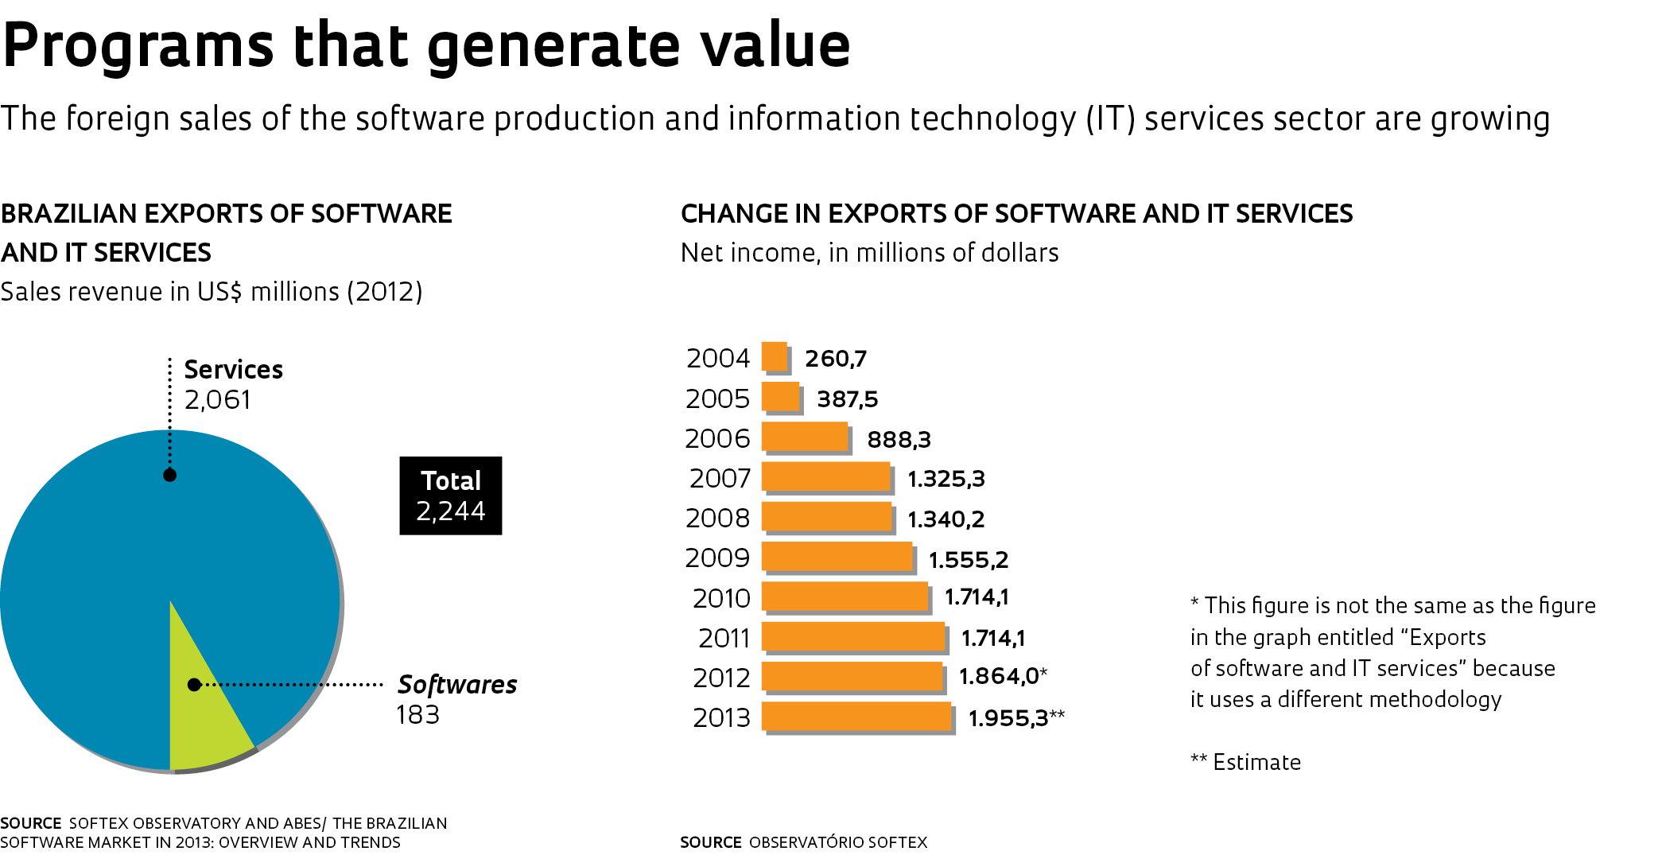
Programs that generate value

Slide 10
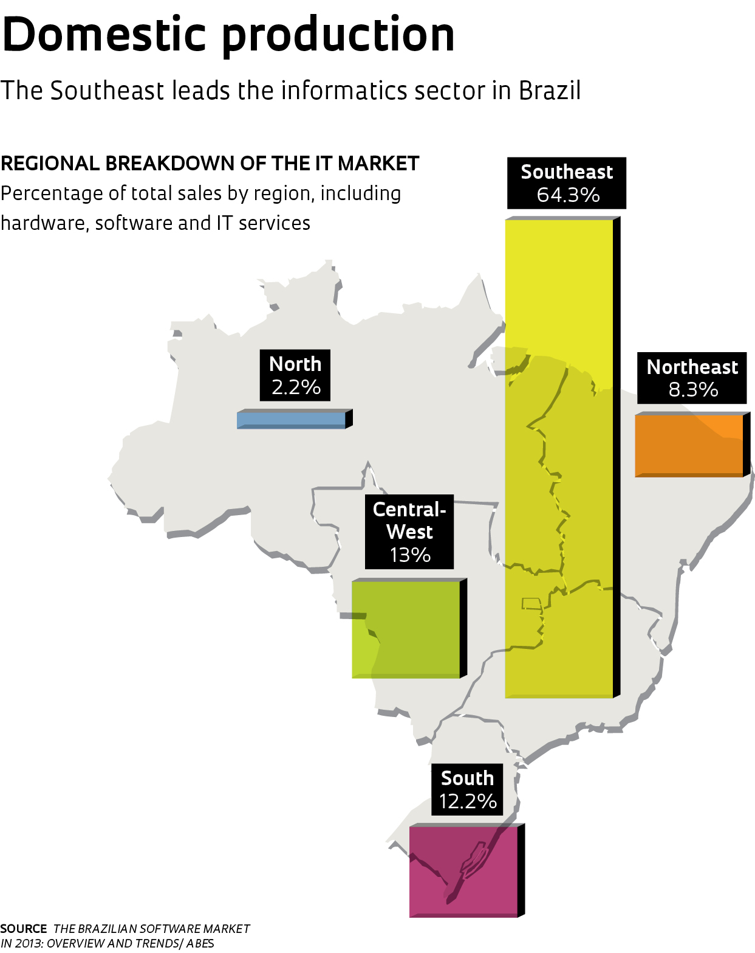
Regional production

Slide 11
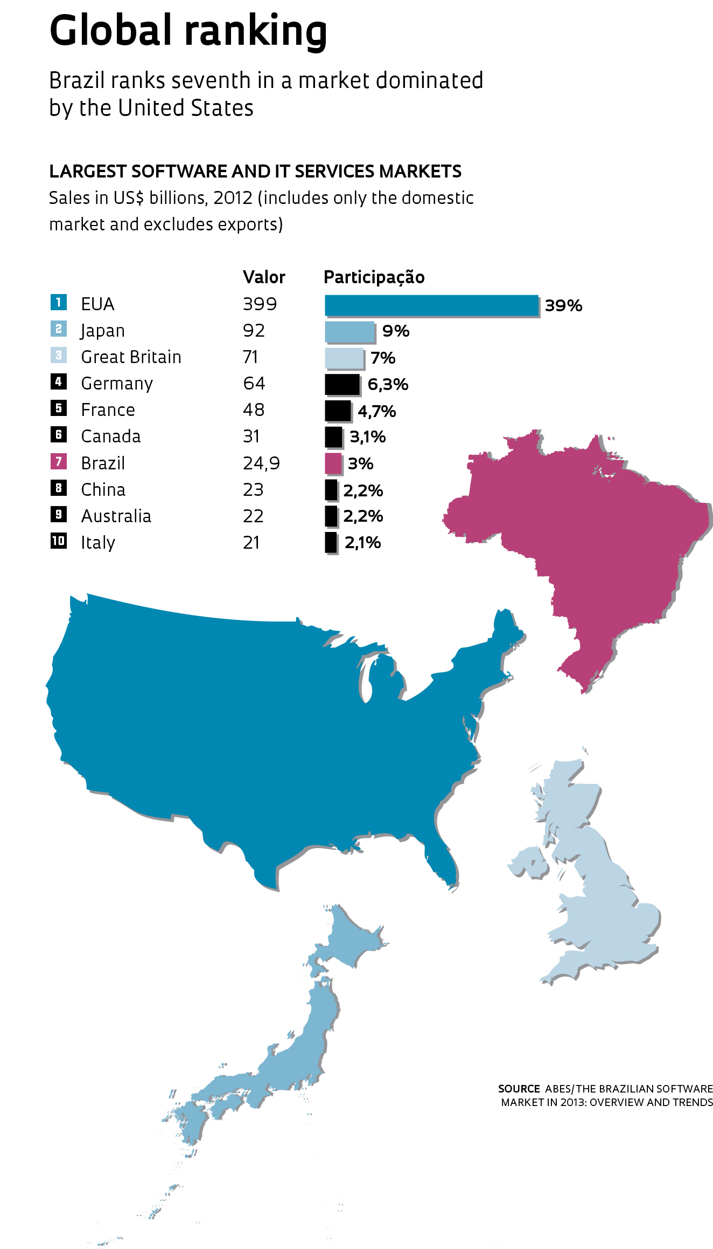
Global ranking

Slide 12
IT evolution
From 2004 to the present, the value of exports of software and information technology services are up about sevenfold. There has been considerable effort to put Brazil on the radar screen of companies that purchase these products
In 2012, foreign sales of software and IT services reached $1.9 billion, versus $260 million in 2004.
IT services include the development of made-to-order software as well as consulting work, support, maintenance and training.

Slide 13
References
VASCONCELOS, Y. Software made in Brazil, FAPESP Magazine, Edition 217, 2014
http://revistapesquisa.fapesp.br/en/2014/04/15/software-made-brazil-2/
Softex
http://www.softex.br/
Pesquisa de Serviços de Tecnologia da Informação 2009, IBGE
http://www.ibge.com.br/home/estatistica/economia/psti/2009/default.shtm
Brazil IT plus
http://www.brasilitplus.com/brasilit/Ingles/

