Slide 1
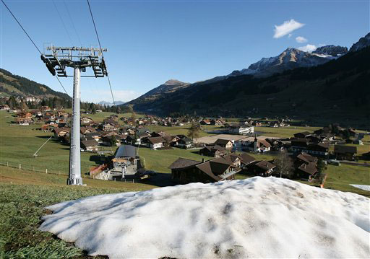
Suíça
Proposta INDC
Francisco Matelli Matulovic

Slide 2
Alpes Suíços
Suíça é um destino turístico
Os Alpes estão sendo fortemente afetados, 3x mais do que a média global
http://www.scientificamerican.com/slideshow/top-10-places-already-affected-by-climate-change/

Slide 3
Suíça Dados
Área
Total41 285³ km² (144.º)
Água (%)4,2%
População
Estimativa de 2012, 8.014.000⁴ ⁵ hab. (94.º)
Censo 20007.288.010 hab. - Densidade186 hab./km² (61.º)
PIB (base PPC)
Estimativa de 2014
Total US$ 444,702 bilhões*⁶ (36.º)
Per capita US$ 55 237⁶ (7.º)

Slide 4
Energia na Suíça
In 2004, energy use was composed of
31.3% motor fuels;
25.7% combustibles;
23.1% electricity;
12.1% gas;
7.8% other.
In Switzerland, water power covers about 60% of the demand for electricity or 1/8 of the entire energy demand.
Nuclear power plants produce about 40% of the Swiss electricity demand.
In 2020, the first nuclear power plants will reach the end of their operating time. Swiss production capacities will decline strongly thereafter.
If measured by electricity production in 2003, the proportion of wind power would amount to 1.8% (12).
Electricity consumption is likely to further increase in the future. If the linear trend continues, the electricity demand will be about 33% higher by 2050 compared to 2003 (12).

Slide 5
Fatos importantes
Gestão participativa
INDC precisa ser aprovado pelo parlamento
Caso mais recente de corrupção
Sumidouro de dinheiro, dinheiro que poderia estar indo para ações mitigatórias, porque não desconfiar disso?

Slide 6
INDC Suíça
Base year: 1990
Emissions in base year: 53.3 Mt per yea
Gases covered: CO2, CH4, N2O, HFCs, PFCs, SF6, NF3 Base year for gases covered: all 1990 (not relevant where reference level is applied)
Sectors covered: energy; industrial processes and product use; agriculture; land-use, land-use change and forestry; waste

Slide 7
Proposta Suíça
Switzerland commits to reduce its greenhouse gas emissions by 50 percent by 2030 compared to 1990 levels
corresponding to an average reduction of greenhouse gas emissions by 35 percent over the period 2021-2030
By 2025, a reduction of greenhouse gases by 35 percent compared to 1990 levels is anticipated
Carbon credits from international mechanisms will partly be used.

Slide 8
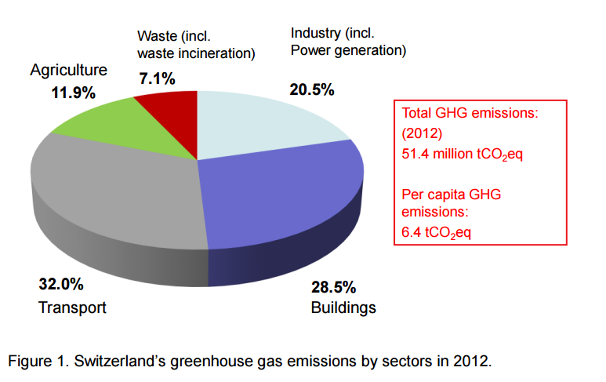
INDC Suíça

Slide 9
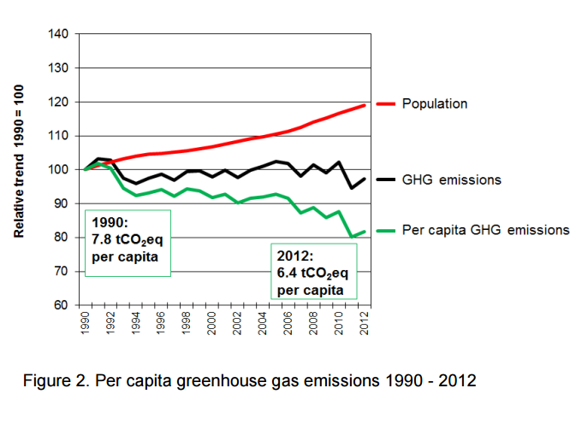
INDC Suíça

Slide 10
Proposta Suíça
Switzerland commits to reduce its greenhouse gas emissions by 50 percent by 2030 compared to 1990 levels
corresponding to an average reduction of greenhouse gas emissions by 35 percent over the period 2021-2030
By 2025, a reduction of greenhouse gases by 35 percent compared to 1990 levels is anticipated
Carbon credits from international mechanisms will partly be used.

Slide 11
Lições Suíças
Com a suíça podemos aprender que quanto antes os esforços começaram mais rápida a adaptação e menor o custo de mudança
em 95 as emissões per capita diminuem mesmo com a população crescendo
Há 20 anos a Suíça mantém a emissão per capita em queda

Slide 12
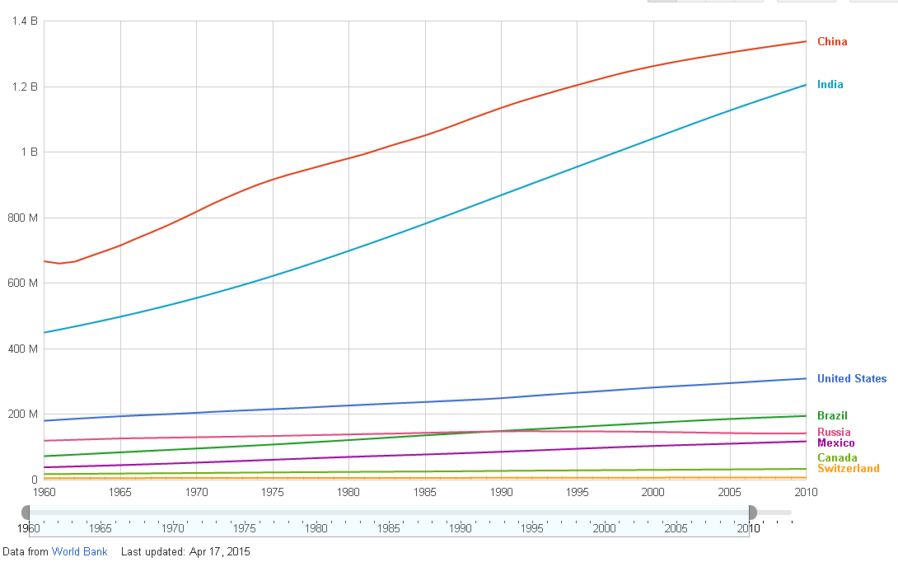
Population
fonte: http://goo.gl/dMd8QT Google Data: WDI

Slide 13
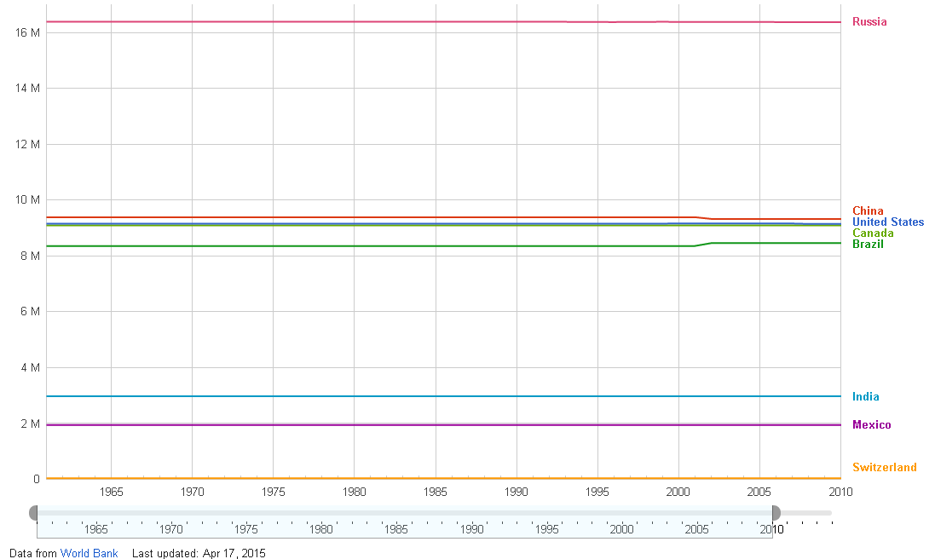
Land area
fonte: http://goo.gl/dMd8QT Google Data: WDI

Slide 14
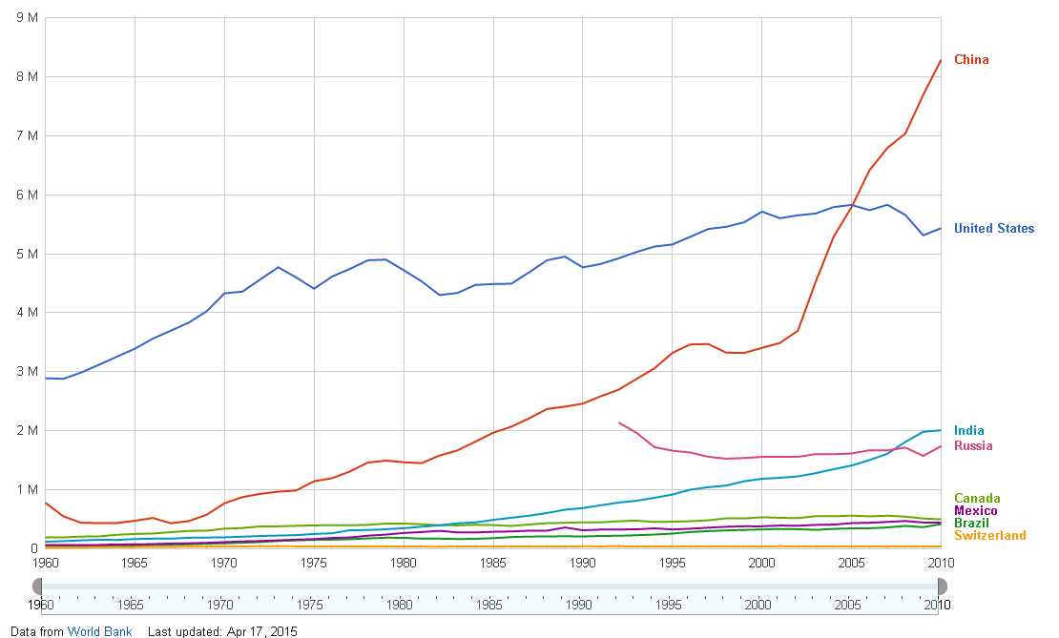
GHG emissions
fonte: http://goo.gl/dMd8QT Google Data: WDI

Slide 15
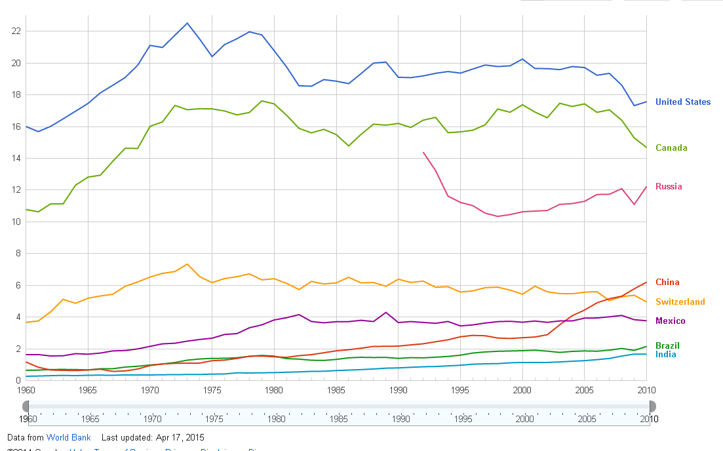
CO2 per capita
fonte: http://goo.gl/dMd8QT Google Data: WDI

Slide 16
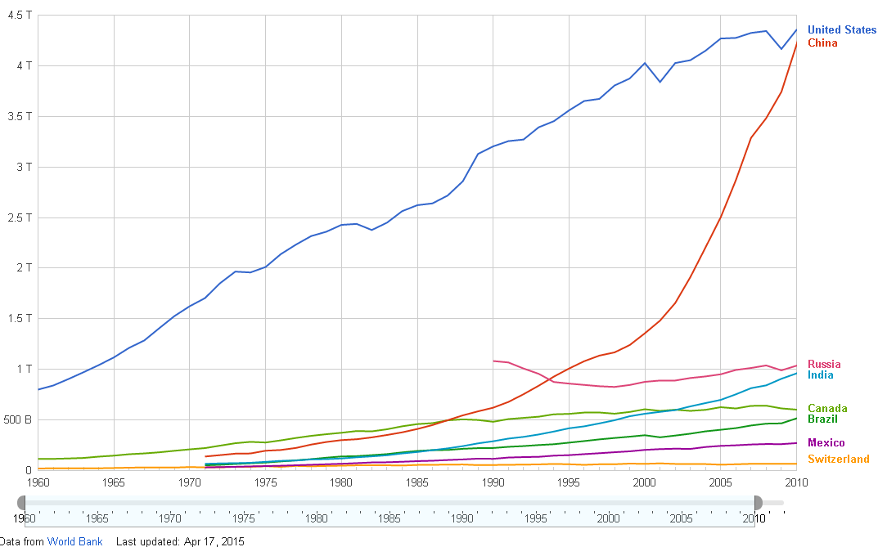
Electrecity production
fonte: http://goo.gl/dMd8QT Google Data: WDI

