Slide 1

Análise de Decisão
EAD 5853 - Aula 02
Prof. Abraham Yu
Monitor Gabriel Venturim
2018

Slide 2
Prefácio (HKR)
“We wrote Smart Choices to bridge the gap between how people actually do make decisions and ... how they should make decisions”
“The essence of our approach is divide and conquer”
“You can apply our method to any decision worthy of serious thought”

Slide 3
Bazerman (Chapter 01)
Hammond, Keeney e Raiffa (Chapter 01)
Definir o problema certo
Especificar seus objetivos
Criar alternativas imaginativas
Entender as consequências
Lançar mão de todas as suas escolhas (grapple with your trade-offs)
Esclarecer suas incertezas
Pensar muito sobre sua tolerância ao risco
Considerar decisões interligadas
Defina o problema
Identifique os critérios
Pondere os critérios
Gere alternativas
Classifique alternativas segundo cada critério
Identifique a solução ideal

Slide 4
Seis Requisitos da Decisão de Qualidade (U. Stanford)
1. Definição apropriada do problema (framing)
2. Alternativas criativas e viáveis
3. Informação relevante e confiável
4. Valores e “trade-off” claros
5. Raciocínio lógico
6. Compromisso para a ação

Slide 5
HK&R Chapter 2: Problem
Be creative
Laziness is the danger
Case West Coast Port ← qual era o problema?
Turn problems into opportunities
Define the decision problem
Trigger, constrains, essential elements, other decisions, workable scope (hierarquia de decisões)
Reexamine ... as you go
Defining decision problem is a decision problem (Meta decisão)
Maintain your perspective

Slide 6
Muitos Nomes para Framing
Framing
Decision basis
Setting problem
Locating problem
Definição de problema
Formulação de problema
Small world representation

Slide 7
Problem Formulation
Problem identification (perception)
Problem definition (conceptualization)
Problem structuring (instrumental reasoning)
Estruturar os elementos da decisão num esquema lógico
Ferramentas: diagrama de influencia, árvore de decisão e outras
Smith, G. Defining managerial problems: a framework for prescriptive theorizing, Management Science, v35, nº8, August 1989

Slide 8
Definindo ...
A problem definition is a representation
The key issue in definition is how problems should be represented
What elements should be included, which relationships among these elements, and how might these selections vary over problem types
In defining a problem one wants to include all and only the important elements, leaving out unnecessary details without losing significant possibilities
(Smith, 1989)

Slide 9
Definindo ...
Frame é o pano de fundo, situação e contexto correto da decisão
Frame é a janela pela qual a empresa observa o problema
Frame é um aspecto da decisão menos observável pelos decisores
As pessoas definem o problema baseados em suas crenças e vieses, portanto predispondo a enxergar os problemas sempre de mesmas formas, muitas vezes independente da realidade
Matheson e Matheson, The smart organization,
Harvard Business Review Press, 1998

Slide 10
Estudos Descritivos de Framing
Plambeck, N. e Weber, K. When the glass is half full and half empty: CEOs' ambivalent interpretations of strategic issues, SMJ, July 2010
Benner, MJ e Tripsas, M. The influence of prior industry affiliation on framing in nascent industries: the evolution of digital cameras, SMJ, March 2012

Slide 11
The influence of prior industry affiliation on framing in nascent industries: the evolution of digital cameras
“The notion of industry level frames: managers of organizations in the same industry develop ‘shared or interlocking metaphors or worldviews’”
“Commonly held perceptions, expectations, and assumptions become particularly salient when ﬁrms enter a highly uncertain emerging industry that incorporates novel technologies with novel uses”
“In this context, managers lack concrete data about what consumers value and therefore must make assumptions about how customers will use the product and what features will have merit”

Slide 12
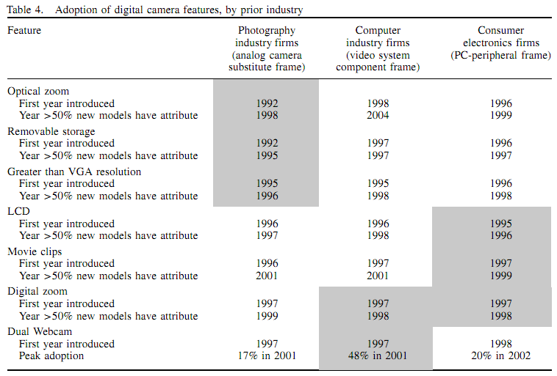

Slide 13
Prescrição em Framing
Pesquisas prescritivas, em definição de problema, procuram melhorar a maneira pela qual os administradores conceituam seus problemas (Smith, 1989)
Pesquisas em prescrição (SMJ):
Hodgkinson et al, Breaking the frame: an analysis of strategic cognition and decision making under uncertainty, SMJ, 1999
Wright e Goodwin, Eliminating a framing bias ... , SMJ, 2002
Baer, M., Dirks, K. T. e Nickerson, J. A. Microfoundations of strategic problem formulation. SMJ, 34: 197-214, 2013

Slide 14
Teorias Frames
Teorias em Estratégia Empresarial
Estrutura setorial: Cinco forças da concorrência
Porter e outros
Análise de recursos e competências: Competências essenciais
Mintzberg e outros

Slide 15
Evidência contra violência: Médico decidiu enfrentar o problema em Cali com as armas da epidemiologia
Daniel Martins de Barros
O Estado de S.Paulo 25 Fevereiro 2018

Slide 16
Os Desafios do Médico
1992: o médico Rodrigo Guerrero Velasco, PhD em Epidemiologia, assumiu a prefeitura de Cali
A taxa de homicídio na cidade era de 124 pessoas a cada 100 mil.
Velasco decidiu enfrentar o problema com as armas da epidemiologia
Levantamento de dados estatísticos, mapeando os homicídios e extraindo informações até então inéditas com base neles.
A primeira descoberta: políticos, médicos, policiais, juízes e promotores tinham conceitos diferentes sobre violência.
Estabeleceu, então, reuniões semanais para unificar discursos e esforços.
Surgiram, assim, propostas com base em evidências, não apenas em palpites ou ideologias.

Slide 17
The science of violence prevention Bulletin of the World Health Organization 2015; 93:672-673. doi: http://dx.doi.org/10.2471/BLT.15.031015
Q: So how did you tackle the violence?
A: We knew we had to be clear about the causes of the violence and so we took an epidemiological approach. This approach requires a clear definition of the problem. … A prerequisite for this method is reliable information, but much of our information was conflicting. For example, the judiciary reported twice as many homicides as the police.

Slide 18
HK&R Chapter 3: Objectives
“Objectives are very personal, but they need not be self-centered”
Objectives guide decision
Information seeking, explain your choice, determine importance
Pitfalls
Focus on tangibles, spend too little time
Art of identifying objectives
Separate means and ends objectives (Why? What?)
Practical advice
Objectives and ease of access to data

Slide 19
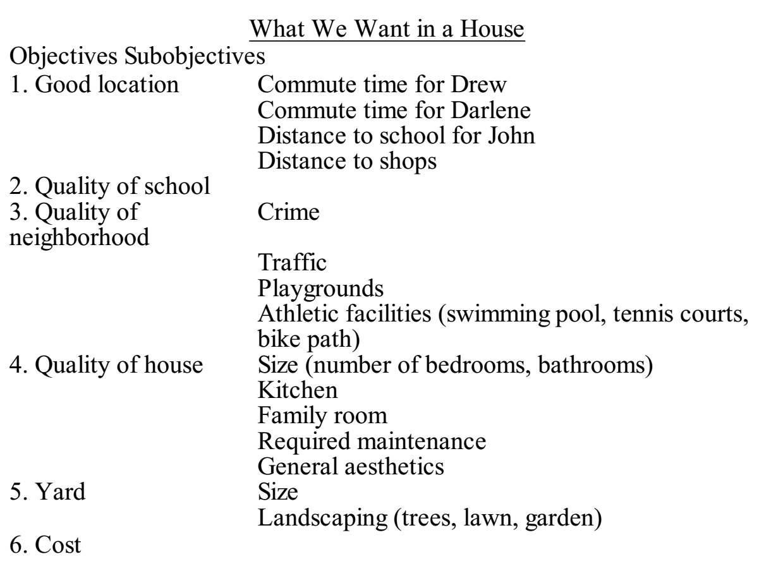

Slide 20
Bazerman & Moore Chapter 1
“Rational" decision-making process: it assumes that decision makers (1) perfectly define the problem, (2) identify all criteria, (3) accurately weigh all of the criteria according to their preferences, (4) know all relevant alternatives, (5) accurately assess each alternative based on each criterion, and (6) accurately calculate and choose the alternative with the highest perceived value. (pg. 3)
Hammond, Keeney, and Raiffa (1999) suggest eight steps: Both of these lists provide a useful order for thinking about what an optimal decision-making process might look like.
Hammond, Keeney, and Raiffa's (1999) logical steps above provide a prototype of System 2 thinking.

Slide 21
B&M 01: Prescriptive vs Descriptive
“Prescriptive decision scientists develop methods for making optimal decisions” ← ??!!
For example, they might suggest a mathematical model to help a decision maker act more rationally.
Example “Marla Bannon” (pg. 8)
HKR: “You can learn to make better decisions” (pg. 3)
“By contrast, descriptive decision researchers consider how decisions are actually made”
O que é método normativo para B&M?
Fully rational process (pg. 6)
Abordagens normativas, prescritivas e descritivas ← → Racionalidade limitada

Slide 22
B&M 01
Sistema 1 e Sistema 2
Judgmental heuristics
The Availability Heuristic
The Representativeness Heuristic
Positive Hypothesis Testing
The Affect Heuristic
The main objective of this book is to improve your judgment.
E a decisão tomada dentro de organização?

Slide 23
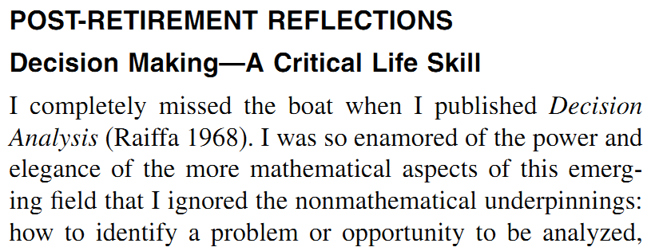
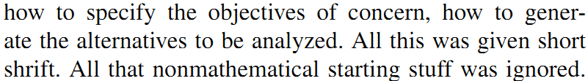
Decision Analysis: a Personal Account of How it Got Started and Evolved, Howard Raiffa (2002)
Raiffa, Decision analysis: a personal account of how it got started and evolved,
Operations Research, v. 50, n. 1, 2002
Notes:
15/9
.....................................
Finalização desta parte de XYZ (precisa dar um nome – comportamento decisório? Desafios a SEU): as reflexões do Raiffa sintetiza a descoberta/reconhecimento de problemas de aplicar a SEU no mundo real.
Evolução é a evolução da AD.
Desafios são problemas novos que a AD precisa resolver.

Slide 24
Normative, Descriptive and Prescriptive Decision Theories
Normative: models are built on axioms that people should consider (Examples: expected utility model, probability theory, Bayesian statistics)
Descriptive: how real people make judgments and decisions (Example: prospect theory)
Prescriptive: helping people make better decisions by using normative models, but with awareness of the limitations of human judgment and of the practical problems of implementing a rational model in a complex world (Example: decision analysis)
Edwards, W., Miles, R. F., and von Winterfeldt, D. (Eds.). Advances in Decision Analysis: From Foundations to Applications. Cambridge University Press, 2007

Slide 25
Análise de Decisão (Decision Analysis, Decision Engineering)
“A discipline distinct from decision theory in that it focuses on the application of decision theory to real-world, complex problems”
R. F. Miles, Jr. The emergency of decision analysis. In Edwards, W., Miles, R. F., and von Winterfeldt, D. (Eds.). Advances in Decision Analysis: From Foundations to Applications. Cambridge University Press, 2007
Notes:
Engenharia de decisão denota que o foco é a aplicação. Mas é uma disciplina acadêmica, como nas escolas de engenharia, as missões são 1) treinar os futuros pesquisadores sobre a AD e decisores; 2) desenvolver conceitos e ferramentas para os decisores.
Observa a afirmação de que a AD é distinta da teoria de decisão. Uma analogia: uma é a engenharia e a outra é a física.
Será que a AD pode ser aplicada para tomar a decisão sobre a erupção do vulcão da Islandia?

Slide 26
Bazerman & Moore (2009)
Dedicated to
MHB: To Howard Raiffa, for his influence on the field of decision making and on me
DAM: To my dad, for his influence on me and
my decision making

Slide 27
Fusão de Prescrição com Descrição
Hammond, Keeney, & Raiffa
Bazerman & Moore
Chapter 10
Psychological Traps: How to avoid some of the tricks your mind can play on you when you're deciding
Chapter 11 Improving Decision Making
Strategy 1: Use Decision-Analysis Tools
Strategy 2: Acquire Expertise
Strategy 3: Debias Your Judgment
Strategy 4: Reason Analogically
Strategy 5: Take an Outsider's View
Strategy 6: Understand Biases in Others

Slide 28
“Nothing is quite so practical as a good theory”
(Kurt Lewin, 1945)
Descongelar, entender e congelar

Slide 29
Lewin, K. The research centre for group dynamics at MIT, Sociometry, 126-36, 1945.
[Citado por van Aken, J. E., Management research based on the paradigm of the decision science: the quest for field-tested and grounded technological rules, Journal of Management Studies, 41:2 March 2004]

