Slide 1

How to Request Access
BIA, Application & IIQ

Slide 2
Requesting Access to BIA: Access Requirements
1) BIA ID
Purpose: Provides BIA information about who you are
Approval: There is no approval process. Once you create your BIA profile, it’s set.
2) IIQ access to BIA application
Purpose: Provides you general access to the BIA application
Approval: The business sponsor of this application must approve your access
3) BIA Security access to BIA application
Purpose: Provides you further and specific access to the BIA application
Approval: People that have administrative rights to the application can approve this request

Slide 3

Why All The Changes?
Security is becoming a more critical issue for all of us, not only at UPS, but everywhere and we must ensure we secure our information as best as we can. Because of these efforts, BIA has been working with ISNJ teams to ensure the security of our confidential information.
Notes:
3

Slide 4
QUICK REFERENCE:
… IF YOU SEE THESE SCREENS …

Slide 5
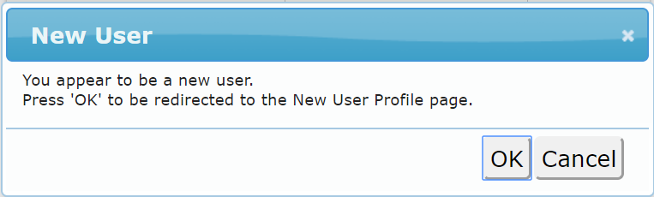
IF You Do Not Have a BIA ID:
THEN you will see a screen like this:
NEXT: Click on the OK to create your BIA ID
You can also Click Here for a direct link to new user creation page.
See section below, How to Create Your BIA ID, for further details
Notes:
5

Slide 6
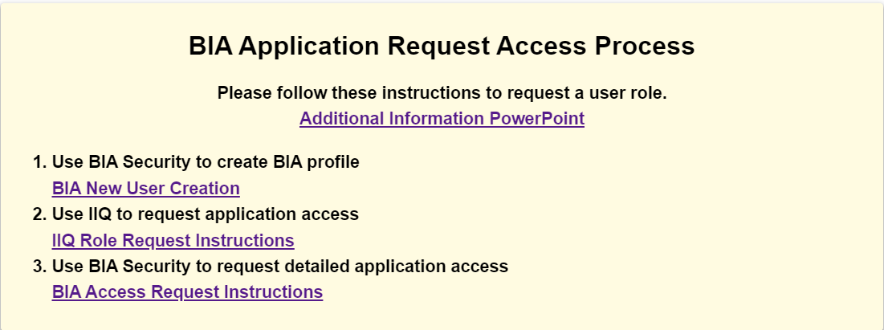
IF You Have No IIQ Access:
THEN you will see a screen like this:
NEXT: Click on link to request access via IIQ
See section below, How to Request Access in IIQ, for further details

Slide 7
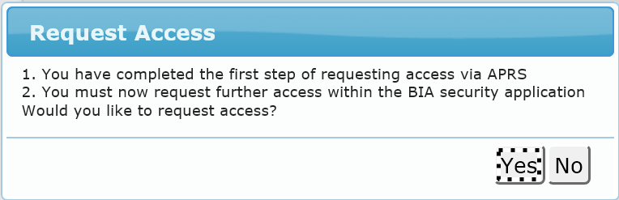
IF You Have IIQ Access But Not BIA Security Access:
THEN you will see a screen like this:
NEXT: Click on the Yes button to request access in BIA Security
See section below, How to Request Access in BIA Security, for further details

Slide 8
How to Create Your BIA ID

Slide 9
BIA Profile Creation
1. You will see the image below when trying to access app and do not have a BIA profile. Click Here for a direct link to new user creation page.
Notes:
9

Slide 10
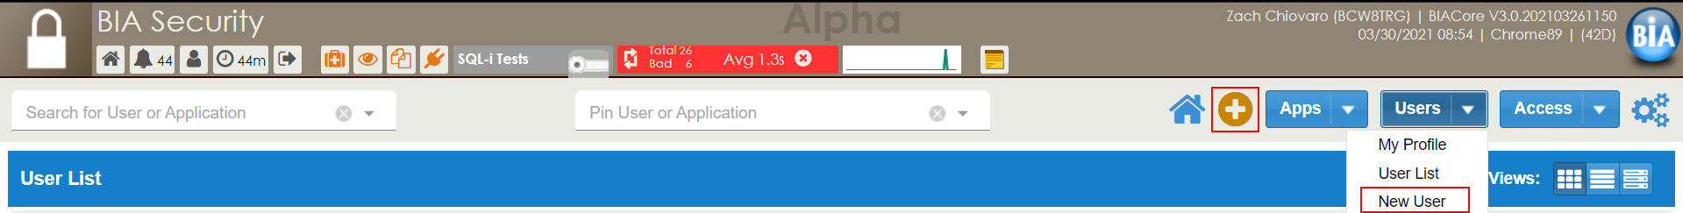
BIA Profile Creation
2. Select New User from the Users dropdown or press the orange + button while viewing the User List.
Notes:
10

Slide 11
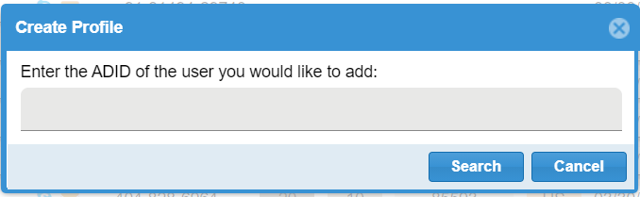
BIA Profile Creation
3. Enter a valid ADID. Hit Search.
Notes:
11

Slide 12
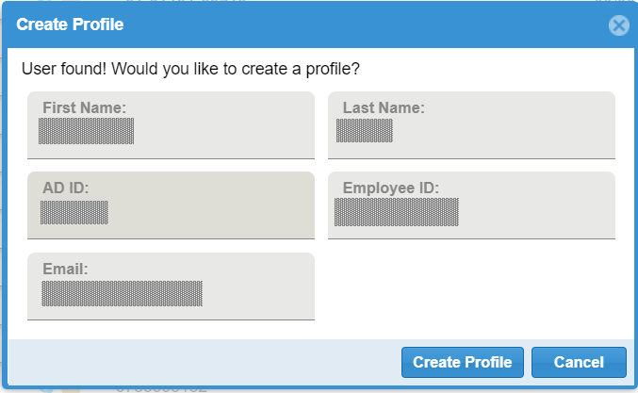
BIA Profile Creation
4. User profile info will be automatically generated. Hit Create Profile.
Notes:
12

Slide 13
How to Request BIA application in IIQ

Slide 14
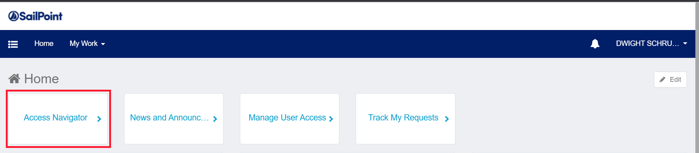
IIQ Request Steps
1. Log in to IIQ using this link using ADID:
https://iiq.inside.ups.com/iiqcertification/
2. Select “Access Navigator" in the menu.
Notes:
14

Slide 15
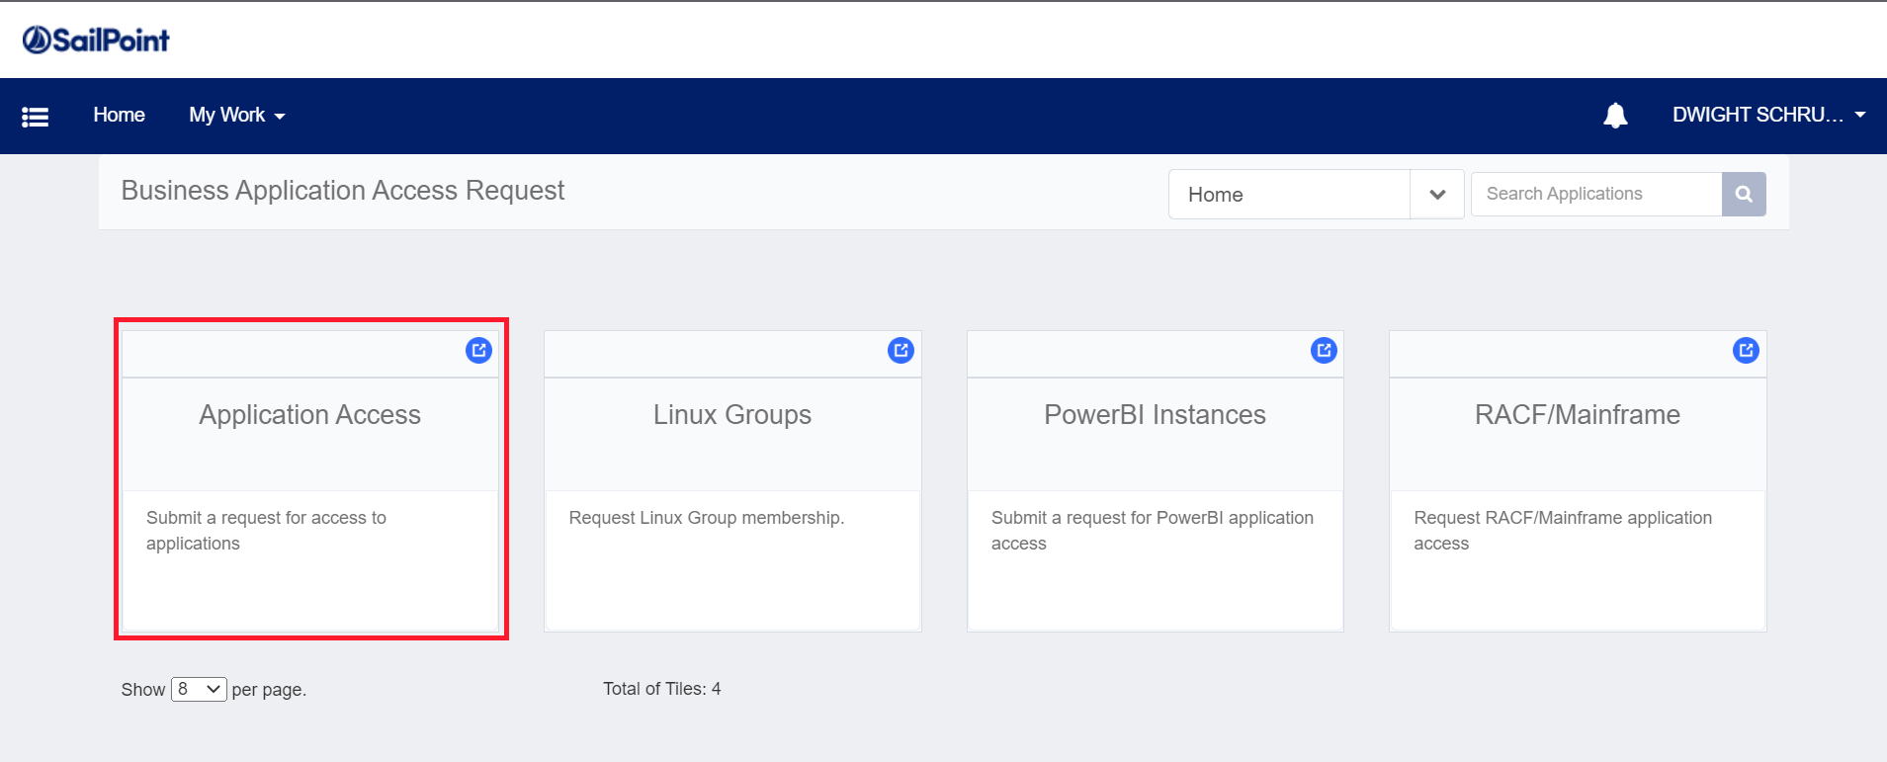
IIQ Request Steps
3. Select “Application Access" in the menu.
.
Notes:
15

Slide 16
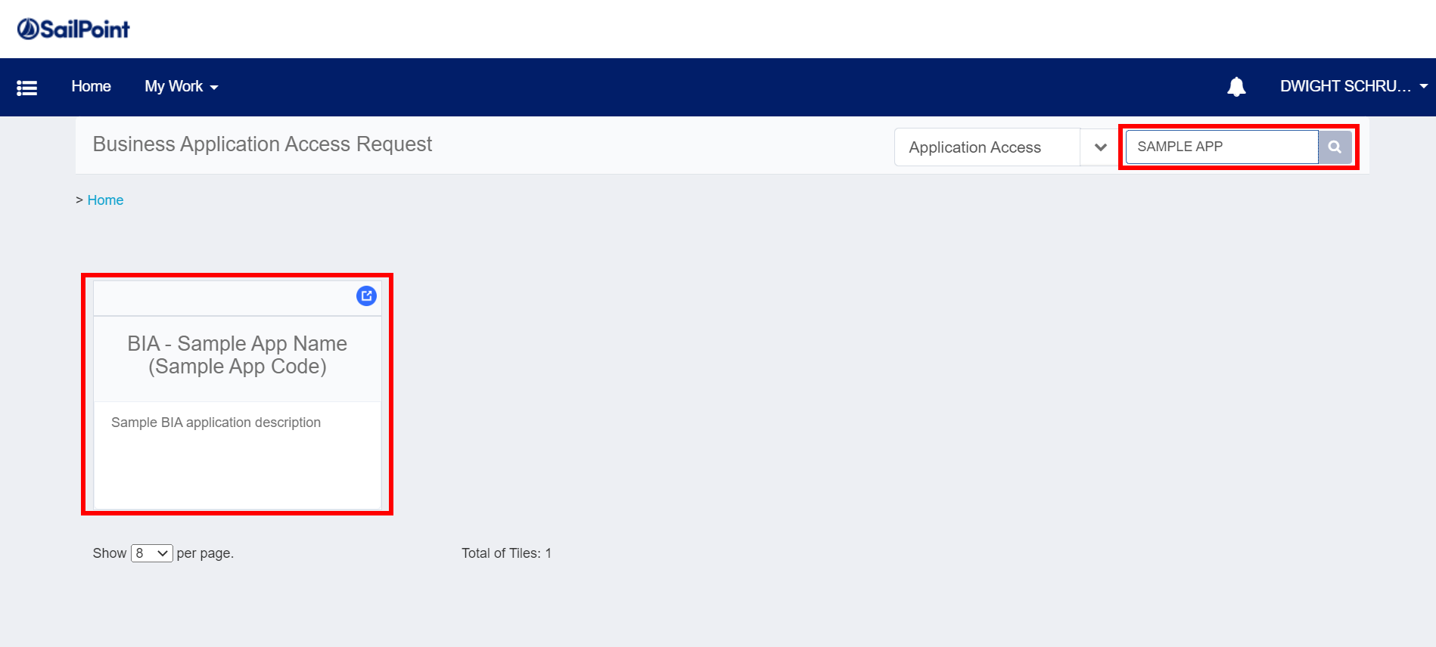
IIQ Request Steps
4. Search for application name or code
5. Click the application’s card
Notes:
16

Slide 17
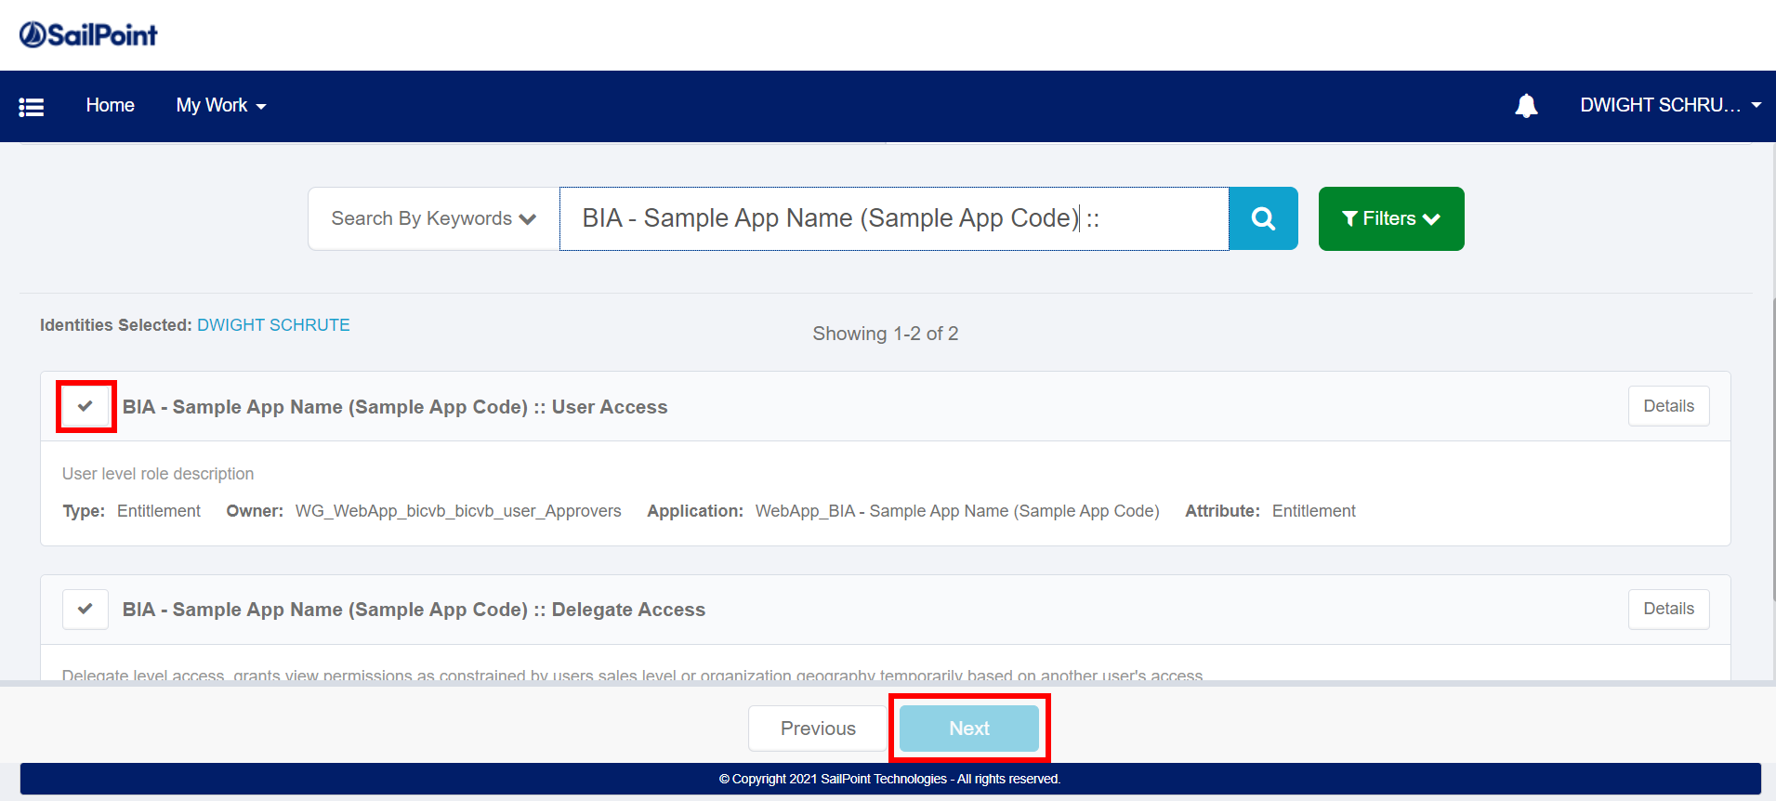
IIQ Request Steps
5. Select the application role(s) and click Next.
Notes:
17

Slide 18
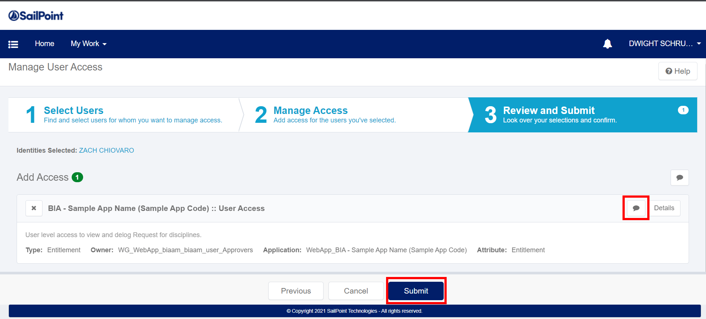
IIQ Request Steps
6. Select comment icon to enter reason for application access and then click Submit.
7. An email will be sent to your supervisor for approval.
Notes:
18

Slide 19
How to Request BIA application in
BIA Security

Slide 20
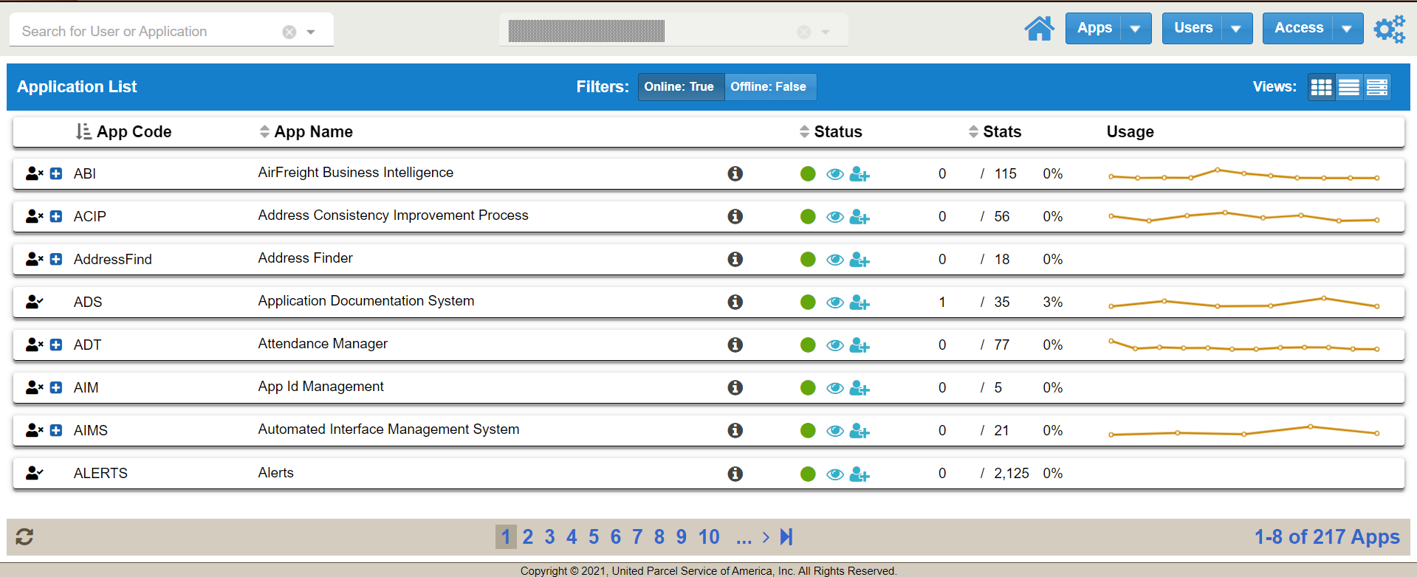
BIA Application Access Request Steps
Login to BIA Security using this link:
https://biasecurity.bia.inside.ups.com/
Notes:
20

Slide 21

BIA Application Access Request Steps
2. User the Search field to find the needed app. Click the blue + button next to an app to request access.
Notes:
21

Slide 22
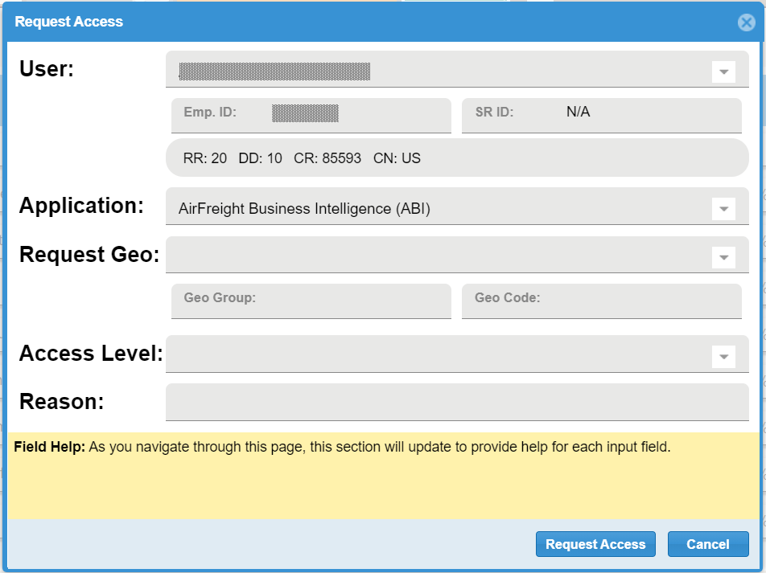
BIA Application Access Request Steps
3. Provide Request Geo, Access Level and a detailed Reason. Hit Request Access. The app manager will be notified of your request and will review.
Notes:
22

