Slide 1
FINAL PROJECT · VIBE CODING CEDIA 2026
Vibe Coding Platform
Practice software development and image analysis with AI
Francisco Higuera (UTE) · Carlos Bermeo (UTPL) · Programming and Communication & Arts
Guides 02 and 18 · Research image analysis and educational simulation
Narration generated with an AI voice (ElevenLabs) and reviewed by the authors.
Vibe Coding CEDIA 2026 · Universidad UTE · UTPL
1 / 10
Notes:
COVER
Vibe Coding Platform. We are Francisco Higuera, from U T E, and Carlos Bermeo, from U T P L. We built a platform to practice software development and image analysis with artificial intelligence.

Slide 2
FINAL PROJECT · VIBE CODING CEDIA 2026
The problem
The task: turning a textbook model into code you can check.
A CONCRETE EXAMPLE
Example: distance = speed × time, never run or checked.
Vibe Coding CEDIA 2026 · Universidad UTE · UTPL
2 / 10
Notes:
PART A · PRESENTATION (3 min in total)
Students in the course learn a model or a counting rule in theory. They rarely turn it into code they can run and check. For example, someone works out that at sixty kilometers per hour, in two hours, you travel one hundred twenty kilometers. But they never build an activity where they predict that result and compare it with what a program calculates. The same gap shows up when counting objects in research photographs by eye. Without that practice, the learning stays on the whiteboard.

Slide 3
FINAL PROJECT · VIBE CODING CEDIA 2026
The tool
WHO USES IT
WHAT GOES IN
WHAT COMES OUT
Students and instructors in the course
A practice with objectives and instructions
Evaluated result and AI feedback
Vibe Coding CEDIA 2026 · Universidad UTE · UTPL
3 / 10
Notes:
THE TOOL · NARRATION · ≈30 s · 70–80 words
We built Vibe Coding Platform for students and instructors. The student picks a practice and builds it with help from an artificial intelligence tutor. Then the student submits the result. The instructor publishes practices, organizes categories, assigns roles, and reviews each student's progress. The platform combines two course guides: the interactive prediction activity and the image counting rule. It follows a clean, hexagonal architecture on both the server and the browser.

Slide 4
FINAL PROJECT · VIBE CODING CEDIA 2026
How it works
1 · INPUT
2 · AI
3 · REVIEW
4 · RESULT
Picks a practice, predicts a result
Hints, with a limit on iterations
Decides when to submit the result
Evaluation and progress recorded
A person always decides.
Vibe Coding CEDIA 2026 · Universidad UTE · UTPL
4 / 10
Notes:
HOW IT WORKS · NARRATION · ≈40 s · 95–105 words
The student predicts a result before seeing any control, exactly as the guide asks. Then the student adjusts speed and time. A program calculates the distance; the language model never invents the number. The artificial intelligence tutor offers hints and feedback. It has a fixed limit of eight iterations and a token limit. It logs every tool call in its own table, so every decision can be traced later. We chose a hand written, deterministic flow over an open ended agent framework, for safety. The person always decides when to submit the result. An instructor reviews the cases that need manual evaluation.

Slide 5
FINAL PROJECT · VIBE CODING CEDIA 2026
Evidence that it works
68
19
0
server tests, all passed
browser tests, all passed
invented or estimated values
Verified with automated tests and a real production deployment.
Vibe Coding CEDIA 2026 · Universidad UTE · UTPL
5 / 10
Notes:
EVIDENCE · NARRATION · ≈35 s · 80–90 words
We checked the platform with sixty eight automated server tests and nineteen automated browser tests. All of them passed. We tested the image counting rule against photographs with zero, one, two, and several objects, including a blurry one. The rule correctly marked the blurry photo as illegible instead of guessing a count. We deployed the platform on a real server, without Docker containers. That avoided overloading a server shared with other university projects. We confirmed the instructor team's login working in production.

Slide 6
FINAL PROJECT · VIBE CODING CEDIA 2026
Limits and responsible use
WHAT IT DOES NOT DO
DATA AND PRIVACY
NEXT STEP
Does not train its own model
No real personal data in screenshots
More languages and help narration
Vibe Coding CEDIA 2026 · Universidad UTE · UTPL
6 / 10
Notes:
LIMITS AND RESPONSIBLE USE · NARRATION · ≈25 s · 55–65 words
The image counting rule is an explicit formula, not a trained model. It declares when an image is illegible instead of guessing. The artificial intelligence tutor never runs an administrative action; a person always does that. The screenshots in this presentation show no real personal data. The next step is adding more languages, help narration, and a tighter Moodle integration.

Slide 7
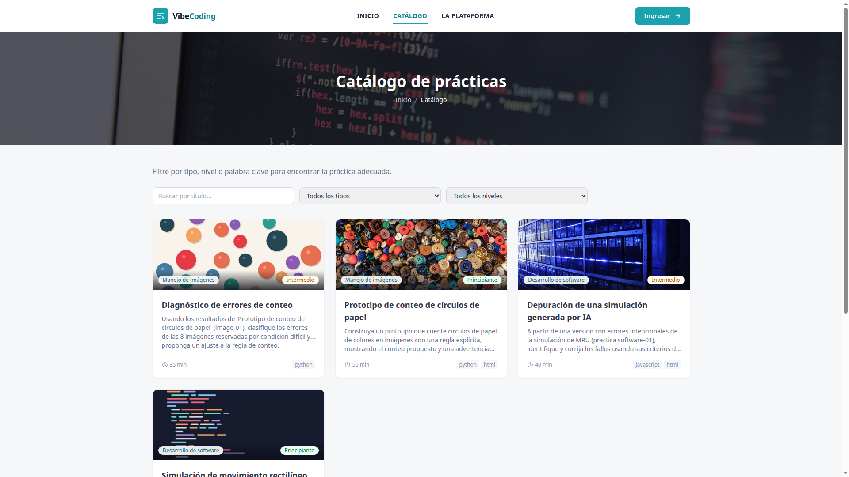
FINAL PROJECT · VIBE CODING CEDIA 2026
Demo · Input
Catalog of published practices
Vibe Coding CEDIA 2026 · Universidad UTE · UTPL
7 / 10
Notes:
PART B · DEMO (2 min in total)
This is the start screen. The person picks a practice from the catalog. They filter by type, difficulty level, or keyword. They read the objectives and the instructions before starting. We show the catalog with the four published practices. Two are software development practices, and two are image handling practices. Each card shows its cover image, its difficulty level, and its estimated duration in minutes. The interface shown here is in Spanish.

Slide 8
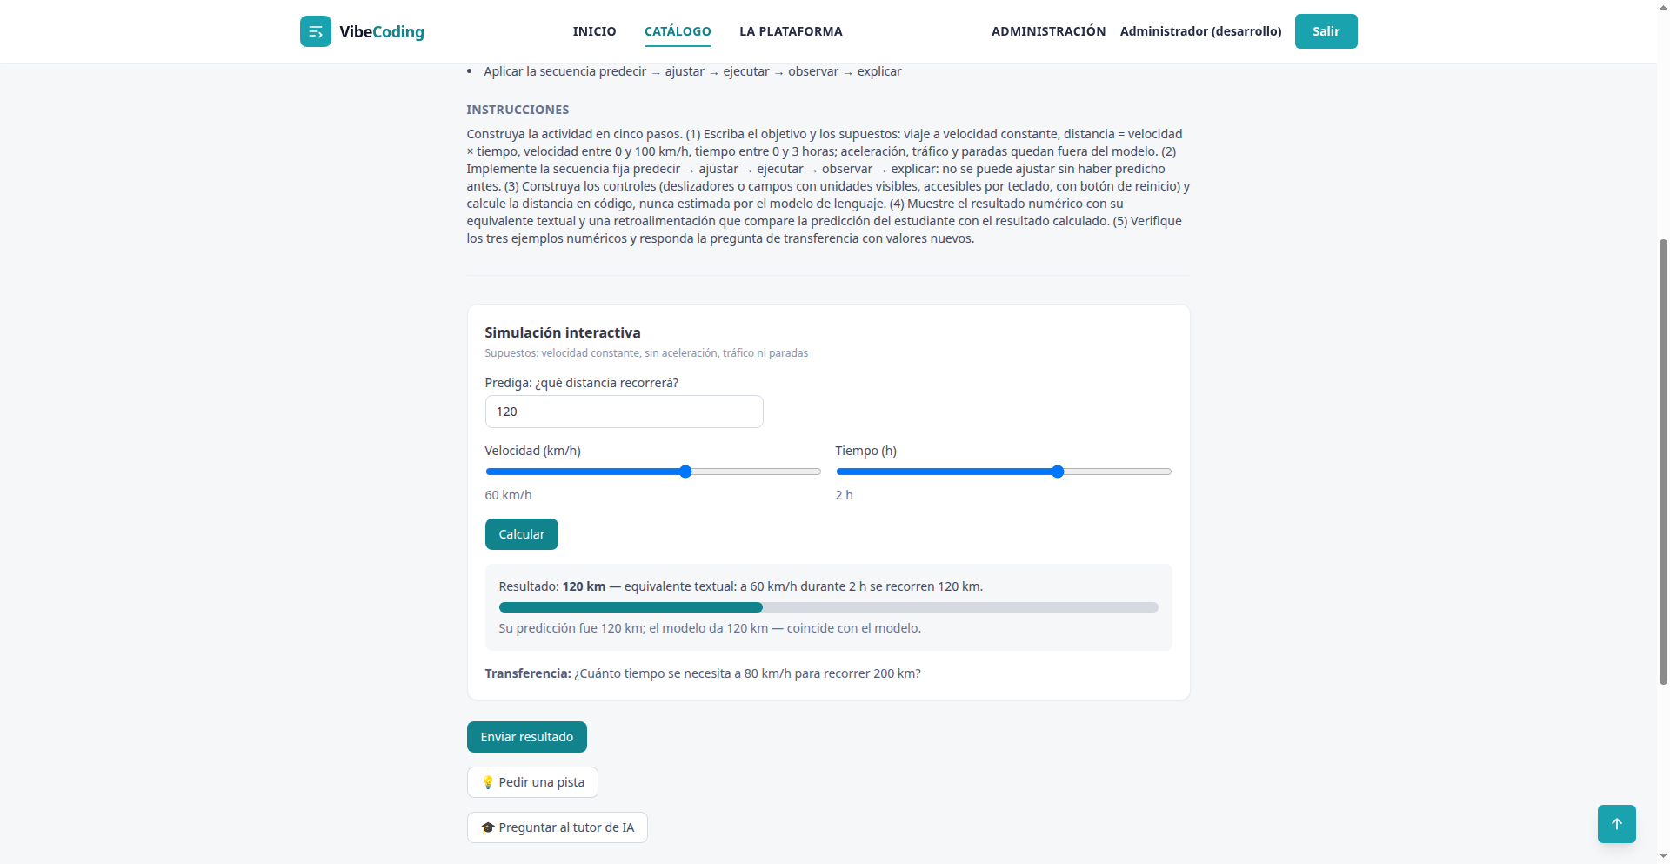
FINAL PROJECT · VIBE CODING CEDIA 2026
Demo · Result
Calculated result and feedback on the prediction
Vibe Coding CEDIA 2026 · Universidad UTE · UTPL
8 / 10
Notes:
NARRATION · ≈35 s · 80–90 words in English
Here the person predicted one hundred twenty kilometers before adjusting the controls. They chose sixty kilometers per hour and two hours. The program calculates one hundred twenty kilometers in code, never with the language model. It shows the number together with its text equivalent, for accessibility. The controls work with a keyboard and always show their units. The feedback compares the prediction with the result and says they match, naming the direct proportion. The activity also asks a transfer question with new values.

Slide 9
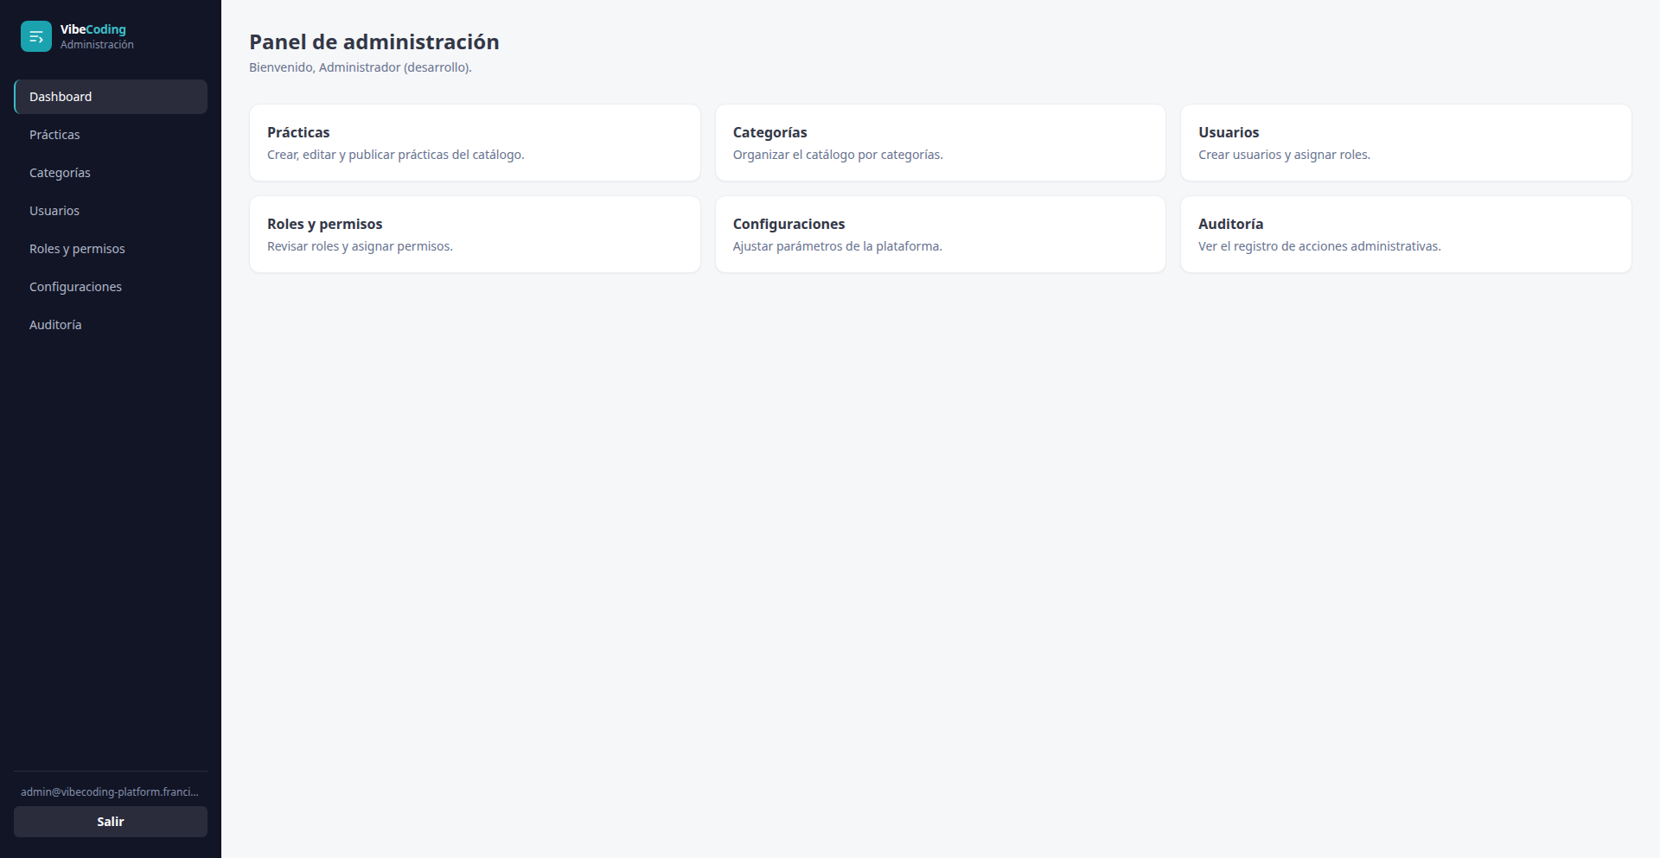
FINAL PROJECT · VIBE CODING CEDIA 2026
Demo · Review and delivery
Admin panel and audit log
Vibe Coding CEDIA 2026 · Universidad UTE · UTPL
9 / 10
Notes:
NARRATION · ≈30 s · 70–80 words in English
In the admin panel, an instructor reviews practices, categories, users, roles, and permissions. They also review the audit log, which records who did what and when across the platform. Each student submission is saved with its evaluation. Cases that need manual review appear clearly marked. A person decides those cases, never the artificial intelligence. This screen shows the full record, with role based access control enforced on every action. Only an administrator can assign roles.

Slide 10
FINAL PROJECT · VIBE CODING CEDIA 2026
Practicing, not just explaining, with real feedback
More languages and help narration are coming next.
vibe-coding-platform.franciscohiguera.site
Francisco Higuera (UTE) · Carlos Bermeo (UTPL) · Programming and Communication & Arts
Vibe Coding CEDIA 2026 · Universidad UTE · UTPL
10 / 10
Notes:
CLOSE · NARRATION · ≈25 s · 55–65 words
Vibe Coding Platform changes how we teach. It helps students predict, build, and check, instead of only explaining on a whiteboard. The next step is adding help narration with artificial intelligence, more languages, and a deeper Moodle integration. We invite you to explore the catalog, try a practice, and write to us with your questions. Thank you for your attention.

