Slide 1
On Weather and its Affects on Chicago Crime
A data driven analysis on how weather relates to crime rates
Francisco H | Mansi S | and John Y

Slide 2
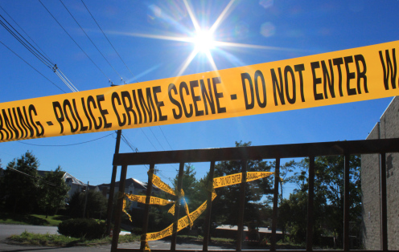
Question
How does weather affect crime in Chicago?
Hypothesis
Warmer weather is responsible for more people outside and more chances for street crimes to occur.
Prediction
Of the weather metrics looked at, temperature will have the strongest, positive correlation to crime.

Slide 3

The Data: Sources
Weather Data
Crime Data
Open Weather Map
6 years of data for 1 city = $10
JSON file
https://openweathermap.org/history-bulk
Chicago Data Portal
Free
CSV file
https://data.cityofchicago.org/Public-Safety/Crimes-2018/3i3m-jwuy

Slide 4
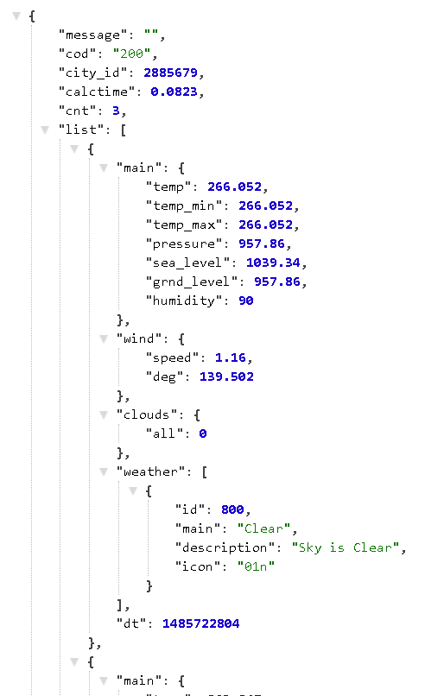
The Data: Weather Exploration
JSON file provided easy handling of data
Feeling loopy
Date and Three weather metrics (Max Temp, Humidity, and Cloudiness)
Some Hiccups
Date was UNIX timestamp (1349096400)
JSON entries by the hour
Temperature in Kelvin, not Fahrenheit
Missing dates (8/8/2014-6/12/2015)

Slide 5
The Data: Weather Cleanup
UNIX timestamp
Hourly JSON entries
Temperature in Kelvin
Missing dates
pd.to_datetime function
dt.date function
pyt.k2f function
dropna after merging
1349096400 to 2012-10-01 13:00:00
Take only y/m/d then .mean
287.59 K to 57.97 F
Avoid skewed data

Slide 6
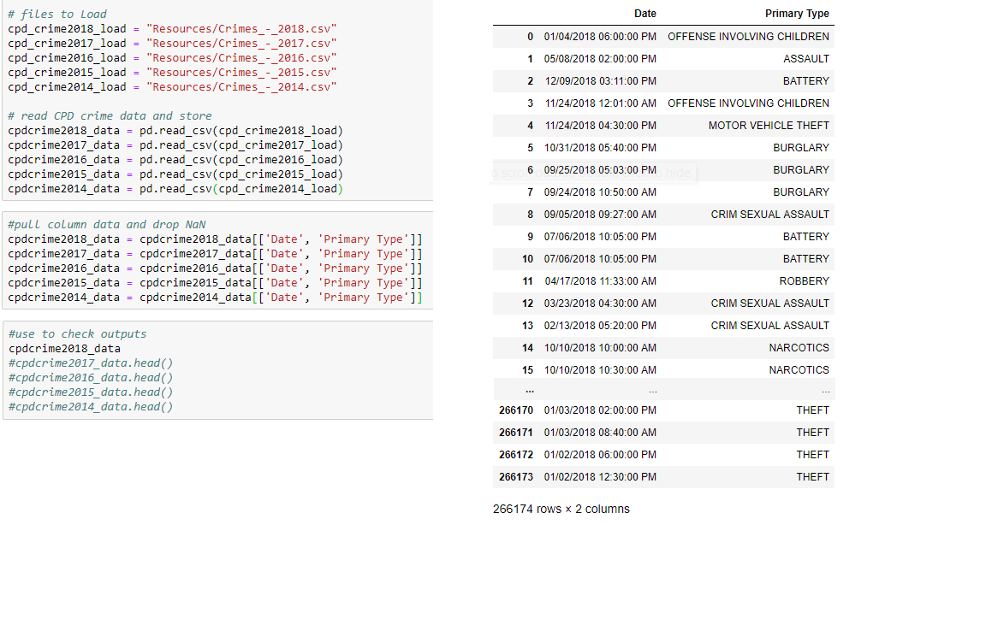
The Data: Weather Exploration
The Easiest Part!
Load in the huge amounts of data
Extract the data we need

Slide 7
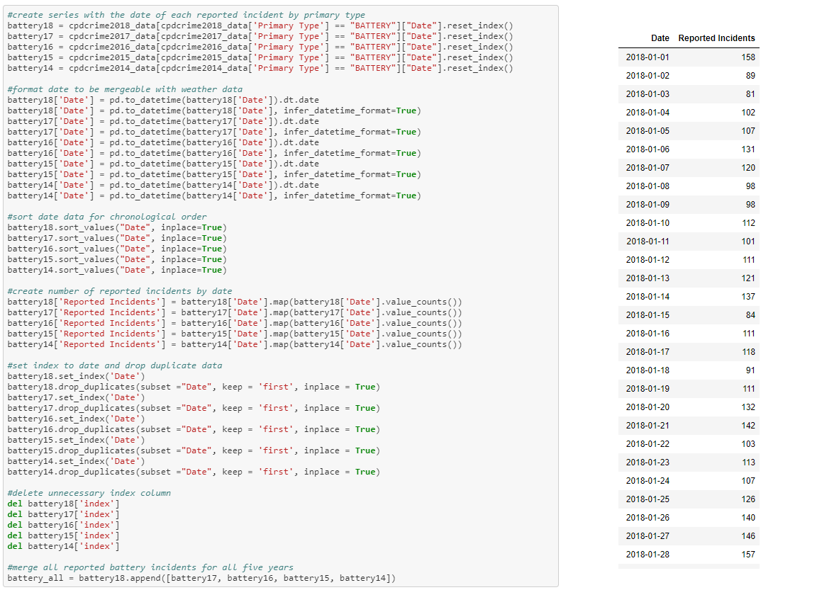
The Data: Crime Exploration

Slide 8
The Data: Crime Cleanup

Slide 9
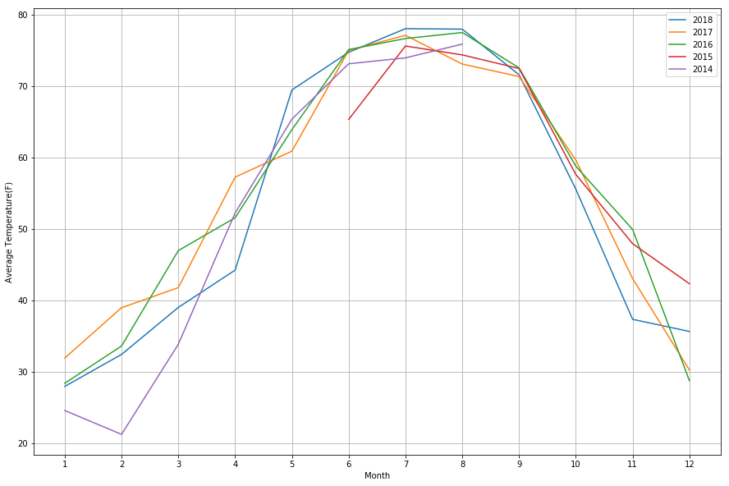
The Data: Analysis Process
Let us first look at trend in temperature in the past 5 years.
The incomplete line is due to insufficient data that wasn’t recorded from August 2014 to June 2015

Slide 10
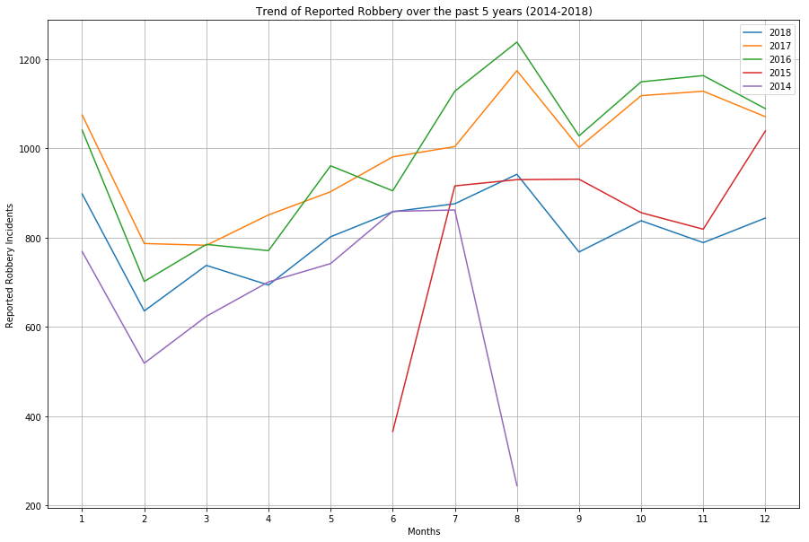
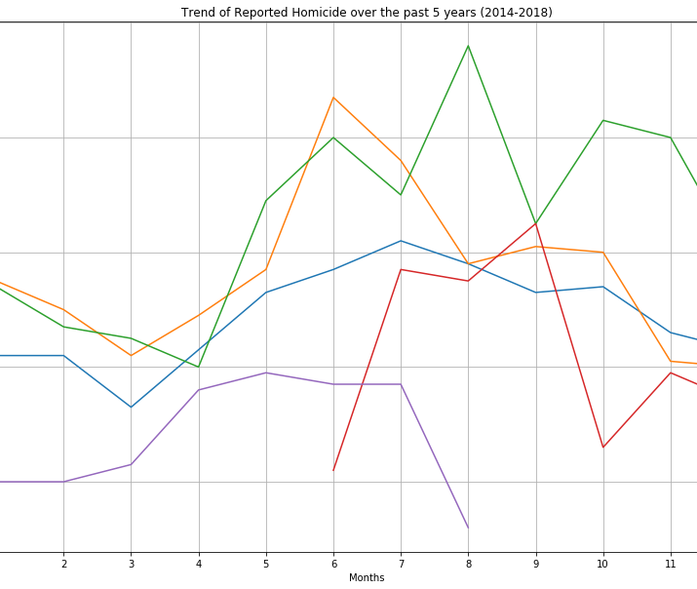
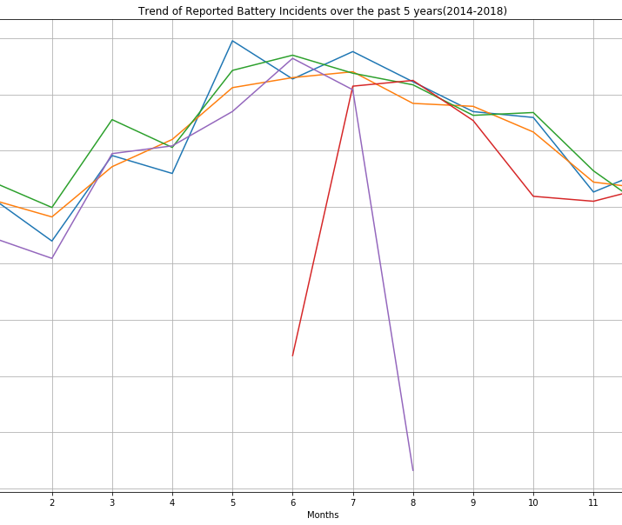
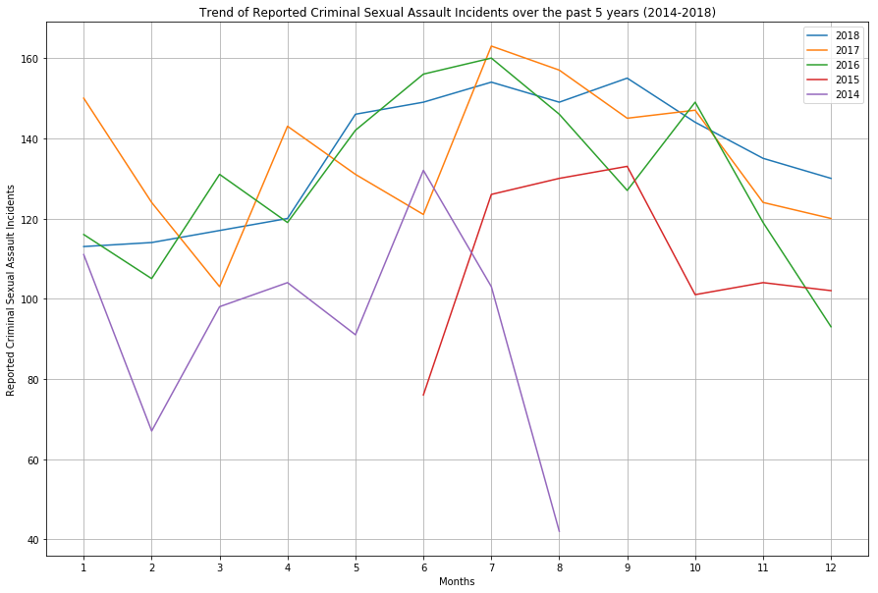
Now let’s take a look at the Trend in 4 Categories of Violent Crimes in the past 5 years

Slide 11
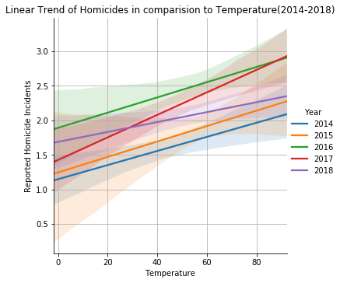
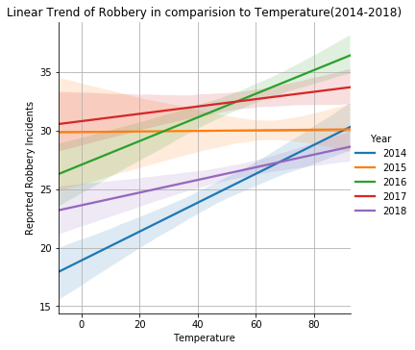
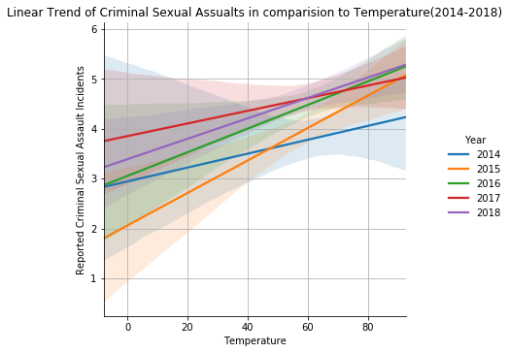
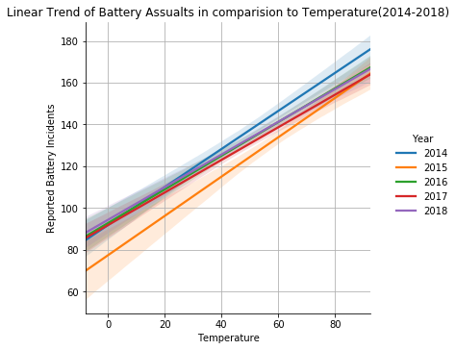
Does a hot summer mean more crime? Here's what the data shows:

Slide 12
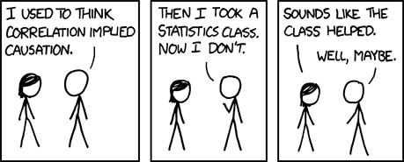
Statistical Analysis: Pearson Correlation
correlation coefficient is a measure of the strength of the linear relationship between two variables.
A perfect positive linear relationship, r = 1.
A perfect negative linear relationship, r = -1.

Slide 13
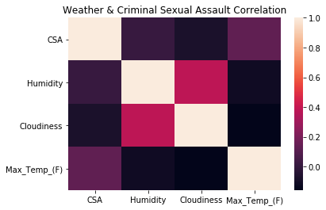
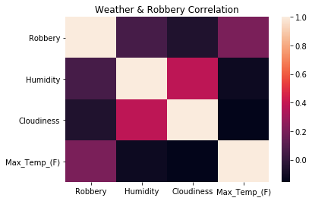
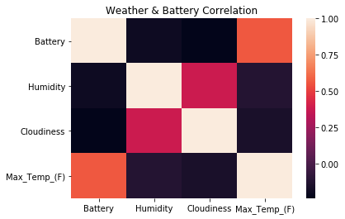
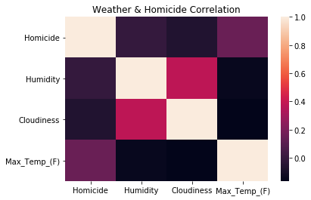
Weather & Crime: Pearson Correlation

Slide 14
Discuss the implications of your findings. This is where you get to have an open-ended discussion about what your findings "mean".

