Slide 1
On Weather and its Affects on Chicago Crime
A data driven analysis on how weather relates to crime rates
Francisco H | Mansi S | and John Y

Slide 2
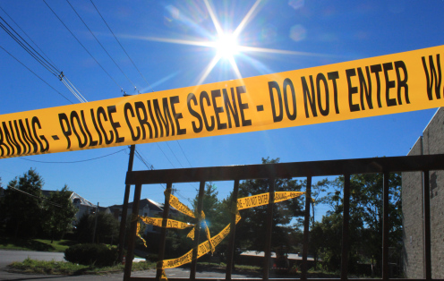
Question
How does weather affect crime in Chicago?
Hypothesis
Warmer weather is responsible for more people outside and more chances for street crimes to occur.
Prediction
With a jump in avg. high temperature of as little as 10 degrees, crime will jump 5%.

Slide 3

The Data: Sources
Weather Data
Crime Data
Open Weather Map
6 years of data for 1 city = $10
JSON file
https://openweathermap.org/history-bulk
Chicago Data Portal
Free
CSV file
https://data.cityofchicago.org/Public-Safety/Crimes-2018/3i3m-jwuy

Slide 4
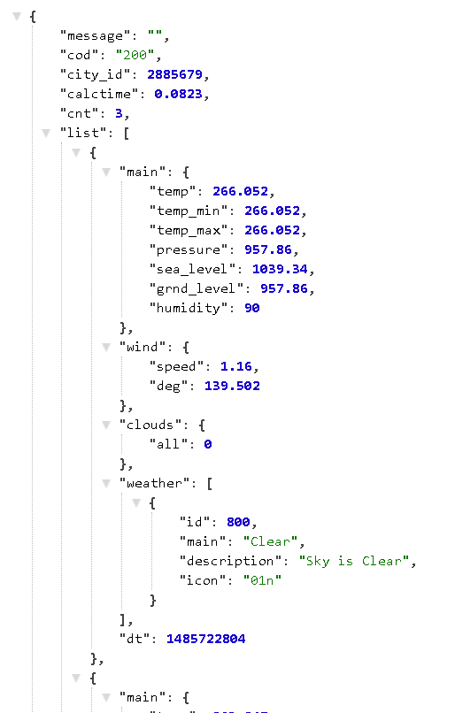
The Data: Weather Exploration

Slide 5
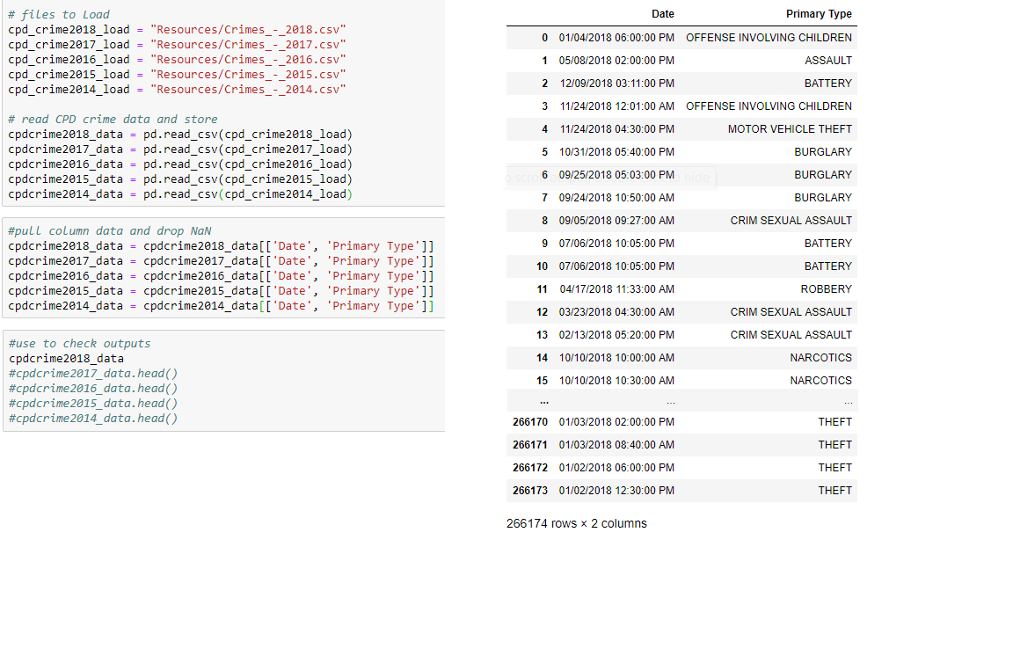
The Data: Weather Exploration
The Easiest Part!
Load in the huge amounts of data
Extract the data we need

Slide 6
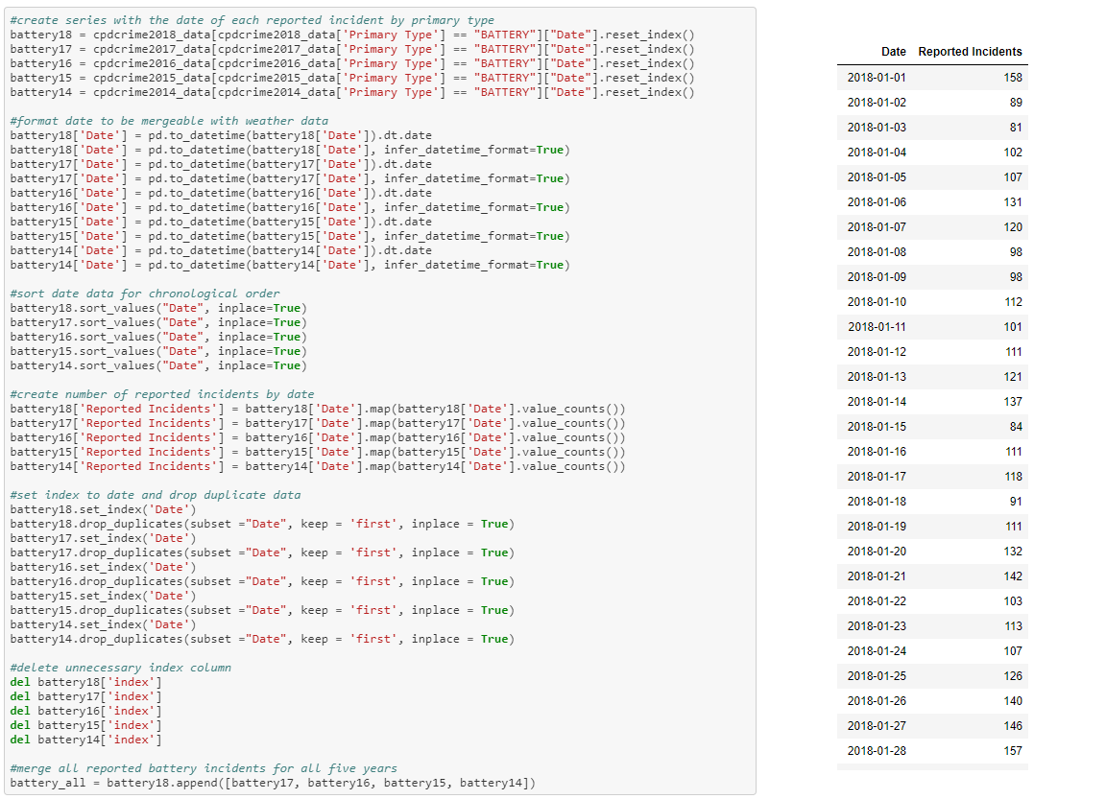
The Data: Crime Exploration

Slide 7
The Data: Crime Cleanup

