Slide 1
On Weather and its Affects on Chicago Crime
A data driven analysis on how weather relates to crime rates
Francisco H | Mansi S | and John Y

Slide 2
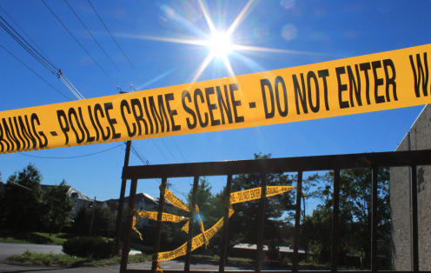
Question
How does weather affect crime in Chicago?
Hypothesis
Warmer weather is responsible for more people outside and more chances for street crimes to occur.
Prediction
With a jump in avg. high temperature of as little as 10 degrees, crime will jump 5%.

Slide 3

The Data: Sources
Weather Data
Crime Data
Open Weather Map
6 years of data for 1 city = $10
JSON file
https://openweathermap.org/history-bulk
Chicago Data Portal
Free
CSV file
https://data.cityofchicago.org/Public-Safety/Crimes-2018/3i3m-jwuy

Slide 4
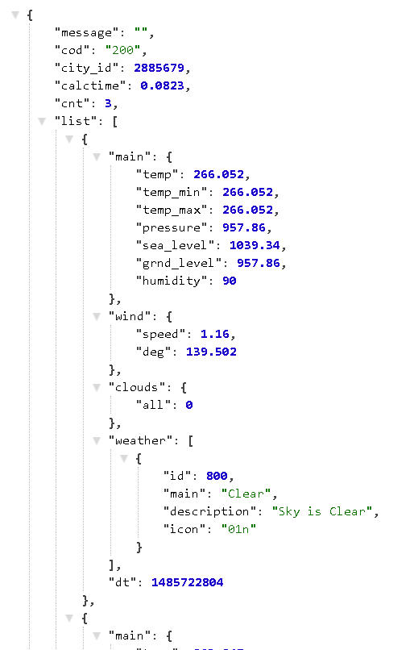
The Data: Weather Exploration

Slide 5
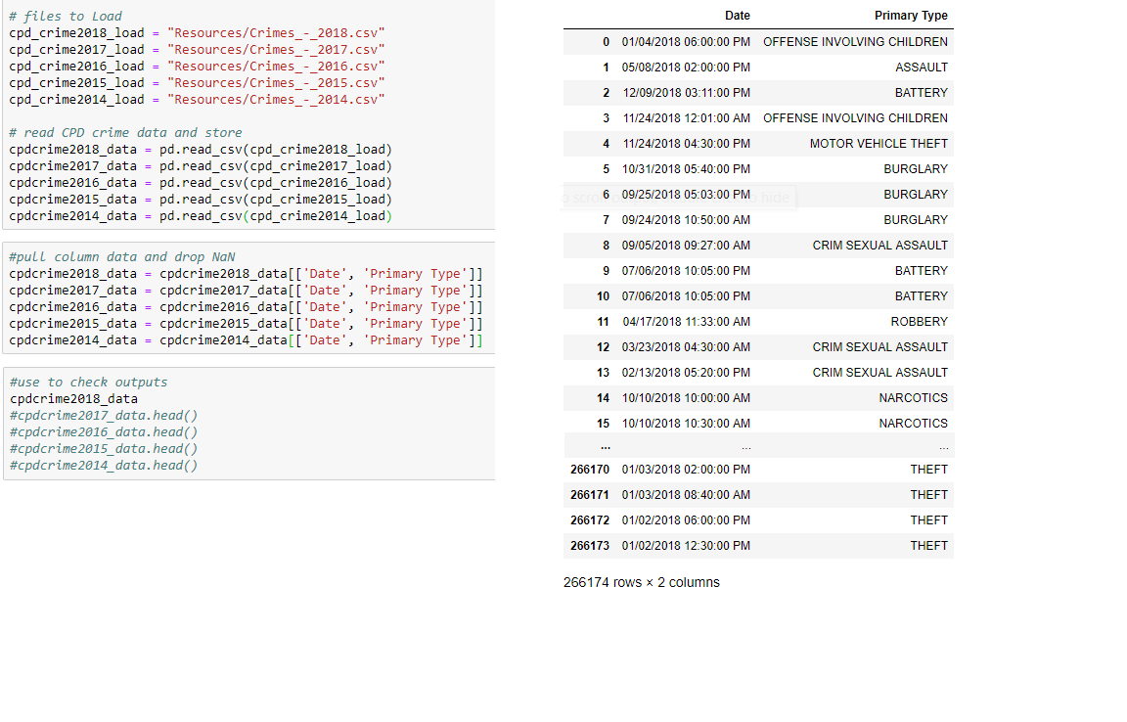
The Data:
Crime Exploration
The Easiest Part!
Load in the huge amounts of data
Extract the general data we need

Slide 6
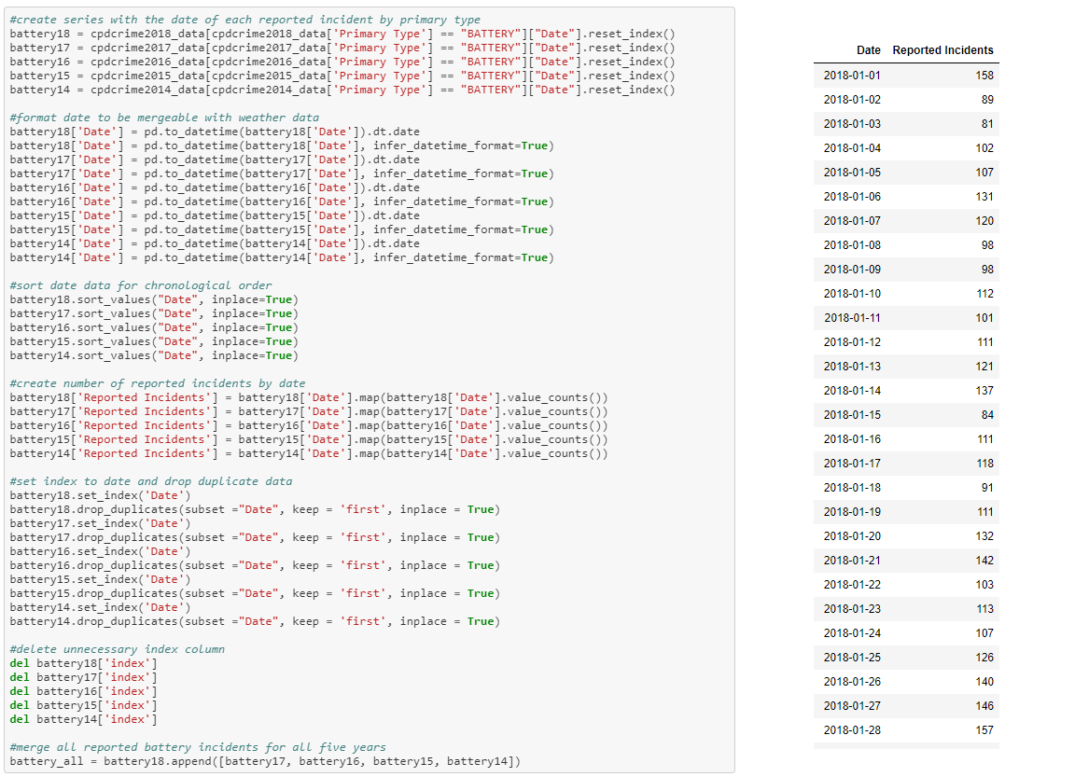
The Data:
Crime Cleanup
First we pulled the specific crime we wanted to look at and saved the date of each reported incident
Next we format the date so it can be mergeable with OpenWeatherMap data
Then we sort by date to make it easier to look at

Slide 7
The Data: Crime Cleanup

