Slide 1
TP3 - Communication Protocols
Lab 1 - Raw 8-bit Ethernet Stream
Vasquez Curetti Francisco Javier
ethernet-phy-labs / lab1-raw-ethernet . test payload: 0xCAFE0001

Slide 2
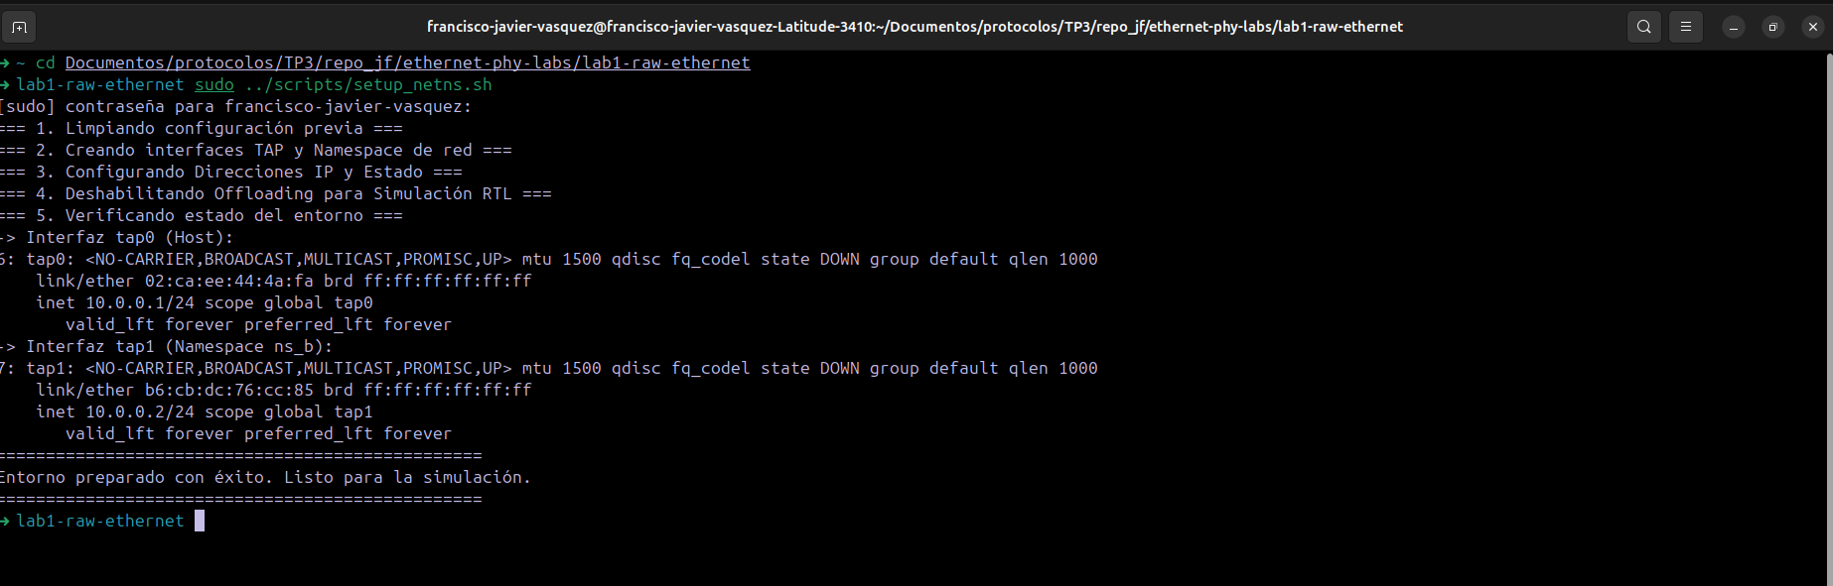
TP3 - Communication Protocols - Lab 1
Testbench: network interfaces up and running
setup_netns.sh creates namespace ns_b and the TAP interfaces:
tap0 -> 10.0.0.1/24, MAC 02:ca:ee:44:4a:fa
tap1 -> 10.0.0.2/24, MAC b6:cb:dc:76:cc:85
2

Slide 3
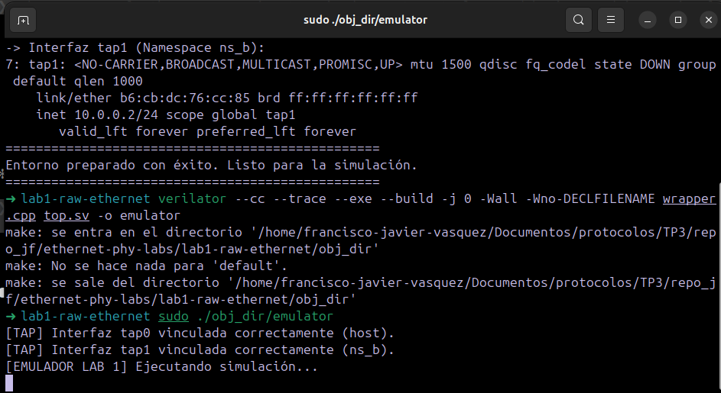
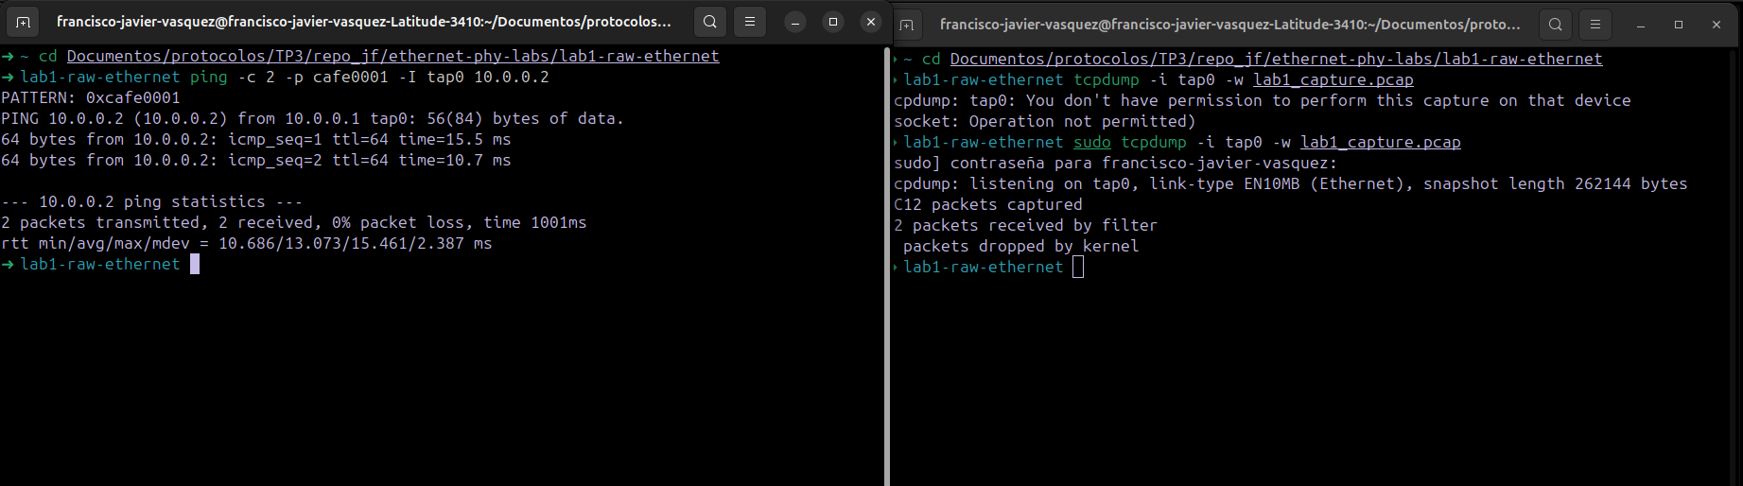
TP3 - Communication Protocols - Lab 1
Compiling the emulator and generating traffic
While [EMULADOR LAB 1] running:
ping -c 2 -p cafe0001 -I tap0 10.0.0.2
tcpdump captured 12 packets on tap0 during the test.
3

Slide 4
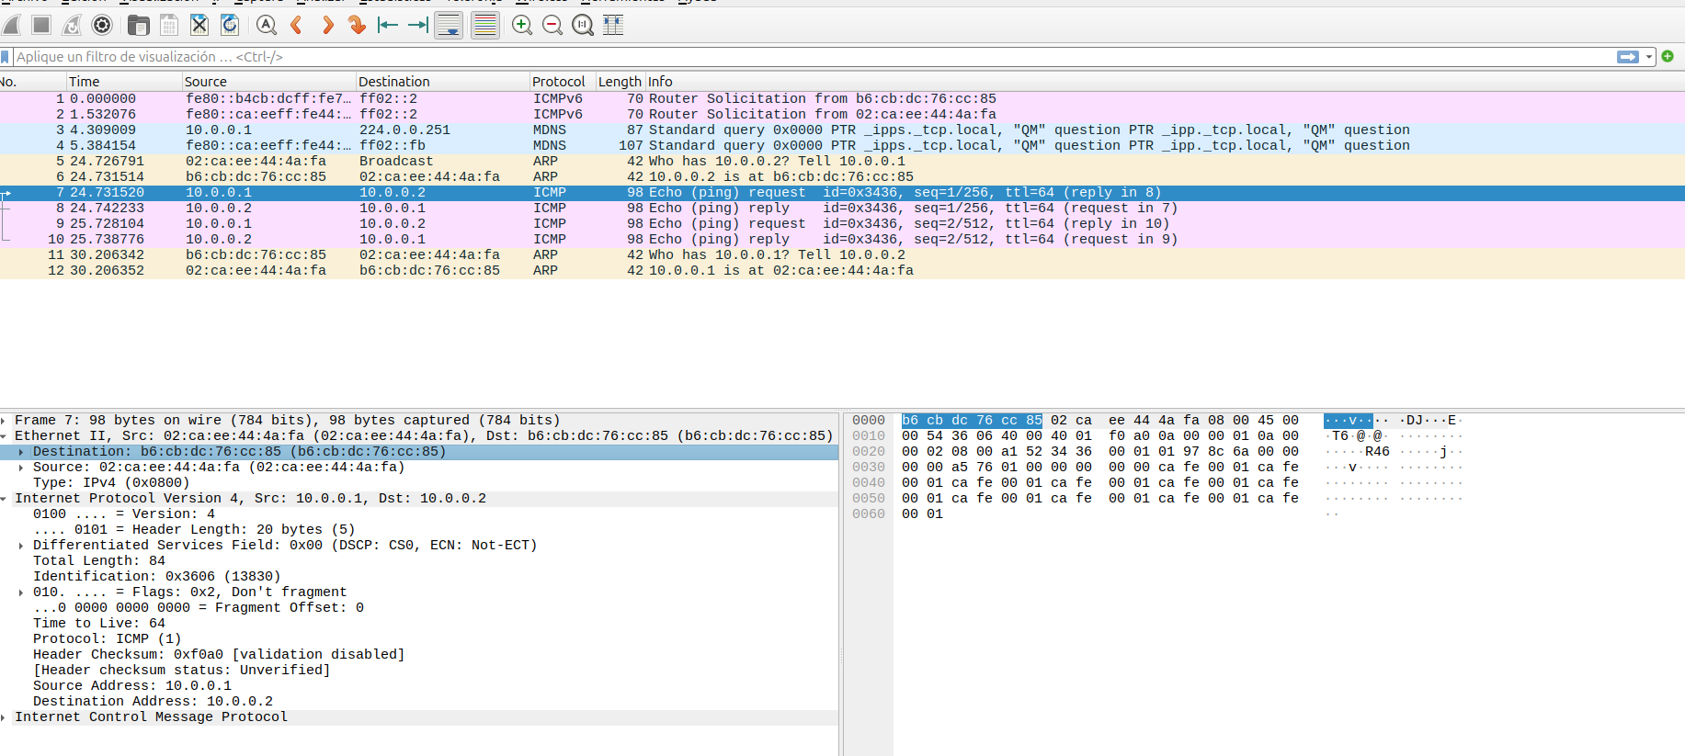
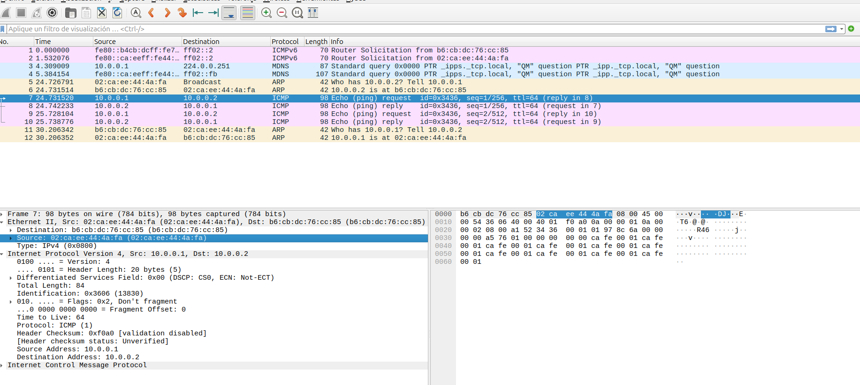
TP3 - Communication Protocols - Lab 1
What to expect: raw Ethernet II frame anatomy
Dst MAC - 6B
Src MAC - 6B
EtherType - 2B
Payload
No Preamble / SFD / FCS at this level: the Linux TAP hands over the frame already stripped of those PHY/MAC-added fields.
Wireshark - Echo Request: Dst b6:cb:dc:76:cc:85 . Src 02:ca:ee:44:4a:fa . EtherType 0x0800 . payload ca fe 00 01
4

Slide 5
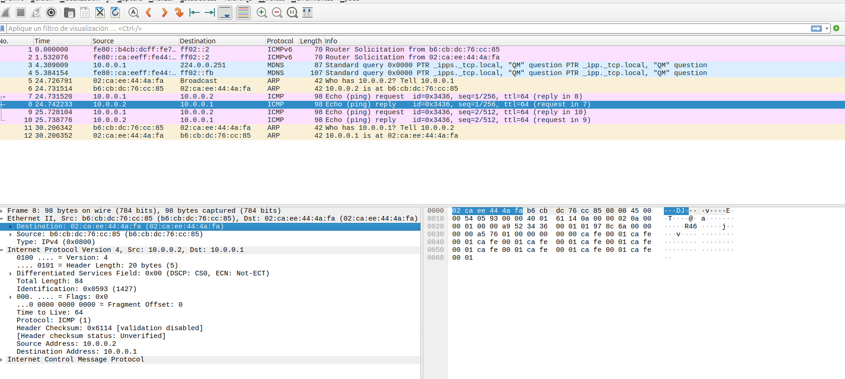
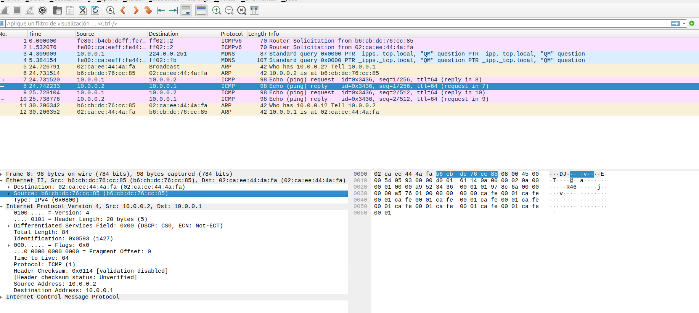
TP3 - Communication Protocols - Lab 1
Wireshark - Echo Reply (reversed direction)
Destination and source swap (10.0.0.2 -> 10.0.0.1).
5

Slide 6
TP3 - Communication Protocols - Lab 1
GTKWave - byte-for-byte match: start of frame
Dst MAC + Src MAC
Type
a_data_in[7:0] = B6 CB DC 76 CC 85 02 CA EE 44 4A FA 08 00 45 00
Identical to the Wireshark hex bytes, one byte per clock cycle.
a_valid_in stays high.
6

Slide 7
TP3 - Communication Protocols - Lab 1
GTKWave - byte-for-byte match: custom payload
Payload = CAFE0001
a_data_in[7:0] repeats CA FE 00 01 - the ping's custom pattern.
7

Slide 8
TP3 - Communication Protocols - Lab 1
GTKWave - request/reply handoff and pipeline latency
a_data_in finishes the Request (...01, a_valid_in->0) right as b_data_in starts the Reply (02 CA EE 44 4A FA B6 CB DC 76 CC 85...).
8

