Slide 1
TP3 - Communication Protocols
Lab 2 - 64-bit XGMII Interface
Vasquez Curetti Francisco Javier
ethernet-phy-labs / lab2-xgmii-64bit . test payload: 0xCAFE0001

Slide 2
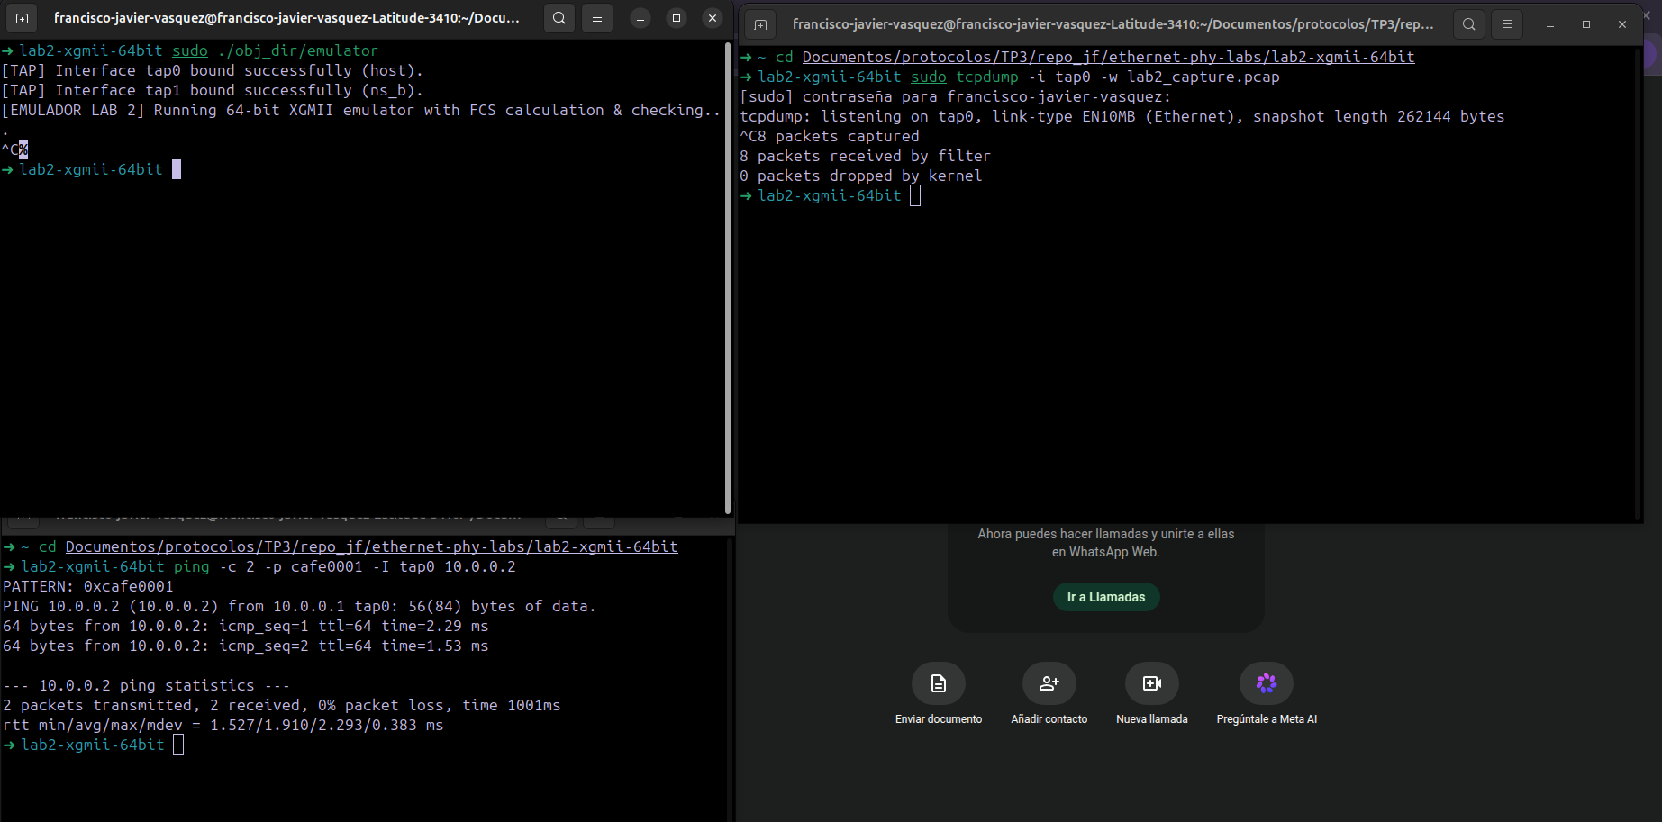
TP3 - Communication Protocols - Lab 2
Testbench: emulator, capture and traffic generation
While [EMULADOR LAB 2] Running 64-bit XGMII...
ping -c 2 -p cafe0001 -I tap0 10.0.0.2 → tcpdump: 8 packets captured on tap0.
2

Slide 3
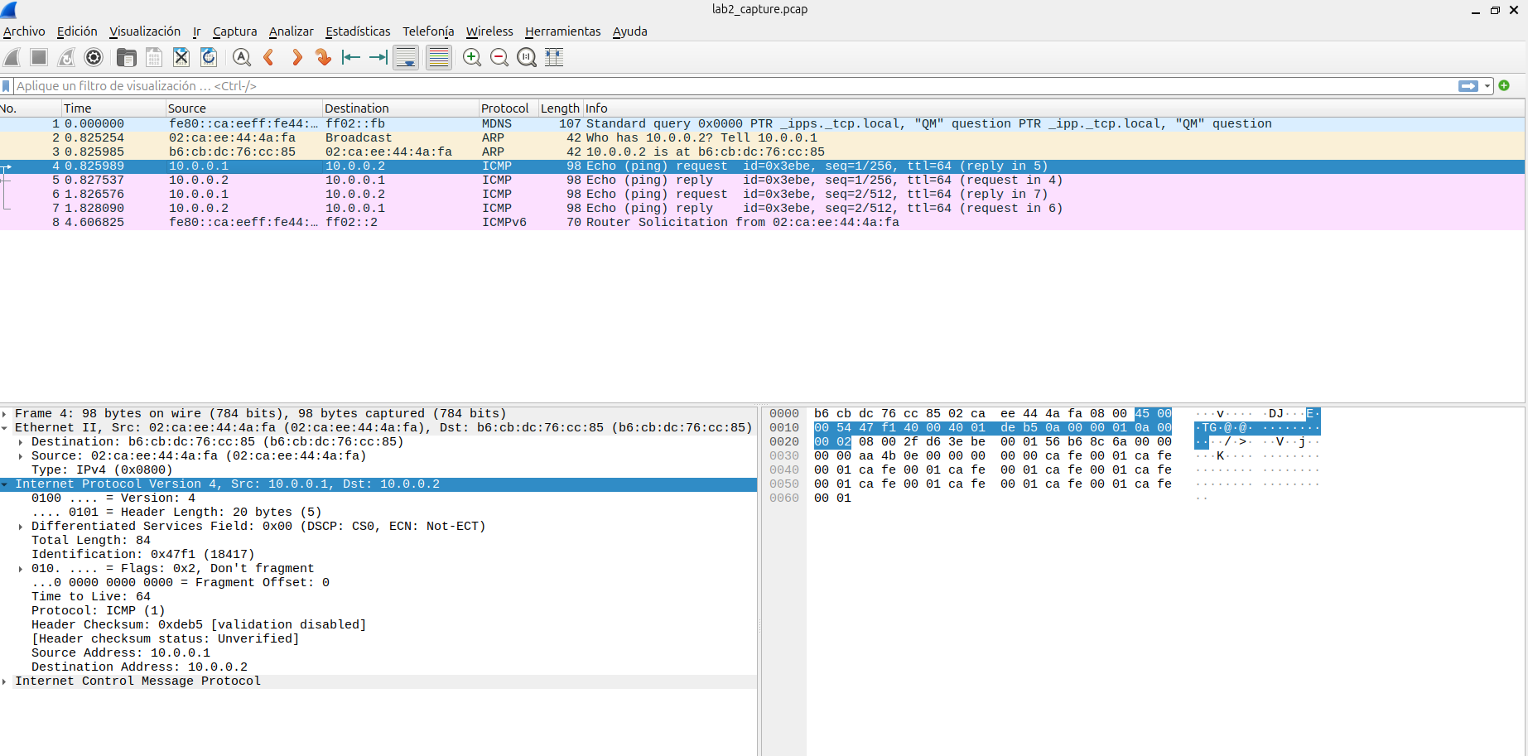
TP3 - Communication Protocols - Lab 2
Wireshark - Echo Request/Reply, EtherType and payload
Type: IPv4 (0x0800) . Dst b6:cb:dc:76:cc:85 / Src 02:ca:ee:44:4a:fa . payload ca fe 00 01.
Same 2 Request/Reply pairs as Lab 1.
3

Slide 4
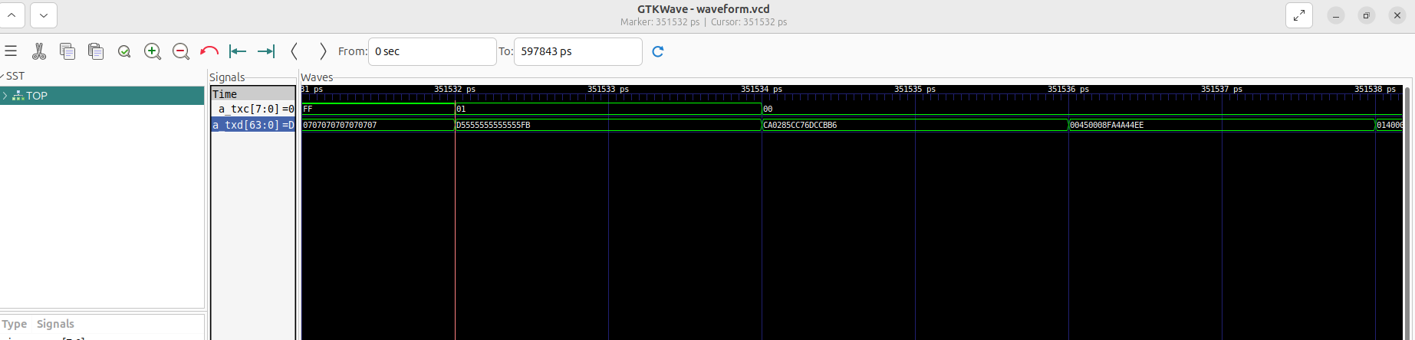
TP3 - Communication Protocols - Lab 2
What to expect: XGMII frame anatomy
Idle /I/
Start /S/ + Preamble + SFD
Dst + Src MAC
EtherType
Payload
FCS + /T/
Control characters (/I/=0x07, /S/=0xFB, /SFD/=0xD5).
Start + Preamble + SFD
Dst + Src MAC +Type
Idle (07...07, txc=FF) -> Start (D5 55 55 55 55 55 55 FB, lane0=/S/=FB, txc=01) -> b6 cb dc 76 cc 85 (Dst MAC) 02 ca (Src MAC start) -> ...ee 44 4a fa 08 00 (EtherType) 45 00.
Each 64-bit word reads right-to-left in 4B: lane 0 = first byte transmitted (right column), lane 7 = last (left column).
4

Slide 5
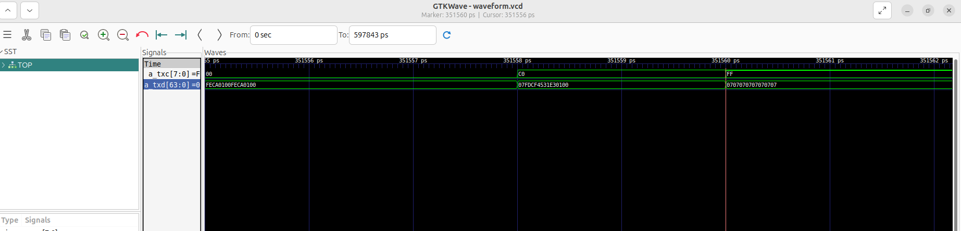
TP3 - Communication Protocols - Lab 2
GTKWave - Echo Request: payload, FCS and Terminate
Payload = CAFE0001
FCS + /T/ + /I/
Payload ca fe 00 01 repeated (txc=00) -> last word: 2 payload bytes + FCS (4 bytes, CRC-32) + /T/=FD + /I/=07 (txc=C0) -> back to Idle.
5

Slide 6
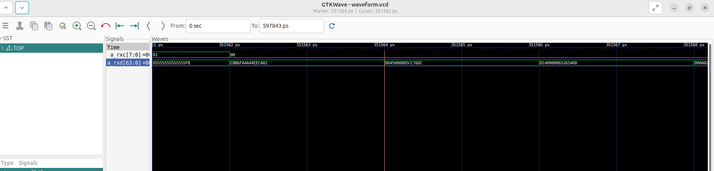
TP3 - Communication Protocols - Lab 2
GTKWave - Echo Reply: same structure, reversed direction
Dst + Src MAC (reversed)
Start
a_rxd/a_rxc: Start -> 02 ca ee 44 4a fa (Dst=host) b6 cb (Src=ns_b start) -> ...dc 76 cc 85 08 00 (EtherType) 45 00.
Same EtherType 0x0800 confirmed on the return path.
Dst/Src MAC exactly swapped compared to the Request.
6

Slide 7
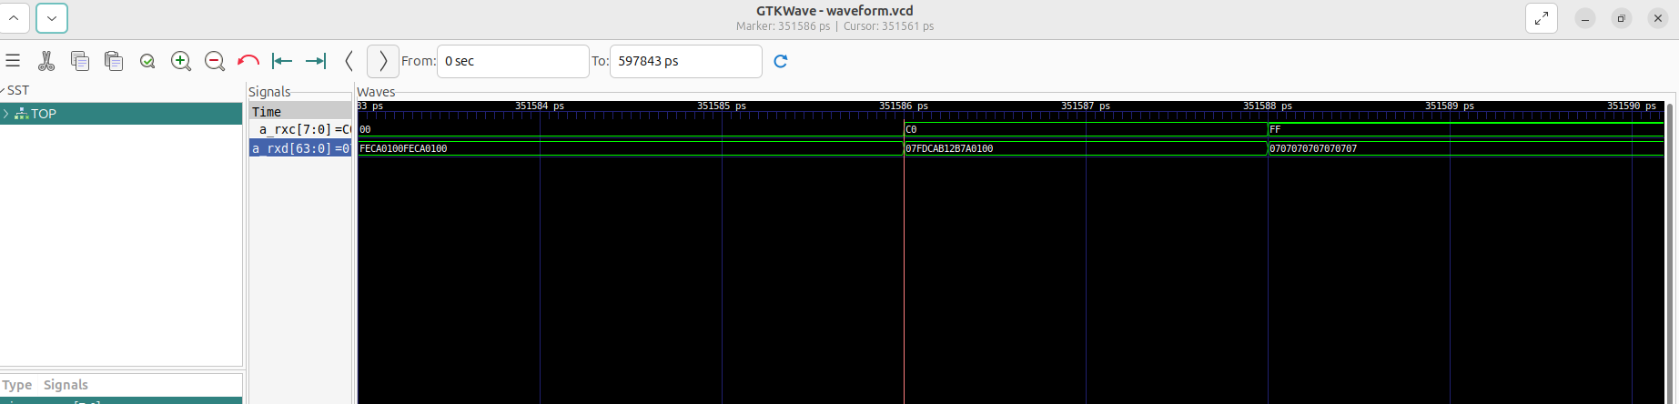
TP3 - Communication Protocols - Lab 2
GTKWave - Echo Reply: payload and closing
Payload = CAFE0001
FCS + /T/ + /I/
Same closing pattern as the Request: payload ca fe 00 01, FCS, /T/ + /I/ (txc=C0), back to Idle (txc=FF).
7

