Slide 1
TP3 · Communication Protocols
Lab 3 — PCS 64b/66b Encoding & Scrambling
Vasquez Curetti, Francisco Javier
ethernet-phy-labs / lab3-pcs-64b66b · test payload: 0xCAFE0003

Slide 2
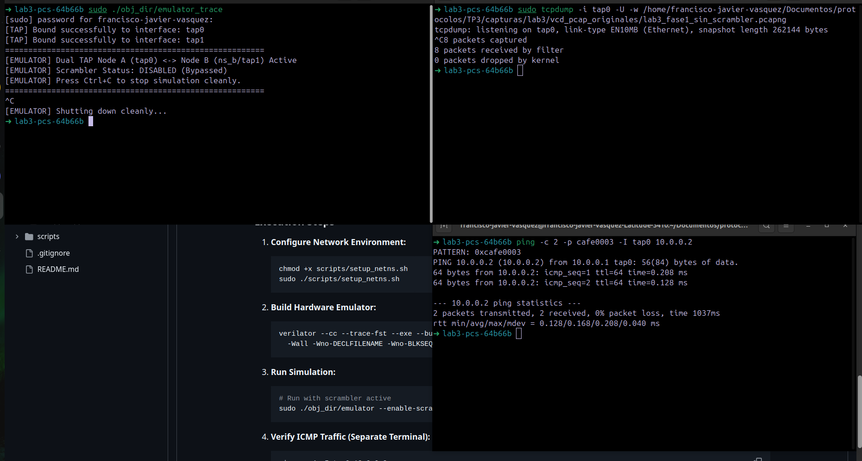
Testbench: emulator, capture & traffic generation
TP3 · Lab 3
Phase 1 (scrambler off): emulator_trace (default, no --enable-scrambler) + tcpdump -i tap0 + ping -c 2 -p cafe0003 -I tap0 10.0.0.2
2

Slide 3
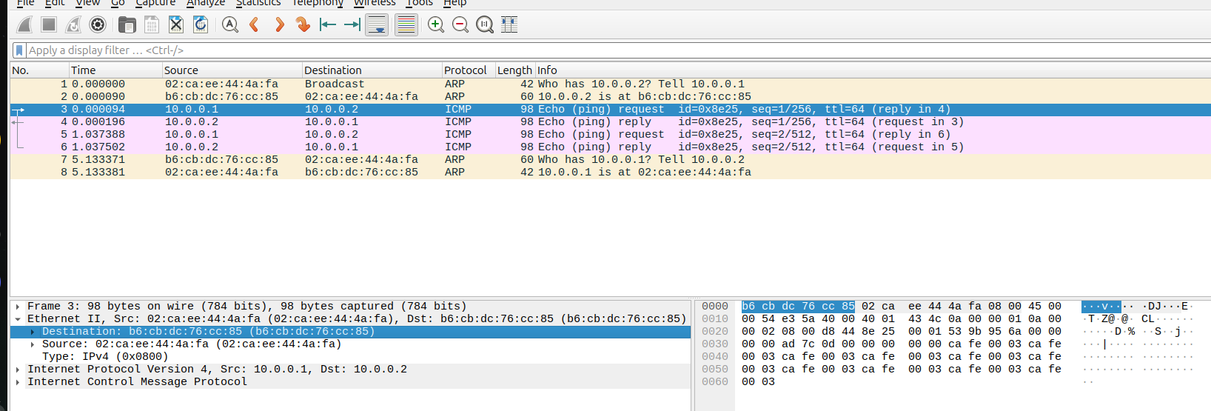
Wireshark — 8 packets: ARP, two Echo pairs
TP3 · Lab 3
3

Slide 4
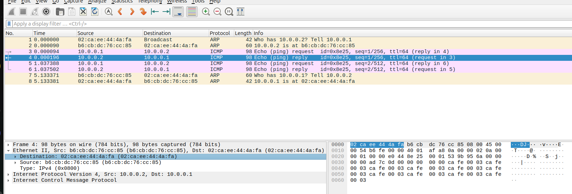
Wireshark — Echo Reply: same structure, reverse direction
TP3 · Lab 3
Src/Dst swapped · ICMP type=0 (Echo Reply) · same cafe0003 pattern in the payload.
4

Slide 5
64b/66b encoding: the Sync Header decides everything first
TP3 · Lab 3
Sync[1:0] | Classification | Description
2'b01 | Data Block | Pure 64-bit payload (8 octets /D0.../D7/), no Block Type Field
2'b10 | Control + Data | Combination of Data and Control bytes. Block Type field indicates the boundary.
hdr = 2'b01 when cgmii_txc == 0x00 (all 8 lanes are data); 2'b10 in any other case (at least one control lane).
5

Slide 6
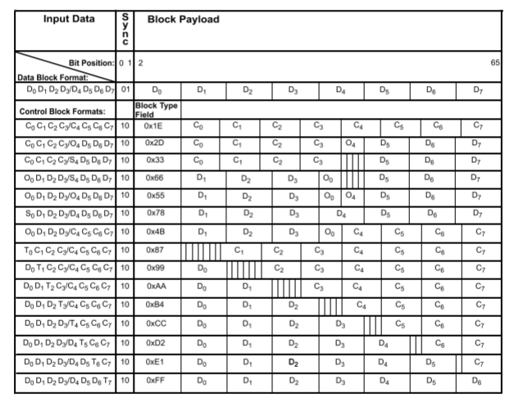
Block Type Field — IEEE 802.3 Clause 49
TP3 · Lab 3
6

Slide 7
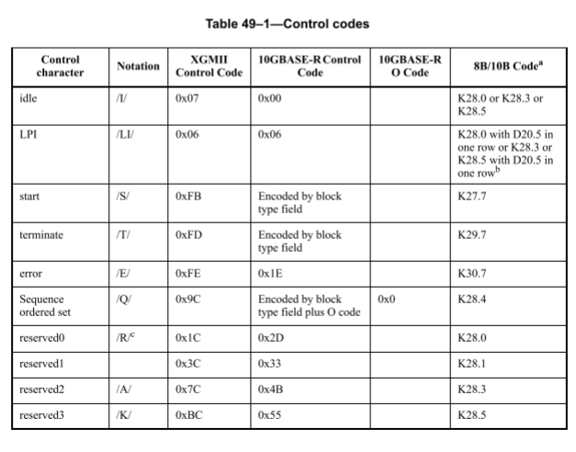
Table 49-1 — Encoding control characters within the PCS
TP3 · Lab 3
7

Slide 8
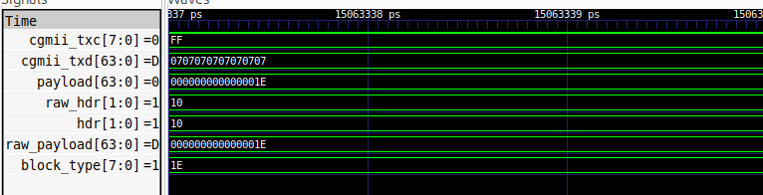
GTKWave — Idle
TP3 · Lab 3
Compression: /I/ (0x07) → 0x00
Framing: sync = 10 ; BTF = 0x1E → All control characters

Slide 9
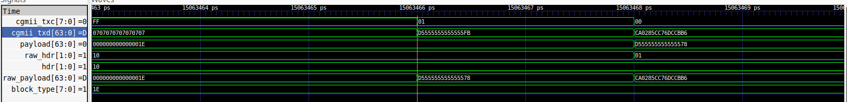
GTKWave — Start /S/
TP3 · Lab 3
Start (/S/): (0xFB) is dropped entirely – its presence is now implicit in sync=10 and BTF=0x78
Preamble + SFD: marked as data, so they pass through into raw_payload unchanged
Next block: txc=0x00 (no control lanes) → hdr flips to 01, no BTF at all

Slide 10
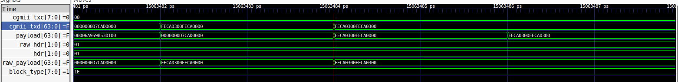
GTKWave — Data blocks
TP3 · Lab 3
txc=00 → hdr=2'b01 (pure Data, no BTF). raw_payload=FECA0300FECA0000 / FECA0300FECA0300 — the same cafe0003 seen in the Wireshark hex dump.

Slide 11
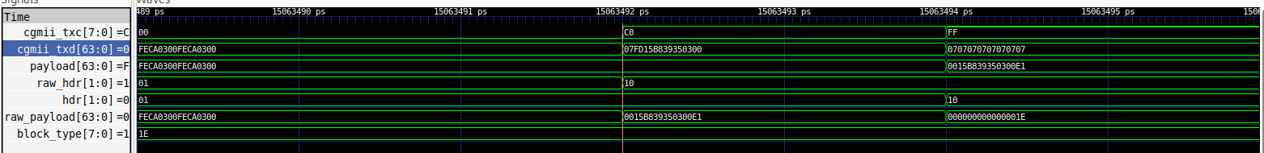
GTKWave — Terminate /T/ & BTF selection
TP3 · Lab 3
/T/=0xFD landed on lane 6 → txc=0xC0, sync= 10, BTF=0xE1. See Table in Slide 6

Slide 12
Self-synchronizing scrambler: G(x) = x^58 + x^39 + 1
TP3 · Lab 3
1
Why to scramble? High-speed serial links require sufficient bit-transition density for clock recovery. Idle, Start, and Terminate blocks sometimes are the worst case: short, repetitive, and filled with zeros patterns.
2
How to encode? A LFSR — G(x) = x⁵⁸ + x³⁹ + 1 — XORs the 64-bit payload against a pseudo-random sequence derived from a fixed seed shared by both ends.
3
Sync header is not scrambled — it must stay a it is so the receiver can manage to achieve block alignment before descrambling

Slide 13
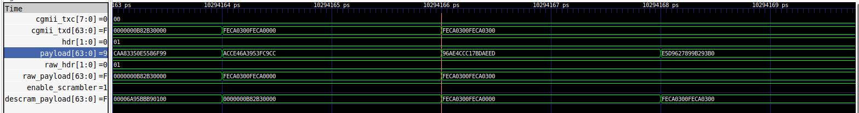
GTKWave — Scrambler active: payload randomization
TP3 · Lab 3
Same instant: raw_payload=FECA0300FECA0000 vs payload=ACCE46A3953FC9CC. The first is recognizable (from cafe0003), the second shows no visible pattern. Sync header is not scrambled.
descram_payload matches raw_payload. Node B's LFSR correctly reconstructs the payload before scrambling.

