Slide 1
TP3 · Communication Protocols
Lab 4 — 100GBASE-R PCS & Multi-Lane Distribution (MLD)
Vasquez Curetti, Francisco Javier
ethernet-phy-labs / lab4-pcs-mld · test payload: 0xCAFE0004

Slide 2
IEEE 802.3 Clause 82: how real 100GBASE-R MLD works
TP3 · Lab 4
1
Round-robin distribution. The 66b block stream is spread across 20 Virtual Lanes (VLs) in sequence, to run over multiple physical channels (e.g. 4×25G, 10×10G).
2
Alignment Markers (AM). Every 16383 blocks per lane, an AM replaces a real data block — a unique 66-bit pattern per lane, carrying a BIP3/BIP7 parity check.
3
Deskew & reorder. The receiver buffers each lane until every AM lines up, then reconstructs the single stream using the lane ID embedded in the marker.
2

Slide 3
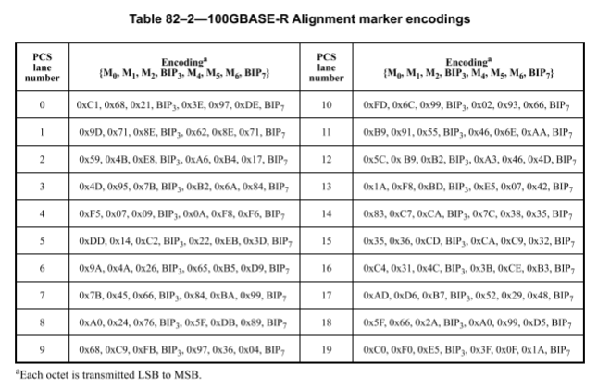
Table 82-2 — Alignment Marker encoding per lane
TP3 · Lab 4
M4=~M0, M5=~M1, M6=~M2 for every lane (e.g. lane 0: 0xC1↔0x3E, 0x68↔0x97, 0x21↔0xDE) — each marker carries its own bitwise complement as a built-in check, on top of the BIP3/BIP7 fields.
3

Slide 4
This lab's abstraction vs. the real Clause 82 mechanism
TP3 · Lab 4
Aspect | Real spec (Clause 82) | This lab's RTL
AM interval | every 16383 blocks | every 64 blocks (AM_INTERVAL param)
Lane data path | 20 physical FIFOs, real demux + skew | 1 continuous stream, blocks never split
AM insertion | replaces a real block; needs idle-rate compensation | never replaces pcs_block_out — rides alongside as sideband wires
Lane ID | implicit; decoded from the 8-byte marker itself | explicit byte inside a fixed template (0xC1+laneID+pad)
BIP3/BIP7 | real running parity, detects bit errors | not implemented — fixed 0x00/0xA5 filler
Goal per TESTBENCH.md: teach the lane-distribution & AM-timing mechanism without the rate-matching / deskew-FIFO complexity of a real implementation.
4

Slide 5
Test setup: dual-namespace TAP + traffic generation
TP3 · Lab 4
1
Two Linux network namespaces. tap0 lives in the host namespace (10.0.0.1/24); tap1 lives inside ns_b (10.0.0.2/24). A single emulator process binds both ends via setns().
2
Build parameters. -GAM_INTERVAL=64 -GNUM_LANES=20. FST tracing is unconditional here — dump.fst is produced on every run, no build flag needed.
3
Traffic. ping -c 5 -p cafe0004 -I tap0 10.0.0.2 — ARP + 5 ICMP echo pairs. Payload distinguishes this lab from labs 1-3 (cafe0001/2/3).
5

Slide 6
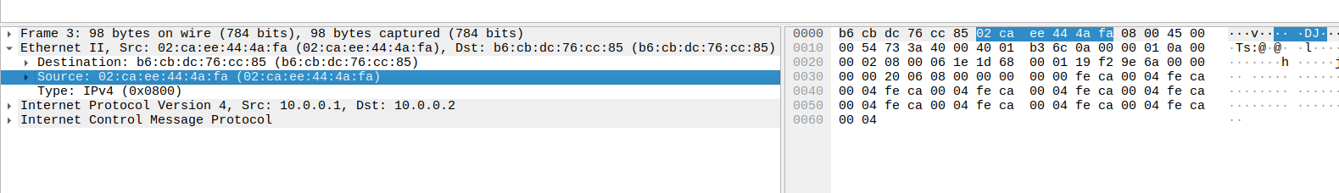
End-to-end integrity: 0% packet loss through the full pipeline
TP3 · Lab 4
ICMP echo request/reply between 10.0.0.1 and 10.0.0.2, cafe0004 payload pattern, round-tripping through MAC -> PCS encoder -> MLD tx -> MLD rx -> PCS decoder -> MAC on both directions.
6

Slide 7
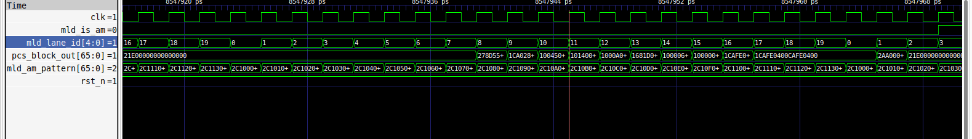
Virtual Lane round-robin: mld_lane_id cycles 0->19 every clock
TP3 · Lab 4
One 66-bit block dispatched per clock edge; lane_ptr wraps 19->0 with NUM_LANES=20 -- answers Q1.1/Q1.2 (sequential increment, one block per lane per cycle, no stalls).
7

Slide 8
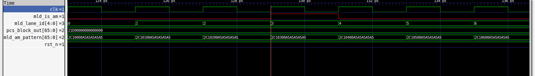
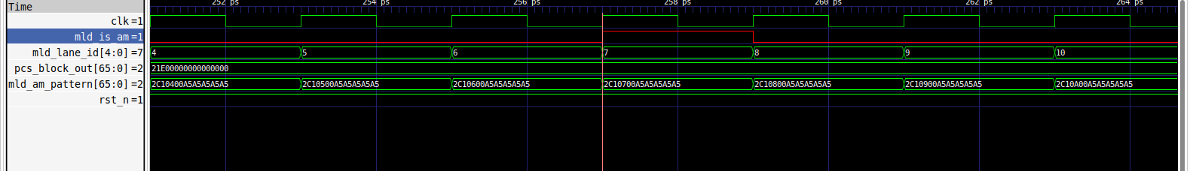
Alignment Marker periodicity: 128 ps = 64 cycles between pulses
TP3 · Lab 4
mld_is_am pulses once every AM_INTERVAL=64 cycles; the pattern byte [55:48] always mirrors the current lane (0x03 -> 0x07 here) -- answers Q2.1/Q2.3.
8

Slide 9
Why VL0 and VL5 never appear at an AM pulse (Q2.2)
TP3 · Lab 4
1
Phase lock. AM_INTERVAL=64 and NUM_LANES=20 share gcd=4. From the reset state, mld_is_am only ever coincides with lane_ptr ≡ 3 (mod 4).
2
Verified in the trace. Pulses land on lanes {3,7,11,15,19} only, repeating every 5 pulses (320 cycles). Lanes 0 and 5 (≡0/1 mod 4) are structurally unreachable at an AM instant.
3
Reported values. VL3/VL7 are real captured evidence; VL0 (0x2C10000A5A5A5A5A5) and VL5 (0x2C10500A5A5A5A5A5) are given by formula, not captured -- a byproduct of the fixed reset phase, not a bug in the marker logic.
9

Slide 10
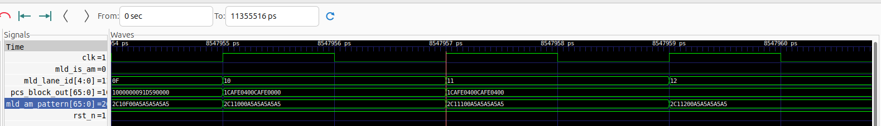
Real ping payload flowing untouched through the pipeline
TP3 · Lab 4
pcs_block_out is never interrupted by the AM logic -- the ICMP payload (0xCAFE0400 pattern) flows through the same wire whether or not mld_is_am fires that cycle.
10

Slide 11
Sideband propagation tx->rx: 0-cycle delay (Task 3)
TP3 · Lab 4
[ Screenshot pending: mld_rx_inst_b signals @ 124-136 ps ]
1
Same wire. mld_rx_inst_b's mld_lane_id/mld_is_am/mld_am_pattern share the exact same net as mld_tx_inst_a's outputs -- confirmed via matching VCD signal IDs, no register in between.
11

Slide 12
Conclusions
TP3 · Lab 4
1
Pass criterion met. 5/5 ping echoes, 0% loss, full MAC->PCS->MLD round trip in both directions.
2
Sideband abstraction understood. Round-robin labeling + periodic AM flag never touch the real data path -- avoids the rate-matching complexity of a physical MLD implementation.
3
Empirical finding beyond the docs. The AM_INTERVAL/NUM_LANES phase-lock (gcd=4) hides 15 of the 20 lanes from ever showing an AM event -- confirmed directly from the waveform trace, not stated anywhere in the assignment.
12

