Slide 1

Restaurants & Tourism:
BombAppetit
a SIRS presentation
Group 57
Duarte Jeremias, 96857
Francisco António, 105741
Rodrigo Liu, 96909

Slide 2
Introduction
BombAppetit is a web application tailored to enhance the dining experience
Users can look up any restaurant information
Restaurants may create discount vouchers to reward loyal customers
Customers may leave a review

Slide 3
Initial Core Data
Restaurant Info
Vouchers
Owner (string);
Name (string);
Address (string);
Genre (string);
Menu (list<item>);
Code (string);
Description (string);

Slide 4
Final Core Data (after Security Challenge considerations)
Restaurant Info
Vouchers
Reviews
Owner (string);
Name (string);
Address (string);
Genre (string);
Menu (list<item>);
Username (string);
Code (string);
Description (string);
Owner (string);
previousOwner (string);
Restaurant (string);
Username (string);
Restaurant (string);
Rating (int);
Comment (string);

Slide 5
Secure Document Algorithms
Confidentiality
Freshness
Integrity & Authenticity
RSA/ECB/PKCS1Padding;
Only used for the vouchers;
Uses the owner of the voucher’s public key;
timestamp;
nonce;
SHA256withRSA digital signature;
Uses a SHA256 digest of the whole file;

Slide 6
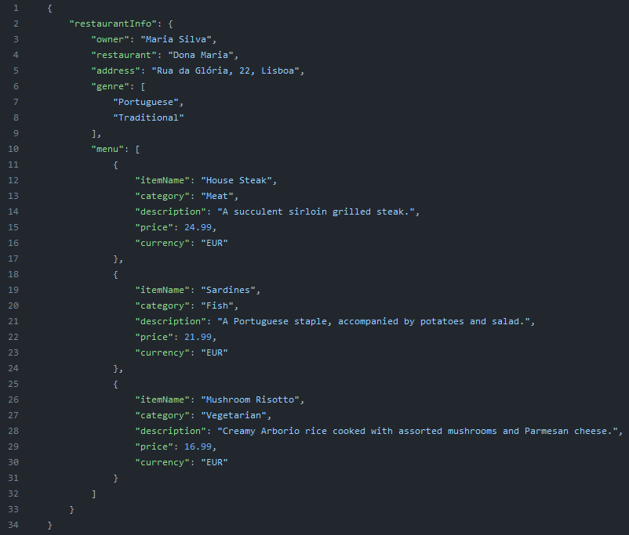
Secure Document Format - Unprotected Restaurant Info

Slide 7
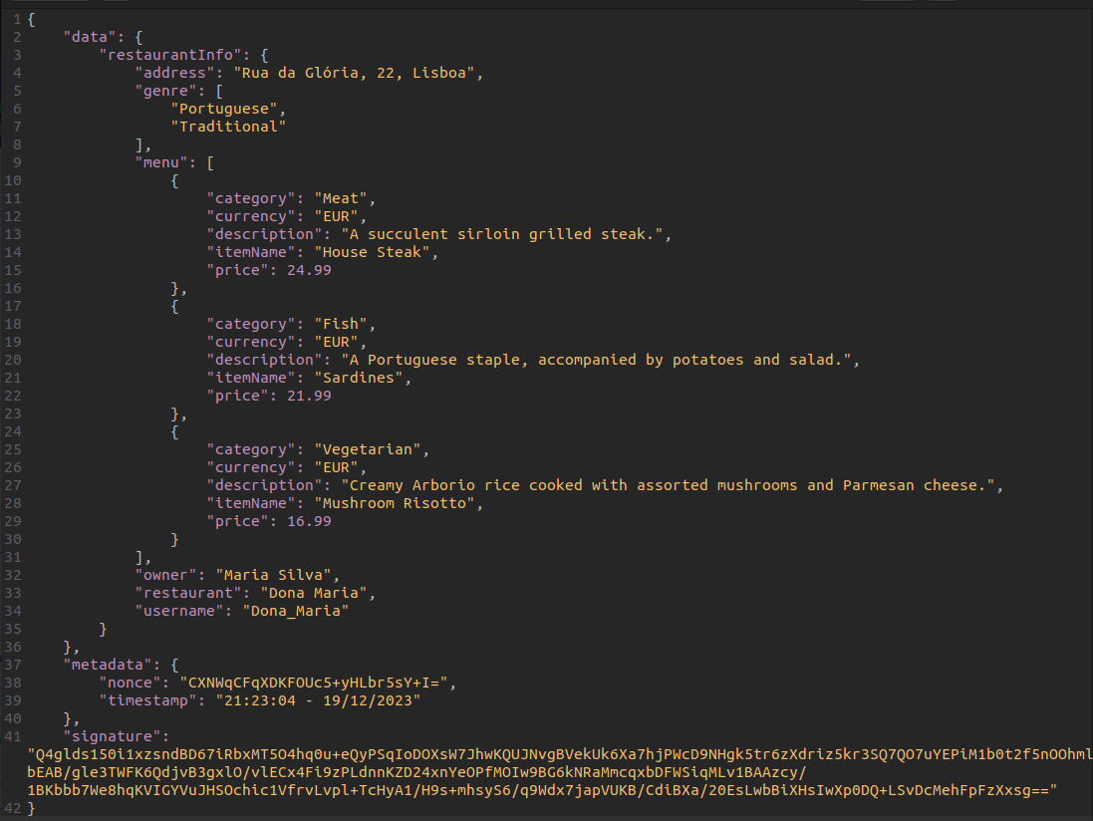
Secure Document Format - Protected Restaurant Info

Slide 8
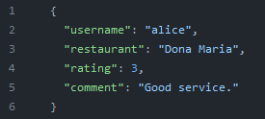
Secure Document Format - Unprotected Review

Slide 9
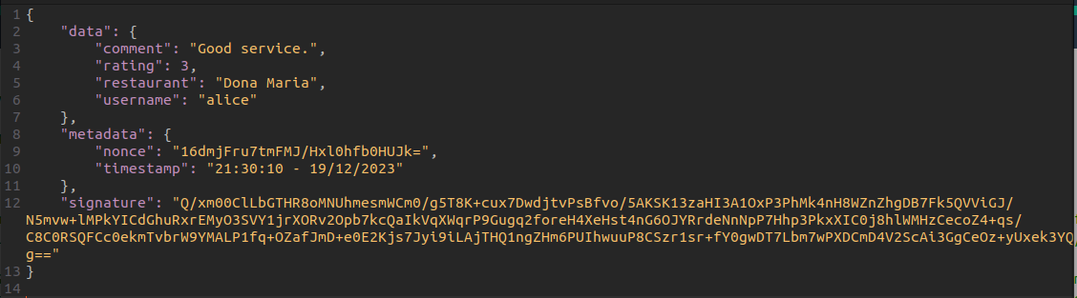
Secure Document Format - Protected Review

Slide 10
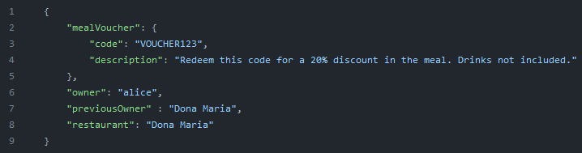
Secure Document Format - Unprotected Voucher

Slide 11
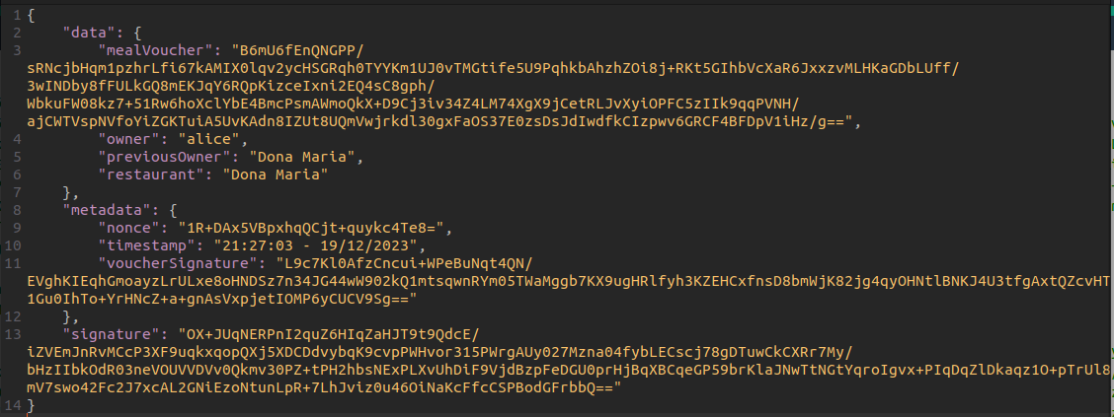
Secure Document Format - Protected Voucher

Slide 12
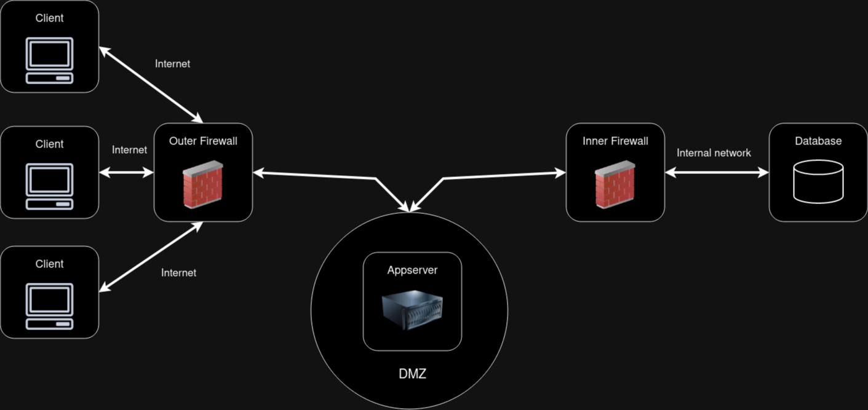
Infrastructure

Slide 13
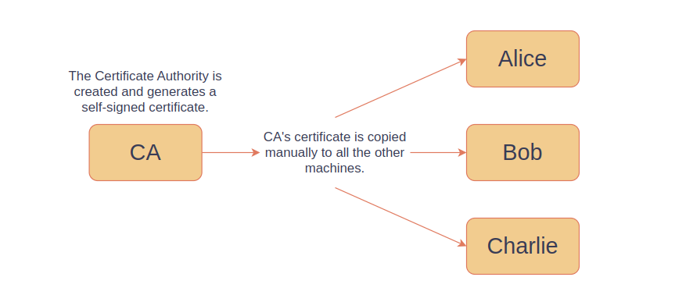
Key Distribution - 1

Slide 14
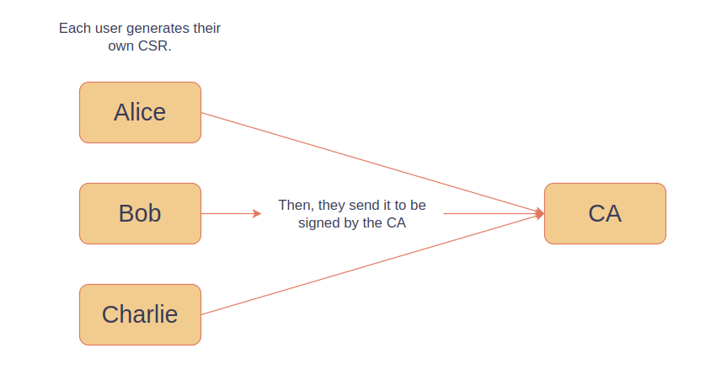
Key Distribution - 2

Slide 15
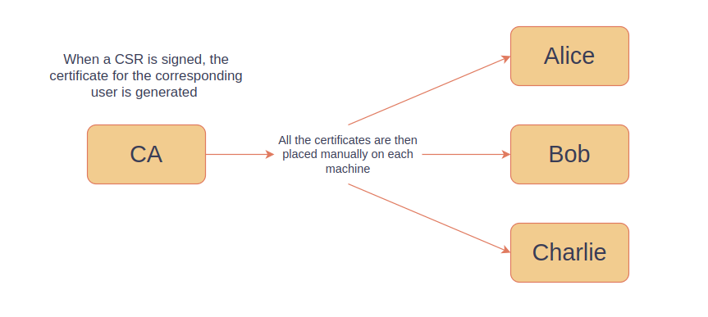
Key Distribution - 3

Slide 16
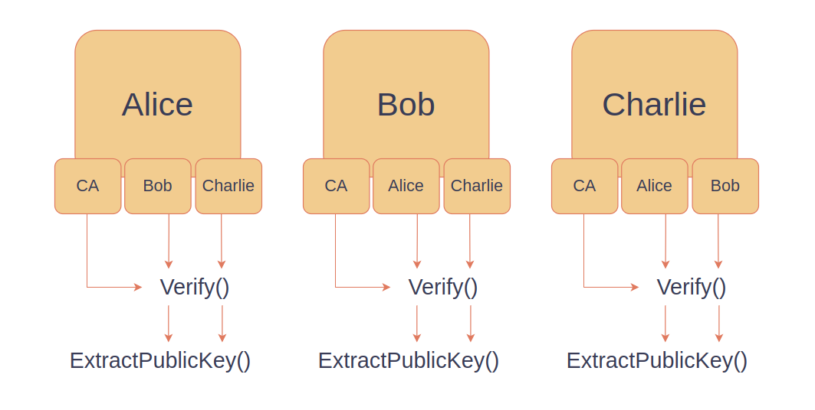
Key Distribution - 4

Slide 17
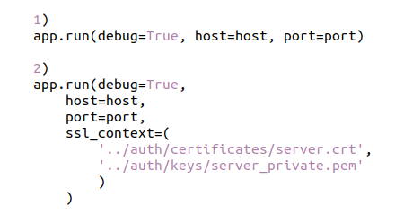
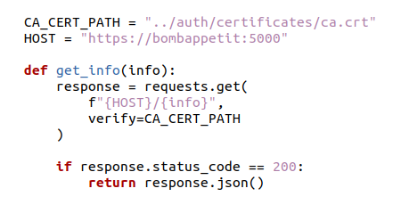
Secure Communication
Flask Server
Python Client

Slide 18
Security Challenge - Reviews
All reviews are signed by their authors
Notes:
Author signs with private key
Check review and use the author’s public key to check authenticity

Slide 19
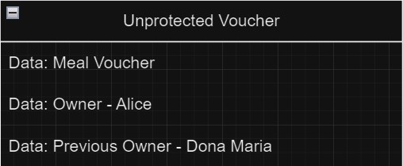
Security Challenge - Vouchers
Unprotected Voucher
Notes:
Normal unprotected voucher
Has Meal Voucher: Discount code, etc

Slide 20
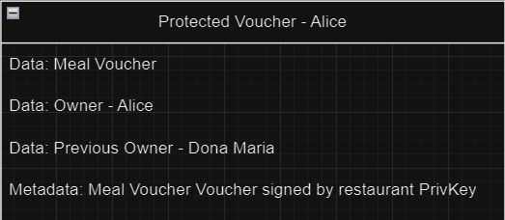
Security Challenge - Vouchers
Voucher Creation
secdoc protect --voucher <restaurant's private key> <owner's public key> <unprotected voucher>
Secdoc signs the meal voucher with the restaurant’s private key
Secdoc encrypts the meal voucher with the owner’s public key
Secdoc signs the data and metadata together with the restaurant’s private key
Restaurant (Dona Maria) becomes previous owner
Signature: Restaurant PrivKey
Notes:
Receive Protected Voucher, we check security: Meal Voucher signature (using Restaurant pub key), signature of previous owner (using his pub key)

Slide 21
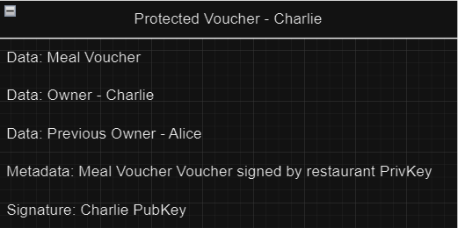
Security Challenge - Vouchers
Voucher Transfer
Alice removes encryption
Changes previous owner to herself
Changes current owner to Charlie
Alice encrypts with Charlie’s public key
Alice signs the whole protected voucher including Metadata, with her private key
The contents of the voucher itself remain authentic since its unencrypted signature is the same, and signed by the restaurant, the original issuer of the voucher, so the current owner can always check it for tampering from the other users
Notes:
We can exchange vouchers with other users directly, without using Servers or Restaurant

Slide 22
Demonstration

