Slide 1


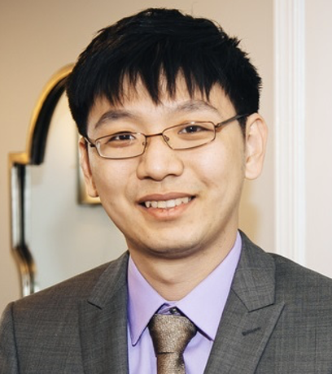
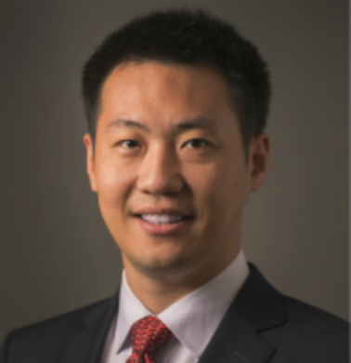



Knowledge Control for Responsible Generative AI: Bridging Academia, Industry and Society
Zheyuan (Frank) Liu
Notre Dame
Yixin (Elaine) Wan
UCLA
Kai-Wei Chang
UCLA
Meng Jiang
Notre Dame
Jieyu Zhao
USC
Nouha Dziri
AI2
Yuning Mao
Meta
Maybe Jindong Gu?

Slide 2
Agenda
Part I: Introduction (15 minutes)
Part II: Machine Unlearning for Knowledge Removal (35 min)
Part III: Knowledge Editing for Targeted Modification (35 min)
Coffee Break (30 minutes)
Part IV: Industry Perspectives on Trustworthy Knowledge Control (30 min)
Part V: Reflective and Bias-Aware Knowledge Control (30 min)
Part VI: Evaluation and Responsible Deployment (25 min)
Part VII: Conclusion and Future Directions (15 min)

Slide 3
Introduction
Meng Jiang
Notre Dame

Slide 4
Part I (30 mins)
Paper Lists:
1. Towards Safer Large Language Models through Machine Unlearning
2. Negative Preference Optimization: From Catastrophic Collapse to Effective Unlearning
3. Dual-Space Smoothness for Robust and Balanced LLM Unlearning
4. MMUnlearner: Reformulating Multimodal Machine Unlearning in the Era of MLLMs
5. Modality-Aware Neuron Pruning for Unlearning in Multimodal Large Language Models (MANU)
Zheyuan (Frank) Liu
Notre Dame

Slide 5
Part I

Slide 6
Part II

Slide 7
Part III
Yixin (Elaine) Wan
UCLA

Slide 8
Part IV
Paper List:
- TOFU
- WMDP
- MUSE
- MLLMU-Bench
- CLEAR

Slide 9
Part V
Nouha Dziri
AI2
Yuning Mao
Meta

