Slide 1
S.T.A.D.O.S.
State Of the Art Digital Ordering System

Slide 2
Mission Statement
Our mission is to take a wasted amount of time and give it purpose. We will take hundreds of thousands of hours per year and make that time beneficial instead of wasteful. Increased productivity will lead to enhanced experiences and services. We will change the world in adding time to a world where time is our greatest asset.

Slide 3
S.T.A.D.O.S. Benefits
Each restaurant loses 7.4% of their net sales per year due to incorrect orders.
We do not promise to save all of those losses. However, our system will guarantee at least a cut in half of the $740,000 lost per $10,000,000.
Taking those numbers into consideration we are adding an extra employee into the restaurant.
A better presentation for the customer.
Elimination of food wait times.
More traffic throughout the restaurant with eat times being cut down.
Increased server productivity.

Slide 4
Product Information
Each working system will contain a combination of a slave computer, PDA’s, Line Monitors, credit card scans and receipt printers, and a wireless hub to connect them all.
Slave Computer:
  The slave computer will be accessed by management. It will obtain all information that goes through each individual PDA and will be categorized accordingly in excel spreadsheets.
PDA:
  Each PDA will have access to the restaurants menu. It will have page options for different modifications the restaurant offers. It will run off of a web-browser so that functionality costs decrease.
Line Monitors:
  Each chef will have his or her own monitor at their particular prep station. The bar will also have a monitor for alcoholic drink orders. It will be a flat, LCD screen. To simplify the cooking process, instead of abbreviations, our system will offer complete word outlines on the LCD screens.
Credit Card Scans and Receipt Printers:
  Both will be wireless or plug-in using USB cables. This will provide the customer with added security knowing their credit card will never leave the table.

Slide 5
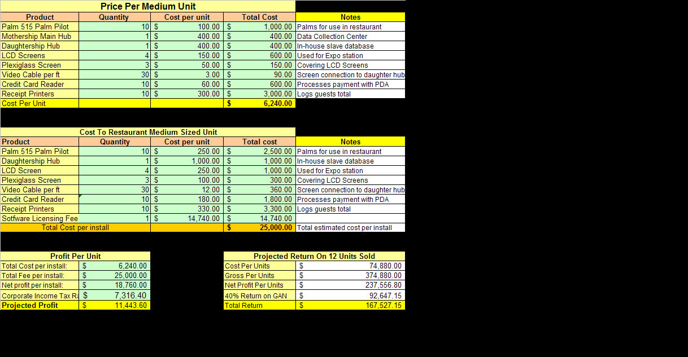

Slide 6
Demographic Profile
Small Restaurants (0-5 years of service):
  Immediate need for S.T.A.D.O.S.
  Growth potential.
    Saying the restaurant substantially grows, we will have guaranteed projects in a new restaurant.
  Over 99% of new restaurants fail.
Medium Restaurants (5-10 years of service):
  Have finally started making a profit.
  Most looking to update and upgrade their restaurant.
  Contracts for larger restaurant chains.
Large Restaurants (Over 10 years of service, chains.):
  Immediate S.T.A.D.O.S growth.
  Large contracts to supplement monthly goals.
  Better for advertising purposes.
All three of these combine to make the restaurant industry worth $298 billion.

Slide 7
Competition
Pocket Cheff:
  Established in 1996.
  Operating since 2001.
  Overall, the Pocket Cheff provides to be a decent competitor. Their major downfall is extreme cost. Our product will cost less then half of all leading competitions.
Other then Pocket Cheff there is no other significant competition for our product.

Slide 8
Logged Operations
All employee info:
  I-9’s, Phone Numbers, Employee Number, Employee Hours, Employee Days Worked.
Job Codes
  Host, Busser, Chef, Server, Manager, Bartender.
Manager access and security privileges.
Promotions and Contests.
Employee schedules and clock in times.
Schedule program (This program takes into account a servers availability and allots them their schedule)
Daily Labor Report
Daily Sales Report
Product Mix (Log of product in and out of the restaurant)
Server check-outs (List of all sales per server for the day/night)
Time card (Maintenance)
Hourly Tracking Report
VCD Report (Voids and Comps)

Slide 9
Logged Operations cont.
Information being plugged in by hand by waiter.
Information sent simultaneously to different areas of the restaurant.
All information inputted combines and is entered into a billing database.
Specific menu items will have to go to different LCD screens.
These areas should not have to expand beyond three other locations.
The information sent to these three other locations will have to be independent of each other.
The information sent to the LCD screens will need to be able to be manipulated.
  By this I mean, to expedite food times there are two screens, one for the expeditor who is tracking where the food goes. One for the cooks so they know what food to make. Once the item is prepared there must be a way for the cooks to alert the expeditor that the food has been prepared. After that, the expeditor will be need to have the ability to clear the screen for more orders.
These LCD screens will also need time capabilities to clock food out time.
The information will also need to be sent to the daughtership where it will need to be protected.

Slide 10
Guest 1 Guest 2 | Guest 3 Guest 4 | Guest 5 Guest 6
DRINKS |  | DINNER
 | SPECIALITY
APPETIZERS |  | DESSERTS
 | SALADS
LUNCH |  | ALCOHOL

Slide 11
Guest 1
 | DRINKS
Coke | Root Beer | Coffee
Diet Coke | Mountain Dew | Expresso
Dr. Pepper | Ice Tea | Lemonade
Sprite | Flavored IT | Flavored Lem
 |  | ⬅ Back Second Page ➔

Slide 12
Guest 1
 | LUNCH
Spaghetti | Chicken Sndwc | Cobb Salad
Pasta Milano | Calzone | Chx Caeser
Meatball Sndwc | Pep Pizza | Florentine Sal
Ravioll | Chz Pizza
 |  | ⬅ Back Second Page ➔

Slide 13
Guest 1
 | APPETIZERS
Calamari |  | Crab Mush
Mozz Sticks |  | Sampler
Caesar Salad |  | Spinach Dip
Garden Salad |  | Artichoke Dip
 |  | ⬅ Back Second Page ➔

