Slide 1
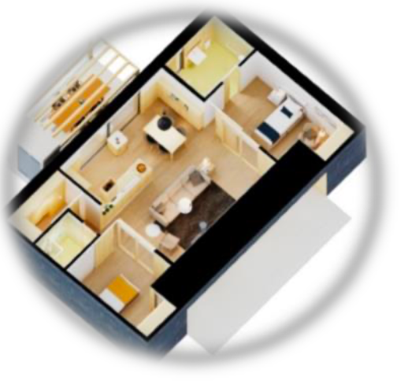
Kitchen Assistant for Active Ageing at Home
Rúben Marinho (40115) Pedro Carneiro (73775) Inês Águia (73882) João Rodrigues (108045) David Palricas (108780)
Supervisors: Ana Rocha Nuno Almeida Antonio Teixeira

Slide 2
Context (Casa Viva+)
Aging population in Portugal
Elders might need assistance with basic activities to keep autonomous and active
Importance of smart homes for active aging

Slide 3
Problem
Lack of intuitive and proactive assistance
Challenges faced by the elderly in daily kitchen tasks
Need for unified system to manage groceries, meal preparation and health information

Slide 4



Goals
Develop a conversational assistant for the kitchen
Provide unified, natural, and intuitive interaction
Extend capabilities for proactive alerts and information
(such as expiration dates on items)

Slide 5


Expected Results
Integration with existing smart home infrastructure
Prototype tested with a few users

Slide 6
Tasks and Workplan
Requirement gathering
Tool selection
Demonstrators/Integration with Smart Home Devices/Tests
Planning/State-of-the-art research
System architecture design
Iterative development
Technical Report and Project Presentations

Slide 7
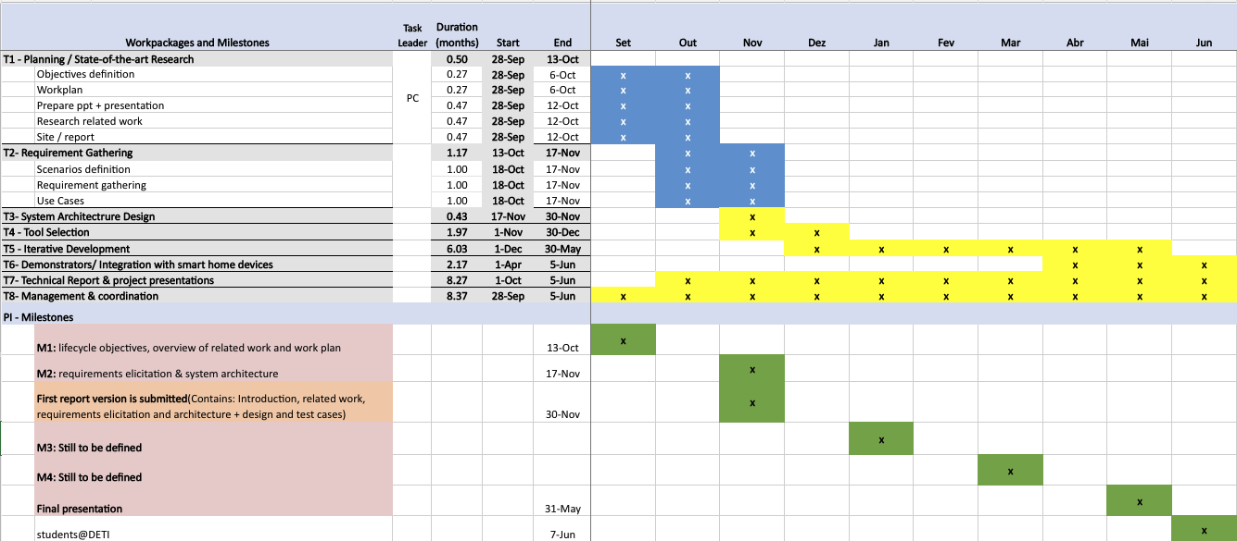
Tentative WorkPlan

Slide 8
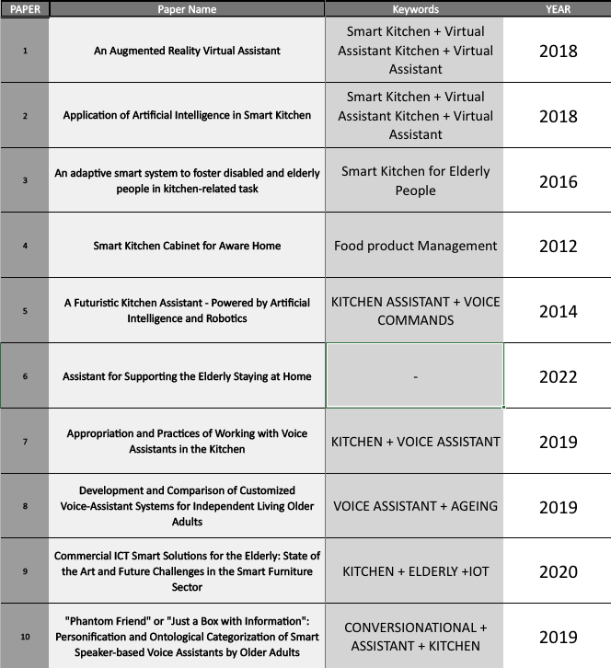
Related Work
Notes:
Estou à espera que os orientadores me respondam ao Email

Slide 9
Potentially Useful Technologies (Early Draft)
Artificial Intelligence, Machine Learning and Robotics
Netica
Bayesian Network
Cozmo
Rasa and Rasa X tools
Voice Recognition
Voice Assistants and Smart Devices
Amazon (Alexa, Eco Show)
Cortana
Apple Siri
Google Home (Assistant)
Lenovo Smart Display (w/ Google Assistant)
Voice User Interface (VUI)
Communication and Networking Technologies
LoRa (Low-Power, Low-Range)
Radio Frequency Identification (RFID)
Database Management System (DBMS)
Sensor and Hardware Technologies
ToF Camera (Microsoft's Kinect)
MYO Armband
AR-Toolkit

Slide 10
Communication
- Weekly meetings with supervisors
- Communication channels
- MS TEAMS
- WhatsApp
- MS Outlook
- Code Version/Control
- GitHub
-Project Management
- Trello - MS Excel

Slide 11
Q&A
Open floor for questions

