Slide 1
Quote generation

Slide 2
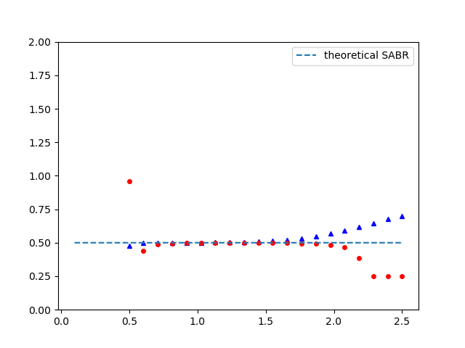
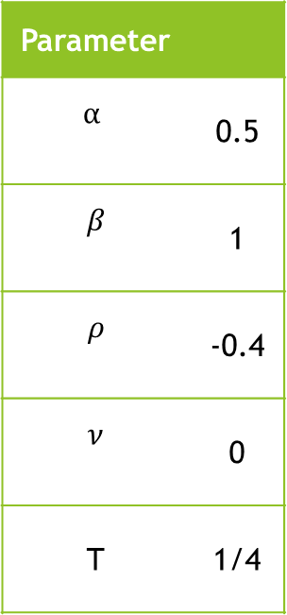


100 000 Simulations per Path
Parameter
$$α$$ | 0.5
$$β$$ | 1
$$ρ$$ | -0.4
$$ν$$ | 0
T | 1/4
European call
European put
Volatility ($σ$)
Normalized Strike ($\frac{K}{f_{0}}$)
t ~ 1min
~ 1%
running time
mean residuals

Slide 3
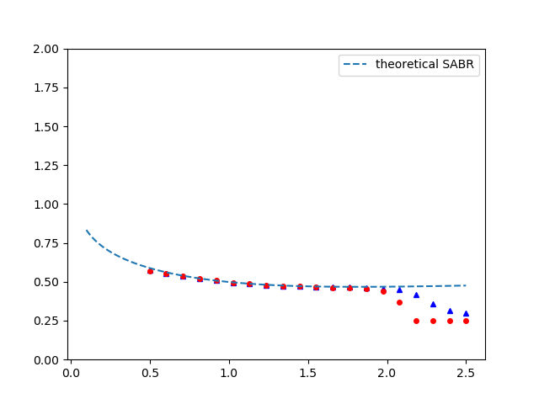

100 000 Simulations per Path
Parameter
$$α$$ | 0.5
$$β$$ | 1
$$ρ$$ | -0.4
$$ν$$ | 0.5
T | 1/4
European call
European put
Volatility ($σ$)
Normalized Strike ($\frac{K}{f_{0}}$)
t ~ 1min
running time

Slide 4
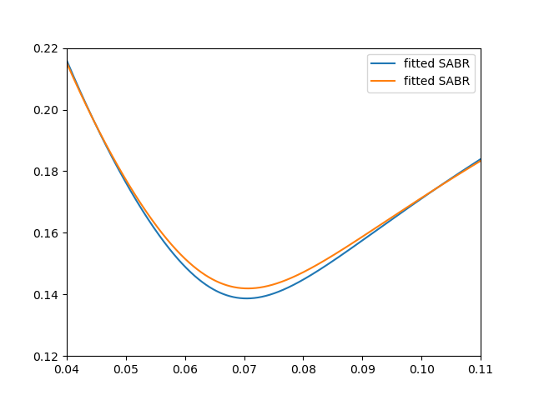
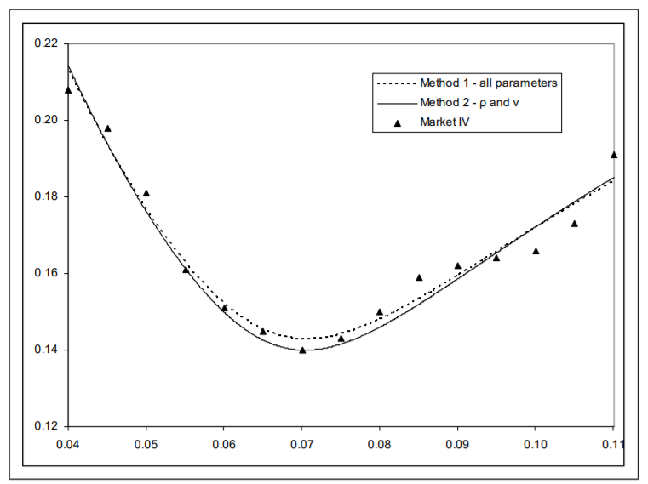
Reproducing Hagan et. al Curves

Slide 5
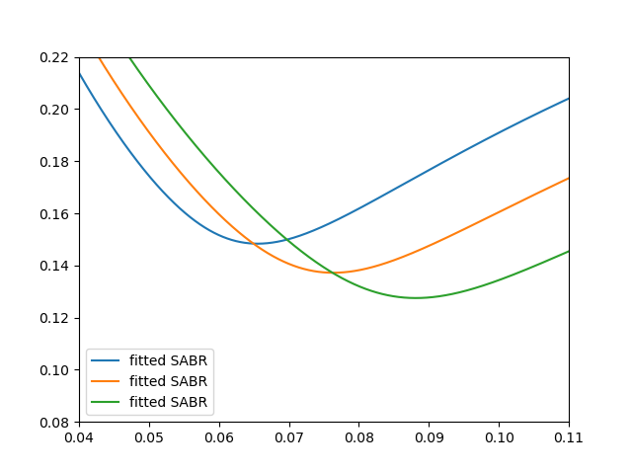
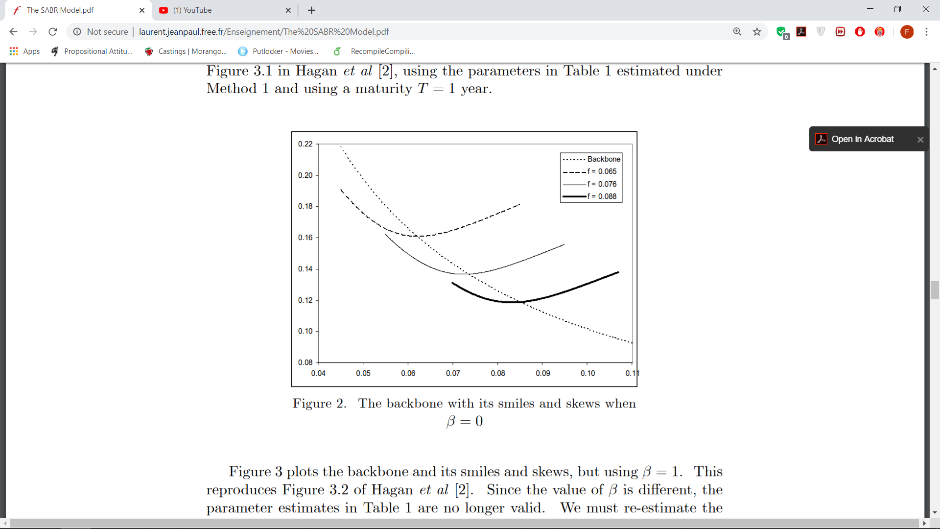
Reproducing Hagan et. al Curves

Slide 6
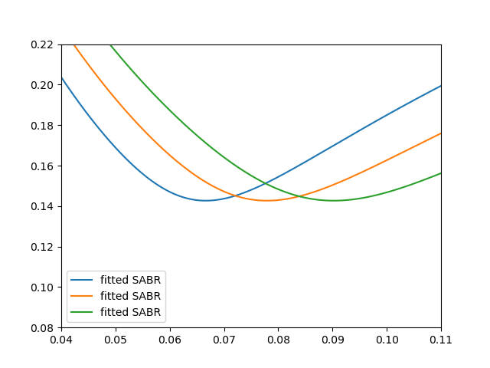
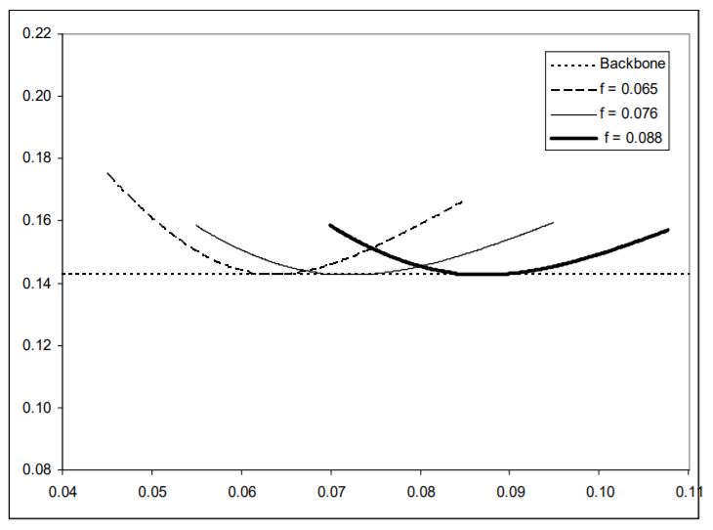
Reproducing Hagan et. al Curves

Slide 7
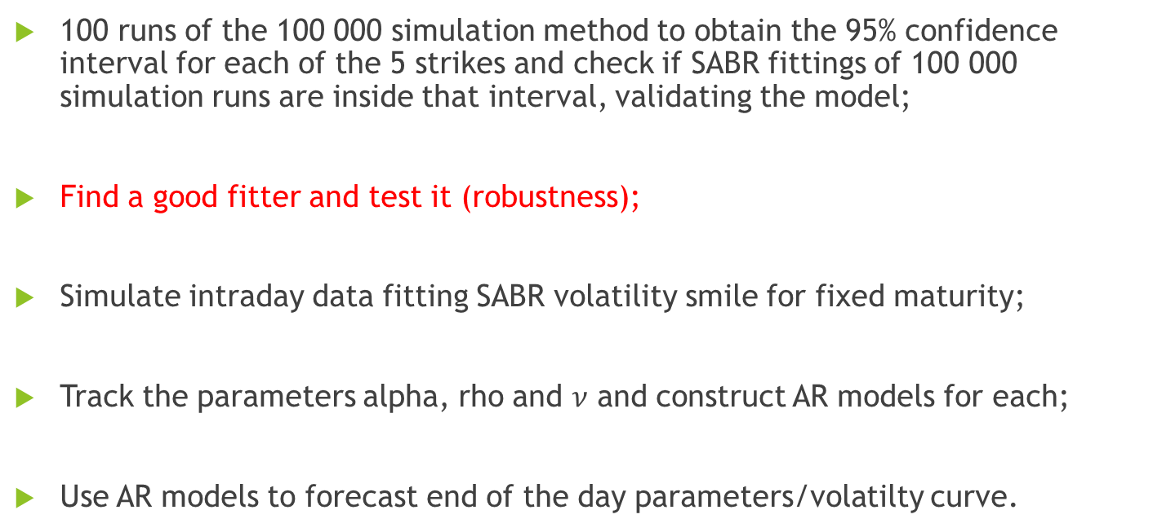
Steps Moving Foward
100 runs of the 100 000 simulation method to obtain the 95% confidence interval for each of the 5 strikes and check if SABR fittings of 100 000 simulation runs are inside that interval, validating the model;
Find a good fitter and test it (robustness);
Simulate intraday data fitting SABR volatility smile for fixed maturity;
Track the parameters alpha, rho and $ν$ and construct AR models for each;
Use AR models to forecast end of the day parameters/volatilty curve.

Slide 8
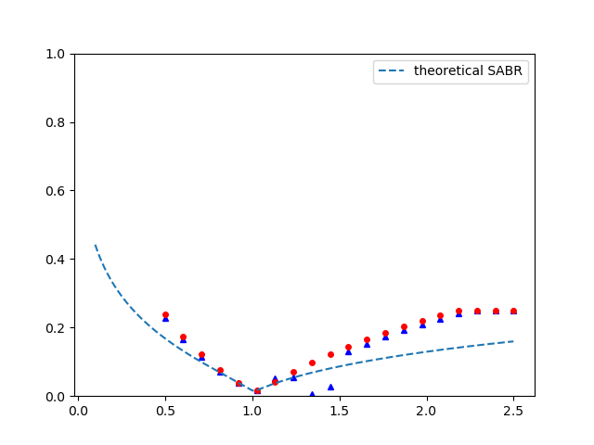
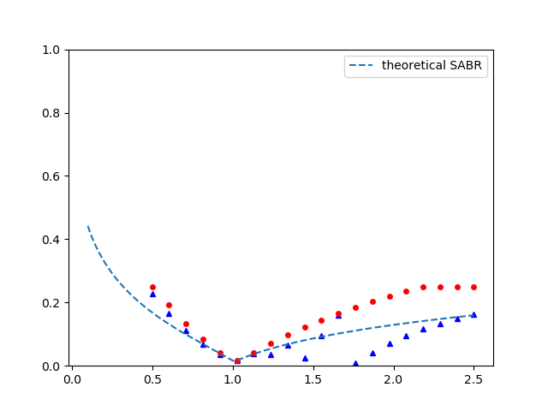


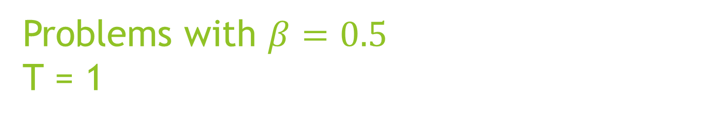


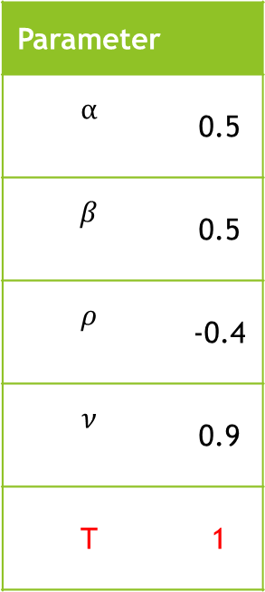
Problems with $β=0.5$ T = 1
Parameter
$$α$$ | 0.5
$$β$$ | 0.5
$$ρ$$ | -0.4
$$ν$$ | 0.9
T | 1
European call
European call
European put
European put
Volatility ($σ$)
Volatility ($σ$)
Normalized Strike ($\frac{K}{f_{0}}$)
Normalized Strike ($\frac{K}{f_{0}}$)

Slide 9
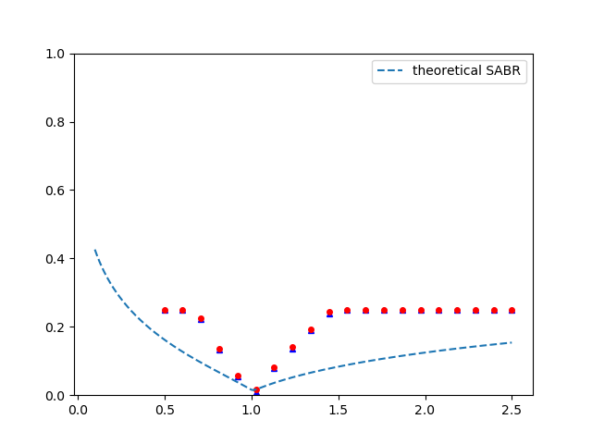
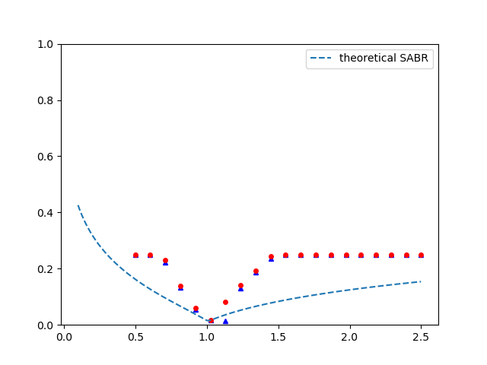
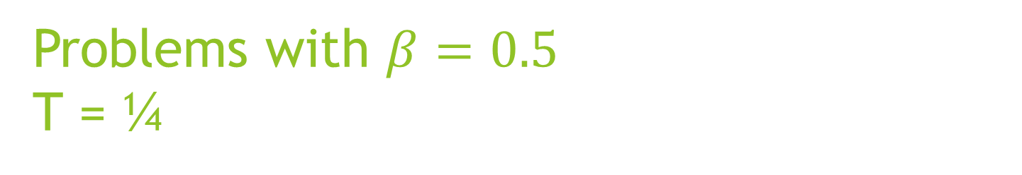
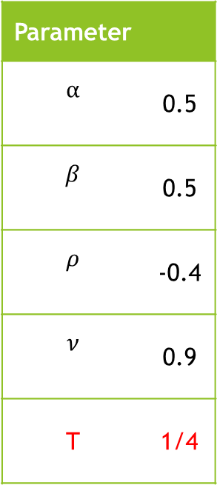
Problems with $β=0.5$ T = ¼
Parameter
$$α$$ | 0.5
$$β$$ | 0.5
$$ρ$$ | -0.4
$$ν$$ | 0.9
T | 1/4
European call
European call
European put
European put
Volatility ($σ$)
Volatility ($σ$)
Normalized Strike ($\frac{K}{f_{0}}$)
Normalized Strike ($\frac{K}{f_{0}}$)

Slide 10
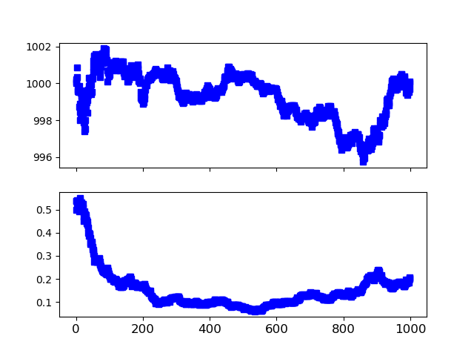
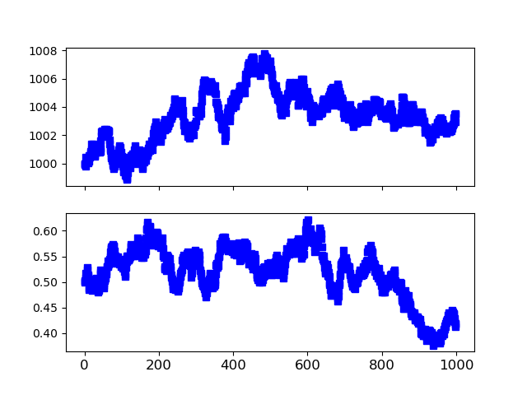

Problems with $β=0.5$
T = 1
T = ¼

