Slide 1
Cyclistic: Member vs casual
Francisco Castro
June 2024

Slide 2


Table of contents
Objective
What does the data say?
Reccomendations
Appendix

Slide 3
What are we talking about?

Slide 4
Objective
Describe how casual riders and annual members use Cyclistic bikes differently to inform a new marketing strategy to convert casual riders into anual subscribers.

Slide 5
What does the data say?

Slide 6
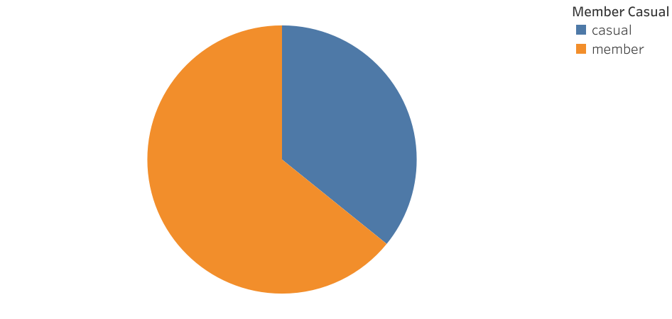
User demographics
64% of all trips were made by annual members
36% of all trips were made by casual riders

Slide 7
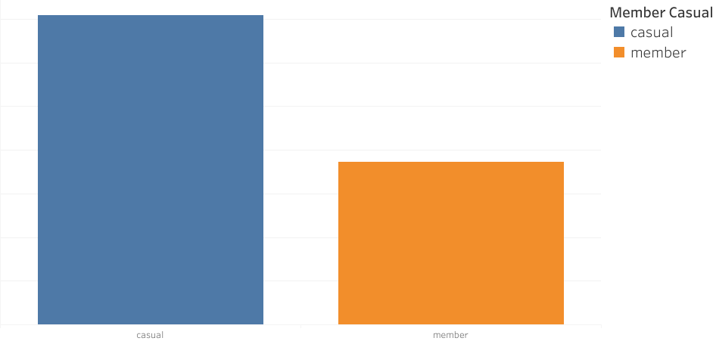
Trip Duration
Casual riders use Cyclistic for longer trips in average

Slide 8
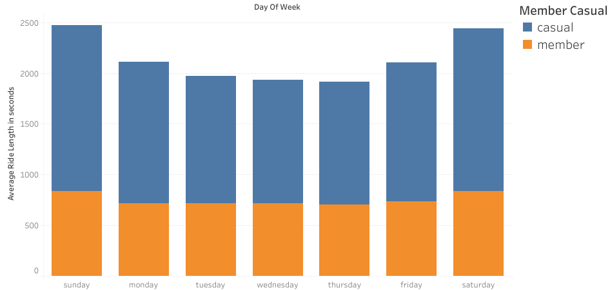
Trip Duration
Casual riders use Cyclistic for longer trips in every day of the week
Casual riders use Cyclistic for longer trips on Saturday and Sunday
Annual members also use Cyclistic for longer trips on Saturday and Sunday

Slide 9
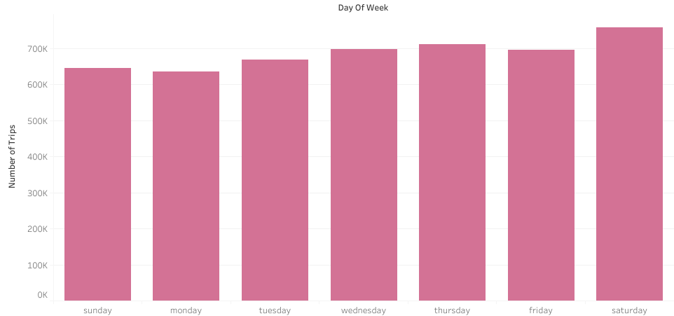
Number of Trips
Thursday and Saturday are the days of the week with the most trips

Slide 10
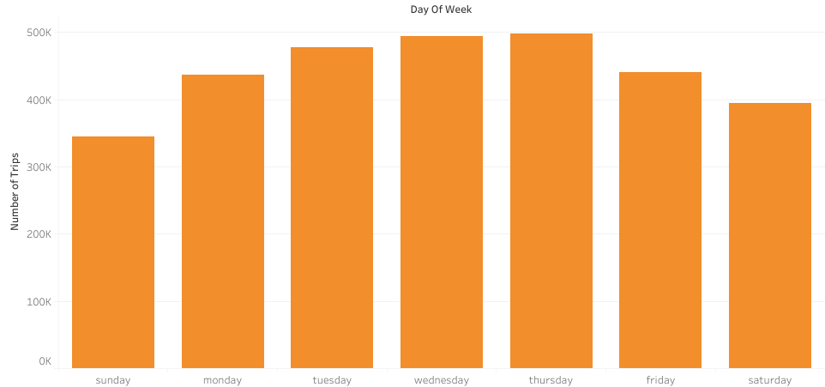
Number of Trips by Members
Annual members use Cyclistic bikes more frequently on weekdays
Wednesday and Thursday are the days of the week with most trips

Slide 11
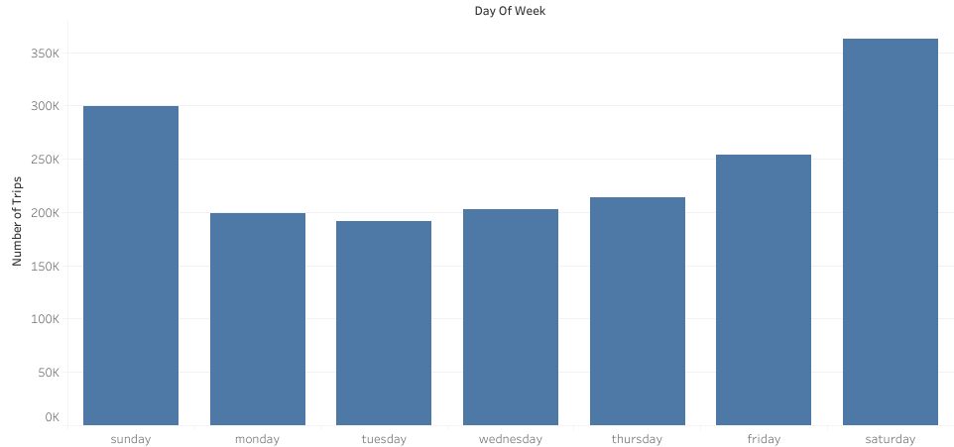
Number of Trips by Casual Riders
Casual riders use Cyclistic bikes more frequently on the weekend

Slide 12
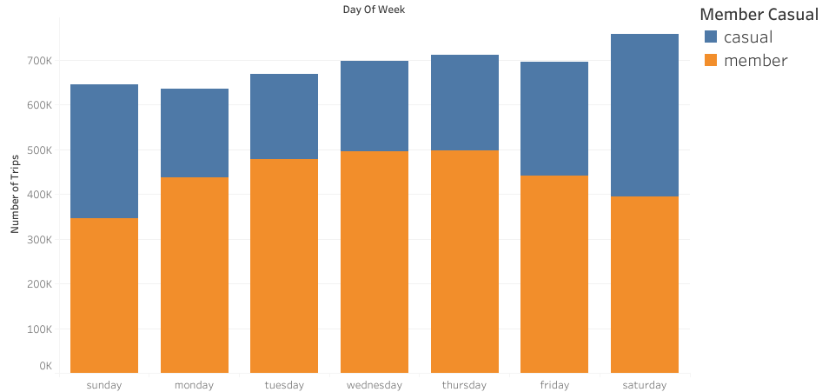
Comparison of Number of Trips
Annual members and casual riders mainly use Cyclistic’s service on different days

Slide 13
What can we do?

Slide 14
Offer a discounted weekend-only annual subscription for users who do not need Cyclistic bikes during the week
Focus the new marketing campaign on the benefits of using Cyclistic bikes to commute
Focus the new marketing campaign on the financial benefits of buying the subscription instead of paying for each trip, especially for longer trips, offering a sign-up discount

Slide 15
Thank you

