Slide 1
Energy Spotlight
Analytics Measurement Plan

Slide 2
AGENDA
01 Introduction
02 Data Structure
03 Energy
04 Cross site events

Slide 3
1
Introduction

Slide 4
Energy Spotlight - Analytics
Introduction
This measurement framework defines the tracking requirements for Amazon Sustainability’s Energy and Energy Spotlight pages. To ensure architectural integrity and cross-environment parity, the plan maps directly to the current Adobe Analytics schema used in the WWS report suites. By utilizing existing dimensions and metrics, we guarantee data consistency and historical comparability across all development phases

Slide 5
2
Data Structure

Slide 6
Energy Spotlight - Analytics
Data Structure
According to the Adobe documentation and measurement framework, these are the references to understand the following plan:
Event: indicates the event name.
Props: describe the traffic variables that are used to measure and analyze the dimensions of traffic on a website; are hit variables, meaning that information is collected only for the current page or interaction.
eVars: describes the eVars associated with each event, are used to track persistent values ​​throughout the user experience.
Example Event = Click
Evars & Props
Prop 1: Timestamp <Timestamp MM/DD/YYYY format>
eVar1: Domain <website domain>
eVar2: Page name <page name>

Slide 7
Name of Project
Main Section
Component | Action
EXAMPLE SLIDE
Event configuration with variables details
Image screenshot with highlights

Slide 8
3
Energy
Events & eVars by component

Slide 9
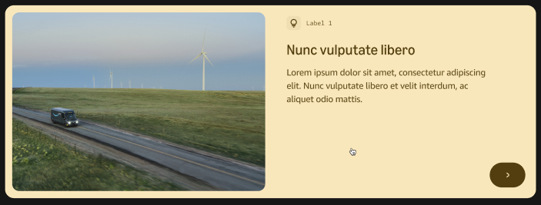
Energy Spotlight - Analytics
Energy Spotlight | C-40
Fact Cards - Image Large
Event: CTA Clicks (event1)
Prop 1 (Timestamp): <Timestamp MM/DD/YYYY format>
eVar1 (Domain): <website domain>
eVar2 (Previous Page): <previous page>
eVar3 (Page name): "Energy Spotlight"
eVar4 (Site Section): "Energy Stories"
eVar10 (Page Type): "Full Website"
eVar12 (CTA Button): <CTA button name/action>
eVar15 (Page URL): <Page URL>
eVar28 (Page Section): "Fact Card Image Large"
eVar31 (Clean Page URL): <Clean URL of the current page>
eVar36 (Component): <C40>

Slide 10
Energy Spotlight - Analytics
Energy Spotlight | C-40
Fact Cards - Image Large | DataLayer Push
var adobeDataLayer = adobeDataLayer || [];
adobeDataLayer.push({
event: "CTA Clicks",
userInteraction: {
timestamp: <Timestamp MM/DD/YYYY format>,
domain: <website domain>,
previousPage: <previous page>,
pageName: "Energy Spotlight",
siteSection: "Energy Stories",
pageType: "Full Website",
ctaButton: <CTA button name/action>,
pageURL: <Page URL>,
pageSection: "Fact Card Image Large",
cleanPageURL: <Clean URL of the current page>,
component: <C40>
}
});

Slide 11
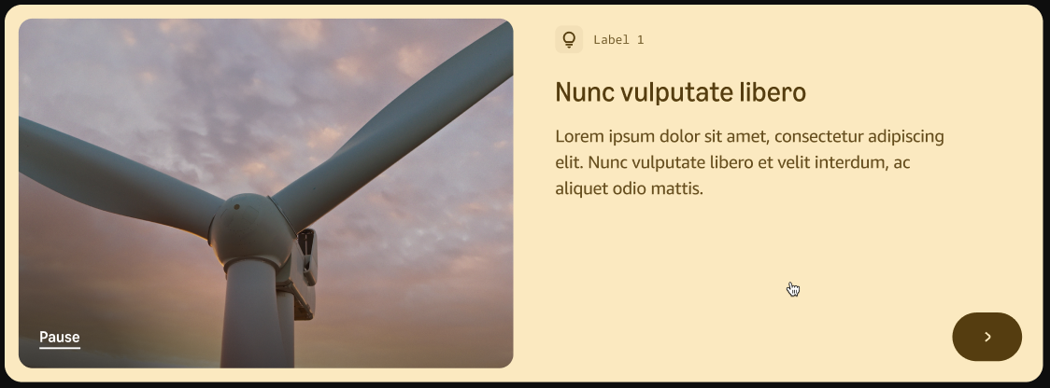
Energy Spotlight - Analytics
Energy Spotlight | C-40
Fact Cards - Video Large
Event: CTA Clicks (event1)
Prop 1 (Timestamp): <Timestamp MM/DD/YYYY format>
eVar1 (Domain): <website domain>
eVar2 (Previous Page): <previous page>
eVar3 (Page name): "Energy Spotlight"
eVar4 (Site Section): "Energy Stories"
eVar10 (Page Type): "Full Website"
eVar12 (CTA Button): <CTA button name/action>
eVar15 (Page URL): <Page URL>
eVar28 (Page Section): "Fact Card Video Large"
eVar31 (Clean Page URL): <Clean URL of the current page>
eVar36 (Component): <C40>

Slide 12
Energy Spotlight - Analytics
Energy Spotlight | C-40
Fact Cards - Video Large | DataLayer Push
var adobeDataLayer = adobeDataLayer || [];
adobeDataLayer.push({
event: "CTA Clicks",
userInteraction: {
timestamp: <Timestamp MM/DD/YYYY format>,
domain: <website domain>,
previousPage: <previous page>,
pageName: "Energy Spotlight",
siteSection: "Energy Stories",
pageType: "Full Website",
ctaButton: <CTA button name/action>,
pageURL: <Page URL>,
pageSection: "Fact Card Video Large",
cleanPageURL: <Clean URL of the current page>,
component: <C40>
}
});

Slide 13
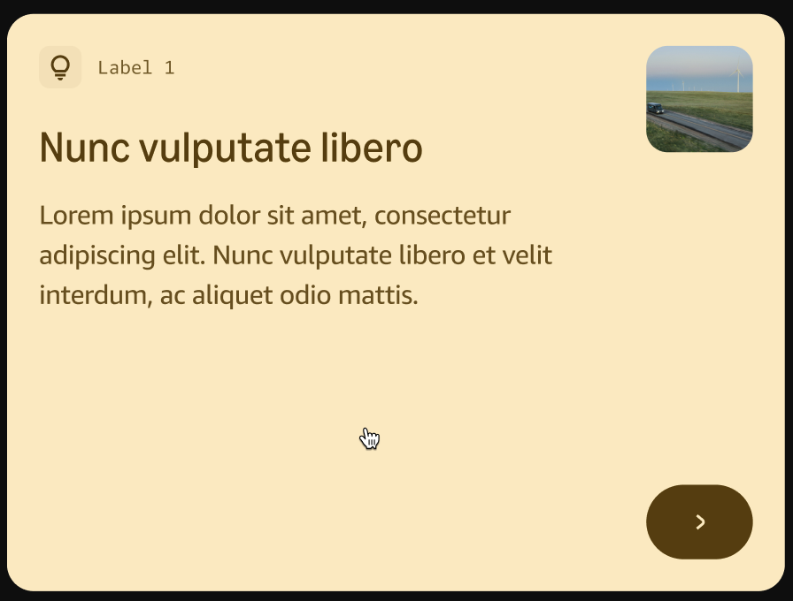
Energy Spotlight - Analytics
Energy Spotlight | C-40
Fact Cards - Image Small
Event: CTA Clicks (event1)
Prop 1 (Timestamp): <Timestamp MM/DD/YYYY format>
eVar1 (Domain): <website domain>
eVar2 (Previous Page): <previous page>
eVar3 (Page name): "Energy Spotlight"
eVar4 (Site Section): "Energy Stories"
eVar10 (Page Type): "Full Website"
eVar12 (CTA Button): <CTA button name/action>
eVar15 (Page URL): <Page URL>
eVar28 (Page Section): "Fact Card Image Small"
eVar31 (Clean Page URL): <Clean URL of the current page>
eVar36 (Component): <C40>

Slide 14
Energy Spotlight - Analytics
Energy Spotlight | C-40
Fact Cards - Image Small | DataLayer Push
var adobeDataLayer = adobeDataLayer || [];
adobeDataLayer.push({
event: "CTA Clicks",
userInteraction: {
timestamp: <Timestamp MM/DD/YYYY format>,
domain: <website domain>,
previousPage: <previous page>,
pageName: "Energy Spotlight",
siteSection: "Energy Stories",
pageType: "Full Website",
ctaButton: <CTA button name/action>,
pageURL: <Page URL>,
pageSection: "Fact Card Image Small",
cleanPageURL: <Clean URL of the current page>,
component: <C40>
}
});

Slide 15
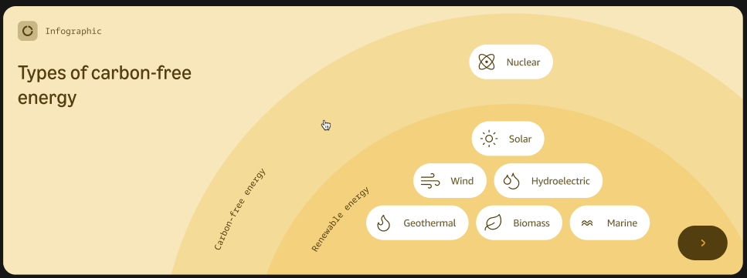
Energy Spotlight - Analytics
Energy Spotlight | C-40
Interactive Card
Event: CTA Clicks (event1)
Prop 1 (Timestamp): <Timestamp MM/DD/YYYY format>
eVar1 (Domain): <website domain>
eVar2 (Previous Page): <previous page>
eVar3 (Page name): "Energy Spotlight"
eVar4 (Site Section): "Energy Stories"
eVar10 (Page Type): "Full Website"
eVar12 (CTA Button): <CTA button name/action>
eVar15 (Page URL): <Page URL>
eVar28 (Page Section): "Interactive Card"
eVar31 (Clean Page URL): <Clean URL of the current page>
eVar36 (Component): <C40>

Slide 16
Energy Spotlight - Analytics
Energy Spotlight | C-40
Interactive Card | DataLayer Push
var adobeDataLayer = adobeDataLayer || [];
adobeDataLayer.push({
event: "CTA Clicks",
userInteraction: {
timestamp: <Timestamp MM/DD/YYYY format>,
domain: <website domain>,
previousPage: <previous page>,
pageName: "Energy Spotlight",
siteSection: "Energy Stories",
pageType: "Full Website",
ctaButton: <CTA button name/action>,
pageURL: <Page URL>,
pageSection: "Interactive Card",
cleanPageURL: <Clean URL of the current page>,
component: <C40>
}
});

Slide 17
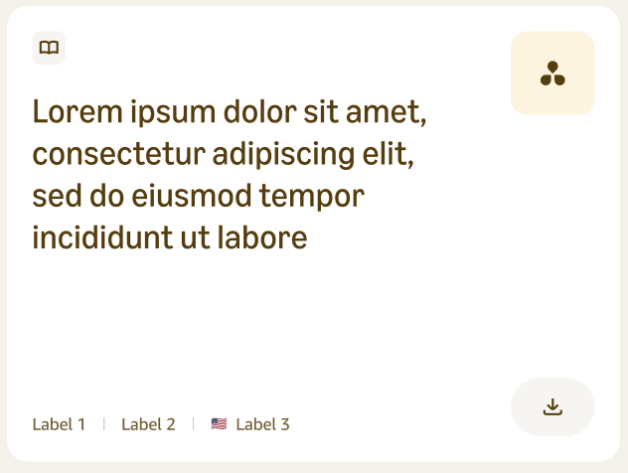
Energy Spotlight - Analytics
Energy Spotlight | C-40
Download
Event: CTA Clicks (event1)
Prop 1 (Timestamp): <Timestamp MM/DD/YYYY format>
eVar1 (Domain): <website domain>
eVar2 (Previous Page): <previous page>
eVar3 (Page name): "Energy Spotlight"
eVar4 (Site Section): "Energy Stories"
eVar5 (File Name): <Name of the document file, e.g., "Overview Document Q4 2025.pdf">
eVar6 (File Type): <Type of file, e.g., "PDF" or "XLS">
eVar10 (Page Type): "Full Website"
eVar12 (CTA Button): "Download"
eVar15 (Page URL): <Page URL>
eVar28 (Page Section): <Page section>
eVar31 (Clean Page URL): <Clean URL of the current page>
eVar36 (Component): <C40>

Slide 18
Energy Spotlight - Analytics
Energy Spotlight | C-40
Download | DataLayer Push
var adobeDataLayer = adobeDataLayer || [];
adobeDataLayer.push({
event: "CTA Clicks",
userInteraction: {
timestamp: <Timestamp MM/DD/YYYY format>,
domain: <website domain>,
previousPage: <previous page>,
pageName: "Energy Spotlight",
siteSection: "Energy Stories",
fileName: <Name of the document file, e.g., "Overview Document Q4 2025.pdf">,
fileType: <Type of file, e.g., "PDF" or "XLS">,
pageType: "Full Website",
ctaButton: "Download",
pageURL: <Page URL>,
pageSection: <Page section>,
cleanPageURL: <Clean URL of the current page>,
component: <C40>
}
});

Slide 19
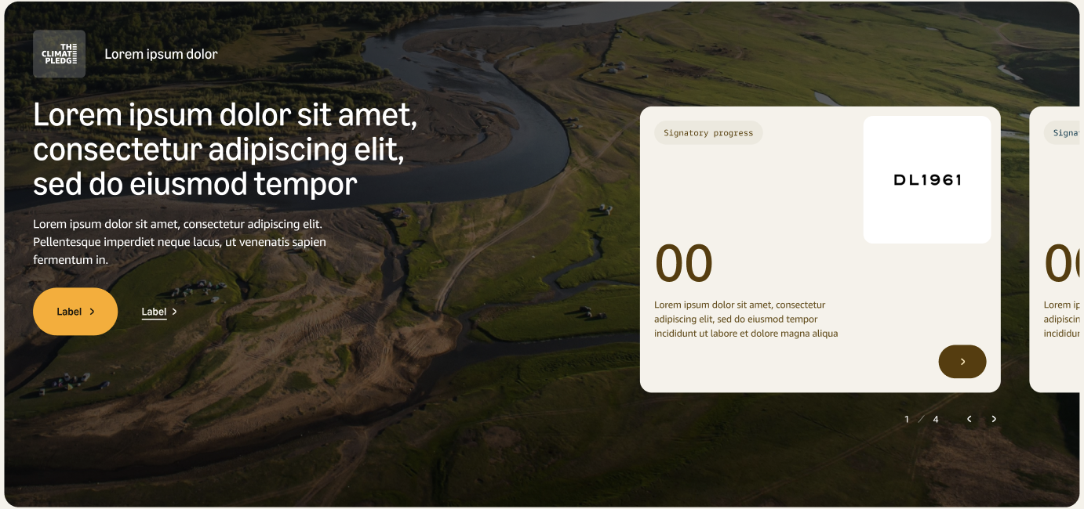
Energy Spotlight - Analytics
Energy Spotlight | C-43
Highlight Slider
Event: CTA Clicks (event1)
Prop 1 (Timestamp): <Timestamp MM/DD/YYYY format>
eVar1 (Domain): <website domain>
eVar2 (Previous Page): <previous page>
eVar3 (Page name): "Energy Spotlight"
eVar4 (Site Section): "Energy Stories"
eVar10 (Page Type): "Full Website"
eVar12 (CTA Button): “ Slide Card CTA button”
eVar15 (Page URL): <Page URL>
eVar28 (Page Section): “Highlight Slider"
eVar31 (Clean Page URL): <Clean URL of the current page>
eVar36 (Component): <C43>

Slide 20
Energy Spotlight - Analytics
Energy Spotlight | C-43
Highlight Slider | DataLayer Push
var adobeDataLayer = adobeDataLayer || [];
adobeDataLayer.push({
event: "CTA Clicks",
userInteraction: {
timestamp: <Timestamp MM/DD/YYYY format>,
domain: <website domain>,
previousPage: <previous page>,
pageName: "Energy Spotlight",
siteSection: "Energy Stories",
pageType: "Full Website",
ctaButton: “Slide Card CTA button”,
pageURL: <Page URL>,
pageSection: “Highlight Slider",
cleanPageURL: <Clean URL of the current page>,
component: <C43>
}
});

Slide 21
Energy Spotlight - Analytics
Energy Spotlight | C-43
Highlight Slider
Event: Link Clicks (event2)
Prop 1 (Timestamp): <Timestamp MM/DD/YYYY format>
eVar1 (Domain): <website domain>
eVar2 (Previous Page): <previous page>
eVar3 (Page name): "Energy Spotlight"
eVar4 (Site Section): "Energy Stories"
eVar10 (Page Type): "Full Website"
eVar14 (Destination Link): <URL of external destination>
eVar15 (Page URL): <Page URL>
eVar17 (Link Title): <Link title>
eVar28 (Page Section): “Highlight Slider"
eVar31 (Clean Page URL): <Clean URL of the current page>
eVar36 (Component): <C43>
*This interaction can be represented as a CTA or Link Click

Slide 22
Energy Spotlight - Analytics
Energy Spotlight | C-43
Highlight Slider | DataLayer Push
var adobeDataLayer = adobeDataLayer || [];
adobeDataLayer.push({
event: "Link Clicks",
userInteraction: {
timestamp: <Timestamp MM/DD/YYYY format>,
domain: <website domain>,
previousPage: <previous page>,
pageName: "Energy Spotlight",
siteSection: "Energy Stories",
pageType: "Full Website",
destinationURL: <URL of external destination>,
pageURL: <Page URL>,
linkTitle: <Link title e.g. "Conditions of Use">,
pageSection: “Highlight Slider",
cleanPageURL: <Clean URL of the current page>,
component: <C43>
}
});

Slide 23
Energy Spotlight - Analytics
Energy Spotlight | C-43
Highlight Slider
Event: CTA Clicks (event1)
Prop 1 (Timestamp): <Timestamp MM/DD/YYYY format>
eVar1 (Domain): <website domain>
eVar2 (Previous Page): <previous page>
eVar3 (Page name): "Energy Spotlight"
eVar4 (Site Section): "Energy Stories"
eVar10 (Page Type): "Full Website"
eVar12 (CTA Button): <CTA Button Label>
eVar15 (Page URL): <Page URL>
eVar28 (Page Section): “Highlight Slider"
eVar31 (Clean Page URL): <Clean URL of the current page>
eVar36 (Component): <C43>
*This interaction can be represented as a CTA or Link Click

Slide 24
Energy Spotlight - Analytics
Energy Spotlight | C-43
Highlight Slider | DataLayer Push
var adobeDataLayer = adobeDataLayer || [];
adobeDataLayer.push({
event: "CTA Clicks",
userInteraction: {
timestamp: <Timestamp MM/DD/YYYY format>,
domain: <website domain>,
previousPage: <previous page>,
pageName: "Energy Spotlight",
siteSection: "Energy Stories",
pageType: "Full Website",
ctaButton: <CTA Button Label>,
pageURL: <Page URL>,
pageSection: “Highlight Slider",
cleanPageURL: <Clean URL of the current page>,
component: <C43>
}
});

Slide 25
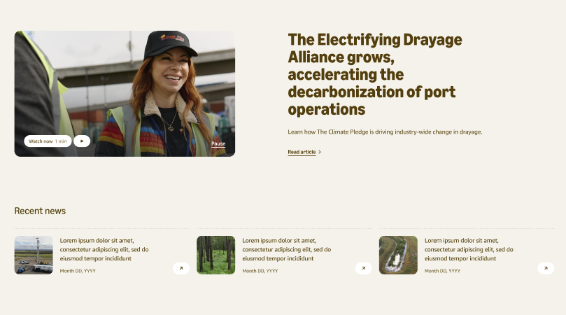
Energy Spotlight - Analytics
Energy Spotlight | C-38.1
Teaser Small Cards
Event: Link Clicks (event2)
Prop 1 (Timestamp): <Timestamp MM/DD/YYYY format>
eVar1 (Domain): <website domain>
eVar2 (Previous Page): <previous page>
eVar3 (Page name): "Energy Spotlight"
eVar4 (Site Section): "Energy Stories"
eVar10 (Page Type): "Full Website"
eVar14 (Destination Link): <URL of external destination>
eVar15 (Page URL): <Page URL>
eVar17 (Link Title): <Link title>
eVar28 (Page Section): “Teaser Small Cards”
eVar31 (Clean Page URL): <Clean URL of the current page>
eVar36 (Component): <C38.1>

Slide 26
Energy Spotlight - Analytics
Energy Spotlight | C-38.1
Teaser Small Cards | DataLayer Push
var adobeDataLayer = adobeDataLayer || [];
adobeDataLayer.push({
event: "Link Clicks",
userInteraction: {
timestamp: <Timestamp MM/DD/YYYY format>,
domain: <website domain>,
previousPage: <previous page>,
pageName: "Energy Spotlight",
siteSection: "Energy Stories",
pageType: "Full Website",
destinationURL: <URL of external destination>,
pageURL: <Page URL>,
linkTitle: <Link title e.g. "Conditions of Use">,
pageSection: “Teaser Small Cards",
cleanPageURL: <Clean URL of the current page>,
component: <C38.1>
}
});

Slide 27

Energy Spotlight - Analytics
Energy Spotlight | C-38.1
Teaser Small Cards
Event: CTA Clicks (event1)
Prop 1 (Timestamp): <Timestamp MM/DD/YYYY format>
eVar1 (Domain): <website domain>
eVar2 (Previous Page): <previous page>
eVar3 (Page name): "Energy Spotlight"
eVar4 (Site Section): "Energy Stories"
eVar10 (Page Type): "Full Website"
eVar12 (CTA Button): <CTA button name/action>
eVar15 (Page URL): <Page URL>
eVar28 (Page Section): “Teaser Small Cards”
eVar31 (Clean Page URL): <Clean URL of the current page>
eVar36 (Component): <C38.1>

Slide 28
Energy Spotlight - Analytics
Energy Spotlight | C-38.1
Teaser Small Cards | DataLayer Push
var adobeDataLayer = adobeDataLayer || [];
adobeDataLayer.push({
event: "CTA Clicks",
userInteraction: {
timestamp: <Timestamp MM/DD/YYYY format>,
domain: <website domain>,
previousPage: <previous page>,
pageName: "Energy Spotlight",
siteSection: "Energy Stories",
pageType: "Full Website",
ctaButton: <CTA button name/action>,
pageURL: <Page URL>,
pageSection: “Teaser Small Cards",
cleanPageURL: <Clean URL of the current page>,
component: <C38.1>
}
});

Slide 29
4
Cross-site events

Slide 30
Energy Spotlight - Analytics
Scroll

Slide 31
Energy Spotlight - Analytics
Scroll
Every time the user reaches 25% scroll rate on any page
adobeDataLayer.event = "Scroll Reach 25%"
Event 15= Scroll Reach 25%
Evars & Props
Prop 1: Timestamp <Timestamp MM/DD/YYYY format>
eVar1: Domain <website domain>
eVar3: Page name <page name>
eVar4: Site Section <Section>
eVar10: Page Type <Full Website>
eVar15: Page URL <Page URL>
eVar28: Page Section <Page section>

Slide 32
Energy Spotlight - Analytics
Scroll
Every time the user reaches 50% scroll rate on any page
adobeDataLayer.event = "Scroll Reach 50%"
Event 16= Scroll Reach 50%
Evars & Props
Prop 1: Timestamp <Timestamp MM/DD/YYYY format>
eVar1: Domain <website domain>
eVar3: Page name <page name>
eVar4: Site Section <Section>
eVar10: Page Type <Full Website>
eVar15: Page URL <Page URL>
eVar28: Page Section <Page section>

Slide 33
Energy Spotlight - Analytics
Scroll
Every time the user reaches 75% scroll rate on any page
adobeDataLayer.event = "Scroll Reach 75%"
Event 17= Scroll Reach 75%
Evars & Props
Prop 1: Timestamp <Timestamp MM/DD/YYYY format>
eVar1: Domain <website domain>
eVar3: Page name <page name>
eVar4: Site Section <Section>
eVar10: Page Type <Full Website>
eVar15: Page URL <Page URL>
eVar28: Page Section <Page section>

Slide 34
Energy Spotlight - Analytics
Scroll
Every time the user reaches 100% scroll rate on any page
adobeDataLayer.event = "Video complete"
Event 14= Video complete
Evars & Props
Prop 1: Timestamp <Timestamp MM/DD/YYYY format>
eVar1: Domain <website domain>
eVar3: Page name <page name>
eVar4: Site Section <Section>
eVar10: Page Type <Full Website>
eVar15: Page URL <Page URL>
eVar28: Page Section <Page section>

Slide 35
TCP - Analytics
Video

Slide 36
TCP - Analytics
Video
Event = Video Start
Evars & Props
Prop 1: Timestamp <Timestamp MM/DD/YYYY format>
eVar1: Domain <website domain>
eVar3: Page name <page name>
eVar4: Site Section <Site section>
eVar10: Page Type <Full Website>
eVar11: Content Type <Video>
eVar13: Video Name <video name>
eVar15: Page URL <Page URL>
eVar28: Page Section <Page section>
eVar36: Component <component>

Slide 37
TCP - Analytics
Video
Event = Video 50%
Evars & Props
Prop 1: Timestamp <Timestamp MM/DD/YYYY format>
eVar1: Domain <website domain>
eVar3: Page name <page name>
eVar4: Site Section <Site section>
eVar10: Page Type <Full Website>
eVar11: Content Type <Video>
eVar13: Video Name <video name>
eVar15: Page URL <Page URL>
eVar28: Page Section <Page section>
eVar36: Component <component>

Slide 38
TCP - Analytics
Video
Event = Video 75%
Evars & Props
Prop 1: Timestamp <Timestamp MM/DD/YYYY format>
eVar1: Domain <website domain>
eVar3: Page name <page name>
eVar4: Site Section <Site section>
eVar10: Page Type <Full Website>
eVar11: Content Type <Video>
eVar13: Video Name <video name>
eVar15: Page URL <Page URL>
eVar28: Page Section <Page section>
eVar36: Component <component>

Slide 39
TCP - Analytics
Video
Event = Video Complete
Evars & Props
Prop 1: Timestamp <Timestamp MM/DD/YYYY format>
eVar1: Domain <website domain>
eVar3: Page name <page name>
eVar4: Site Section <Site section>
eVar10: Page Type <Full Website>
eVar11: Content Type <Video>
eVar13: Video Name <video name>
eVar15: Page URL <Page URL>
eVar28: Page Section <Page section>
eVar36: Component <component>

Slide 40
Thank you!
We have provided this presentation to you for informational and illustrative purposes on a confidential basis. We reserve the right to use of non-disclosure agreements (NDAs) to protect our privacy and intellectual property rights. The information contained in this document is highly sensitive, confidential and/or proprietary and is intended for the express use of the intended recipient, as denoted on the title page of this document. The recipient of this presentation agrees by its receipt not to reproduce, duplicate, or reveal, in whole or in part, information presented herein without written permission of Monks. No representation or warranty, expressed or implied, is made as to the accuracy or completeness of the information contained in this presentation. Any quote contained herein is for estimation purposes. Estimates are based on current, known requirements. Actual estimates may change once project elements are finalized or negotiated. This document may contain confidential pricing information. All pricing is subject to change.
Copyright © 2025 Monks. All rights reserved. Monks and the Monks logo are trademarks or registered trademarks of Monks. in the U.S. and/or other countries. All other trademarks are the property of their respective owners.

