Slide 1
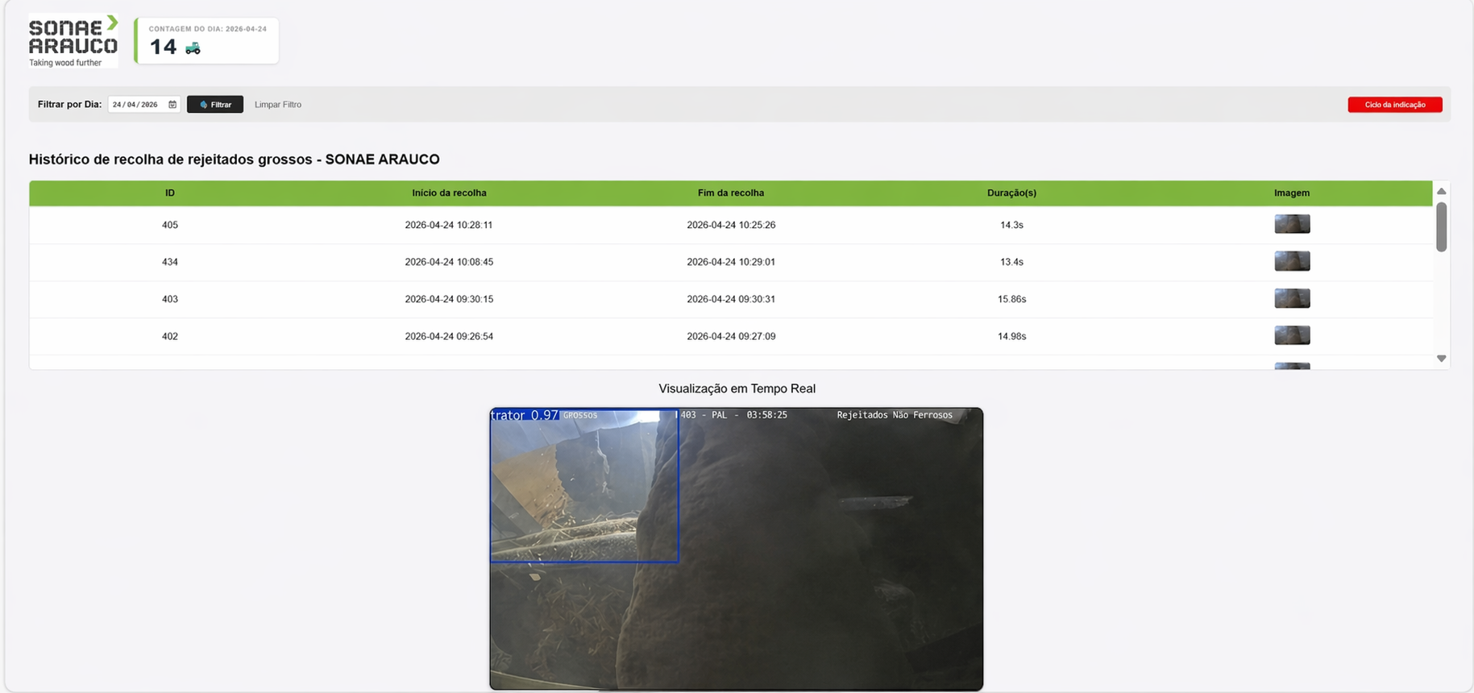
Tractor detector with AI

Slide 2
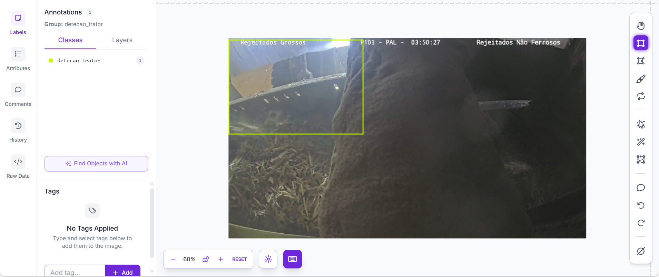
Dataset Creation & Data Annotation

Slide 3

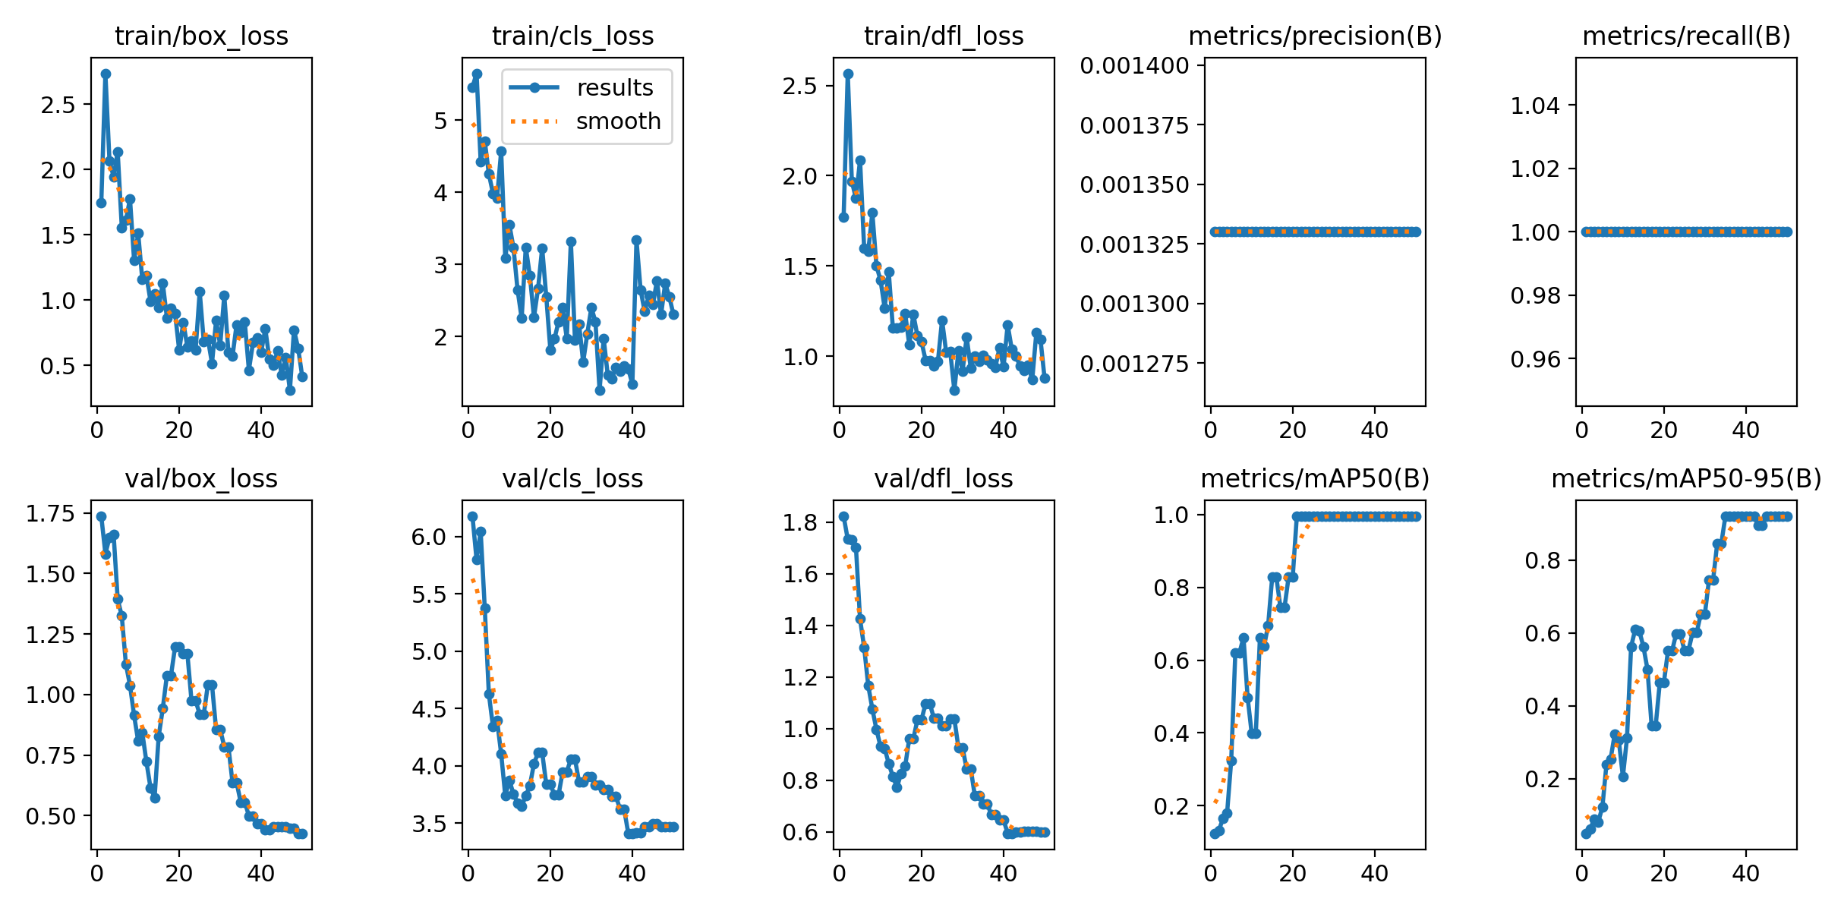
YOLOv8 Model Training & Evaluation

Slide 4
Real-Time Monitoring Dashboard

Slide 5
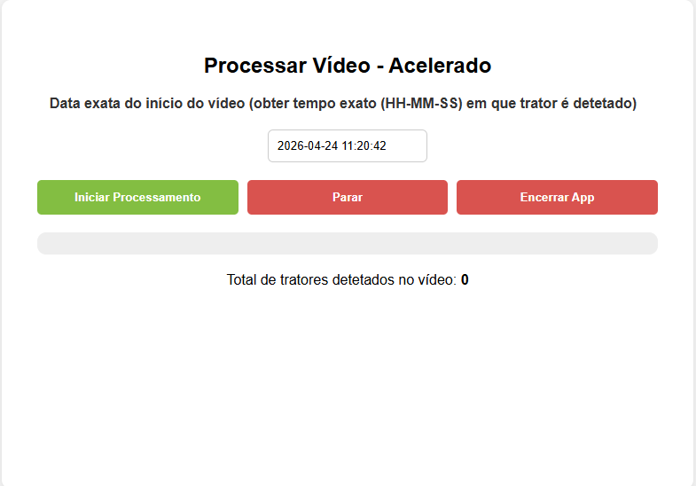
Processing Module

Slide 6
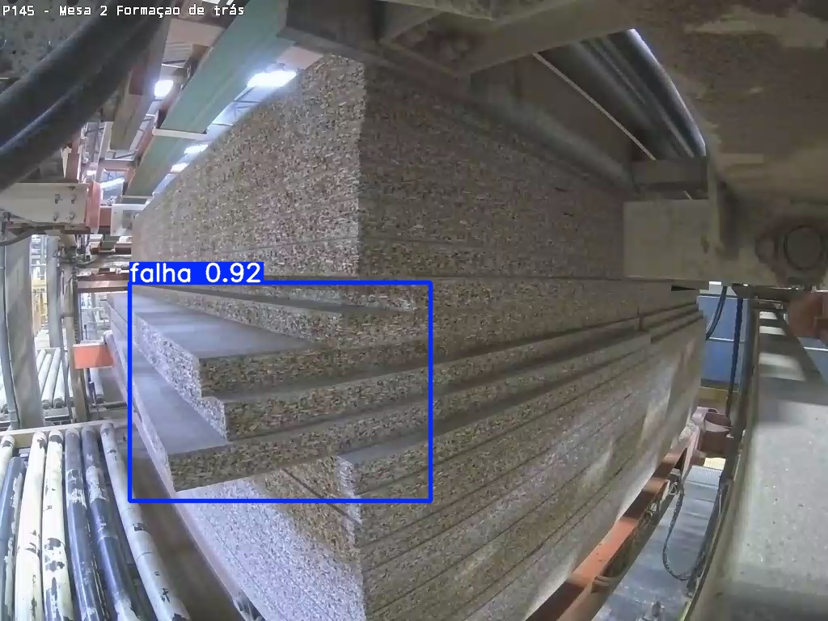
Next project – Plates failures

