Slide 1
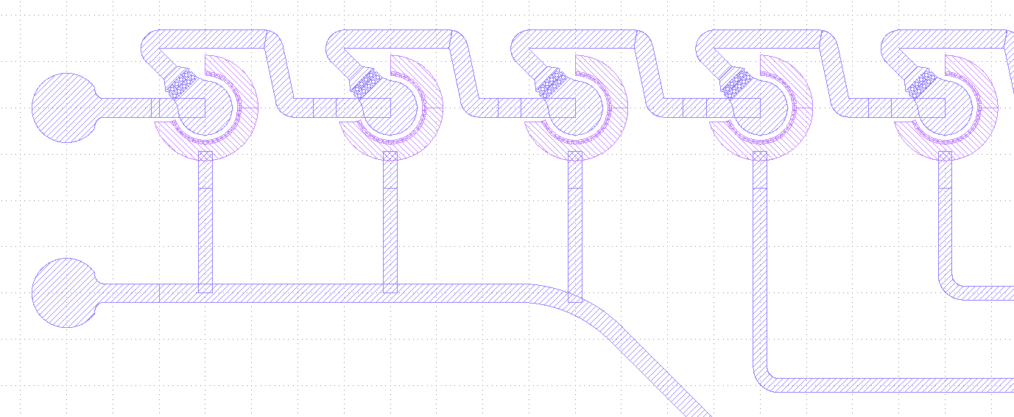
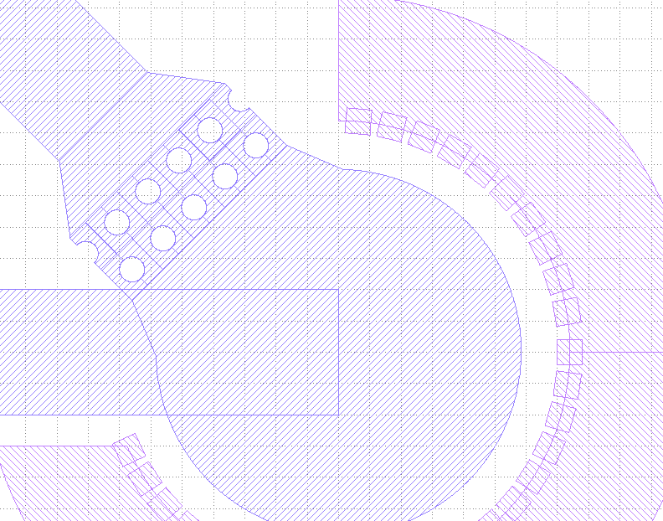
NanoHole Fluidics Chip with Buuble Trap Vacuum on Ipkiss
Francisco Tovar

Slide 2
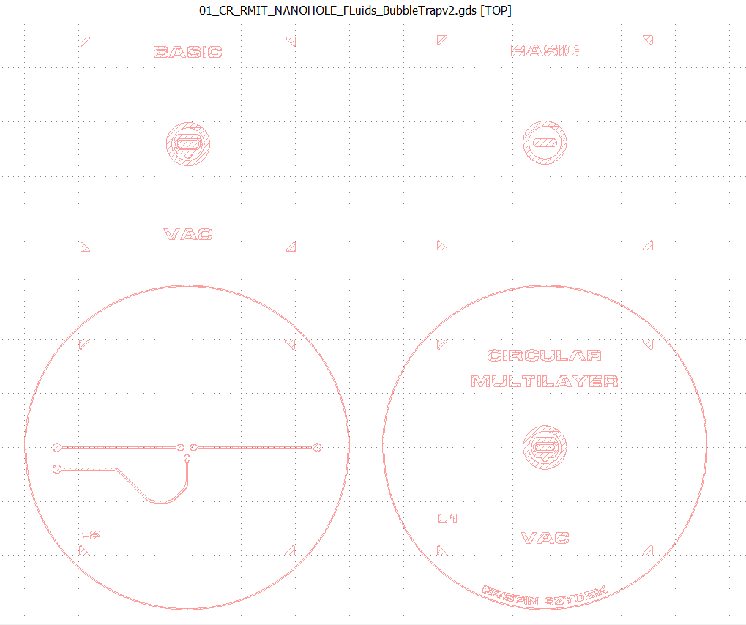
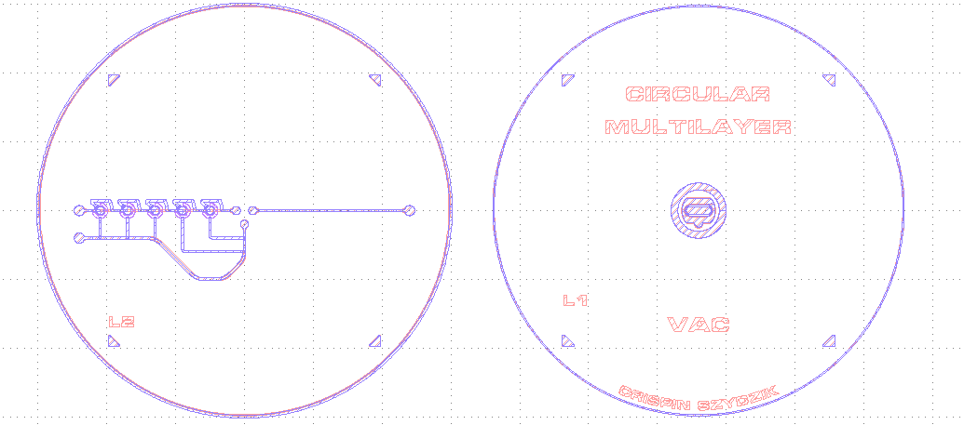
Crispin Solid Works GDS (red layer)
Replication in Ipkiss (blue layer)
…with bubble traps added

Slide 3
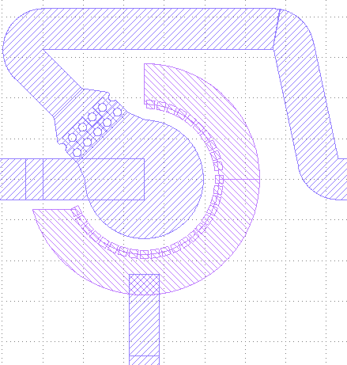
Crispin Solid Works GDS (red layer)
Replication in Ipkiss (blue layer)
…with bubble traps added

Slide 4
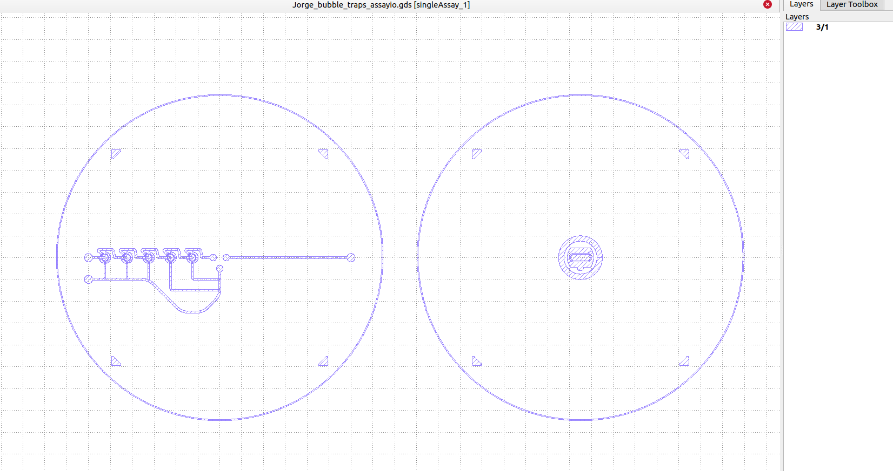
Three different GDS generated by three main scripts
fluid
nanohole chip
Vacuum
fluid
Jorge_single_Assay_PlaceAndAutoRoute_bubbtrap_i_o_bubtrap.py
Vacuum
Jorge_single_Assay_PlaceAndAutoRoute_vacuum_i_o_vactrap.py
nanohole chip
Jorge_single_Assay_PlaceAndAutoRoute_NanoHoleArray_fluidics.py

Slide 5
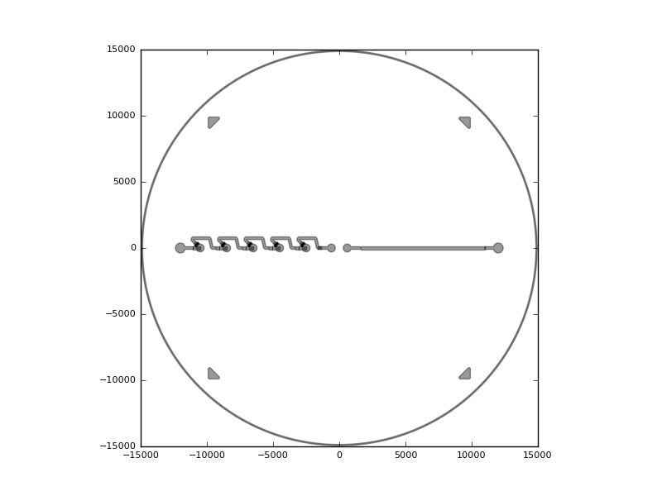
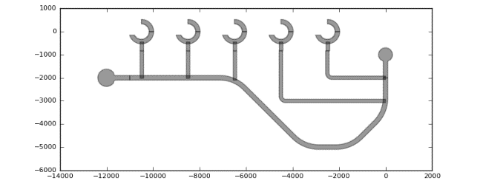
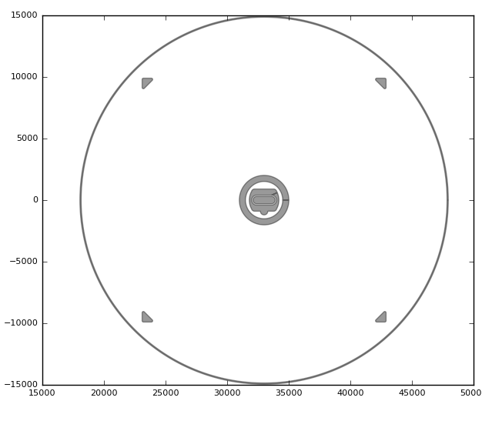
whats inside each GDS
Jorge_bubble_traps_assayio.gds
Jorge_vacuum_route_traps_assayio.gds
Jorge_nano_holeArray_assayio.gds

Slide 6
fluid
Jorge_bubble_traps_assayio.gds
Vacuum nanohole chip
Jorge_vacuum_route_traps_assayio.gds
Jorge_nano_holeArray_assayio.gds
GDS generation code. (From Slide 8)

Slide 7
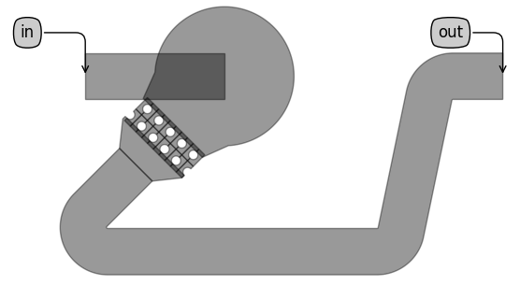
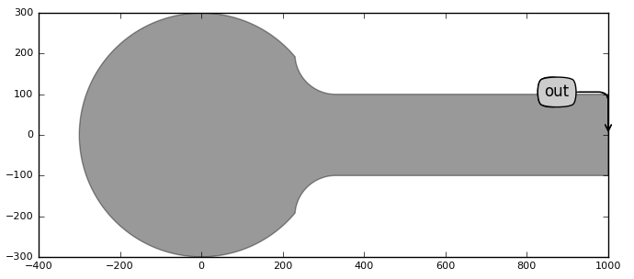
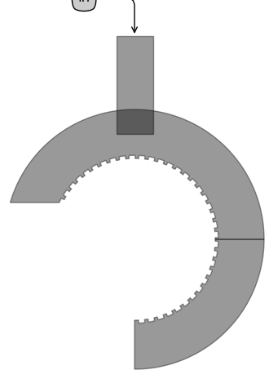
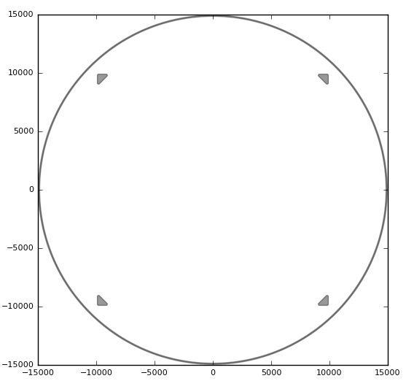
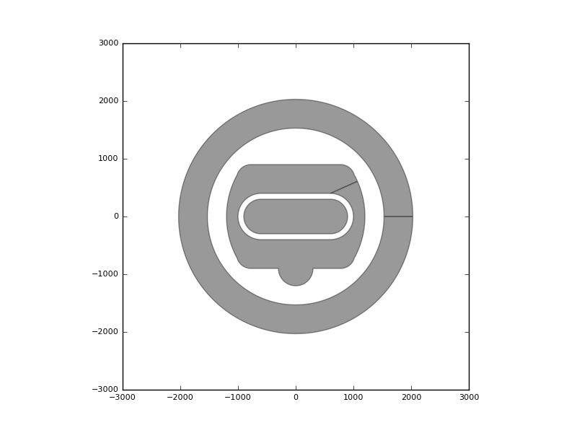
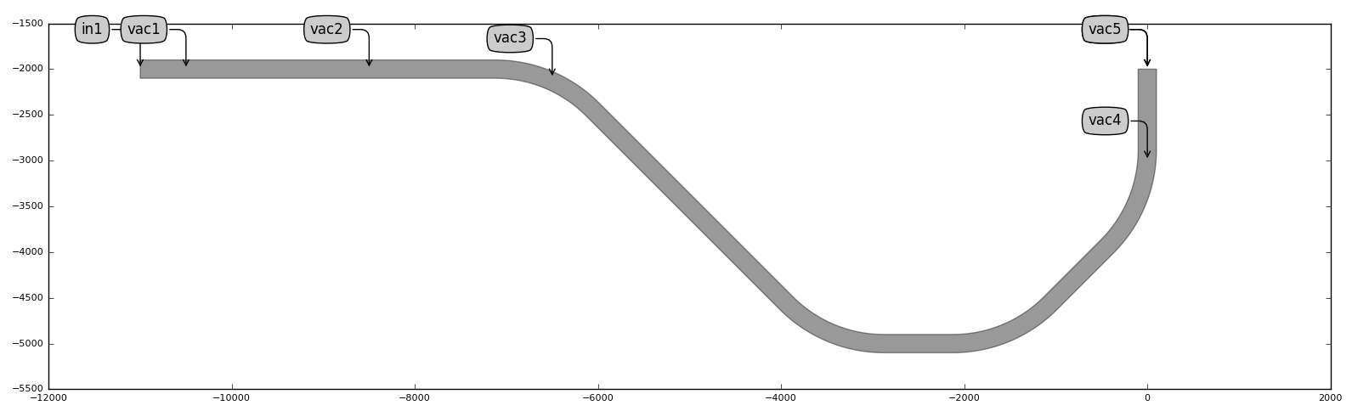
Components
Complex
BubbleTrapFluid
Composed by:
DebriTrapSingle
Obstacle Left
Obstacle Right
Array of obstacles
Reservoir
VacuumTrap
Composed by:
Booleans operations
NanoHoleArrayF
Composed by:
Booleans operations
Single
InletHole
MarksWafer
VacuumChannelRoute
Composed by:
Routing from SolidWorks points

Slide 8
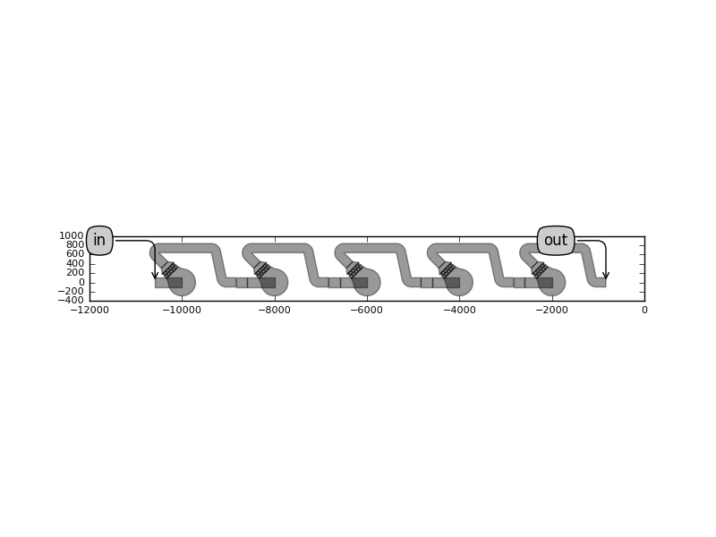
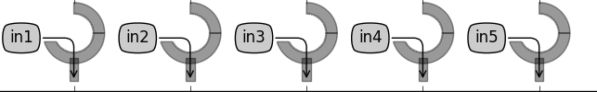
Circuits
CircuitOfTraps
Composed by BubbleTrapFluid on a circuit of traps topology (block 2020 example)
circuit_PlaceAndAutoRoute_BubbleTrap.py
CircuitOfVacTraps
Composed by VacuumTrap on a circuit of traps topology (block 2020 example)
circuit_PlaceAndAutoRoute_BubbleTrapVac.py
code\circuits_using_components
code\circuits_using_components

Slide 9
Code: jorge_single_Assay_PlaceAndAutoRoute_NanoHoleArray_fluidics.py
code\circuits_using_components
Code
(PlaceAndAutoRoute)
input
Output : GDS
Uses 2 components
Nanohole
wafer_marks

Slide 10
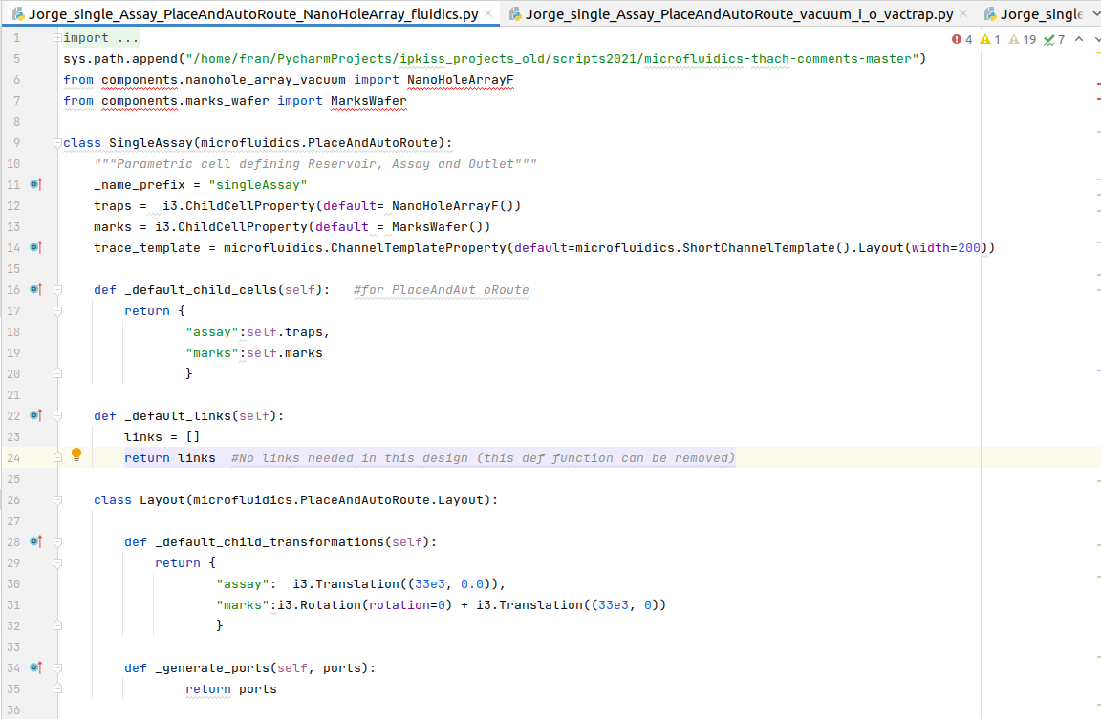
code detail
Position

Slide 11
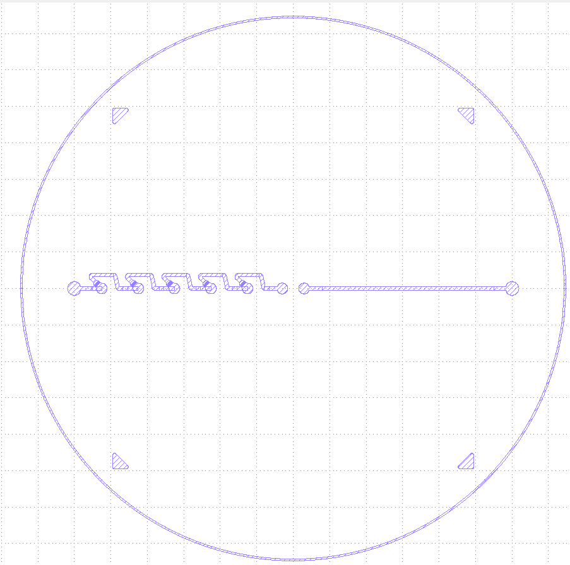
code\circuits_using_components
Code: Jorge_single_Assay_PlaceAndAutoRoute_bubbtrap_i_o_bubtrap.py
Code
(PlaceAndAutoRoute)
input
Output : GDS
Uses 3 components
InletHole
MarksWafer
CircuitOfTraps
‘

Slide 12
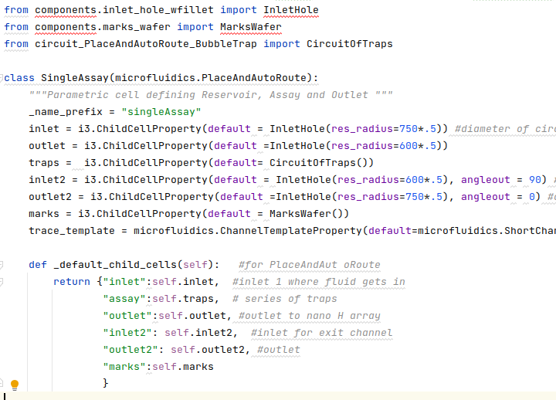
code detail

Slide 13
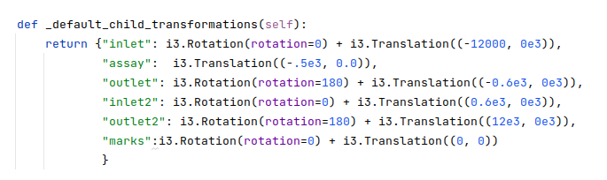
code detail defining positions of objects

Slide 14
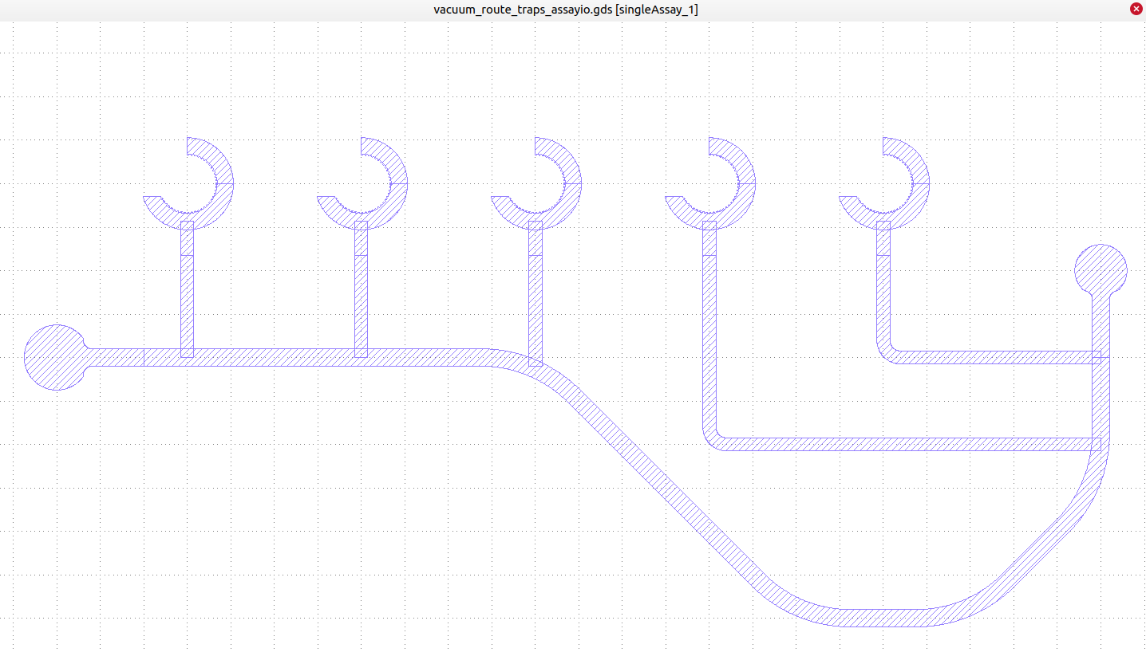
code\circuits_using_components
Jorge_single_Assay_PlaceAndAutoRoute_bubbtrap_i_o_bubtrap.py
input
Code
(PlaceAndAutoRoute)
Output : GDS
3 components:
InletHole
VacuumChannelRoute
CircuitOfVacTraps

Slide 15
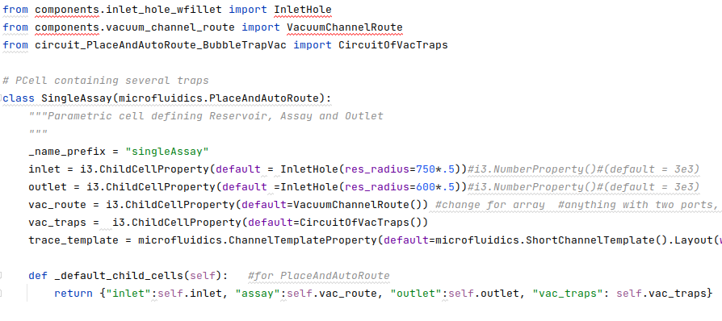
Code detail

Slide 16
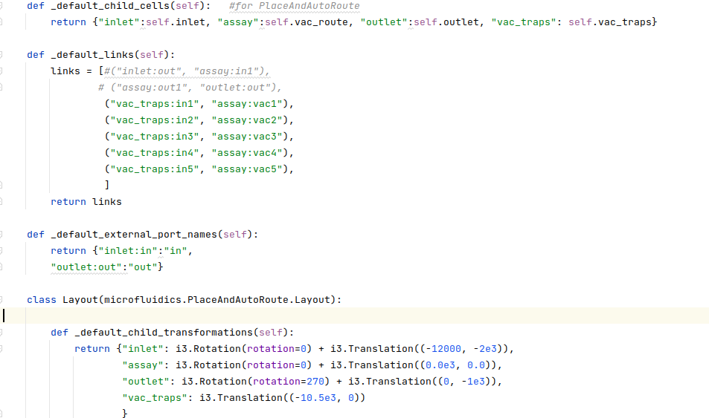
Code detail
Linking route with traps

