Slide 1

What I have:
“Lil Mosey & Lunay”
(a scalar string with both artists names together)
What I want:
[“Lil Mosey”, “Lunay”]
(a list with each artist name as a separate element)

Slide 2

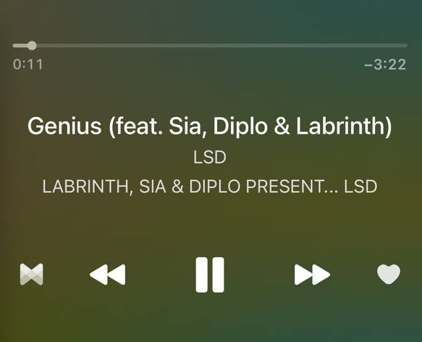
Input:
Name: “Relación (Remix) [feat. ROSALÍA & Farruko]”
Artist: “Sech, Daddy Yankee & J Balvin”
Output:
[“Sech”, “Daddy Yankee”, “J Balvin”, “ROSALÍA”, “Farruko”]
Input:
Name: “Genius (feat. Sia, Diplo & Labrinth”
Artist: “LSD”
Output:
[“LSD”, “Sia”, “Diplo”, “Labrinth”]

