Slide 1
Mongo DB ( Sharding)
Tajendar arora

Slide 2
Sharding
Sharding is the process of storing data records across multiple machines and it is MongoDB's approach to meeting the demands of data growth.
As the size of the data increases, a single machine may not be sufficient to store the data nor provide an acceptable read and write throughput.
Sharding solves the problem with horizontal scaling. With sharding, you add more machines to support data growth and the demands of read and write operations.

Slide 3
Sharding
Use of Sharding
In replication, all writes go to master node
Latency sensitive queries still go to master
Single replica set has limitation of 12 nodes
Memory can't be large enough when active dataset is big
Local disk is not big enough
Vertical scaling is too expensive

Slide 4
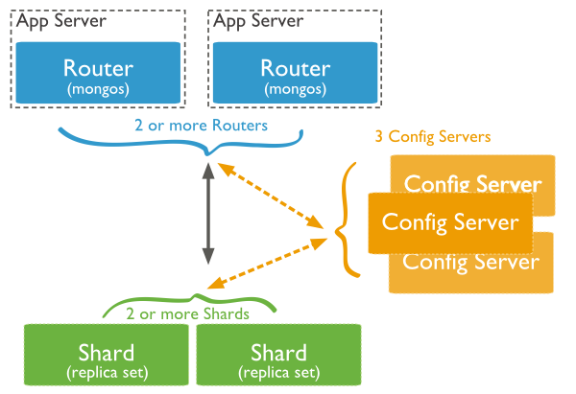
Sharding

Slide 5
Sharding
There are three main components −
Shards − Shards are used to store data. They provide high availability and data consistency. In production environment, each shard is a separate replica set.
Config Servers − Config servers store the cluster's metadata. This data contains a mapping of the cluster's data set to the shards. The query router uses this metadata to target operations to specific shards. In production environment, sharded clusters have exactly 3 config servers.
Query Routers − Query routers are basically mongo instances, interface with client applications and direct operations to the appropriate shard. The query router processes and targets the operations to shards and then returns results to the clients.

Slide 6
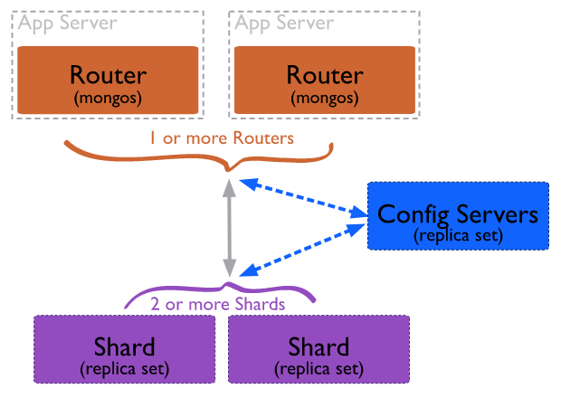
Sharding

Slide 7
Sharding
MongoDB sh.addShard(<url>) command
A shard replica set added to a sharded cluster using this command. If we add it among the shard of cluster, it affects the balance of chunks. It starts transferring chunks to balance the cluster.
<replica_set>/<hostname><:port>,<hostname><:port>, ...
Syntax:
sh.addShard("<replica_set>/<hostname><:port>")
Example:
sh.addShard("repl0/mongodb3.example.net:27327")

