Slide 1
CREDIT SCORING
BY: Francis K.

Slide 2
Outline
Introduction
Exploratory Data Analysis
Data Quality check and cleaning
Feature engineering
A/B Testing
Machine Learning
Deployment

Slide 3
Introduction
credit score is a statistical number that evaluates a consumer's creditworthiness and is based on credit history. Lenders use credit scores to evaluate the probability that an individual will repay his or her debts
ScoreCard is a rewards program tied to credit or debit cards from banks and credit unions. ScoreCard allows those institutions to offer rewards to their customers without having to manage a program themselves.

Slide 4
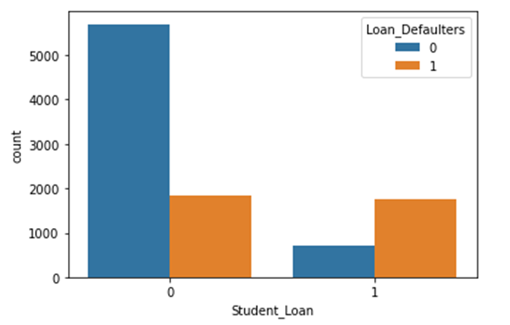
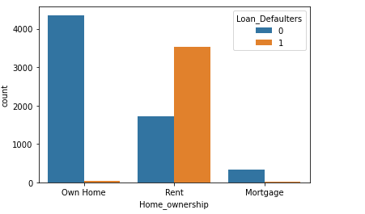

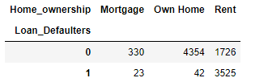
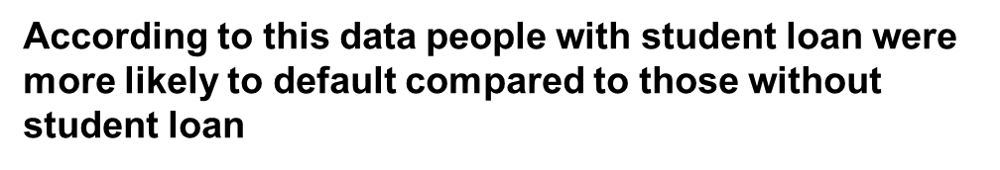
Exploratory Data Analysis
Most of the people who default in their loan payment are those who rent as (3525) compared to thosw who Own Home(42) and Mortgage (23).This shows that there is a high probability for Home_Ownership(Rent) to default from a loan.For the case of non_defaulters those who Own Home were the highest(4354).

Slide 5
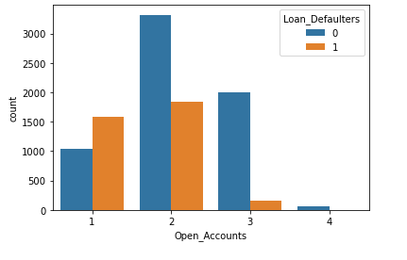
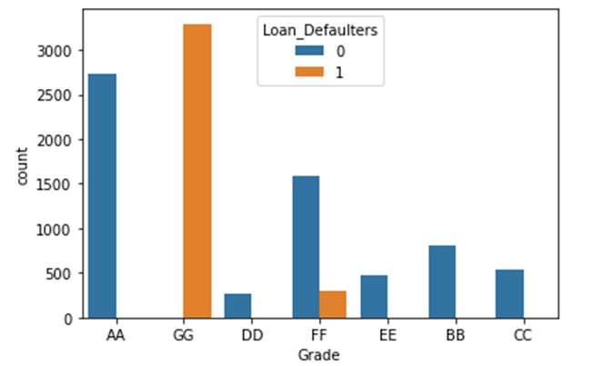
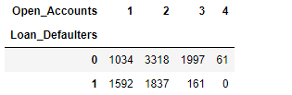
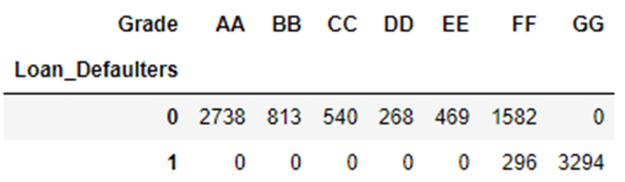
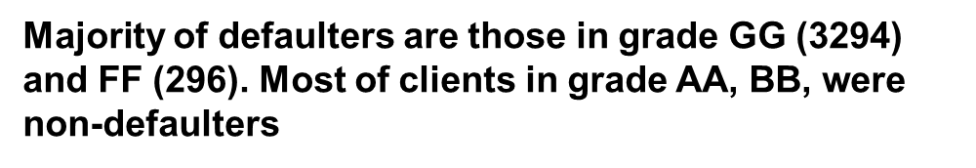
Those with 2 open accounts had the highest number of defaulters (1837) while those with four open accounts had 0 defaulters. Majority of non defaulters had 2 open accounts

Slide 6
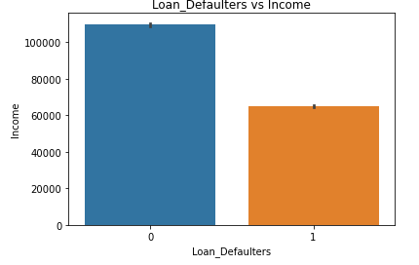
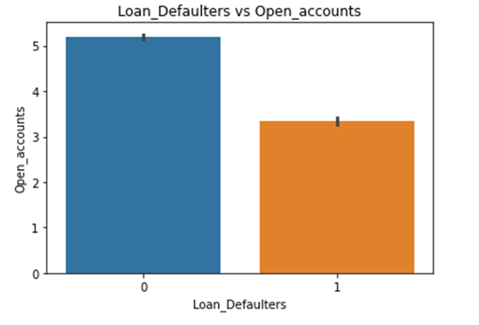

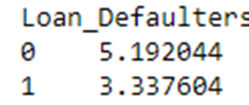

Most of non-defaulters were earning a higher average income (109781.037285) than defaulters (64959)
(using median is better than mean)

Slide 7
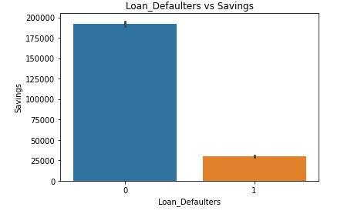
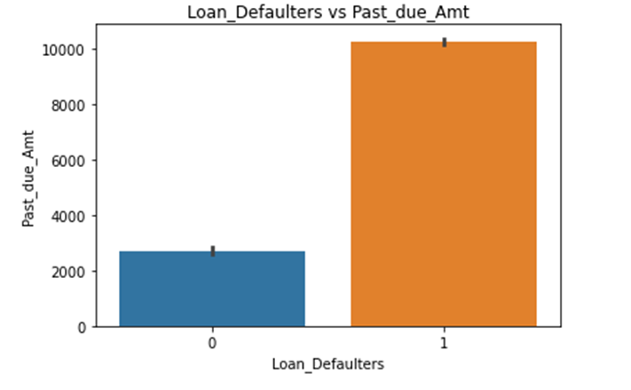

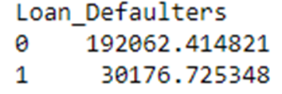
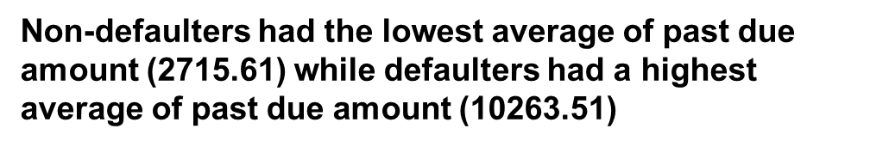
Those who did not defaulted had average saving of 192062.42 while those who defaulted had lowest saving with an average of 30176.73

Slide 8
Data Quality check and Cleaning
Data Quality Checks vs Data Cleaning
Completeness
Consistency
Uniqueness
Outliers/Noise

Slide 9
Feature Engineering / Data Wrangling
Feature engineering is the process that takes raw data and transforms it into features (such as characteristics, properties, attributes) that can be used to create a predictive model using machine learning or statistical modeling.
The reason for performing feature engineering is to prepare an input data set that best fits the machine learning algorithm as well as to enhance the performance of machine learning models.
Feature engineering helps to accelerates the time it takes to extract features from data, allowing for the extraction of more features

Slide 10
Feature Engineering / Data Wrangling
Categorical Encoding
Feature scaling
Feature Selection

Slide 11
Categorical Encoding
Label Encoding- Converting the labels into numeric form so as to convert it into the machine-readable form
One Hot Encoding (Get Dummy Variables)- creates new (binary) columns, indicating the presence of each possible value from the original data

Slide 12
Feature Selection and A/B Testing
Chi-square ( χ2) statistic- For categorical Variables
ANOVA (F-Statistic)- For Numerical Variables
Information Value- (Logistic Regression)

Slide 13
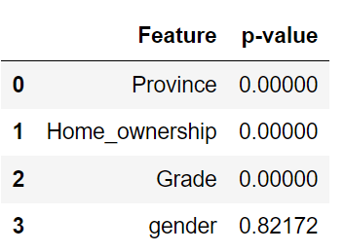
Chi-square ( χ2)
The top three categorical features are significant, however province can be a bias feature.

Slide 14
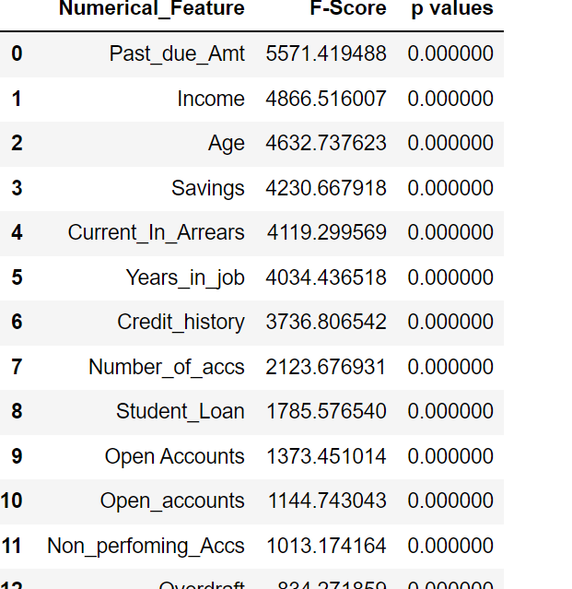
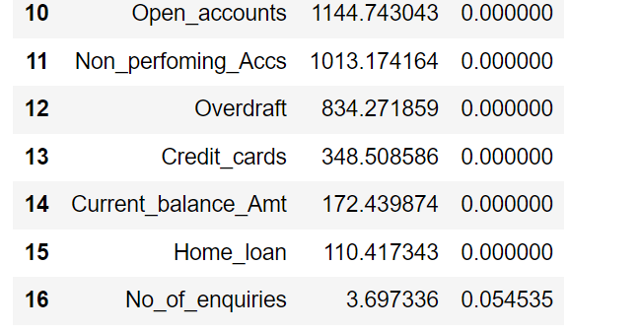
ANOVA (F-Statistic)
The top 15 features are significant however there is a need to calculate pair-wise correlations to check multi-collinearity between them.

Slide 15
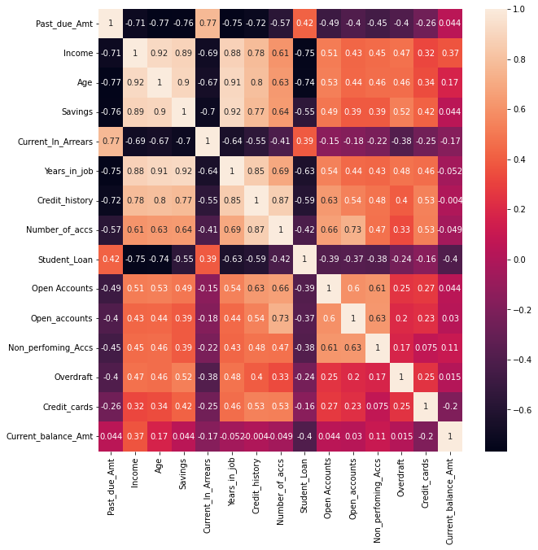
Pearson Correlation

Slide 16
Information value
Information value is one of the most useful techniques to select important variables in a predictive model. It helps to rank variables on the basis of their importance.
Logistic regression model is one of the most commonly used statistical technique for solving binary classification problem. It is an acceptable technique in almost all the domains. These two concepts-
weight of evidence (WOE) -tells the predictive power of an independent variable in relation to the dependent variable.
Information value (IV)
Notes:
Analysis of variance (ANOVA) is a statistical technique to analyze variation in a response variable (continuous random variable) measured under conditions defined by discrete factors (classification variables, often with nominal levels).
Frequently, we use ANOVA to test equality among several means by comparing variance among groups relative to variance within groups (random error).

Slide 17
WOE
It can treat outliers.grouping classes eg income.
It can handle missing values as missing values can be binned separately.
WOE Transformation handles categorical variables.
Rules of WOE
The WOE should be distinct for each category. Similar groups should be aggregated.
The WOE should be monotonic, i.e. either growing or decreasing with the groupings.
Missing values are binned separately
Notes:
Analysis of variance (ANOVA) is a statistical technique to analyze variation in a response variable (continuous random variable) measured under conditions defined by discrete factors (classification variables, often with nominal levels).
Frequently, we use ANOVA to test equality among several means by comparing variance among groups relative to variance within groups (random error).

Slide 18
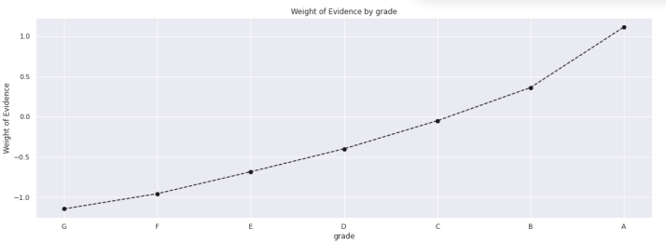
Feature Selection
We can see from the above graph that there is a continuous increase in WoE across the different
grades. Therefore, we do not need to combine any features together and should leave all the grades as they are
Note that there are no missing values in the grade column, otherwise we would have created a
separate and independent category for all Missing values, that would never be combined with any
other category. We will come across this scenario when working through other features.
Check IV

Slide 19
MACHINE LEARNING
ML Computer programs that automatically improve their performance
Supervised
Unsupervised

Slide 20
MACHINE LEARNING
Logistic Regression
Tree-based models
SVM
KNN
Naïve Bayes
NN

Slide 21
Logistic Regression-
Assumptions
The logistic regression assumes that there is minimal or no multicollinearity among the independent variables.
The logistic regrssion usually requires a large sample size to predict properly.
The Logistic regression which has two classes assumes that the dependent variable is binary and ordered logistic regression requires the dependent variable to be ordered, for example Too Little, About Right, Too Much.
The Logistic regression assumes the observations to be independent of each other

Slide 22

Evaluation Metrics
Accuracy=$\frac{TP+TN}{TP+FP+FN+TN}$
Recall =$\frac{TP}{TP+FN}$
Precision =$\frac{TP}{TP+FP}$
F1 Score=$\frac{2∗Recall∗Precision}{Recall+Precision}$

Slide 23
ML Models Comparison
 | Model | Precision score | Recall score | F1_score | Accuracy | log loss
1 | Logistic Regression | 0.9096 | 0.9031 | 0.9063 | 0.9321 | 0.1304
2 | Decision Tree | 0.8932 | 0.8919 | 0.8926 | 0.9268 | 1.3793
3 | Random Forest | 0.8987 | 0.9011 | 0.9004 | 0.9301 | 0.6985
4 | Gradient Boosting | 0.8977 | 0.9008 | 0.8982 | 0.9223 | 0.1495
5 | XGBoost | 0.9080 | 0.8927 | 0.8993 | 0.9315 | 0.1498

Slide 24
Hyperparameters- Logistic Regression
Hyperparameters | Range | Optimal Value
solver | ['newton-cg', 'lbfgs', 'liblinear', 'sag', 'saga’] | 'liblinear',
penalty | ['l1', 'l2', 'elasticnet] | 'l2'
C | 1.0 to 8.0 | 4.0
dual | [False, True] | FALSE

Slide 25
Prediction and Deployment
Define Custom Class for WoE Binning/Reengineering
Create a custom scikit-learn class to take care of all binning transformations on any given data set. This custom class will help us in performing k fold cross validation
Fit most robust model and save it (pickle Logistic model)
Pickle scaler if it exist
Transform probabilities to score then transform into a Score
(if income is between a and b score if grade is x score Then sum after binning)
Use Flask, Fast API,- Deploy (aws ec2 instance, aws lambda, Amazon SageMaker )
Predict probabilities (0 to 1)

Slide 26
Deployment
Plan to launch and iterate.
Automate Model Deployment
Continuously Monitor the Behaviour of Deployed Models
When performance plateaus, look for qualitatively new sources of information to add rather than refining existing signals.
Keep model simple

