Slide 1

PROGRAMMING FUNDAMENTALS
BY
BAZIGU ALEX

Slide 2
Today’s Lecture
Why do we need programming Language
C++ and C
Basics of a typical C++ Environment
Basic Program Construction

Slide 3
C++, a computer language that supports object oriented programming
  Why do we need OOP?
  What does it do that traditional languages such as C, Pascal, and BASIC don’t?
  Two key concepts in OOP are objects and classes. What do these terms mean?
  What is the relationship between C++ and the older C language?

Slide 4
Why do we need OOP?
Limitations in earlier approaches to programming.
To appreciate what OOP does, we need to understand what these limitations are and how they arose from traditional programming languages.

Slide 5
Procedural Languages
C, Pascal, FORTRAN, and similar languages
Each statement in the language tells the computer to do something
  Get some input,
  Add these numbers,
  Divide by six,
  Display that output.
A program in a procedural language is a list of instructions.

Slide 6
Division into Functions
When programs become larger, a single list of instructions becomes unwieldy.
  function was adopted as a way to make programs more comprehensible to their human creators.
A procedural program is divided into functions, and each function has a clearly defined purpose.

Slide 7
Division into Functions
The idea of breaking a program into functions can be further extended by grouping a number of functions together into a larger entity called a module.
Dividing a program into functions and modules is one of the cornerstones of structured programming.
This influenced programming organization for several decades before the advent of object-oriented programming.

Slide 8
Problems with Structured Programming
As programs grow ever larger and more complex, even the structured programming approach begins to show signs of strain.

Slide 9
C++ and C
C++ is derived from the C language.
It is a superset of C
  Almost every correct statement in C is also a correct statement in C++
The most important elements added to C to create C++ concern classes, objects, and object-oriented programming.
  C++ was originally called “C with classes.”

Slide 10
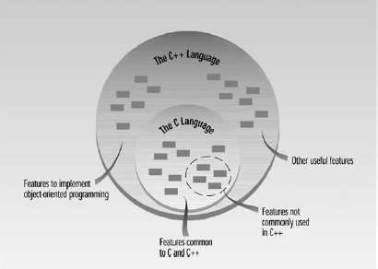
C++ and C
New features in C++
  an improved approach to input/output (I/O)
  a new way to write comments

Slide 11
Basics of a typical C++ Environment
It consist of 6 phases
    Editor
    Preprocessor
    Compilers
    Linkers
    Loaders
    Execute

Slide 12
Program is created in the editor and stored on disk.
Editor
Disk
Preprocessor program
processes the code.
Preprocessor
Disk
Compiler creates object code and stores
it on disk.
Compiler
Disk
Linker
Disk
Linker links the object
code with the libraries
Primary Memory
Loader
Loader puts program in memory.
Disk
.
.
.
.
.
.
Primary Memory
CPU takes each
instruction and executes it, possibly storing new data values as the program executes.
CPU
.
.
.
.
.
.

Slide 13
Edit
The first phase consist of editing a file.
The programmer types a C++ program with editor.
The program source file is then stored on secondary storage device such as disk.
C++ program file names often end with .cpp

Slide 14
Compile
Next, the programmer gives the command to compile the program.
The compiler translates the C++ program into machine language code.
In C++ system
  A preprocessor program executes automatically before the compiler’s translation phase begins.
  Preprocessor obeys commands called preprocessor directives.
      Indicates that certain manipulations are to be performed on the program before compilation.

Slide 15

Linker
The preprocessor is invoked by the compiler before the program is converted to machine language.
The next phase is called linking.
  A linker links the object code with the code for the missing functions to produce an executable image.
If the program compiles and links correctly, an executable image is produced.

Slide 16
Loader
The next phase is called loading.
  Before a program can be executed, the program must first be placed in memory. This is done by the loader, which takes the executable image from disk and transfers it to memory.

Slide 17
Execute
Finally, the computer executes the program one instruction at a time.

Slide 18
Basic Program Construction
Compilers take source code and transform it into executable files, which your computer can run as it does other programs.
Source files are text files (extension .CPP)
Executable files have the .EXE extension

Slide 19
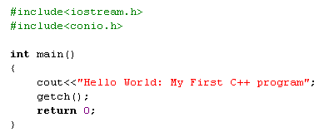
Your First Program

Slide 20
Preprocessor Directives
The first two lines that begin the program are preprocessor directives.
e.g., #include <iostream.h>
#include<conio.h>
It isn’t a program statement
It isn’t a part of a function body
It does not end with a semicolon

Slide 21
Program statement vs preprocessor directive
Program statements are instructions to the computer to do something, such as adding two numbers or printing a sentence.
A preprocessor directive, on the other hand, is an instruction to the compiler.
A part of the compiler called the preprocessor deals with these directives before it begins the real compilation process.

Slide 22
Program statement vs preprocessor directive
The preprocessor directive #include tells the compiler to insert another file into your source file.
The type file usually included by #include is called a header file.

Slide 23
Header Files
The preprocessor directive #include tells the compiler to add the file iostream to the source file before compiling.
Why do this?

Slide 24
Header Files
iostream is an example of a header file.
It’s concerned with basic input/output operations, and contains declarations that are needed by the cout identifier and the << operator.
Without these declarations, the compiler won’t recognize cout and will think << is being used incorrectly

Slide 25
Always Start with main()
When you run a C++ program, the first statement executed will be at the beginning of a function called main().
The program may consist of many functions, but on startup, control always goes to main().
If there is no function called main() in your program, an error will be reported when you run the program.

Slide 26
Functions
The parentheses following the word main are the distinguishing feature of a function.
Without parentheses compiler would think that main refers to some other program element.
The word int preceding the function name indicates that this particular function has a return value of type int.

Slide 27
Braces and the Function Body
The body of a function is surrounded by braces (sometimes called curly brackets).
Every function must use this pair of braces around the function body.
In this example there are only three statements in the function body:
  the line starting with cout, the line starting with getch and the line starting with return.
However, a function body can consist of many statements.

Slide 28
Program Statements
There are three statements in the FIRST program: the line
  cout << “Hello World: My first C++ program”;
  getch();
  and the return statement return 0;

Slide 29
Output Using cout
The identifier cout (pronounced “C out”) is actually an object. It is predefined in C++ to correspond to the standard output stream.
The operator << is called the insertion or put to operator.
It directs the contents on its right to the object on its left.
In our example it directs the string constant “Hello World: My first C++ program” to cout, which sends it to the display.

Slide 30
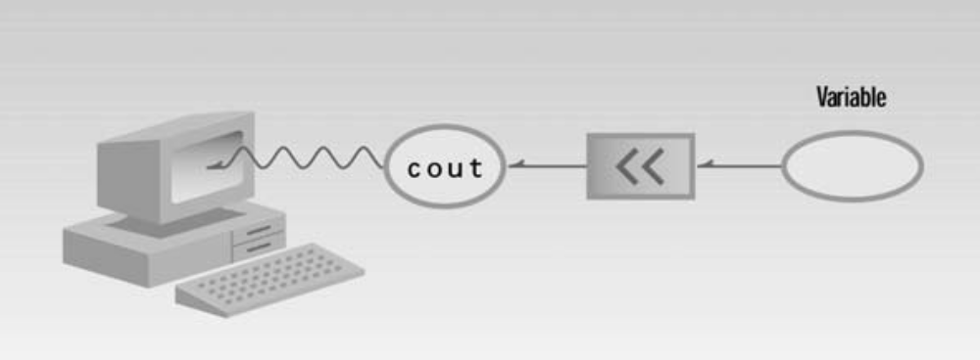

Slide 31
String Constants
The phrase in quotation marks, “Hello World: My first C++ program”, is an example of a string constant.
Its value is set when the program is written, and it retains this value throughout the program’s existence.

Slide 32
Program Statements
The first statement tells the computer to display the quoted phrase.
A semicolon signals the end of the statement.
If you leave out the semicolon, the compiler will signal an error.

Slide 33
Program Statements
getch() apart from holding the screen or waiting for a character to be entered to exit the output screen , it also print the input given by the user.
The last statement in the function body is return 0;
This tells main() to return the value 0 to whoever called it, in this case the operating system or compiler. The value 0 indicates that the program had terminated successfully.

Slide 34
Whitespace
Compiler ignores whitespace almost completely.
Whitespace is defined as spaces, tabs and newlines.
These characters are invisible to the compiler.
You can put several statements on one line, separated by any number of spaces or tabs, or you can run a statement over two or more lines.

Slide 35
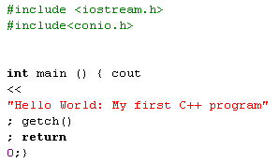
Two new lines

Slide 36
Exceptions to the rule
The first line of the program, starting with #include, is a preprocessor directive, which must be written on one line.
Also, string constants, such as “Every age has a language of its own”, cannot be broken into separate lines.
If you need a long string constant, you can insert a backslash(\) at the line break or divide the string into two separate strings, each surrounded by quotes.

Slide 37
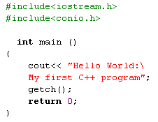
Backslash

Slide 38
Comments
They help the person writing a program, and anyone else who must read the source file, understand what’s going on.
The compiler ignores comments

Slide 39

Comment Syntax
Comments start with a double slash symbol (//) and terminate at the end of the line.

Slide 40

Alternative Comment Syntax

Slide 41

If you attempt to use the // style comment in this case, the closing brace won’t be visible to
the compiler-- since a // style comment runs to the end of the line—and the code won’t compile correctly.

Slide 42
QUESTIONS ??

Slide 43
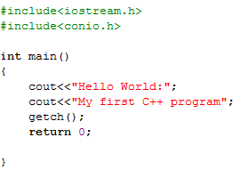
Outputs

Slide 44
