Slide 1
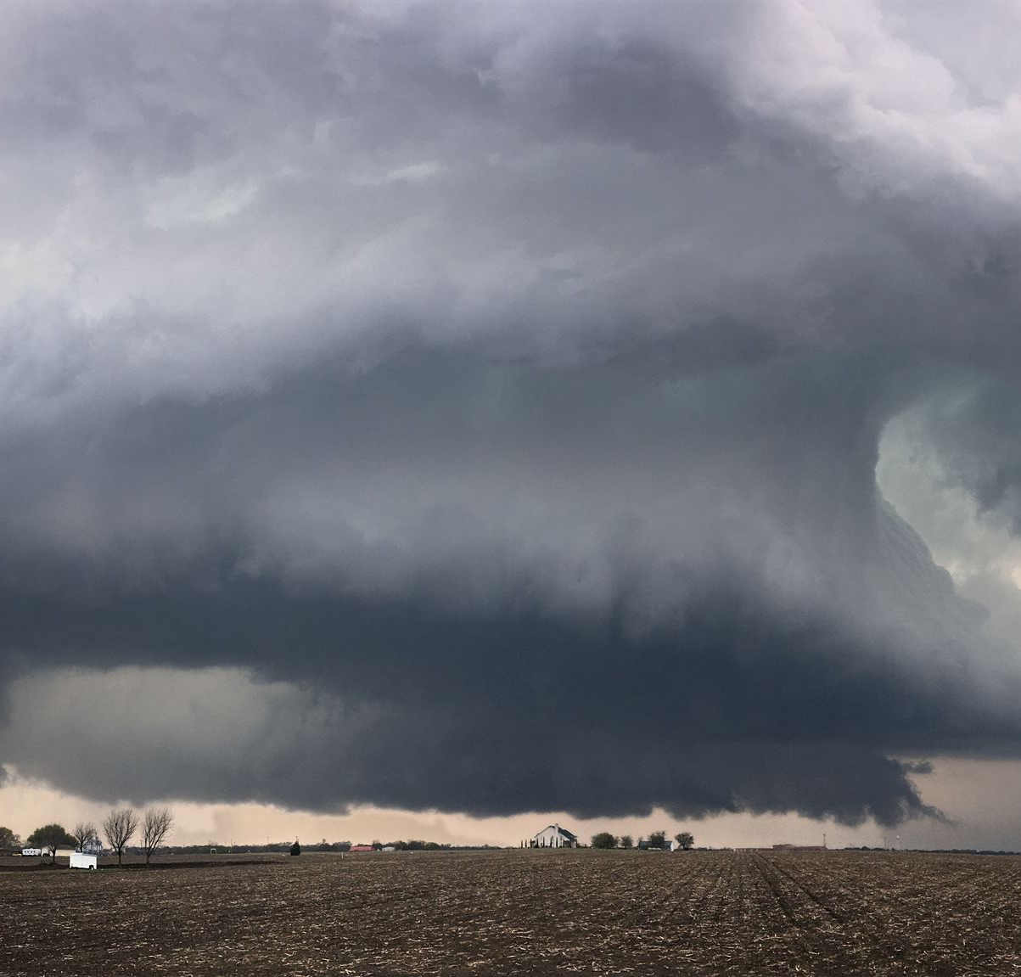
Daily Heavy Rainfall Prediction in Bugisu Sub-Region
Forecasting intense rainfall for regional preparedness
Notes:
---

Slide 2
Project Overview and Objectives
Notes:
Problem & Objectives, CRISP-DM Overview

Slide 3
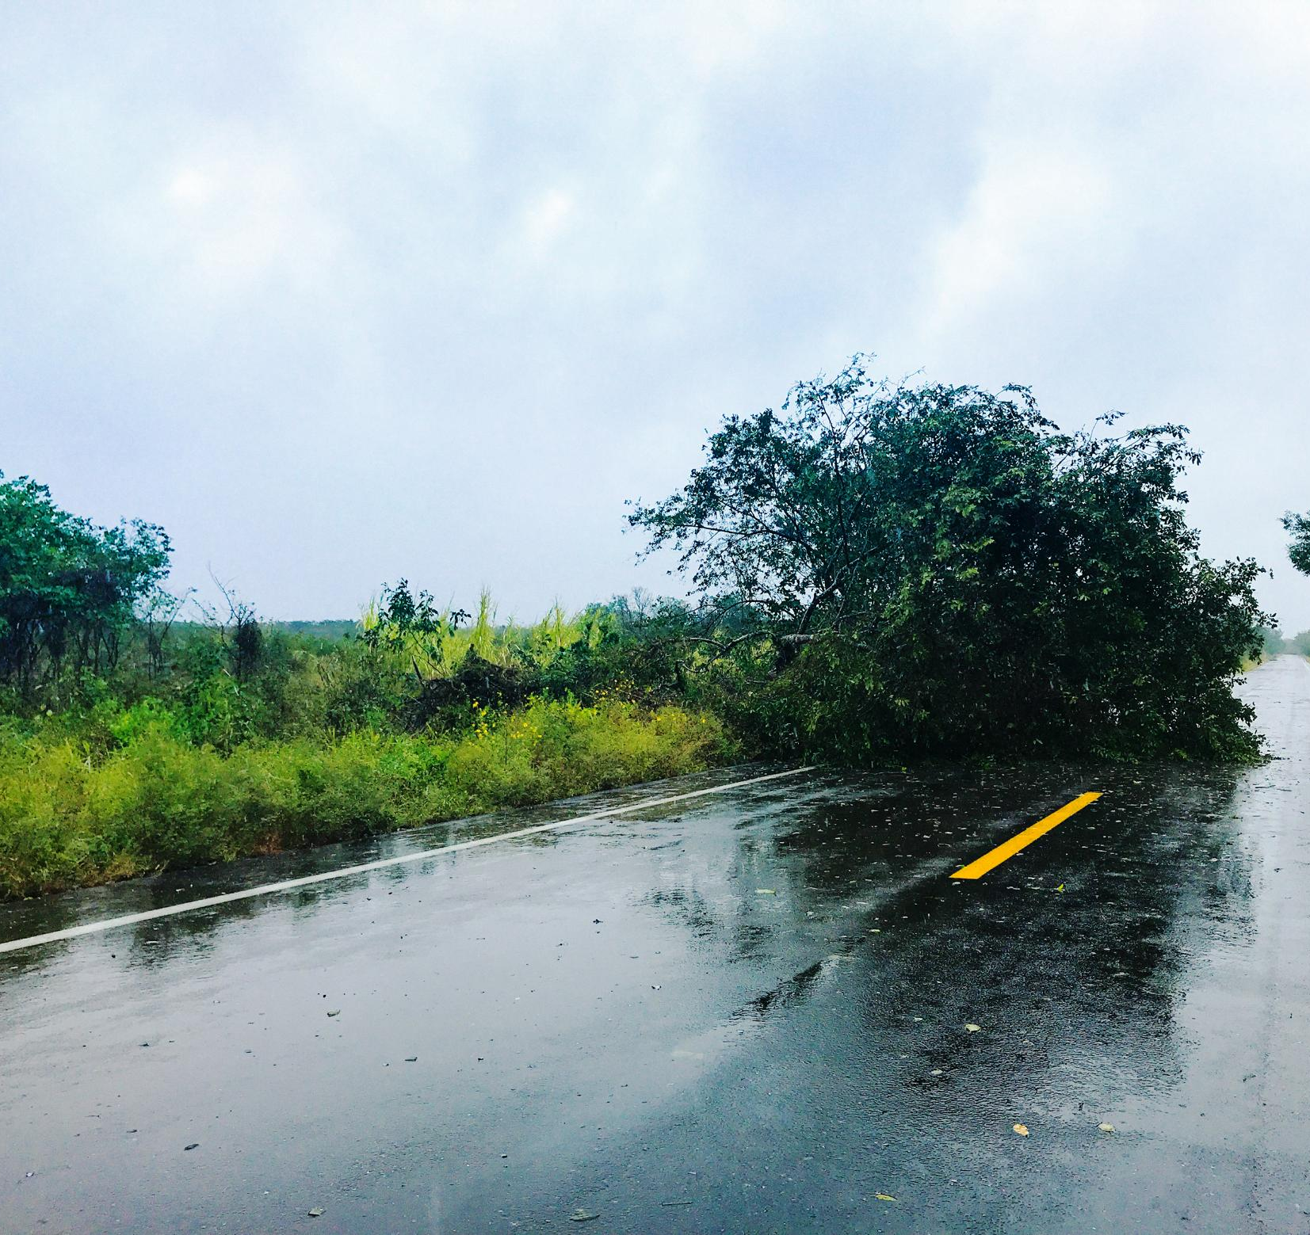
Problem & Objectives
Regional Disaster Challenges
  Bugisu sub-region suffers heavy rainfall causing floods, landslides, and extensive damage to life and infrastructure.
Predictive System Goal
  Develop a system to predict heavy rainfall days exceeding the 95th percentile for early disaster warnings.
Machine Learning Application
  Utilize machine learning and distributed processing to achieve high recall and model interpretability for disaster prediction.
Ethical and Stakeholder Focus
  Ensure data privacy, transparent uncertainty communication, and build trust among governments and disaster agencies.
Notes:
The Bugisu sub-region in Eastern Uganda, comprising districts such as Mbale, Bududa, Manafwa, and Sironko, faces recurrent heavy rainfall events that often lead to floods and landslides. These disasters result in significant loss of life, damage to infrastructure, and disruption of agricultural activities. The primary objective of this project is to develop a predictive system capable of identifying days with heavy rainfall, defined as those exceeding the 95th percentile of historical daily rainfall. By leveraging machine learning and distributed data processing, the system aims to provide early warnings to mitigate disaster risks. Success criteria include achieving high recall to minimize missed extreme events, ensuring model interpretability, and deploying a robust solution that can integrate into early warning systems. The project also emphasizes ethical considerations, such as data privacy compliance and transparent communication of uncertainty, to build trust among stakeholders including local governments, disaster response agencies, and farmers.

Slide 4

CRISP-DM Overview
Project Lifecycle Framework
  CRISP-DM provides structured phases for managing data science projects from business understanding to deployment.
Data Preparation and Understanding
  Simulated datasets are cleaned and engineered, addressing missing values, outliers, and seasonal rainfall features.
Modeling and Evaluation
  Various algorithms like Logistic Regression and Random Forest are evaluated using metrics such as F1 score and ROC-AUC.
Deployment and Monitoring
  Deployment uses FastAPI and Docker with monitoring systems to track data and model drift, ensuring ongoing model effectiveness.
Notes:
The CRISP-DM framework guides the entire lifecycle of this project. Business Understanding focuses on reducing disaster risk through accurate rainfall predictions. Data Understanding involves simulating a realistic dataset reflecting Bugisu's bimodal rainfall pattern, identifying issues like missing values, outliers, and skewed distributions. Data Preparation includes cleaning, imputation, outlier handling, and feature engineering such as rainfall lags, rolling averages, and seasonal indicators. Modeling explores multiple algorithms, including Logistic Regression for baseline interpretability and Random Forest for robust performance on non-linear patterns. Evaluation employs metrics like F1 score, ROC-AUC, and precision-recall curves, alongside fairness checks across districts. Deployment integrates FastAPI for serving predictions, Docker for containerization, and monitoring strategies for data and model drift. This structured approach ensures that each phase aligns with the project’s objectives and ethical standards.

Slide 5
Data and Feature Engineering
Notes:
Data Simulation and Characteristics, Feature Engineering and Target Definition

Slide 6
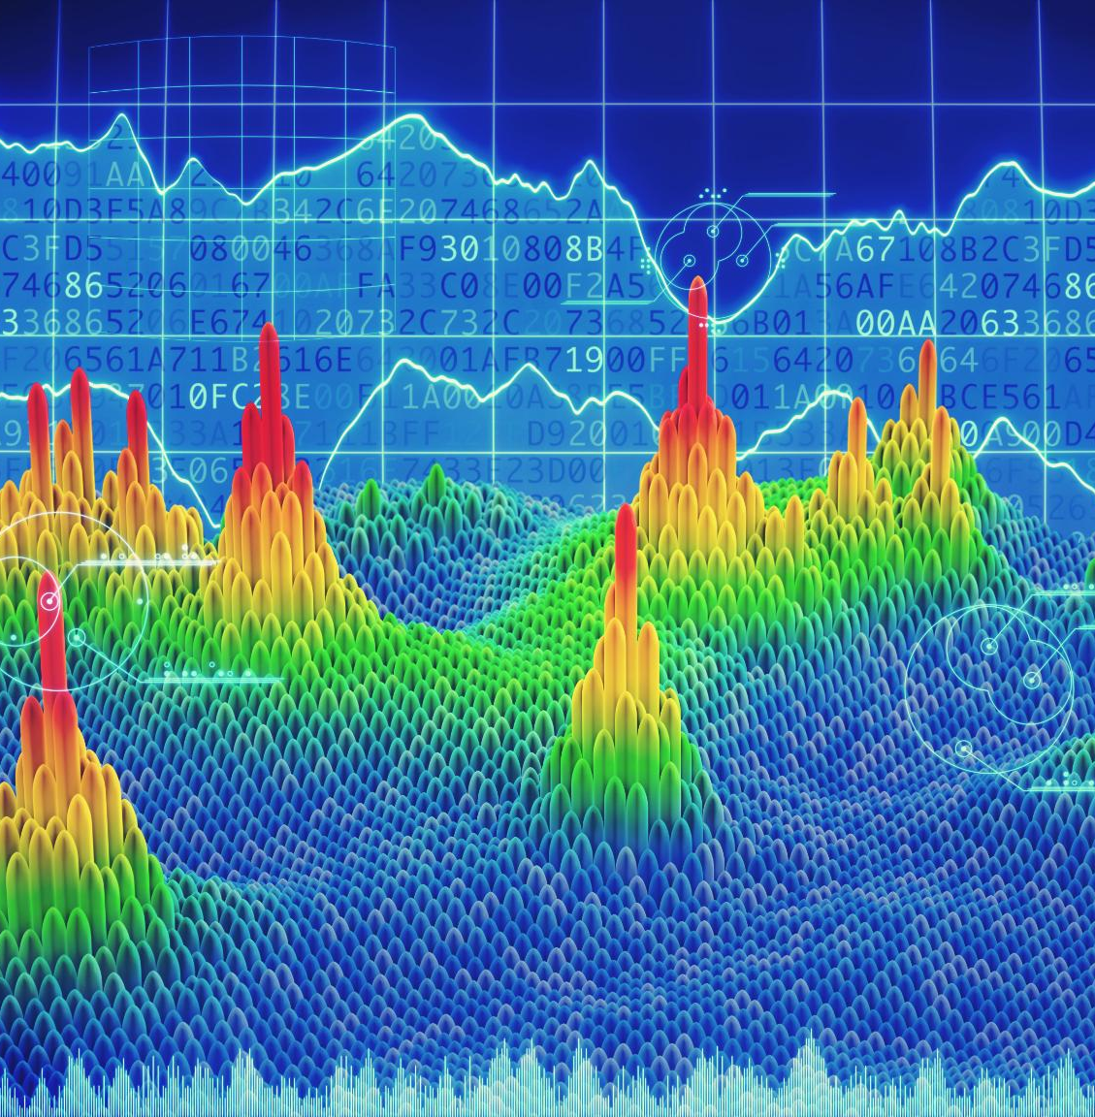
Data Simulation and Characteristics
Simulated Weather Dataset
  Dataset simulates five years of daily weather data across four Bugisu districts with key variables and seasonal patterns.
Data Cleaning Challenges
  Missing humidity, rainfall outliers, and skewed data were managed using median imputation, outlier capping, and log transforms.
Feature Engineering
  Engineered features such as rainfall lags and rolling averages were created to capture temporal dependencies.
Notes:
The dataset was simulated to represent five years of daily weather observations across four districts in Bugisu. Key variables include rainfall (in millimeters), temperature, humidity, wind speed, and atmospheric pressure. Seasonal patterns were incorporated to reflect Uganda’s bimodal rainfall regime, with peaks during March-May (MAM) and September-November (SON). Additional features such as district identifiers and seasonal indicators were added to capture spatial and temporal variability. Challenges identified during data understanding included missing humidity values, outliers in rainfall due to extreme events, and skewed distributions. These issues were addressed through median imputation for missing values, outlier capping, and log transformations for rainfall. The final dataset also includes engineered features like rainfall lags (1, 3, and 7 days) and rolling averages, which enhance the model’s ability to capture temporal dependencies critical for predicting heavy rainfall events.

Slide 7

Feature Engineering and Target Definition
Capturing Rainfall Trends
  Lag features and rolling averages captured short- and medium-term rainfall trends to improve model insight.
Encoding Spatial and Temporal Factors
  Seasonal indicators and district-level categorical variables encoded heterogeneity in space and time.
Defining Target Variable
  Heavy rainfall was defined by days exceeding the 95th percentile per district-season, ensuring localized relevancy.
Preprocessing and Pipeline
  Scaling numeric features and one-hot encoding categorical variables prepared data for machine learning within a pipeline.
Notes:
Feature engineering was a crucial step in improving model performance and interpretability. Lag features were created to capture short-term rainfall trends, while rolling averages provided insights into medium-term patterns. Seasonal indicators and district-level categorical variables were encoded to account for spatial and temporal heterogeneity. The target variable, heavy rainfall, was defined as days exceeding the 95th percentile of rainfall within each district-season group, ensuring that the classification reflects localized extremes rather than global thresholds. This approach improves fairness and relevance for disaster preparedness. Data preprocessing also included scaling numeric features and one-hot encoding categorical variables to prepare the dataset for machine learning algorithms. These transformations were implemented within a pipeline to ensure reproducibility and facilitate deployment in production environments.

Slide 8
Modeling and Evaluation
Notes:
Model Selection and Development, Evaluation Metrics and Fairness Analysis

Slide 9
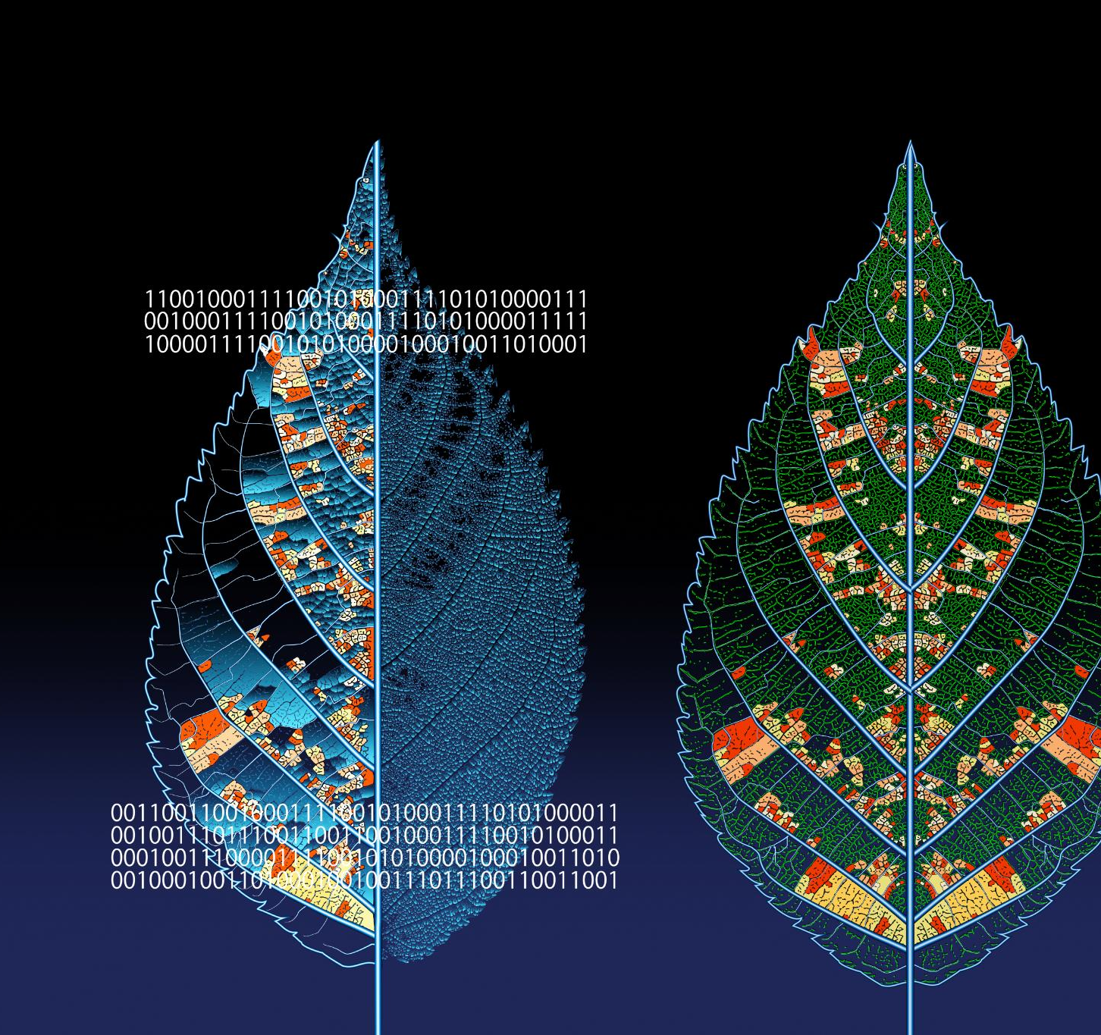
Model Selection and Development
Model Types
  Logistic Regression was used for baseline testing due to its simplicity and interpretability. Random Forest handled complex, non-linear feature interactions effectively.
Hyperparameter Tuning
  Randomized search optimized model performance by tuning hyperparameters for improved accuracy and robustness.
Experiment Tracking
  MLflow was used to track experiments, ensuring reproducibility and transparency throughout the model development lifecycle.
Model Explainability
  Explainability tools like SHAP provided insights into feature importance, building trust for disaster response decision-making.
Notes:
Two primary models were developed: Logistic Regression and Random Forest. Logistic Regression served as a baseline due to its simplicity and interpretability, making it suitable for initial hypothesis testing. Random Forest was selected as the primary model because of its ability to handle non-linear relationships and interactions among features, which are common in meteorological data. Hyperparameter tuning was performed using randomized search to optimize performance. Experiment tracking was facilitated through MLflow, ensuring reproducibility and transparency. The modeling process adhered to ethical guidelines by incorporating explainability tools such as SHAP for feature importance analysis, enabling stakeholders to understand the drivers of predictions. This interpretability is critical for building trust in the system, especially when informing disaster response decisions.

Slide 10

Evaluation Metrics and Fairness Analysis
Temporal Data Splitting
  Time-based train-validation-test split preserves temporal dependencies in rainfall data.
Key Performance Metrics
  F1 score, ROC-AUC, and Precision-Recall AUC assess model effectiveness for imbalanced classification.
Error Pattern Analysis
  Confusion matrices reveal false negatives during rainfall spikes and false positives in transitional seasons.
Fairness Across Districts
  Recall comparison across districts ensures equitable model performance and ethical deployment.
Notes:
Model evaluation employed a time-based train-validation-test split to respect temporal dependencies in the data. Key metrics included F1 score, ROC-AUC, and Precision-Recall AUC, which are particularly relevant for imbalanced classification problems like extreme rainfall prediction. Confusion matrices were analyzed to understand error patterns, revealing that false negatives often occurred during abrupt rainfall spikes, while false positives were more common in transitional seasons. Fairness analysis was conducted by comparing recall across districts to ensure equitable performance. The Random Forest model demonstrated strong predictive capability with minimal disparity in recall between districts, supporting its suitability for deployment. These evaluation steps not only validate the model’s technical performance but also its alignment with ethical and operational objectives.

Slide 11
Deployment and Ethical Considerations
Notes:
MLOps and Deployment Strategy, Ethical and Governance Framework

Slide 12

MLOps and Deployment Strategy
Real-time Model Access
  The Random Forest model is available via a FastAPI endpoint for real-time predictions with a RESTful interface.
Containerization and Portability
  Docker containerization ensures the model runs consistently across different environments, improving portability.
Automated CI/CD Pipeline
  A CI/CD pipeline automates testing and deployment for efficient and reliable model updates and releases.
Monitoring and Scalability
  Monitoring tracks data drift and model performance, while architecture supports cloud autoscaling and disaster alerts.
Notes:
The deployment strategy focused on scalability, reliability, and maintainability. The final Random Forest model was exposed via a FastAPI endpoint, enabling real-time predictions through a RESTful interface. Containerization using Docker ensured portability across environments, while a CI/CD pipeline was designed to automate testing and deployment. Monitoring components were proposed to track data drift and model performance over time, safeguarding against degradation in predictive accuracy. These measures are essential for operationalizing the model in dynamic environments where climate patterns and data distributions may evolve. Additionally, the architecture supports future integration with cloud platforms for autoscaling and disaster alert systems, enhancing the system’s resilience and reach.

Slide 13

Ethical and Governance Framework
Privacy and Data Protection
  The project ensured privacy by avoiding use of personally identifiable information and following data protection laws.
Transparency and Explainability
  Explainability tools and clear communication promoted transparency about model limitations and uncertainties.
Fairness and Bias Mitigation
  Performance validation across districts ensured fairness and helped avoid biases affecting vulnerable communities.
Governance and Trust
  Strong governance measures fostered trust and accountability essential for sensitive predictive system deployment.
Notes:
Ethical considerations were central to the project design. No personally identifiable information was used, minimizing privacy risks. Compliance with the Uganda Data Protection and Privacy Act (2019) and GDPR principles was ensured through data minimization, secure storage, and de-identification practices. Transparency was promoted by incorporating explainability tools and clearly communicating model limitations and uncertainty to stakeholders. The project also emphasized fairness by validating performance across different districts and avoiding biases that could disproportionately affect vulnerable communities. These governance measures not only fulfill legal requirements but also foster trust and accountability, which are critical for deploying predictive systems in sensitive domains like disaster management.

Slide 14
Limitations and Future Directions
Notes:
Current Limitations, Future Work and Recommendations

Slide 15

Current Limitations
Simulated Dataset Limitations
  The use of simulated data may reduce the model's applicability to real-world scenarios and limit generalizability.
Missing Hydrological Variables
  Excluding soil moisture and runoff could decrease the accuracy of flood impact predictions.
Limited Deep Learning Integration
  LSTM models were only briefly explored and not fully integrated, affecting sequence modeling potential.
Deployment Constraints
  Local environment deployment without cloud integration restricts scalability and wider application.
Notes:
Despite its promising results, the project has several limitations. The dataset was simulated rather than sourced from real-world observations, which may limit the model’s generalizability. Hydrological variables such as soil moisture and runoff were not included, potentially reducing predictive accuracy for flood-related impacts. Deep learning models, such as LSTMs for sequence modeling, were only briefly explored and not fully integrated. Additionally, the deployment was limited to a local environment without full cloud integration, restricting scalability. These constraints highlight areas for improvement and underscore the need for continuous iteration and validation using real-world data.

Slide 16

Future Work and Recommendations
Data Integration
  Incorporate real datasets like CHIRPS and ERA5 to enhance model robustness and accuracy.
Advanced Modeling Techniques
  Explore LSTM networks to capture temporal dependencies and improve risk prediction.
Cloud Deployment
  Transition to cloud platforms with autoscaling to support scalable, large-scale operations.
Alert Systems and Monitoring
  Integrate SMS alert systems and continuous monitoring to deliver timely warnings and maintain model relevance.
Notes:
Future enhancements should focus on integrating real datasets from sources like CHIRPS or ERA5 to improve model robustness. Incorporating hydrological and topographical variables can enhance predictive accuracy for flood and landslide risks. Advanced modeling techniques, including LSTM networks, should be explored to capture temporal dependencies more effectively. Deployment should transition to cloud platforms with autoscaling capabilities to support large-scale operations. Additionally, integrating SMS-based alert systems can extend the model’s impact by delivering timely warnings to at-risk communities. Continuous monitoring for data and model drift, coupled with periodic retraining, will ensure sustained performance and relevance in dynamic climatic conditions.

