Slide 1





SHOCKTWIN
Problem
ShockTwin
SAP
Impact
01 / 14
01 · VISION
See the shock
before it hits.
See the supply shock coming; borrow the capacity to
survive it.
PRODUCT
TEAM · RV UNIVERSITY
ShockTwin
Francis Reuben R · Avaneesh
Affan · Vivek
Detect · Simulate · Respond · supplied brief
SAP HACKFEST 2026 · RV UNIVERSITY
Event, team and product: supplied brief · P-ID P2012988948
RESILIENT SUPPLY CHAINS
Notes:
SLIDE 01 · 25 SECONDS · 0:00–0:25
Good morning. We are Francis, Avaneesh, Affan and Vivek from RV University. This is ShockTwin: see the supply shock coming, borrow the capacity to survive it. Imagine a supplier map that can reveal the dependency nobody showed you, rehearse its failure, and help you approve a practical response before your production line stops.
SOURCE / QUALIFICATION (not additional spoken copy):
Event, team and product: supplied brief · P-ID P2012988948

Slide 2






SHOCKTWIN
Problem
ShockTwin
SAP
Impact
02 / 14
02 · THE COST
OVERALL CHIP SHORTAGE · 2021
One fire.
$210 billion lost.
The total reflects the overall chip shortage in 2021, not the
loss attributable to one fire.
VEHICLES NOT BUILT
AUTOMOTIVE MCU SHARE
7.7M
~30%
AlixPartners, Sep 2021
Reuters, Mar 2021; Renesas
SAP HACKFEST 2026 · RV UNIVERSITY
Reuters, Mar 2021 · AlixPartners, Sep 2021 · Overall shortage impact, not fire-only loss
RESILIENT SUPPLY CHAINS
Notes:
SLIDE 02 · 35 SECONDS · 0:25–1:00
In March 2021, fire hit Renesas, a firm supplying about thirty percent of automotive microcontrollers. That concentration exposed how one upstream facility could affect many manufacturers. Separately, AlixPartners estimated the entire 2021 chip shortage cost automakers two hundred and ten billion dollars and seven point seven million vehicles. We are not attributing that whole loss to one fire. The lesson is that a small-looking upstream dependency can become a system-wide production problem.
SOURCE / QUALIFICATION (not additional spoken copy):
Reuters, Mar 2021 · AlixPartners, Sep 2021 · Overall shortage impact, not fire-only loss

Slide 3




SHOCKTWIN
Problem
ShockTwin
SAP
Impact
03 / 14
03 · VISIBILITY
Most firms can't
see past tier 1.
VISIBILITY BEYOND TIER ONE
Beyond-tier-one visibility is shrinking when upstream
exposure matters most.
McKinsey Supply Chain Risk Survey 2024
SAP HACKFEST 2026 · RV UNIVERSITY
McKinsey Supply Chain Risk Survey 2024
RESILIENT SUPPLY CHAINS
Notes:
SLIDE 03 · 30 SECONDS · 1:00–1:30
Yet visibility is moving in the wrong direction. McKinsey's survey reports visibility beyond tier one falling from fifty-six percent in 2022, to thirty-seven percent, to thirty percent in 2024. This is not a forecast; it is the published survey series. If a purchasing dashboard stops at direct suppliers, it can display several alternatives while missing the single upstream dependency that makes them fail together.
SOURCE / QUALIFICATION (not additional spoken copy):
McKinsey Supply Chain Risk Survey 2024

Slide 4






SHOCKTWIN
Problem
ShockTwin
SAP
Impact
04 / 14
04 · THE BLIND SPOT
The danger sits
below the surface.
The shared dependency you cannot see can stop the
production you can.
DISRUPTIONS AT TIER 2+
SEE TIER 3
RESPONSE TIME
~2/3
~10%
~2 weeks
McKinsey, 2022
McKinsey Supply Chain Risk Survey 2024
McKinsey [exact report VERIFY]
SAP HACKFEST 2026 · RV UNIVERSITY
McKinsey [report details VERIFY] · McKinsey 2022 · McKinsey Supply Chain Risk Survey 2024
RESILIENT SUPPLY CHAINS
Notes:
SLIDE 04 · 30 SECONDS · 1:30–2:00
The iceberg is the problem. About two-thirds of disruptions originate at tier two or deeper, according to McKinsey. Only about ten percent of firms see their tier-three suppliers, and the average response to a new disruption is about two weeks. These measures come from different published observations, not one experiment. ShockTwin asks a practical question: can a buyer identify a consequential hidden dependency and act while inventory still gives them time?
SOURCE / QUALIFICATION (not additional spoken copy):
McKinsey [report details VERIFY] · McKinsey 2022 · McKinsey Supply Chain Risk Survey 2024

Slide 5






SHOCKTWIN
Problem
ShockTwin
SAP
Impact
05 / 14
05 · ROUTE RISK
The Red Sea
closed.
India paid.
INDIA–EUROPE CONTAINER COST
Disrupted shipping routes transmitted cost pressure to
Indian supply chains; the sea was not literally closed.
$1,500
$600
SUEZ TRAFFIC
SHANGHAI–EUROPE SPOT
-57%
+256%
Reuters, Jan 2024 · approximate costs
UNCTAD; from peak to Oct 2024
UNCTAD, 2024
SAP HACKFEST 2026 · RV UNIVERSITY
Reuters, Jan 2024 · UNCTAD, 2024 · Different measures and periods
RESILIENT SUPPLY CHAINS
Notes:
SLIDE 05 · 30 SECONDS · 2:00–2:30
The Red Sea illustrates how a distant route becomes a local cost. The sea was disrupted, not literally closed. UNCTAD reports Suez traffic down fifty-seven percent from its peak by October 2024 and Shanghai–Europe spot rates up two hundred and fifty-six percent. Reuters reported India–Europe container costs moving from about six hundred to fifteen hundred dollars in January. Different periods, different measures, one message: geography does not contain supply-chain consequences.
SOURCE / QUALIFICATION (not additional spoken copy):
Reuters, Jan 2024 · UNCTAD, 2024 · Different measures and periods

Slide 6






SHOCKTWIN
Problem
ShockTwin
SAP
Impact
06 / 14
06 · THE COUNTEREXAMPLE
Toyota survived
because it
had a map.
Mapping upstream dependencies can turn a hidden
concentration into a decision.
CRITICAL PARTS MAPPED
US OUTPUT KEPT
GM UNITS CUT
~1,500
~90%
~278,000
Bloomberg Apr 2021 / Fortune Jan 2022
Bloomberg Apr 2021 / Fortune Jan 2022
Bloomberg Apr 2021 / Fortune Jan 2022
SAP HACKFEST 2026 · RV UNIVERSITY
Bloomberg, Apr 2021 · Fortune, Jan 2022
RESILIENT SUPPLY CHAINS
Notes:
SLIDE 06 · 30 SECONDS · 2:30–3:00
There is a useful counterexample. After 2011, Toyota mapped about fifteen hundred critical parts. During the chip crisis it kept US production near ninety percent, while GM cut about two hundred and seventy-eight thousand units. The cited reporting does not prove that mapping alone caused that difference. It shows why upstream knowledge deserves attention. Our aim is to make mapping actionable through a connected warning, rehearsal and response workflow.
SOURCE / QUALIFICATION (not additional spoken copy):
Bloomberg, Apr 2021 · Fortune, Jan 2022

Slide 7






SHOCKTWIN
Problem
ShockTwin
SAP
Impact
07 / 14
07 · DETECT · SIMULATE · RESPOND
Meet
ShockTwin.
One connected loop: Detect, Simulate, Respond.
01
02
03
Detect
Simulate
Respond
Supplied product loop
Supplied product loop
Supplied product loop
SAP HACKFEST 2026 · RV UNIVERSITY
Product workflow: supplied brief · Implementation: repository
RESILIENT SUPPLY CHAINS
Notes:
SLIDE 07 · 20 SECONDS · 3:00–3:20
Meet ShockTwin. Detect proposes hidden upstream links. Simulate translates a shock into material and order consequences. Respond brings CapacityMesh into that same workflow, finding spare capacity and preparing an action for human approval. We are demonstrating one product, with one continuous decision loop, rather than two disconnected tools.
SOURCE / QUALIFICATION (not additional spoken copy):
Product workflow: supplied brief · Implementation: repository

Slide 8




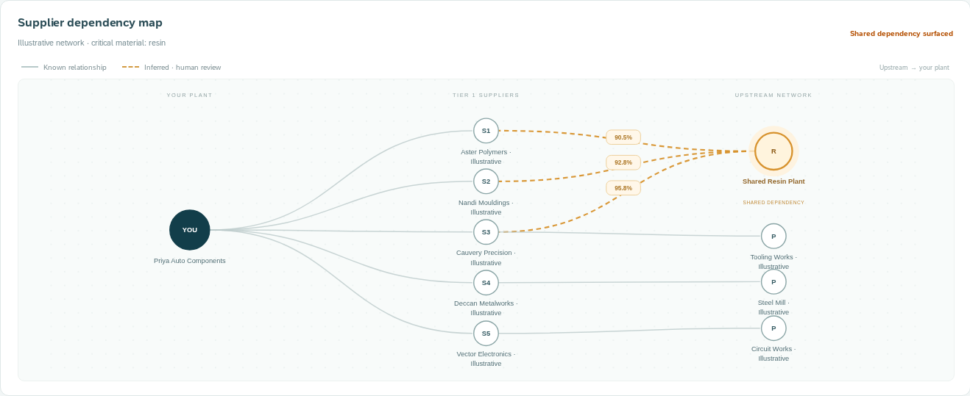



SHOCKTWIN
Problem
ShockTwin
SAP
Impact
08 / 14
08 · 01 · DETECT
Find the suppliers
you never knew.
DETECT · REAL APP · ILLUSTRATIVE
Illustrative: three immediate suppliers share one hidden resin
plant.
Illustrative local app · actual browser capture
IMMEDIATE
SUPPLIERS
SHARED
UPSTREAM PLANT
DEPENDENT
SUPPLIERS
5
1
3 of 5
Illustrative seed
Illustrative seed
Illustrative seed
SAP HACKFEST 2026 · RV UNIVERSITY
Illustrative local demo · Synthetic GraphSAGE scores · Kosasih & Brintrup, IJPR 2022
RESILIENT SUPPLY CHAINS
Notes:
SLIDE 08 · 40 SECONDS · 3:20–4:00
Meet Priya, our illustrative procurement head at a Bengaluru auto-parts manufacturer. She starts with five immediate suppliers. We run the model and reveal a candidate shared resin plant behind three of them. The dashed edges carry actual synthetic-model scores and evidence; they are hypotheses, not verified commercial relationships. Priya can confirm or reject them. Our GraphSAGE model is trained on synthetic data; its measured test results are labelled accordingly. The research basis is supplier-network link prediction by Kosasih and Brintrup, not a borrowed accuracy claim.
SOURCE / QUALIFICATION (not additional spoken copy):
Illustrative local demo · Synthetic GraphSAGE scores · Kosasih & Brintrup, IJPR 2022

Slide 9




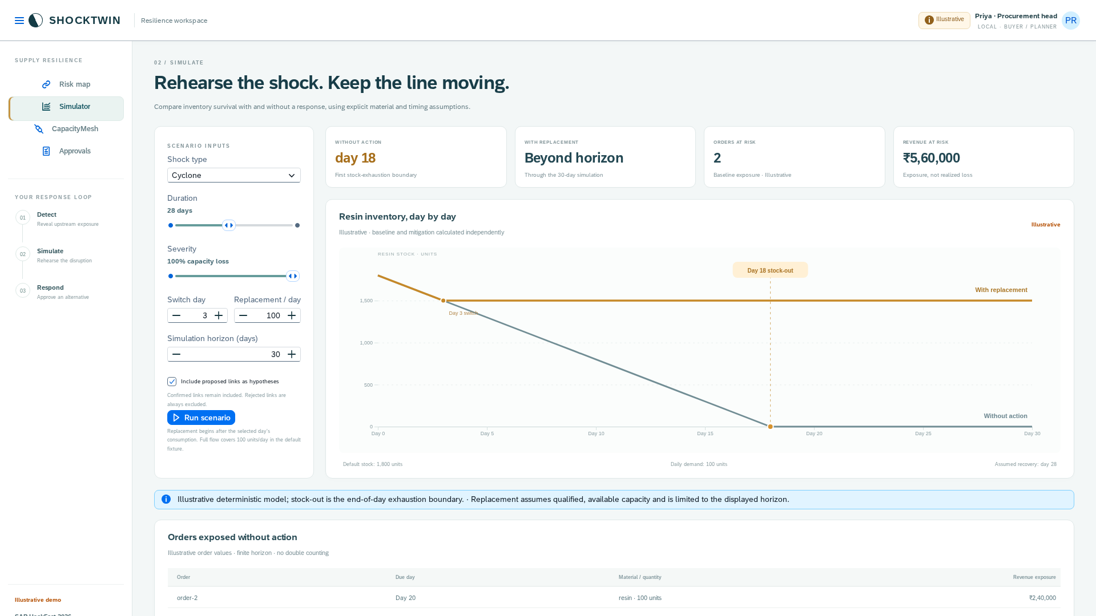

SHOCKTWIN
Problem
ShockTwin
SAP
Impact
09 / 14
09 · 02 · SIMULATE
War-game
the storm
before it lands.
SIMULATE · REAL APP · ILLUSTRATIVE
Illustrative: a day-three replacement switch avoids a line
stop through the displayed simulation horizon.
RESIN STOCK LEFT · ILLUSTRATIVE
DAY 18
Illustrative local app · actual browser capture
DAY-3 SWITCH
DAY 18 · STOCK-OUT
0
6
12
18
24
30
Real local API · 100 units/day · 30-day horizon
SAP HACKFEST 2026 · RV UNIVERSITY
Illustrative local simulation · Assumptions and real app result in screenshot
RESILIENT SUPPLY CHAINS
Notes:
SLIDE 09 · 45 SECONDS · 4:00–4:45
Now we rehearse the cyclone. This is the real simulator, using illustrative inputs: eighteen hundred resin units and demand of one hundred units per day. Under the default full-loss shock, baseline stock reaches zero on day eighteen. Switch on replacement flow after day three, and the curve holds at fifteen hundred units because replacement covers daily demand. That avoids a line stop through this displayed horizon. It is conditional on timing, volume and availability, not a promise of endless continuity. We can change severity, duration and switch timing to see where the plan fails.
SOURCE / QUALIFICATION (not additional spoken copy):
Illustrative local simulation · Assumptions and real app result in screenshot

Slide 10




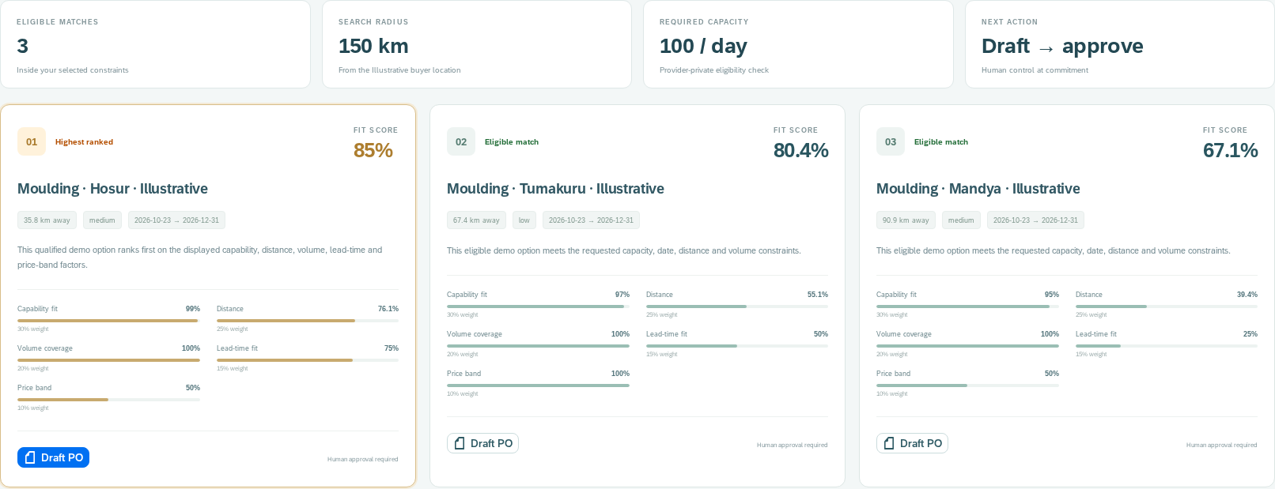

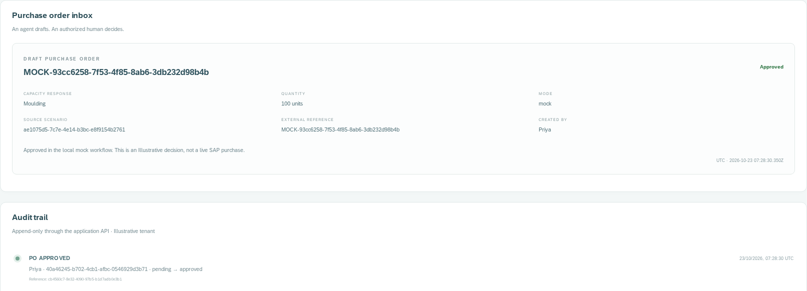



SHOCKTWIN
Problem
ShockTwin
SAP
Impact
10 / 14
10 · 03 · RESPOND · CAPACITYMESH
Borrow capacity
in minutes,
not weeks.
RANKED CAPACITY · ILLUSTRATIVE
Illustrative local app · actual browser capture
HUMAN APPROVED · MOCK ERP
CapacityMesh turns a qualified match into a
human-approved draft; minutes describes the demo
workflow, not physical activation.
UP TO · EMPTY RUNNING
CAPACITY UTILISATION
VENTILATORS · ~3
MONTHS
40%
74.6%
~60,000
DPIIT–NCAER, 2025
RBI OBICUS Q1 2026–27 [VERIFY]
COVID sharing case [source
VERIFY]
Illustrative local app · actual browser capture
SAP HACKFEST 2026 · RV UNIVERSITY
DPIIT–NCAER 2025 · RBI OBICUS Q1 2026–27 [VERIFY] · COVID case source [VERIFY]
RESILIENT SUPPLY CHAINS
Notes:
SLIDE 10 · 45 SECONDS · 4:45–5:30
CapacityMesh is the response step. We request suitable moulding capacity, inspect the eligible matches and see exactly how capability, distance, volume, lead time and price band affect ranking. Only minimal capacity envelopes are public; raw transactions stay private. Priya drafts a purchase order, reviews it in the inbox and approves it, leaving an audit trail. The local ERP is explicitly a mock. India's empty-running and utilisation figures suggest capacity worth investigating, while the ventilator collaboration shows precedent. They do not prove every idle asset is usable, and our minutes headline describes the demonstrated workflow, not physical production activation.
SOURCE / QUALIFICATION (not additional spoken copy):
DPIIT–NCAER 2025 · RBI OBICUS Q1 2026–27 [VERIFY] · COVID case source [VERIFY]

Slide 11









SHOCKTWIN
Problem
ShockTwin
SAP
Impact
11 / 14
11 · SAP BTP
Built on
SAP BTP.
SAPUI5 / Horizon
UI
Project target/implementation
AGENT
Build Process Automation
SAP target; local fallback
APP
CAP / Node.js
Project target/implementation
AI
AI Core / Gen AI Hub
SAP target; local GraphSAGE/template fallback
One decision workflow, with human approval at the
boundary of action.
DATA
HANA Cloud
SAP target; SQLite local
SOURCE
Integration Suite / S/4HANA
SAP target; mocks local
SAP HACKFEST 2026 · RV UNIVERSITY
SAP target architecture: project design · Live cloud integration [VERIFY]
RESILIENT SUPPLY CHAINS
Notes:
SLIDE 11 · 35 SECONDS · 5:30–6:05
The target platform is SAP BTP. SAPUI5 provides the Horizon interface; CAP owns the domain services; HANA Cloud holds graph, vector and relational data; AI Core and AI Launchpad host the model; and Generative AI Hub supports bounded explanations. Integration Suite connects enterprise and external sources, while Build Process Automation routes approval. Today the complete local flow runs with SQLite and explicit mocks. Live SAP service bindings and purchasing semantics still require verification. Human authorization remains the final control.
SOURCE / QUALIFICATION (not additional spoken copy):
SAP target architecture: project design · Live cloud integration [VERIFY]

Slide 12








SHOCKTWIN
Problem
ShockTwin
SAP
Impact
12 / 14
12 · DESIGN THINKING
Designed step
by step
with empathy.
Published cases informed the persona; interviews and a
cluster pilot are planned.
EMPATHIZE
DEFINE
IDEATE
PROTOTYPE
TEST
Published cases +
persona
Hidden dependency
+ response gap
One connected loop
Working local app
Engineering tests;
interviews next
Project process record
Project process record
Project process record
Project process record
Project process record
SAP HACKFEST 2026 · RV UNIVERSITY
Project process record · Published cases and persona; interviews planned
RESILIENT SUPPLY CHAINS
Notes:
SLIDE 12 · 25 SECONDS · 6:05–6:30
We followed the five Design Thinking phases honestly. Empathy currently comes from published cases and our Priya persona, not completed interviews. We defined the hidden-dependency and response gap, explored a connected loop, built the prototype and tested its engineering flow. Next come interviews and a real cluster pilot. We will not present automated tests as customer validation.
SOURCE / QUALIFICATION (not additional spoken copy):
Project process record · Published cases and persona; interviews planned

Slide 13







SHOCKTWIN
Problem
ShockTwin
SAP
Impact
13 / 14
13 · VALUE CONTEXT
What resilience
is worth.
DECADE DISRUPTION COST
LEAD TIME
~45%
-30.8%
MGI 2020; fraction of one year’s profits
Collaboration study from brief [original
source VERIFY]
Published context motivates the product; these are not
measured ShockTwin savings.
TRANSPORT COST
MONTH-LONG SHOCK
-25.83%
~Every 3.7
years
Collaboration study from brief [original
source VERIFY]
MGI, 2020
SAP HACKFEST 2026 · RV UNIVERSITY
MGI 2020 · Collaboration studies from brief [original sources VERIFY] · Not product results
RESILIENT SUPPLY CHAINS
Notes:
SLIDE 13 · 30 SECONDS · 6:30–7:00
The stakes are substantial, but these are published context, not our results. McKinsey estimates month-long disruptions about every three point seven years and decade losses around forty-five percent of one year's profits. The brief also supplies collaboration-study reductions in lead time and transport cost; their original studies still need verification. We will measure ShockTwin by warning gained, mitigation time, qualified matches and completed human decisions, rather than borrow those percentages as promised savings.
SOURCE / QUALIFICATION (not additional spoken copy):
MGI 2020 · Collaboration studies from brief [original sources VERIFY] · Not product results

Slide 14





SHOCKTWIN
Problem
ShockTwin
SAP
Impact
14 / 14
14 · NEXT STEP
Never be
surprised again.
Next: a BTP-connected prototype and a pilot with one
Bengaluru auto-parts cluster.
NEXT STEP
TEAM
P-ID
BTP + cluster pilot
Francis Reuben R · Avaneesh
Affan · Vivek
P2012988948
Proposed project plan; no partner commitment
Team and P-ID: supplied brief
SAP HACKFEST 2026 · RV UNIVERSITY
Team, P-ID and proposed next step: supplied brief · Pilot commitment [VERIFY]
RESILIENT SUPPLY CHAINS
Notes:
SLIDE 14 · 30 SECONDS · 7:00–7:30
We want to make this workflow real for one Bengaluru auto-parts cluster: a BTP-connected prototype, authorized data, qualified capacity providers and a measured pilot. Our closing line is an aspiration, not a guarantee that every surprise disappears. ShockTwin helps teams see the supply shock coming and borrow the capacity to survive it. We are Francis, Avaneesh, Affan and Vivek. Thank you.
SOURCE / QUALIFICATION (not additional spoken copy):
Team, P-ID and proposed next step: supplied brief · Pilot commitment [VERIFY]

