Slide 1
Introduction to Git (and GitHub)

Slide 2
Slides
https://hckr.cc/orbital23-git-slides

Slide 3
Things you need

Slide 5
What is version control and why should you care?
A version control system (VCS) helps to record changes to a file or a set of files over time
It allows you to revert a project to a previous state, or to compare changes over time
Acts as an “undo” button for your code and lets your collaborate with your team

Slide 6
What is Git?
Created by Linus Torvalds in 2005 as a replacement for existing VCS for the Linux kernel
A distributed version control system (DVCS)
Every commit is a snapshot of your files
GitHub != Git

Slide 7
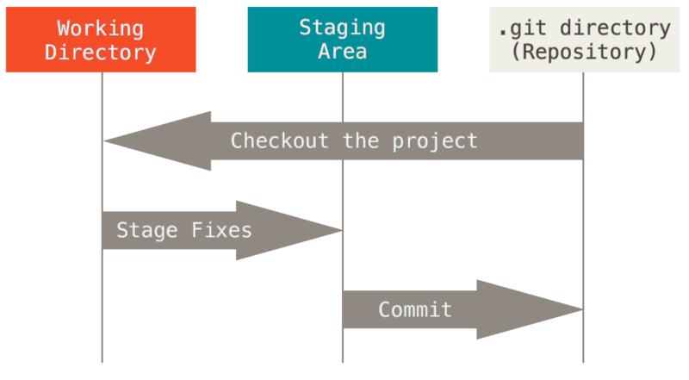
The three "areas"
Working directory: where you actually work
Index/"staging" area: where you construct a commit
Repository/commit: the repository itself

Slide 8
Getting started
In each commit, Git stores the author and committer's name and email
You need to configure Git:
git config --global user.name "Your Name" git config --global user.email "your@email.com"

Slide 9
Setting your editor
Git sometimes launches an editor e.g. when you commit, to edit the commit message
Configure your favourite editor:
git config --global core.editor nano git config --global core.editor emacs # VS Code git config --global core.editor "code --wait --new-window" # For Windows git config --global core.editor "'C:/Program Files/Notepad++/notepad++.exe' -multiInst -nosession" git config --global core.editor "'C:/Program Files/Microsoft VS Code/code.exe' -n -w"
Now, we will create a new repository for this session.

Slide 10
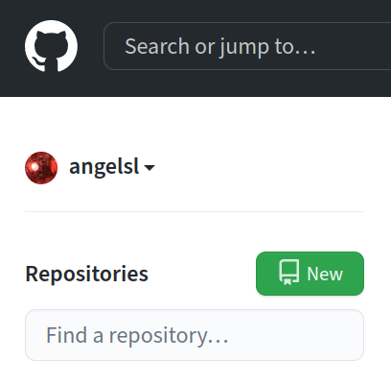
Creating a new GitHub repository

Slide 11
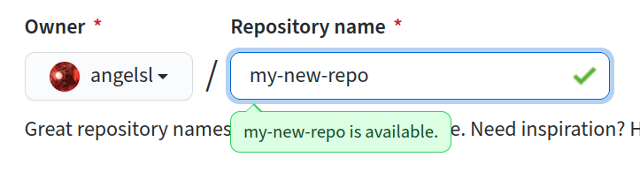
Creating a new GitHub repository

Slide 12
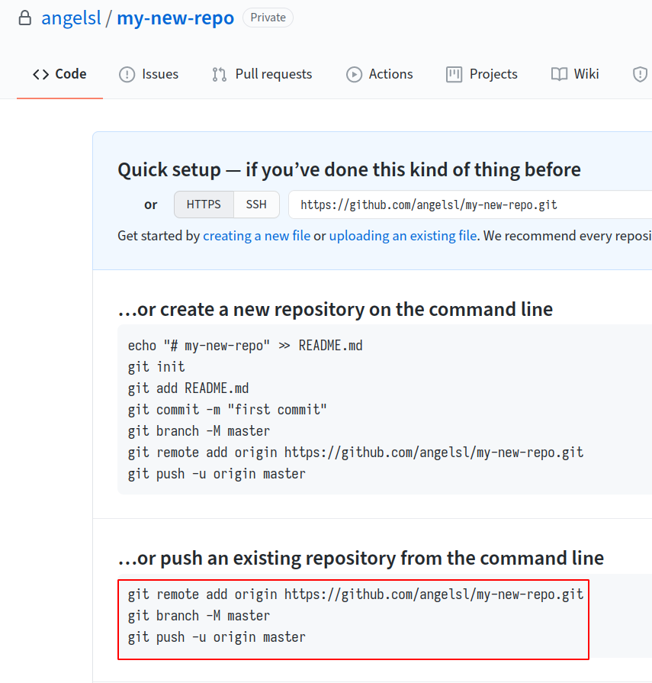
Creating a new GitHub repository

Slide 13
Cloning the repository
Downloading a local copy of the repository
git clone https://github.com/<your GitHub username>/learning-git.git
The server (i.e. GitHub) stores the remote copy (like a single source of truth)

Slide 14
Initialising a repository
Let's create a new Git repository.
$ mkdir my-git-repo $ cd my-git-repo $ git init Initialized empty Git repository in my-git-repo/.git/

Slide 15
Stage a file
Create a new file in hello.txt, however you want. Then add it:
$ echo 'Hello world' > hello.txt $ git add hello.txt
Staging tells Git that you want to include the file in your next snapshot.

Slide 16
Check the status
We've just staged a file! So what is the state of the repository?
$ git status
On branch master No commits yet Changes to be committed: (use "git rm --cached <file>..." to unstage) new file: hello

Slide 17
Make your first commit
Committing files is taking the snapshot of the files that have been staged.
$ git commit -m "Add hello"
[master (root-commit) 5d74ce3] Add hello 1 file changed, 1 insertion(+) create mode 100644 hello
You can leave the -m ... part out. Git will open your editor for you to compose a commit message.

Slide 18
Push your changes to GitHub
After committing your changes, you can now push these changes to GitHub
$ git push origin main
origin is a shorthand name for the remote repo that the project was cloned from. It is used instead of the URL for convenience.

Slide 19
Make some changes, and look at them
Make edits to hello.txt (or whatever file you made), then
$ git diff
diff --git a/hello b/hello index 802992c..5d56d4d 100644 --- a/hello +++ b/hello @@ -1 +1 @@ -Hello world +Hello Hackerschool!
git diff shows the changes to file content.

Slide 20
Viewing commit history
$ git log
commit 19c32155172a20f2fd14fe0e6c0fea954c17296b (HEAD -> master) Author: Your Name <your@email.com> Date: Sat May 8 21:36:58 2021 +0800 Change world to Hackerschool! commit dc37b1cb2627f9829db0072cfa7d3d6bf9eb6822 Author: Your Name <your@email.com> Date: Sat May 8 21:16:45 2021 +0800 Add hello

Slide 21
Summary so far
git init: Initialise repository
git add: Stage changes
git diff(--staged): Look at differences between working tree and index (--staged: index and current commit)
git status: Look at repository status
git commit(-m): Commit staged changes (-m: with this commit message)
git show: Show current commit
git log: View the log
git push: Push your branch to a remote
The commands' manuals are linked. (They all have many more options than what we've covered.)

Slide 22
Intermission
5 minutes…
In the meantime, try out the commands that you have learnt! Add new files, edit them, commit them, and stage them!

Slide 23
Collaborating with others

Slide 24
Collaboration Workflows
Branch & PR
Fork & PR
This workshop focuses on the former - “Branch & PR”
For more information about “Fork & PR”, you can visit this link here

Slide 25
What is a branch?
A branch is an independent line of development, often used for features or bug fixes that should not be directly and immediately saved onto the main branch

Slide 26
What is a branch?
Main branch is the initial and primary place where most development occurs (main is traditionally used but can be named anything, used to be known as master branch)

Slide 27
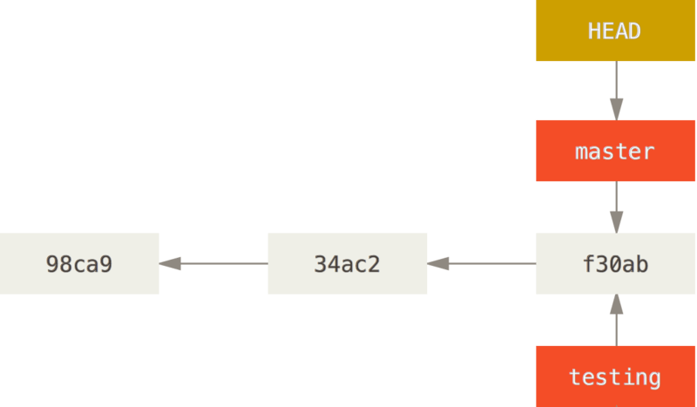
HEAD
HEAD is a special name given to the current commit of your current branch for ease of reference

Slide 28
Why use branching?
work on different versions of our code simultaneously. Think of branches as alternative timelines.
create separate contexts where we can try new things or even work on multiple ideas in parallel without risking the codebase.
if feature A and feature B are being developed, if A breaks, it doesn’t affect B.

Slide 29
Creating a branch
$ git checkout -b new-feature Switched to a new branch 'new-feature'
Alternatively:
$ git branch new-feature $ git checkout new-feature Switched to branch 'new-feature'

Slide 30
Creating a branch

Slide 31
Listing branches
$ git branch main * new-feature

Slide 32
Changing branches
$ git checkout main Switched to branch 'main'

Slide 33
Branch & PR Workflow
Each member owns their copy of the repository locally (through cloning)
When working on a new feature or bug fix, each member will

Slide 34
Branch & PR Workflow
Pull the latest changes from the remote repository
Create a branch per feature/bug fix on their local copy
Edit the files in their respective branch
Push their local branch to the repository
Make a pull request of their feature/bug fix branch to the main branch (remote copy)

Slide 35
Hands-on Time!

Slide 36
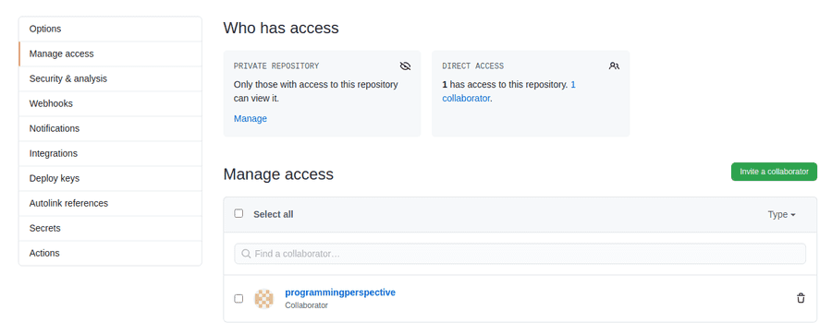
Setup
Add your teammate as a collaborator to your newly created GitHub repository (Settings > Manage access > Invite a collaborator)

Slide 37
Setup
Clone their repository onto your machine (name it something different from your own):
$ git clone https://github.com/<your teammate's GitHub name>/my-new-repo.git my-friend-repo/ $ cd my-friend-repo/

Slide 38
Creating a branch
$ git checkout -b feature-1

Slide 39
Making your changes
Edit your friend’s hello.txt to have whatever content you want and then stage and commit the file:
$ git add hello.txt $ git commit -m "Update hello.txt"

Slide 40
Pushing local changes to the remote repository
$ git push origin feature-1
origin is a shorthand name for the remote repo that the project was cloned from. It is used instead of the URL for convenience.

Slide 41
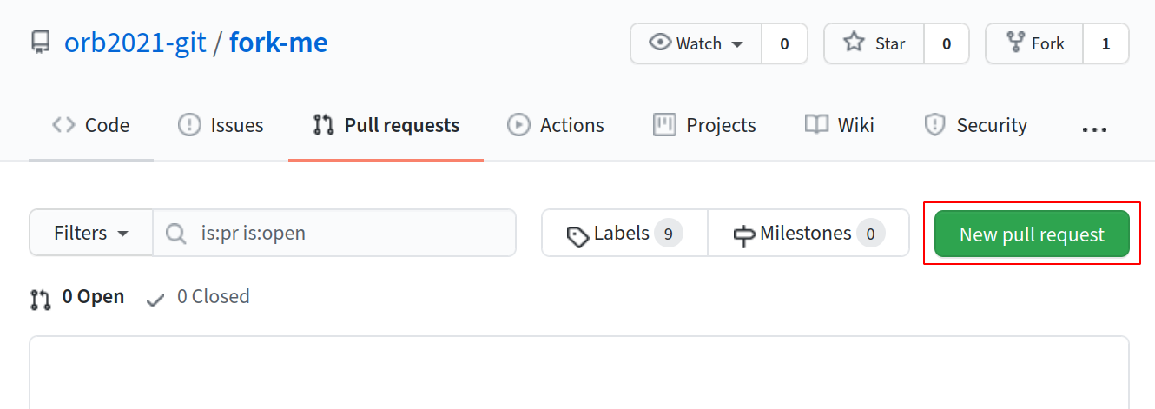
Opening a pull request on the repository
Repository page > Pull Requests > New pull request

Slide 42
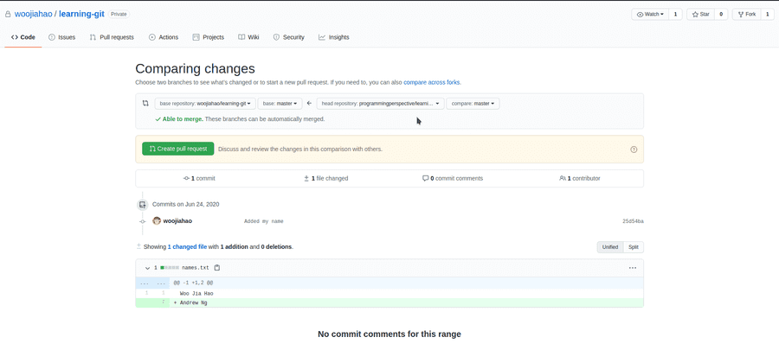
Creating pull request
Ensure that the compare branch is your local feature branch and base branch is main branch

Slide 43
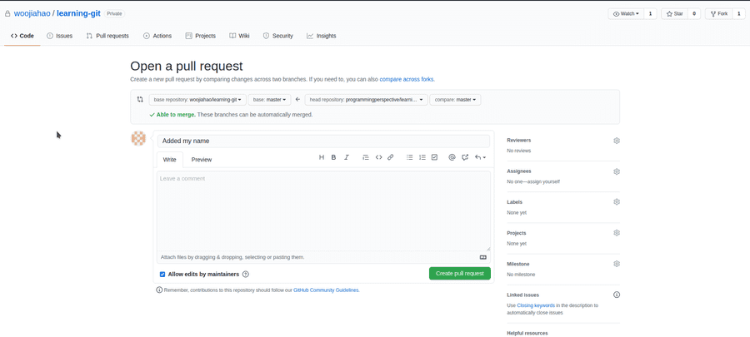
Creating pull request
Confirm pull request with “Create pull request”

Slide 44
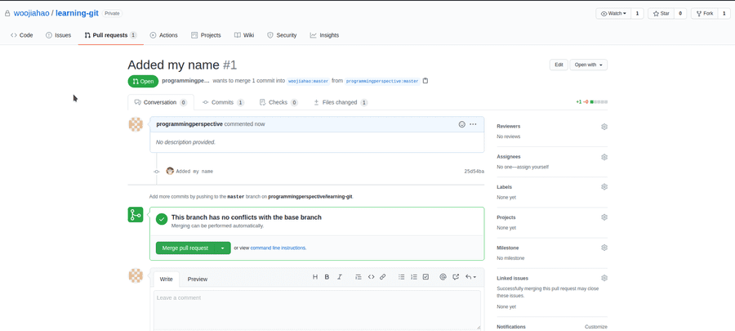
Reviewing pull requests
Your repository > Pull Requests > Select your friend’s pull request

Slide 45
View the commits and the files changed through the tabs.

Slide 46
Accepting pull requests
If the files are in order, click “Merge pull request” to accept their changes into your repository’s main branch

Slide 47
Getting latest remote copy on your local copy
git pull origin main
origin is a shorthand name for the remote repo that the project was cloned from. It is used instead of the URL for convenience.

Slide 48
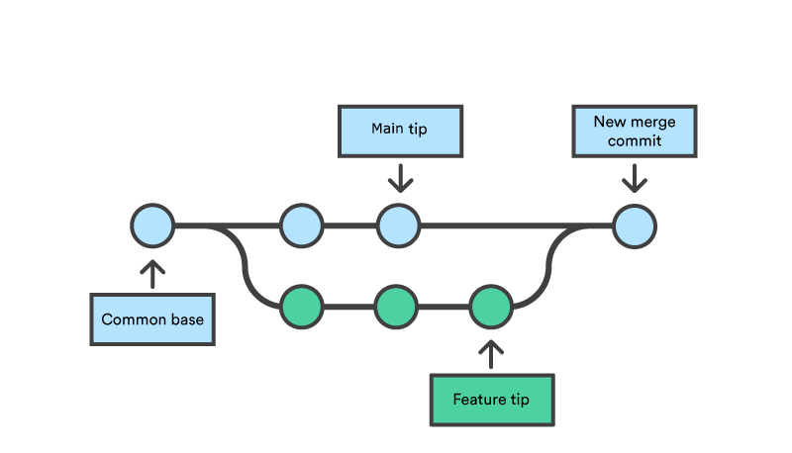
Merging
Combining your branch to another branch

Slide 49
Handling (merge) conflicts
Merge conflicts arise when the same line of code is changed across two commits so there is a conflict in which to be used

Slide 50
Simulating merge conflicts
In your repository, create branch conflict-1 from main and edit the first line of hello.txt
$ git checkout -b conflict-1
Return to main and create another branch conflict-2 from main and edit the first line of hello.txt again
$ git checkout main $ git checkout -b conflict-2

Slide 51
Merge conflicts

Slide 52
Merge conflicts
Now, try to merge conflict-1 and conflict-2 into main.
$ git merge conflict-1 Updating b53e9cf..87a92c3 Fast-forward hello.txt | 2 +- 1 file changed, 1 insertion(+), 1 deletion(-) $ git merge conflict-2 Auto-merging hello.txt CONFLICT (content): Merge conflict in hello.txt Automatic merge failed; fix conflicts and then commit the result.

Slide 53
Handling merge conflicts
$ git status On branch master Your branch is ahead of 'origin/master' by 1 commit. (use "git push" to publish your local commits) You have unmerged paths. (fix conflicts and run "git commit") (use "git merge --abort" to abort the merge) Unmerged paths: (use "git add <file>..." to mark resolution) both modified: hello.txt no changes added to commit (use "git add" and/or "git commit -a")

Slide 54
Handling merge conflicts
$ cat hello.txt <<<<<<< HEAD Goodbye! ======= Farewell! >>>>>>> conflict-2
What we have in main
What we want to merge in conflict-2

Slide 55
Handling merge conflicts
Edit hello.txt as such…

Slide 56
Handling merge conflicts

Slide 57
Summary
git checkout: Checkout a branch (and also files, etc)
git merge: Merge a branch
git clone: Clone a remote repository
git remote: Manage remotes
git push: Push your branch to a remote
git pull: Pull updates from a remote to your repository

Slide 58
Intermission!
5 minute break and Q&A!

Slide 59
Additional Notes

Slide 60
Commit manipulation

Slide 61
Revert
Undo accidental changes made
$ git log --graph --oneline * d1f4fcc (HEAD -> master, origin/master, origin/HEAD) Add file3 * 643aec6 Update file to c * 4ec21c7 Update file to b * 055cab4 Initial commit
Suppose we want to revert this commit.

Slide 62
Revert
$ git revert 643aec6 [master 7b73baf] Revert "Update file to c" 1 file changed, 1 insertion(+), 1 deletion(-) $ git show commit 7b73baf229e2b8db19bc594c450743b50adf649d (HEAD -> master) Author: Your Name <your@email.com> Date: Tue May 11 01:21:31 2021 +0800 Revert "Update file to c" This reverts commit 643aec6d2a1b4cd485d678886fc1cef25b15bee0. diff --git a/file b/file index f2ad6c7..6178079 100644 --- a/file +++ b/file @@ -1 +1 @@ -c +b

Slide 63
Reset
Undo git add.
$ echo e > file $ git add file $ git status On branch master Changes to be committed: (use "git restore --staged <file>..." to unstage) modified: file $ git reset file Unstaged changes after reset: M file $ git status On branch master Changes not staged for commit: (use "git add <file>..." to update what will be committed) (use "git restore <file>..." to discard changes in working directory) modified: file no changes added to commit (use "git add" and/or "git commit -a")

Slide 64
Checkout
Undo changes to a file in the working tree.
$ echo e > file $ git status On branch master Changes not staged for commit: (use "git add <file>..." to update what will be committed) (use "git restore <file>..." to discard changes in working directory) modified: file no changes added to commit (use "git add" and/or "git commit -a") $ git checkout -- file $ git status On branch master nothing to commit, working tree clean

Slide 65
Summary
git revert: Revert a commit
git reset: Unstage files
git checkout: Checkout files (and also a branch) commits

Slide 66
Ignoring files
Sometimes we don't want Git to track a certain file
$ touch ignore-me $ git status
On branch master Untracked files: (use "git add <file>..." to include in what will be committed) ignore-me nothing added to commit but untracked files present (use "git add" to track)

Slide 67
Ignoring files
We can add it to .gitignore
$ echo "/ignore-me" >> .gitignore $ git status
On branch master Untracked files: (use "git add <file>..." to include in what will be committed) .gitignore nothing added to commit but untracked files present (use "git add" to track)
.gitignore should be committed.

Slide 68
Ignoring files
$ git add .gitignore && git commit -m "Add .gitignore"
[master 5ada1cf] Add .gitignore 1 file changed, 1 insertion(+) create mode 100644 .gitignore
$ git status
On branch master nothing to commit, working tree clean
$ git status --ignored
On branch master Ignored files: (use "git add -f <file>..." to include in what will be committed) ignore-me nothing to commit, working tree clean

Slide 69
What to ignore?
Typically, we ignore files like build artifacts and generated files that are usually derived from the human-authored code in the repository. E.g.
dependency caches like /node_modules
compiled code like .o, .pyc files
build output directories like /bin, /out
runtime-generated files like log files
personal configuration files e.g. of your IDE

Slide 70
.gitignore format
/logs/*/*.log /logs/**/*.log **/logs **/logs/debug.log *.log /debug.log debug.log
See the full pattern format.

Slide 71
HTTPS vs SSH
It doesn't really matter.
Use HTTPS if you don't have an SSH key set up with GitHub, or if it is a repository that you cannot write to.
Use SSH if you have an SSH key set up, and you can write to the repository.

Slide 72
Or it kinda does
Using your GitHub password is no longer allowed after August 13, 2021. If you use HTTPS, you’ll need to create a Personal Access Token (PAT).
In your GitHub account, go to
Settings > Developer Settings > Personal Access Token
to generate one.

Slide 73
Or does it?
Some enteprise network/universities may block SSH connections. However, you can try using SSH over HTTPS port (443).
$ ssh -T -p 443 git@ssh.github.com > Hi USERNAME! You've successfully authenticated, but GitHub does not > provide shell access.

Slide 74
Or does it?
If you get the success message, you can proceed to set SSH over HTTPS as a default connection by adding this to your .ssh/config
Host github.com Hostname ssh.github.com Port 443 User git

Slide 75
Commit message discipline
First line: 80-character title, phrased imperatively
Then if your change is complex, elaborate on the change in prose.
Change greeting from "Hi" to "Hello" "Hi" is a bit too informal for a greeting. We should change it to "Hello" instead, so that our users don't feel like we are being too informal. Blah blah blah blah. Blah blah.

Slide 76
Forking and PR setup
Clone this repository: fork-me.
$ git clone https://github.com/hackerschool-git/fork-me.git Cloning into 'fork-me'... remote: Enumerating objects: 3, done. remote: Counting objects: 100% (3/3), done. remote: Total 3 (delta 0), reused 3 (delta 0), pack-reused 0 Unpacking objects: 100% (3/3), done.

Slide 77
Forking and PR
You've made some improvements, and now you want it upstreamed!
$ cd fork-me/ $ nano hello # Edit hello $ git add hello && git commit -m "Improve hello" [master df48f95] Improve hello 1 file changed, 1 insertion(+), 1 deletion(-)

Slide 78
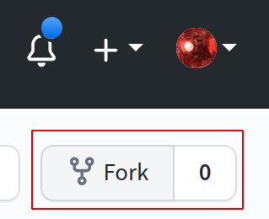
Forking and PR
Fork the repository:

Slide 79
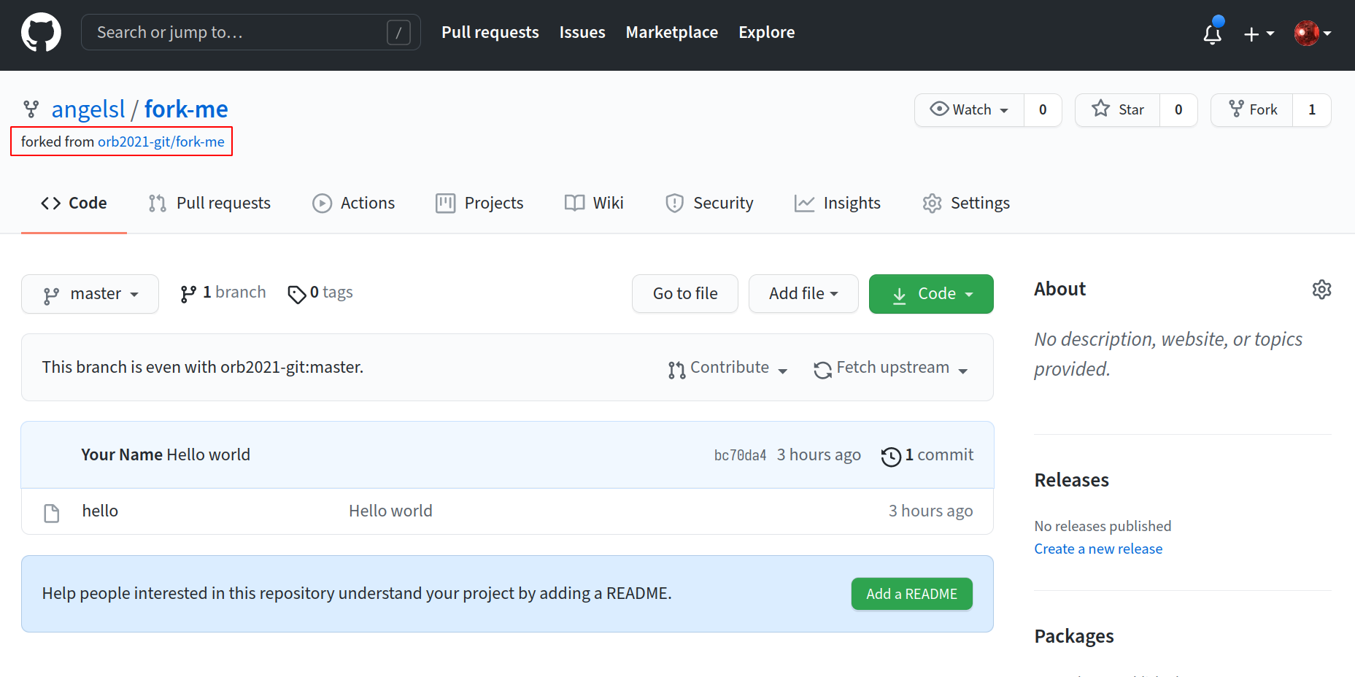
Forking and PR
Get the URL:

Slide 80
Update your repository
Make sure there haven't been new changes made to the upstream.
$ git pull --rebase Already up to date.
We use --rebase because merge commits are generally frowned-upon in GitHub-style PRs.
Also merge commits will look extremely funky in your PRs.

Slide 81
Forking and PR
Add the remote, and push
$ git remote add fork git@github.com:.../fork-me.git $ git push fork master Enumerating objects: 5, done. Counting objects: 100% (5/5), done. Writing objects: 100% (3/3), 248 bytes | 248.00 KiB/s, done. Total 3 (delta 0), reused 0 (delta 0) To github.com:.../fork-me.git 18cac44..df48f95 master -> master

Slide 82
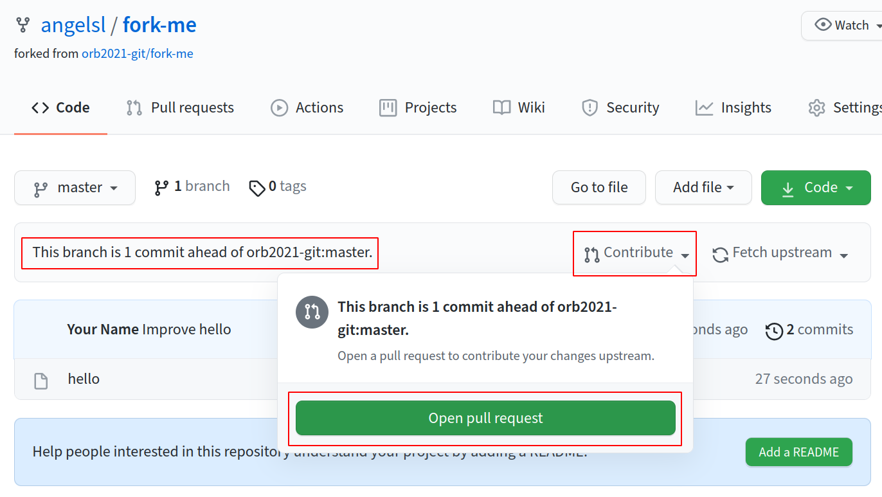
Forking and PR

Slide 83
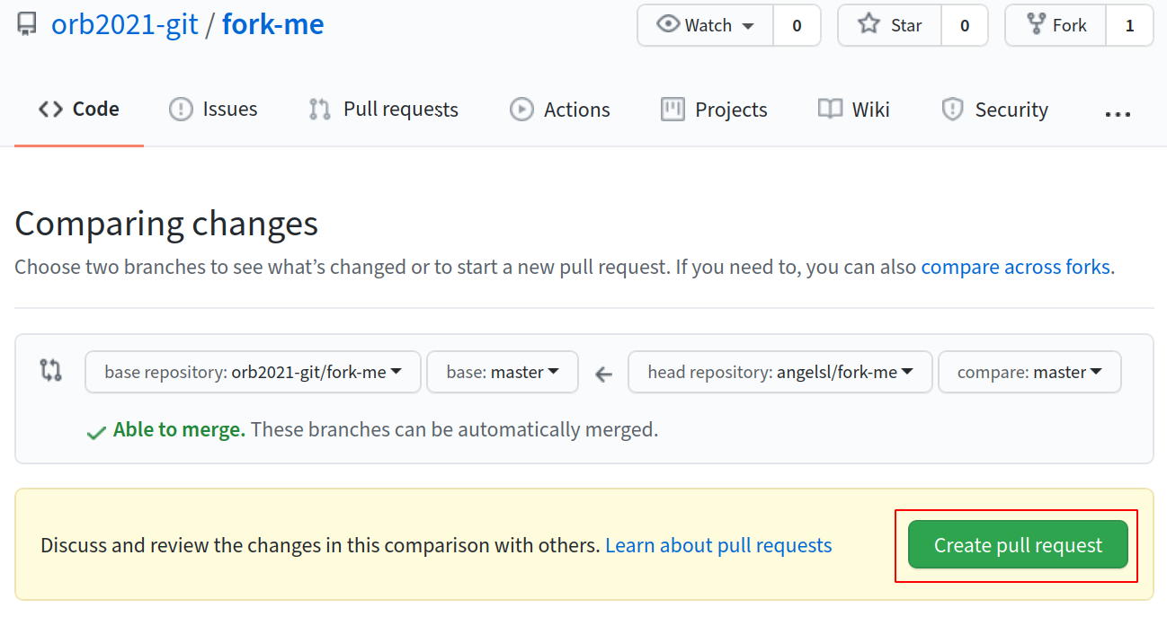
Forking and PR

Slide 84
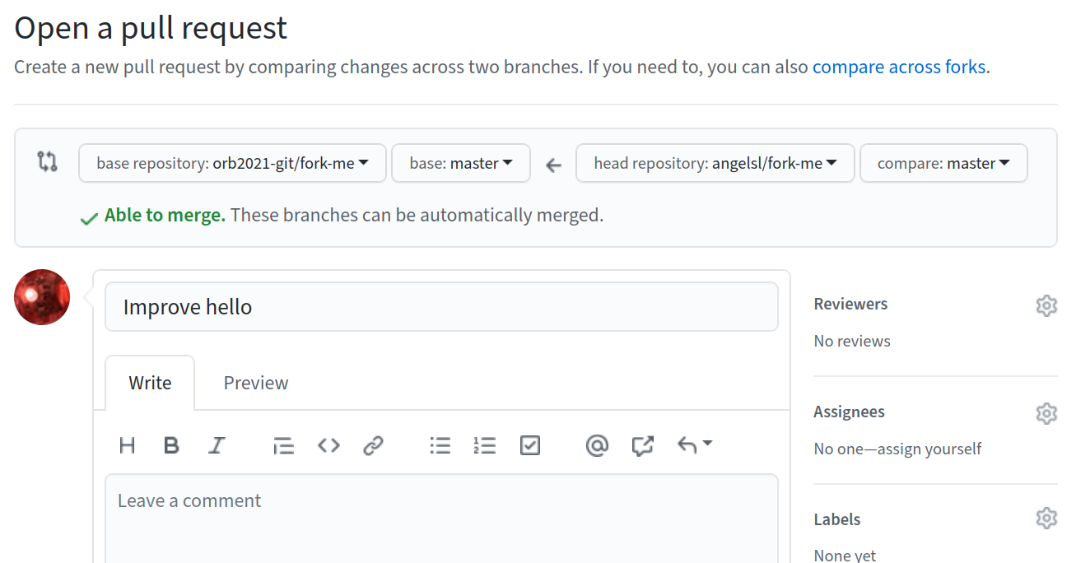
Forking and PR

Slide 85
A real commit message
Randomly chosen from the Linux kernel.
net_sched: sch_fq: handle non connected flows FQ packet scheduler assumed that packets could be classified based on their owning socket. This means that if a UDP server uses one UDP socket to send packets to different destinations, packets all land in one FQ flow. This is unfair, since each TCP flow has a unique bucket, meaning that in case of pressure (fully utilised uplink), TCP flows have more share of the bandwidth. If we instead detect unconnected sockets, we can use a stochastic hash based on the 4-tuple hash. This also means a QUIC server using one UDP socket will properly spread the outgoing packets to different buckets, and in-kernel pacing based on EDT model will no longer risk having big rb-tree on one flow. Note that UDP application might provide the skb->hash in an ancillary message at sendmsg() time to avoid the cost of a dissection in fq packet scheduler. Signed-off-by: Eric Dumazet <edumazet@google.com> Signed-off-by: David S. Miller <davem@davemloft.net>

Slide 86
Where to go from here?
Additional readings: - Git manual - Pro Git - NUS Hackers Git Cheatsheet - Look into Gitworkflows - Atlassian's collaboration guide

Slide 87
Where to go from here?
If you’re interested in how version control works with lots of technical details, look into Customizing Git and Git Internals
GitHub isn’t the only way you can share you repositories online! You could even self host your own Git servers.
Why stop at learning? Build your own Git!

Slide 88
Where to go from here?
Check out Hackerschool: Advanced Git (last run on 7 Nov 2020)
Recording: https://www.youtube.com/watch?v=pGAorBdZ6Y8
Slides: https://hs2010-git.github.io/adv

Slide 89
Feedback

Slide 90
End

