Slide 1
Fraud detection on credit card transactions using machine learning (with python) By Franck Benault franck.Benault@gmail.com

Slide 2
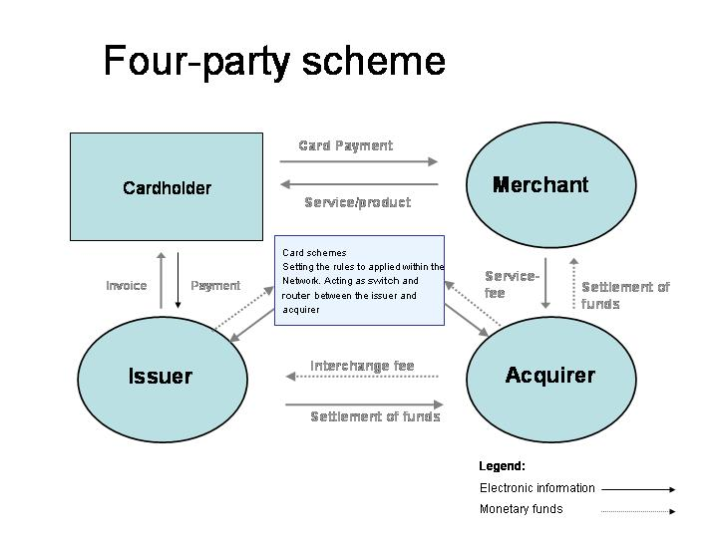

Fraud detection
Context :
Payment four corners model
Issuing side

Slide 3
Fraud detection
Context : Machine Learning Supervised learning
Fraud detection may mean a lot of things
Here I speak about Supervised Learning
Simple two classes “Genuine or Fraudulent”
The card schemes (Visa Mastercard) send “fraudulent” status with a delay (few days or weeks)
I won’t speak about Anomaly detection (detection unknown fraud patterns)

Slide 4

Fraud detection
Challenge : No data available
There is no public data available really convincing
Kaggle example (old, fraud rate quite high, only one day)
Data used here “Project reproductible Machine Learning for credit card fraud detection”
Not perfect
Used for this presentation

Slide 5
Fraud detection
Challenge : Severe/extreme imbalanced data
IR = Imbalance Ratio
IR = Majority class / Minority class
IR >=1
IR credit approval around 3
IR bank churn around 4
IR credit card fraud >= 800
Fraud analysts speak more about “fraud rate” (around 0,1%)

Slide 6
Fraud detection
Challenge : The transaction data alone is not enough
Document from Olivier Caelen [A1]
Now there is the fraud score from Visa and Mastercard
Present in the transaction (real time score ?)
Fraud detection needs a “kind of memory”
Here it is set in the input data
Card holder profile
Card holder statistics
Transactions distance
Impact on the real time

Slide 7
Fraud detection
Simple algorithms : Decision tree, and ensemble
Decision Tree
risk overfitting when the tree becomes too depth
Ensemble = Several trees
Bagging :several parallel tree
Boosting :a tree tries to fix the error done by the previous

Slide 8
Fraud detection
Decision Tree

Slide 9
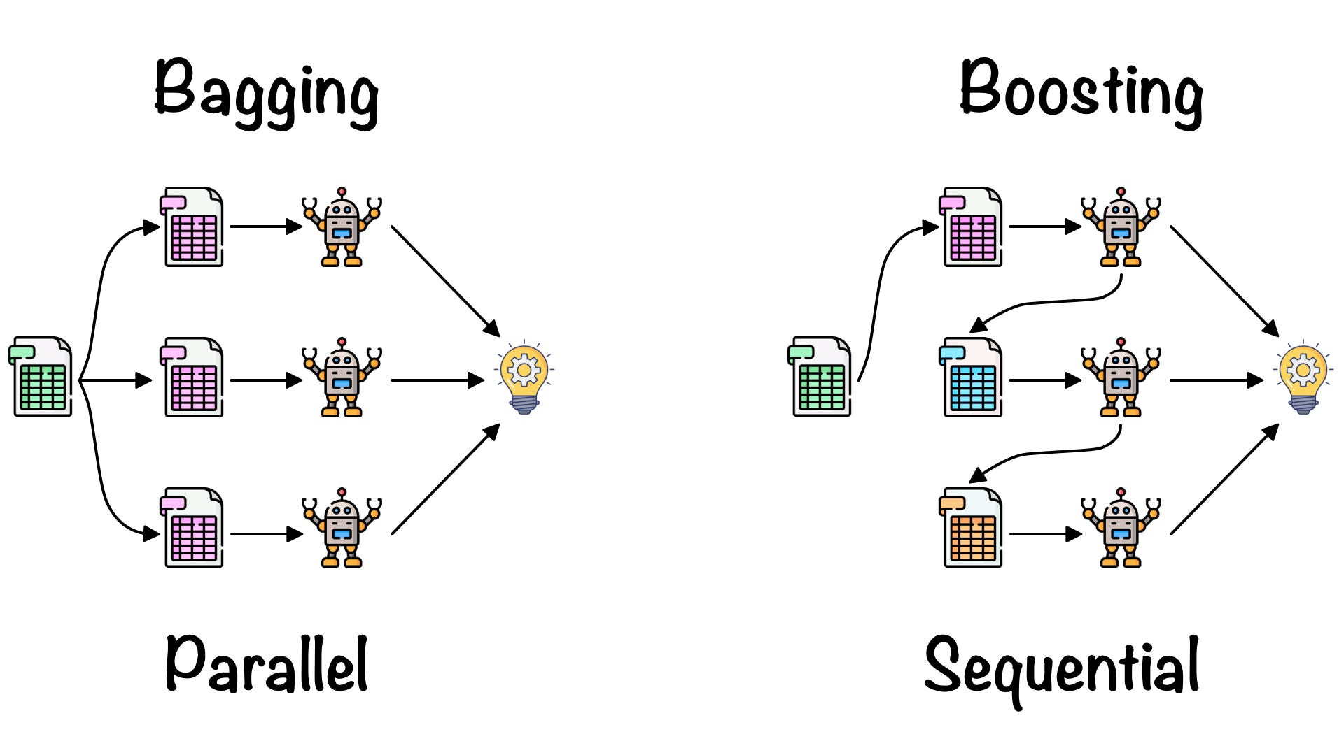
Fraud detection
Ensemble : bagging / boosting

Slide 10
Fraud detection
Time for a demo with Jupyter Notebooks
….

Slide 11
Fraud detection
Results / conclusion
Too early to give you any conclusions
Binary classification should be simple
The imbalance of the data makes difficult

Slide 12

Fraud detection
Questions

Slide 13
Fraud detection
Links
Learned lessons in credit card fraud detection from a practitioner perspective (Olivier Caelen)
https://euro.ecom.cmu.edu/resources/elibrary/epay/1-s2.0-S095741741400089X-main.pdf
Kaggle credit card transactions
https://www.kaggle.com/datasets/mlg-ulb/creditcardfraud
Reproducible Machine Learning for Credit Card Fraud detection - Practical handbook
https://fraud-detection-handbook.github.io/fraud-detection-handbook

