Slide 1
COORDINATE REFERENCE SYSTEMS &
MAP PROJECTIONS

Slide 2
THE EARTH IS NOT A SPHERE
6356 Km
6378 Km

Slide 3
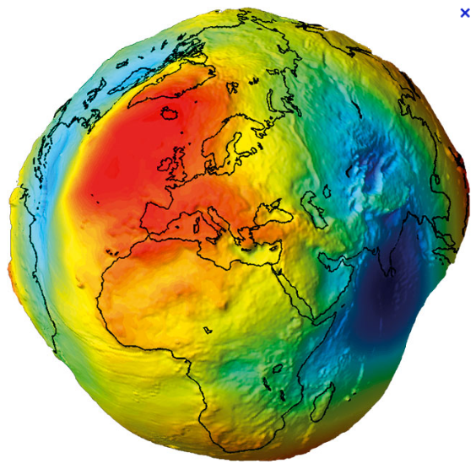
THE EARTH IS NOT AN ELLIPSOID EITHER

Slide 4
THE EARTH IS NOT AN ELLIPSOID EITHER

Slide 5
THE EARTH IS NOT AN ELLIPSOID EITHER

Slide 6
THE EARTH IS NOT AN ELLIPSOID EITHER

Slide 7
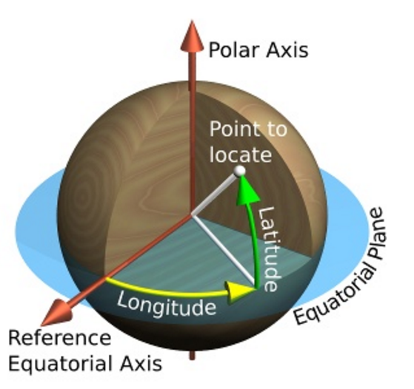
SPHERICAL COORDINATES
http://www.progonos.com/furuti

Slide 8
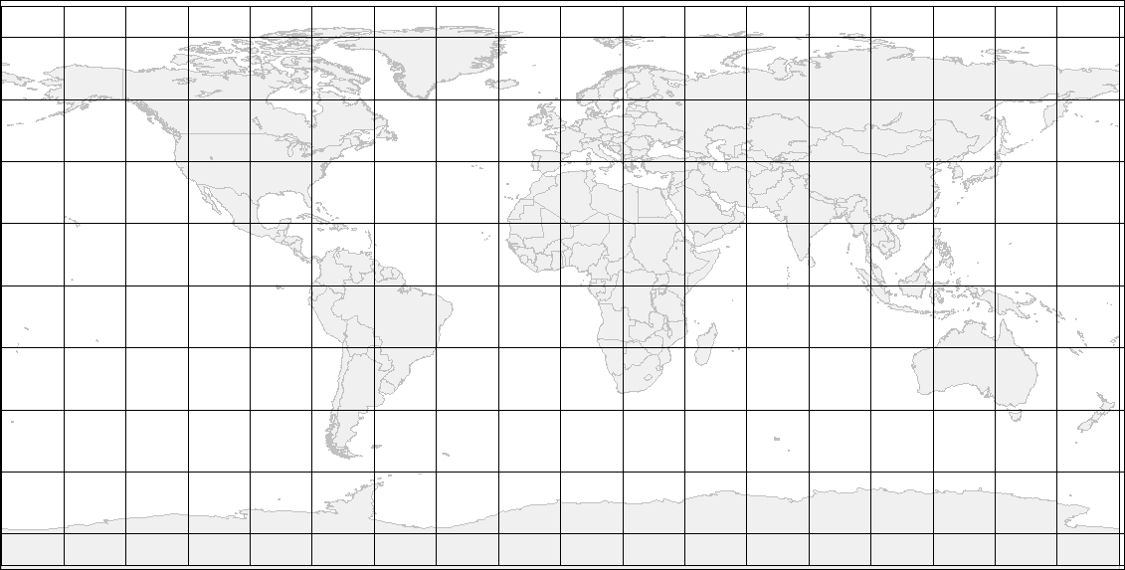
CRS & MAP PROJECTIONS

Slide 9
CRS & MAP PROJECTIONS
20° N
120° W

Slide 10
CRS & MAP PROJECTIONS
20° S
60° W

Slide 11
CRS & MAP PROJECTIONS
50° N
40° E

Slide 12
CRS & MAP PROJECTIONS
10° S
130° E

Slide 13
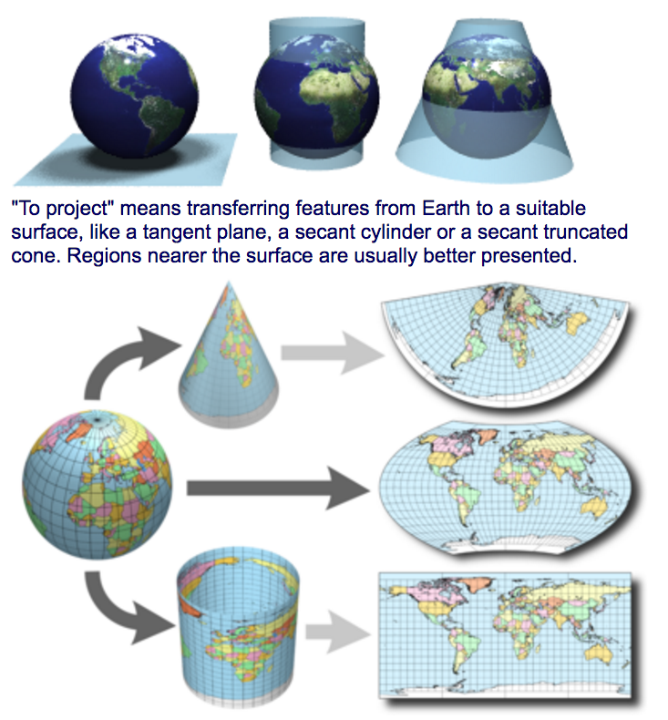
FLATTEN THE WORLD
http://www.progonos.com/furuti

Slide 14
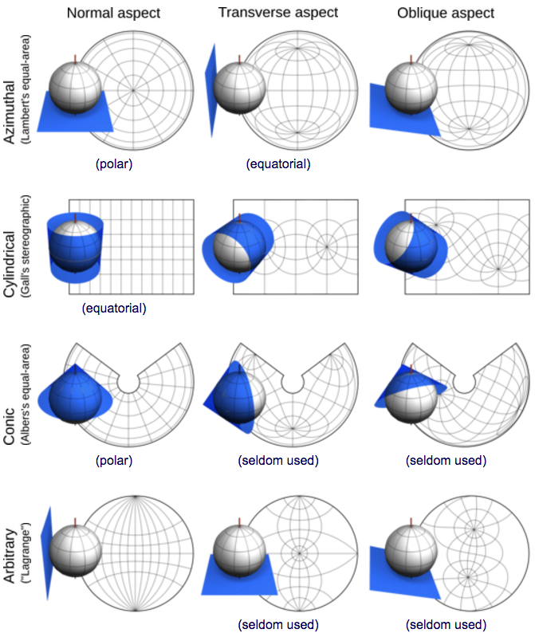
TYPES & ASPECTS OF MAP PROJECTIONS
http://www.progonos.com/furuti

Slide 15
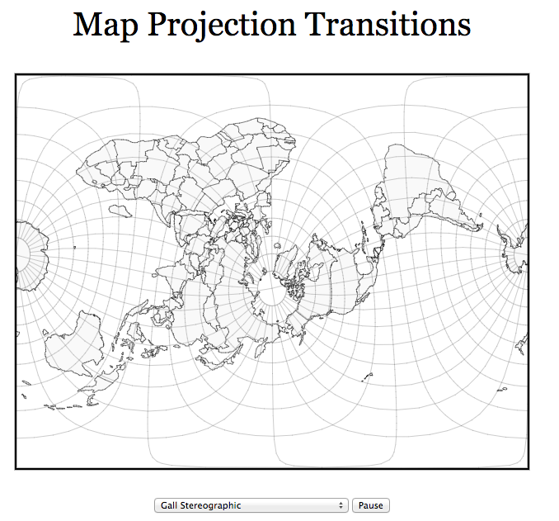
TYPES & ASPECTS OF MAP PROJECTIONS
https://www.jasondavies.com/maps/transition/

Slide 16
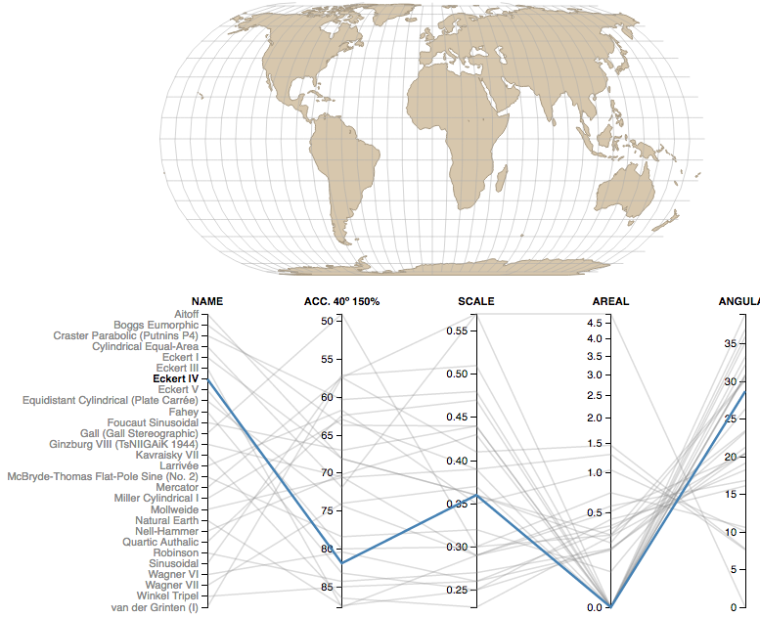
COMPARING MAP PROJECTIONS
https://bl.ocks.org/syntagmatic/ba569633d51ebec6ec6e

Slide 17
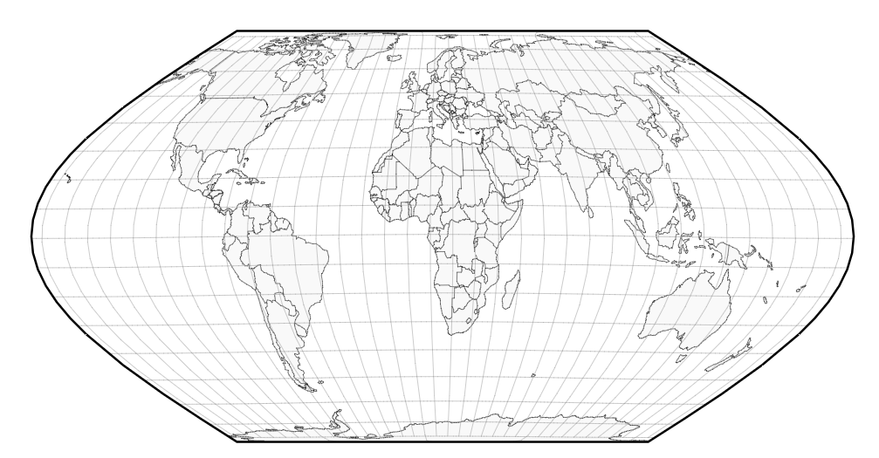
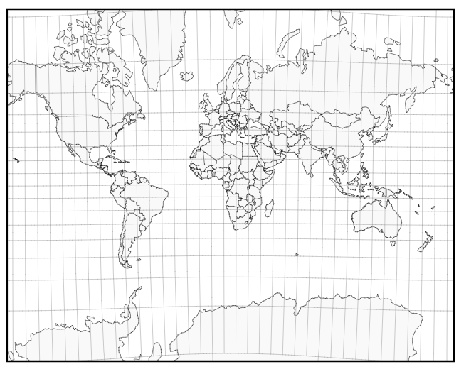
COMPARING MAP PROJECTIONS
https://www.jasondavies.com/maps/transition/
Eckert VI
Mercator

