Slide 1


NBTC – ITU Training
on Building IoT solutions for e-applications
Session 3: Machine learning introduction

Slide 2
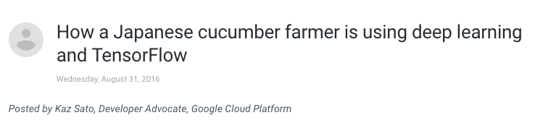
A MOTIVATING EXAMPLE
https://cloud.google.com/blog/big-data/2016/08/how-a-japanese-cucumber-farmer-is-using-deep-learning-and-tensorflow

Slide 3
AN ATTEMPT TO REVERSE ENGINEER …
LET’S LEARN THE CONCEPT OF “SHPINSH”

Slide 4
SHPINBLE or not SHPINBLE ?
X
X
X
X
X

Slide 5
MACHINE LEARNING ALGORITHM DEFINITION
“A COMPUTER PROGRAM IS SAID TO LEARN FROM EXPERIENCE E
WITH RESPECT TO SOME CLASS OF TASKS T AND PERFORMANCE MEASURE P, IF ITS PERFORMANCE AT TASKS IN T, AS MEASURED BY P, IMPROVES WITH EXPERIENCE E ”
Michell (1997)

Slide 6
LET’S SEE HOW WE LEARN?
“A COMPUTER PROGRAM IS SAID TO LEARN FROM EXPERIENCE E
WITH RESPECT TO SOME CLASS OF TASKS T AND PERFORMANCE MEASURE P, IF ITS PERFORMANCE AT TASKS IN T, AS MEASURED BY P, IMPROVES WITH EXPERIENCE E ”
Michell (1997)

Slide 7
THIS IS SUPERVISED LEARNING & CLASSIFICATION!
WHAT ELSE?

Slide 8
Python vs. microPython
Could be C or whatever
Protype vs. production
Illustration Python vs. assembly vs. C++
Python everywhere (trend, examples) ESP32
Python quiz – where you are?

Slide 9

THE MEANING OF BIG?
https://www.itu.int/dms_pub/itu-t/oth/23/01/T23010000220001PDFE.pdf

Slide 10
LET’S TRY TO MAKE IT BIG!

Slide 11
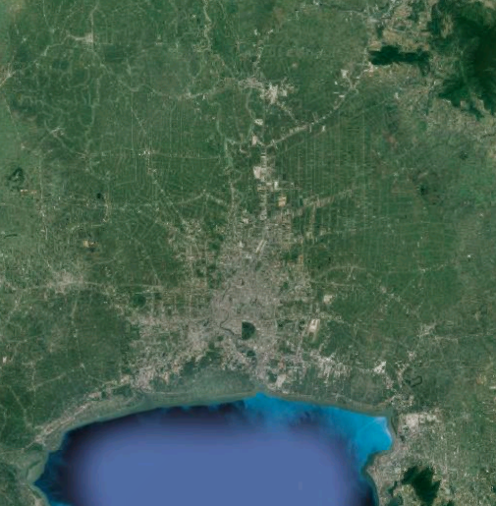
CASE STUDY: MONITORING AIR POLLUTION IN BANGKOK

Slide 12
SCENARIO 1
AREA: 1,569 km² ~ 40 x 40 km
SPATIAL SAMPLING: 1 station every 100 meters
TEMPORAL SAMPLING: 1 measurement every 1 hour
DATA STRUCTURE: ~100 bytes [ TIME, LON, LAT, STATION_ID, CO_2, SO_2, PM, … ]
~ 376 MB / day 1,569 x (10 x 10) x 100 x 24
~ 137 GB / year 1,569 x (10 x 10) x 100 x 24 x 365

Slide 13
SCENARIO 1: HOW BIG IS IT?
0
1
2
3
4
* NOT REALLY!

Slide 14
SCENARIO 2
AREA: 1,569 km² ~ 40 x 40 km
SPATIAL SAMPLING: 1 station every 50 meters
TEMPORAL SAMPLING: 1 measurement every 1 minute
DATA STRUCTURE: ~1000 bytes/measurement
[ TIME, LON, LAT, STATION_ID, CO_2, SO_2, PM, … , … , … , … , … ]
~ 903 GB / day 1,569 x (20 x 20) x 24 x 60 X 1000
~ 329 TB / year 1,569 x (20 x 20) x 24 x 60 x 1000 x 365

Slide 15
SCENARIO 2: HOW BIG IS IT?
0
1
2
3
4
Volume
* Only use case justify accessing a year of data

Slide 16
SCENARIO 3
AREA: 1,569 km² ~ 40 x 40 km
SPATIAL SAMPLING: 1 station every 50 meters
TEMPORAL SAMPLING: 1 measurement every 1 second
DATA STRUCTURE: ~1000 bytes/measurement
[ TIME, LON, LAT, STATION_ID, CO_2, SO_2, PM, … , … , … , … , … ]
~ 54 TB / day 1,569 x (20 x 20) x 24 x 3600 X 1000
~ 20 PB / year 1,569 x (20 x 20) x 24 x 3600 x 1000 x 365

Slide 17
SCENARIO 3: HOW BIG IS IT?
0
1
2
3
4
Volume
Velocity
* of acquisition and processing

Slide 18
SCENARIO 4
IDEM AS SCENARIO 3 ~54 TB / day and ~20 PB /year
+ CROWD-SOURCED DATA - citizen science, third party institutions, …
+ WEB APP. DATA COLLECTION - perception on air quality (good, moderate, poor)
+ SENTIMENT ANALYSIS ON SOCIAL NETWORKS
+ IMAGE CLASSIFICATION (SATELLITE IMAGERY, CAMERAS, …)

Slide 19
SCENARIO 4: HOW BIG IS IT?
0
1
2
3
4
Volume
Velocity
Variety
Veracity
…

Slide 20
CHECK LIST
Different problems | different solutions

Slide 21
USE CASE FIRST *
WHAT IS THE USE CASE ?
WHAT DECISION WE WANT TO MAKE ?
WHICH DATA WILL SUPPORT THAT DECISION ?
* as opposed to “let’s collect everything we can, then we will see what we can do with it” syndrom.

Slide 22
DOMAIN KNOWLEDGE IS A KEY INPUT
DOMAIN KNOWLEDGE PROVIDES PERSPECTIVE AND INSIGHTS
MIGHT DOWNSIZE CONSIDERABLY THE AMOUNT OF DATA NEEDED

Slide 23
REAL-TIME vs. BATCH PROCESSING
DOES YOUR USE CASE REQUIRE PROCESSING HISTORICAL DATA REAL-TIME ?
DOES CLASSICAL DRILL-DOWN ROLL-UP STRATEGY ADDRESS YOUR PROBLEM ?

Slide 24
TECHNOLOGY OVERVIEW
Evading the hype

Slide 25
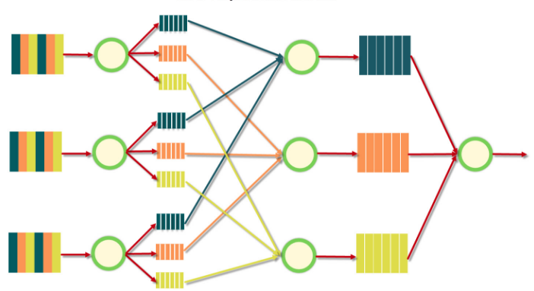
CLASSICAL DIVIDE & CONQUER APPROACH
https://blog.sqlauthority.com/2013/10/09/big-data-buzz-words-what-is-mapreduce-day-7-of-21/

Slide 26
USE CASE: # OF PARTICIPANTS BY MOBILE OS USED
KEY: ANDROID
KEY: iOS
KEY: OTHERS
…
VALUE: 12
VALUE: 6
VALUE: 3

Slide 27
NAIVE IMPLEMENTATION
VS.
DIVIDE & CONQUER | PARALLELIZING | MapReduce*
*ROLE PLAYING: MAKING CONRETE THE MAP-SHUFFLE-REDUCE PHASES

Slide 28
KEY: ANDROID
KEY: iOS
KEY: OTHERS
VALUE:
VALUE:
VALUE:
*TO BE PRINTED IN 10 COPIES

Slide 29
WHAT ABOUT VELOCITY, VARIETY, … ?
BATCH vs. STREAM PROCESSING
VARIETY OF DBMS TECHNOLOGIES
PIPELINES (DATA MOVING AROUND)
VARIETY OF PROGRAMMING PARADIGMS
SCALABILITY

Slide 30
CANONICAL TECHNOLOGICAL ECOSYSTEM/STACK
CLUSTERED FILE SYSTEM: HDFS, GFS, …
“DIVIDE & CONQUER”: Hadoop, Spark, …
“FLAT FILE STORAGE” | API: Simple Storate Service (S3), …
RDBMS: PostGres, …
NoSQL DB: MongoDB, DynamoDB, …
“PREPARE DATA FOR DATA ANALYTICS” | DATA WAREHOUSE: Redshift, …
“MOVING DATA AROUND”: AWS Data pipeline, …
STREAMING PROCESSING: AWS Kinesis, Spark stream, …
BI/ANALYTICS CLIENT PLATFORM: JasperSoft, Python, R, SAS, Tableau…

Slide 31
LEARNING RESOURCES
COURSERA: https://www.coursera.org/courses?languages=en&query=big+data
PLURALSIGHT: https://www.pluralsight.com/search?q=big%20data
UDACITY: https://www.udacity.com/courses/all
…

Slide 32
THANK YOU

