Slide 1


NBTC – ITU Training
on Building IoT solutions for e-applications
Session 3: Building an IoT product Programming aspects

Slide 2
RAPID PROTOTYPING | IN PRODUCTION TRADEOFF
WHAT IS THE USE CASE ?
IS/WHEN OPTIMIZATION REQUIRED ?
ITERATE OVER IDEAS / CLIENT REQUIREMENTS / QUICK FEEDBACK?
NEED FOR LOW ENTRY BARRIERS ?
WHAT ARE THE WHOLE TECHNOLOGICAL STACK & DATA/WORK FLOWS?
WHAT ARE THE HUMAN RESOURCES ?
A SINGLE LANGUAGE CONVENIENT BUT OFTEN A NON ISSUE ?

Slide 3
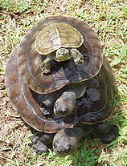
PYTHON[S]
TURTLES ALL THE WAY DOWN!
https://en.wikipedia.org/wiki/Turtles_all_the_way_down

Slide 4



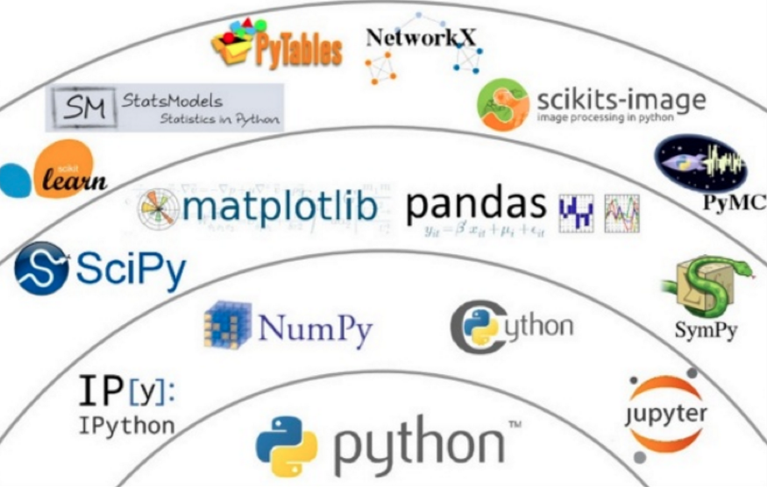


Slide 5
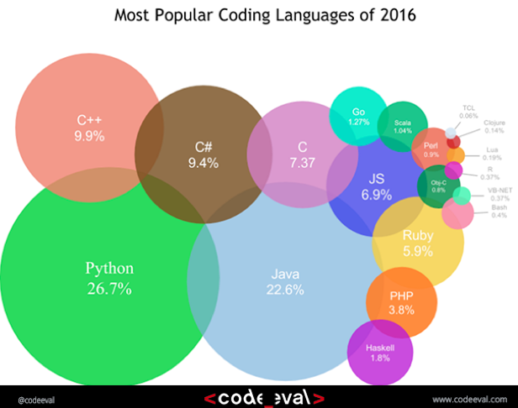

Slide 6
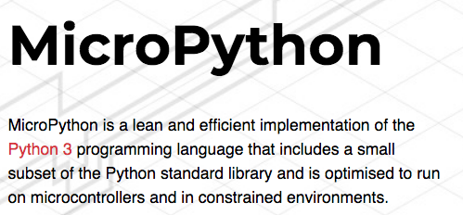
https://micropython.org/

Slide 7
https://micropython.org/

Slide 8
https://micropython.org/

Slide 9

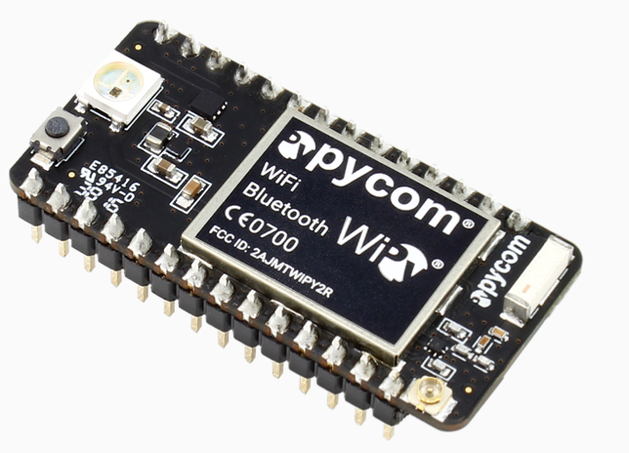

Slide 10
https://micropython.org/
http://microbit.org/

Slide 11
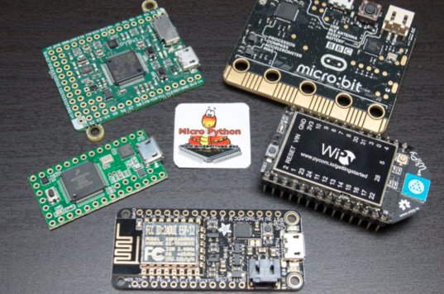

Slide 12
THANK YOU

