Slide 1


NBTC – ITU Training
on Building IoT solutions for e-applications
Session 3: Machine learning | A Big picture

Slide 2
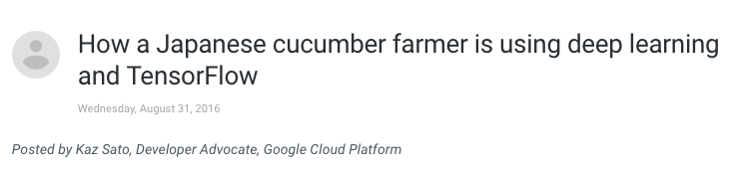
A MOTIVATING EXAMPLE
https://cloud.google.com/blog/big-data/2016/08/how-a-japanese-cucumber-farmer-is-using-deep-learning-and-tensorflow

Slide 3
WHAT IS MACHINE LEARNING [1] ?
GIVING COMPUTERS THE ABILITY TO LEARN FROM DATA
PREDICTING vs. EXPLAINING
CAN BE SUPERVISED, UNSUPERVISED, REINFORCEMENT LEARNING

Slide 4
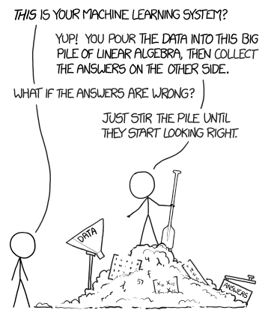
MACHINE LEARNING PRACTITIONER CARICATURE?
https://xkcd.com/1838/

Slide 5
WHAT IS MACHINE LEARNING [2] ?
SUPERVISED LEARNING | Labeled data Direct feedback Predict outcome/future
UNSUPERVISED LEARNING | No labels/targets No feedback Find hidden structure in data
REINFORCEMENT LEARNING | Decision process Reward system Learn series of action
S. Raschka & V. Mirjalili, Python Machine Learning, Second Edition, Packt, 2017

Slide 6


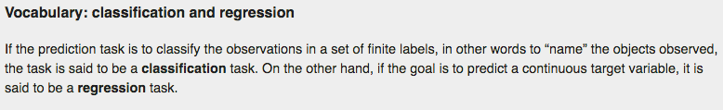
SUPERVISED LEARNING
http://scikit-learn.org/stable/tutorial/statistical_inference/supervised_learning.html

Slide 7
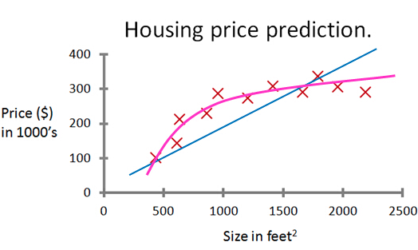
SUPERVISED LEARNING - REGRESSION
TARGET
CONTINUOUS
FEATURE(S)

Slide 8
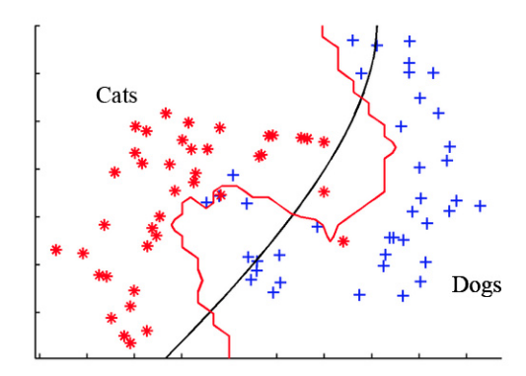
SUPERVISED LEARNING - CLASSIFICATION
TARGET DISCRETE: DOGS vs CATS
FEATURE 2
FEATURE 1

Slide 9
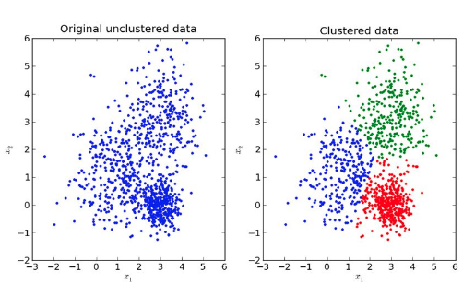
UNSUPERVISED LEARNING | DISCOVERING HIDDEN STRUCTURE
http://scikit-learn.org/stable/unsupervised_learning.html#unsupervised-learning

Slide 10
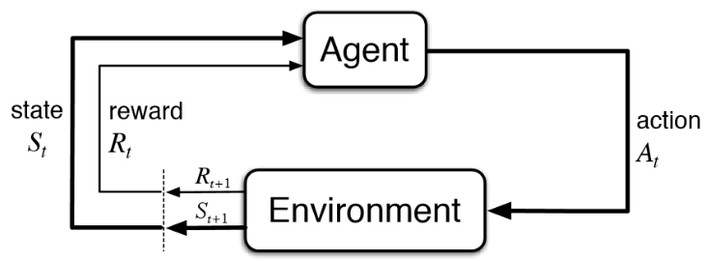
REINFORCEMENT LEARNING
EXAMPLE: ROBOT LEARNING HOW TO PLAY TABLE TENNIS
https://www.youtube.com/watch?v=SH3bADiB7uQ

Slide 11
THE LEARNING PROCESS [1]
ZOOM ON SUPERVISED LEARNING & REGRESSION
h_{θ}
h_{θ}
DATA (TRAINING/TEST)
h_{θ}
HYPOTHESIS FUNCTION
h_{θ} (X) = θ₀ + θ₁ X
COST FUNCTION TO MINIMIZE
J (θ_{0,} θ₁) = Σ( hθ(x(i)) – y(i) )2

Slide 12
THE LEARNING PROCESS [2]
ZOOM ON SUPERVISED LEARNING & REGRESSION
h_{θ}
DATA (TRAINING/TEST)
y(i)
i^{th} point
HYPOTHESIS FUNCTION
h_{θ} (X) = θ₀ + θ₁ X
hθ(x(i))
COST FUNCTION TO MINIMIZE
J (θ_{0,} θ₁) = Σ( hθ(x(i)) – y(i) )2

Slide 13
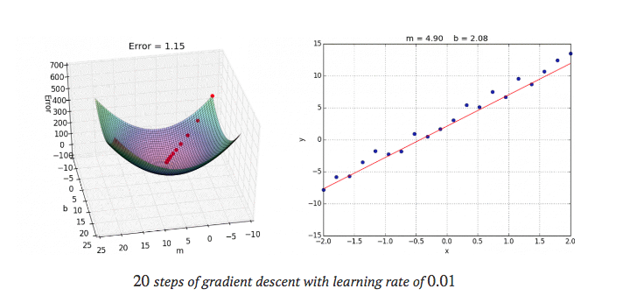
THE LEARNING PROCESS [3]
ZOOM ON SUPERVISED LEARNING & REGRESSION
https://alykhantejani.github.io/a-brief-introduction-to-gradient-descent/

Slide 14
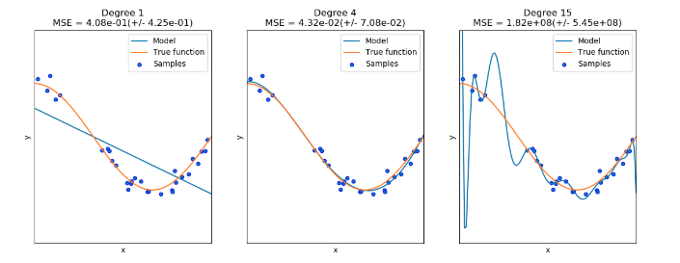
BIAS/VARIANCE & OVER/UNDERFITTING
http://scikit-learn.org/stable/auto_examples/model_selection/plot_underfitting_overfitting.html

Slide 15
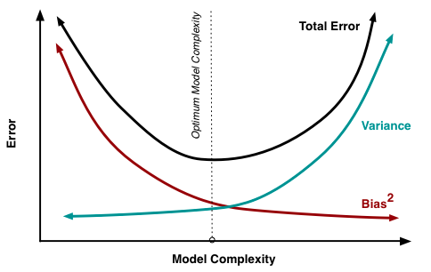
DIAGNOSING BIAS/VARIANCE
https://www.researchgate.net/post/How_does_model_complexity_impact_the_bias-variance_tradeoff

Slide 16
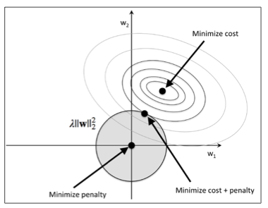
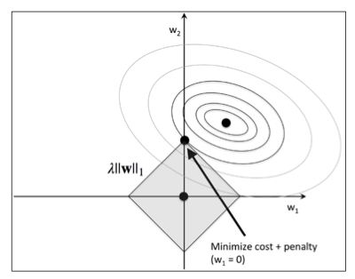


REGULARIZATION | PENALIZING COST FUNCTION
RIDGE REGRESSION
LASSO REGRESSION
S. Raschka & V. Mirjalili, Python Machine Learning, Second Edition, Packt, 2017

Slide 17
BUT THIS IS ONLY ONE TYPE OF ALGORITHM!
WHAT ELSE?

Slide 18
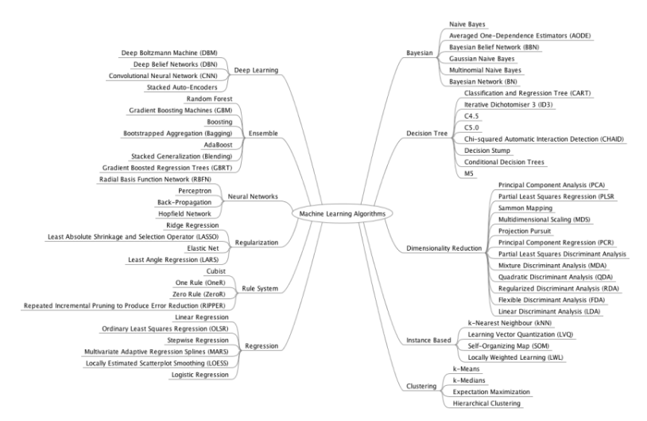
https://machinelearningmastery.com/a-tour-of-machine-learning-algorithms/

Slide 19
CLASSIFICATION | LOGISTIC REGRESSION [1]
DATA (TRAINING/TEST)
h_{θ}
HYPOTHESIS FUNCTION
h_{θ} (X) = θ₀ + θ₁ X ?
COST FUNCTION TO MINIMIZE

Slide 20
CLASSIFICATION | LOGISTIC REGRESSION [2]
DATA (TRAINING/TEST)
σ: Sigmoid/logistic function
HYPOTHESIS FUNCTION
h_{θ} (X) = σ(θ₀ + θ₁ X)
h_{θ} : output a probability
of being blue or orange
0.5
COST FUNCTION TO MINIMIZE

Slide 21
CLASSIFICATION | DECISION TREE
A TOY EXAMPLE: ARRANGING A LOAN [the 20 questions game]
AGE > 30 ?
YES
NO
UNIVERSITY DEGREE ?
INCOME > 5000 ?
YES
NO
…
LEND
LOAN IN PROGRESS ?
YES
NO
DO NOT LEND
LEND

Slide 22
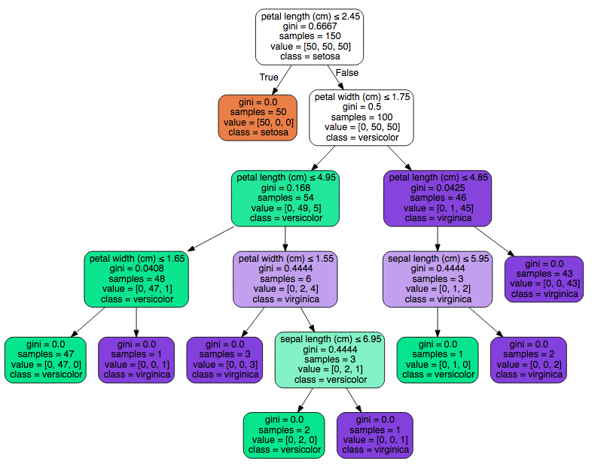
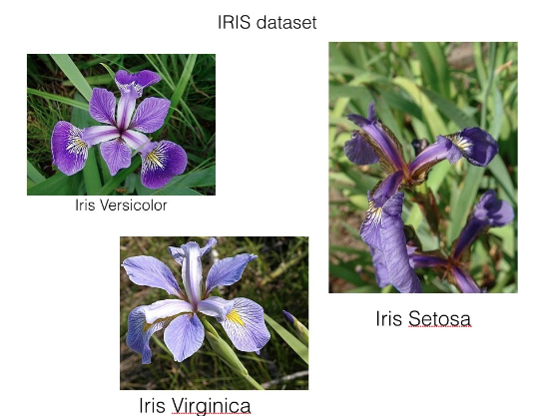
DECISION TREE | IRIS DATASET
http://scikit-learn.org/stable/modules/tree.html#classification

Slide 23
DECISION TREE | ENSEMBLE METHODS
PREDICTING AS A TEAM RATHER THAN SOLO
SEVERAL SUBSETS OF FEATURES
SEVERAL SUBSETS OF SAMPLES
INDIVIDUAL CLASSIFIER FOR EACH SUBSETS
AGGREGATE PREDICTIONS
See labs exercise

Slide 24
TUNING & EVALUATING MODELS

Slide 25
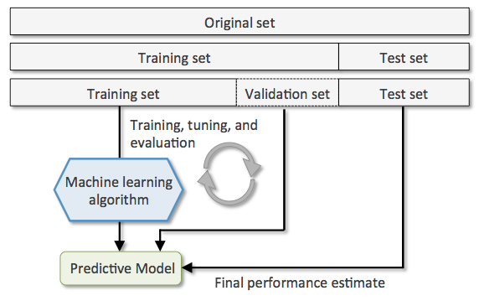
TYPICAL PIPELINE | HOLD OUT METHOD
http://www.cs.nthu.edu.tw/

Slide 26
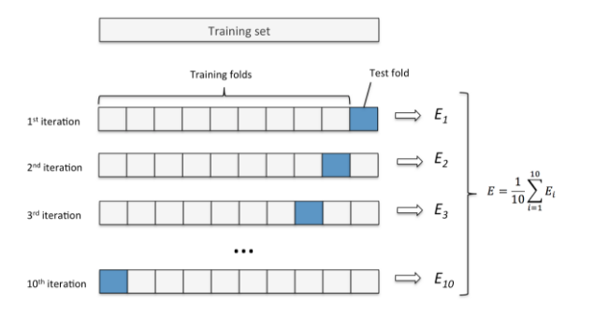
TYPICAL PIPELINE | K-FOLD CROSS VALIDATION
http://www.cs.nthu.edu.tw/

Slide 27
TYPICAL PIPELINE | K-FOLD CROSS VALIDATION
http://www.cs.nthu.edu.tw/

Slide 28
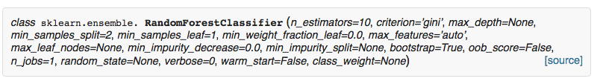
TYPICAL PIPELINE | GRID SEARCH

Slide 29
THE IMPORTANCE OF FEATURES
MIGHT BE 1,000,000 INPUT FEATURES
DIMENSIONALITY REDUCTION SOMETIMES RELEVANT
FEATURE ENGINEERING IS SOMETIMES KEY (see lab exercise)
THE CASE OF DEEP LEARNING AND COMPUTER VISION

Slide 30
DEEP LEARNING & NEURAL NETWORKS

Slide 31
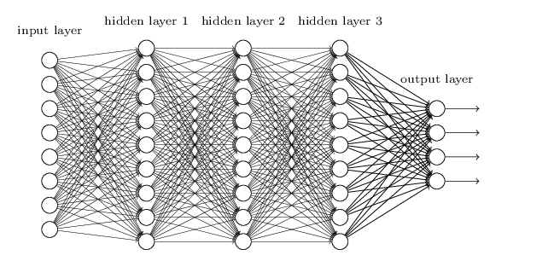
DEEP LEARNING & NEURAL NETWORKS
A LOGISTIC REGRESSION IS ALREADY A NEURON (BUT NEED NON-LINEARITY)
BY INCREASING # OF NODES/NEURON and CONNECTIVITY -> NON-LINEARITY
http://neuralnetworksanddeeplearning.com/chap6.html

Slide 32
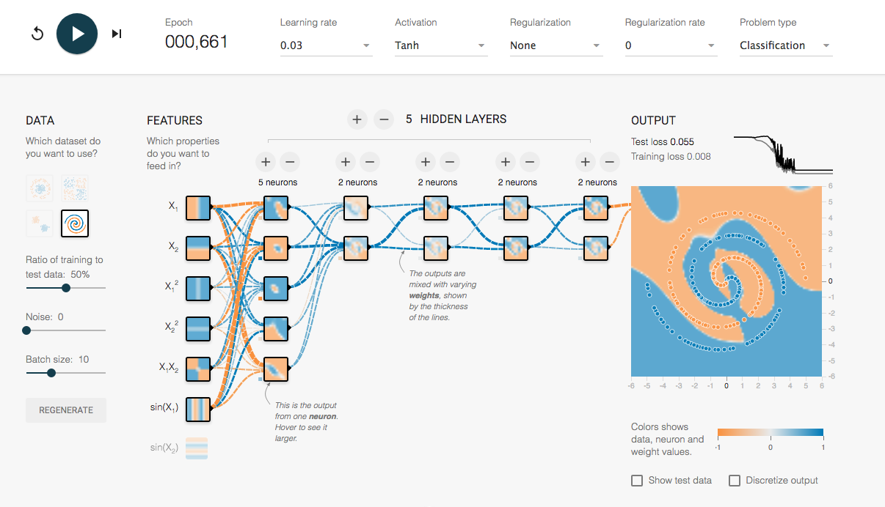
http://playground.tensorflow.org/

Slide 33
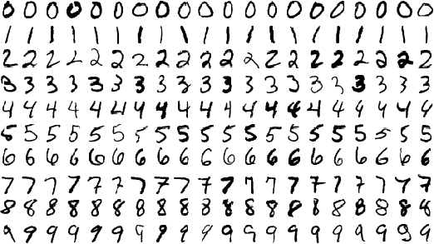
DEEP LEARNING FOR IMAGE RECOGNITION
THE CASE OF “MNIST” HANDWRITTEN DIGIT DATASET RECOGNITION
TRAINING SET OF 60,000 EXAMPLES, TEST SET OF 10,000 EXAMPLES OF 28 x 28 IMAGES
CLASSIFIERS BENCHMARK:
http://yann.lecun.com/exdb/mnist/

Slide 34
DEEP LEARNING FOR IMAGE RECOGNITION
CONVOLUTIONAL NETS MOTIVATION(S)
28 x 28 PIXELS IMAGE = 784 FEATURES, 1 BY PIXEL, VALUE FROM 0-255 (LEVEL OF GRAY)
WHAT IF 1000 x 1000 x 3 (R,G,B) + 4 HIDDEN LAYERS + … ?
WHAT IF IMAGE IS TRANSLATED, ROTATED, AT DIFFERENT SCALES ?
NEED FOR HIGHER ABSTRACTION
ONE OF THE GREATEST SUCCESS STORY OF BIOLOGICALLY INSPIRED AI https://en.wikipedia.org/wiki/David_H._Hubel

Slide 35
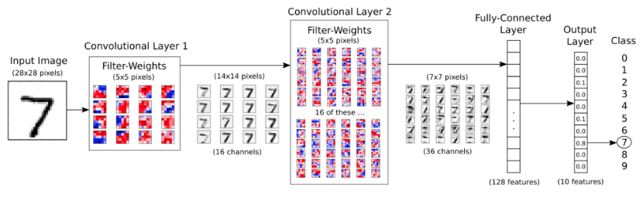
DEEP LEARNING FOR IMAGE RECOGNITION
CONVOLUTIONAL NETS EXAMPLE [1]
https://github.com/Hvass-Labs/TensorFlow-Tutorials/blob/master/02_Convolutional_Neural_Network.ipynb

Slide 36
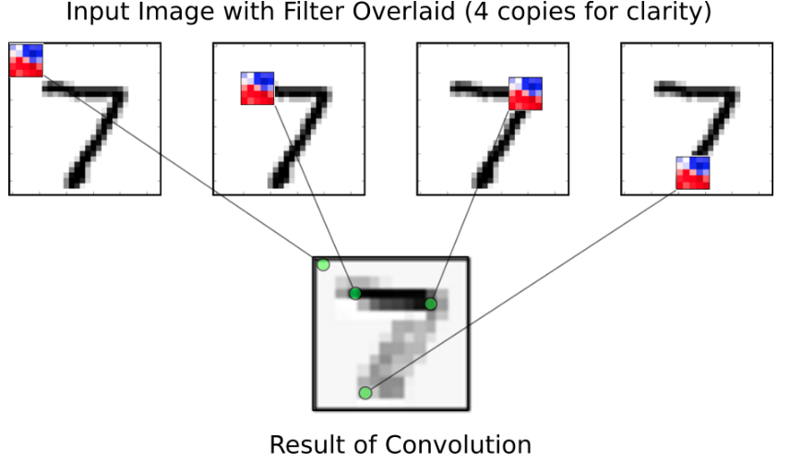
DEEP LEARNING FOR IMAGE RECOGNITION
CONVOLUTIONAL NETS EXAMPLE [2]
https://github.com/Hvass-Labs/TensorFlow-Tutorials/blob/master/02_Convolutional_Neural_Network.ipynb

Slide 37
DEEP LEARNING | TRANSFER LEARNING
RE-USE (USE WEIGHTS & TOPOLOGY) OF STATE OF THE ART MODELS
LeNet-5
AlexNet
VGG
ResNet
Inception

Slide 38
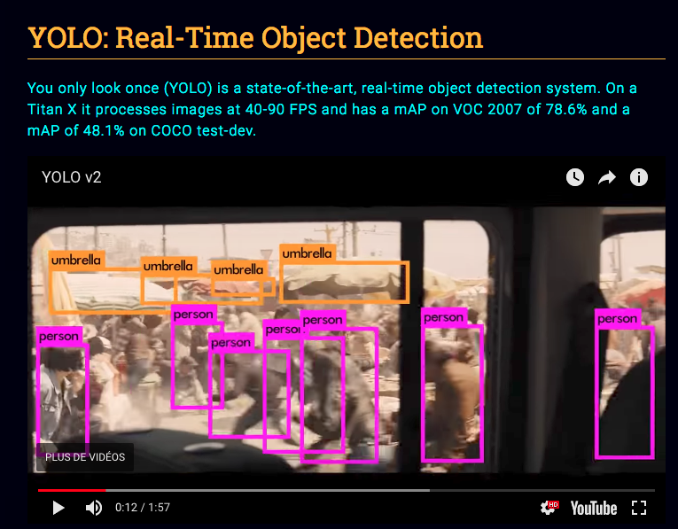
STATE OF THE ART IN OBJECT DETECTION
https://pjreddie.com/darknet/yolo/

Slide 39
DEEP LEARNING | TRANSFER LEARNING
RE-USE (USE WEIGHTS & TOPOLOGY) OF STATE OF THE ART MODELS
LeNet-5
AlexNet
VGG
ResNet
Inception

Slide 40
A WORD ON CPU vs GPU
FORWARD/BACKWARD PROPAGATION CAN BE // AND VECTORIZED
GAMER’S GPUs CAN BE FULLY HARNESSED
BACKWARD PROPAGATION WITH MILLION OF PARAMETERS REQUIRES CONSIDERABLE RESOURCES
FORWARD PROPAGATION IS FAST

Slide 41
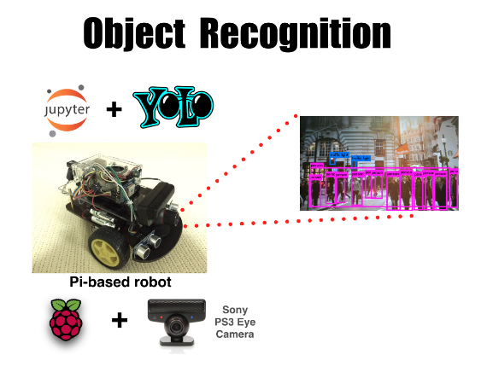
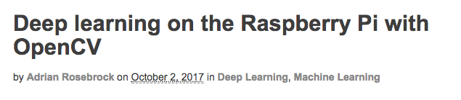
BTW, WHAT THE RELATION WITH IOT ? [1]
https://www.pyimagesearch.com/2017/10/02/deep-learning-on-the-raspberry-pi-with-opencv/
https://github.com/leehaesung/YOLO-
Powered_Robot_Vision

Slide 42
BTW, WHAT THE RELATION WITH IOT ? [2]
OTHER DOMAIN SUCH AS SEQUENTIAL MODELS ARE RELEVANT AS WELL (TIME SERIES PREDICTION, …)
WILL NOT RUN ON A IoT NODE BUT SOMEWHERE IN YOUR TOPOLOGY …
THOUGH SIMPLER MODEL SUCH AS LOGISTIC REG., DECISION TREE, … MIGHT BE EMBEDDED IN IoT DEVICES ?
USE CASES ?

Slide 43
PYTHON LIBRARIES FOR ML & DL
Scikit-learn: http://scikit-learn.org/
TensorFlow: https://www.tensorflow.org/
Theano: http://deeplearning.net/software/theano/
Keras [wrapper]: https://keras.io/
PyTorch: http://pytorch.org/
…

Slide 44
LEARNING RESOURCES
Coursera/Stanford: https://www.coursera.org/learn/machine-learning
Deeplearning.ai: https://www.deeplearning.ai/
FastAI: http://www.fast.ai/
UDACITY: https://www.udacity.com/courses/all
…

Slide 45
THANK YOU

